Slide 1
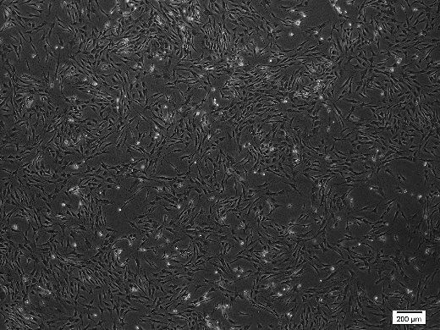
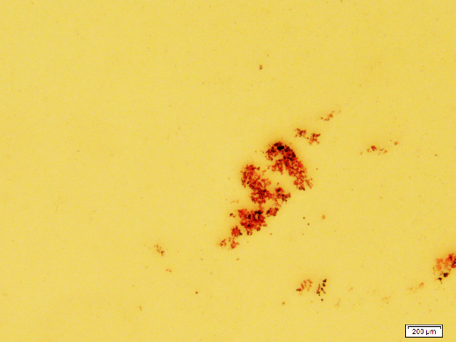
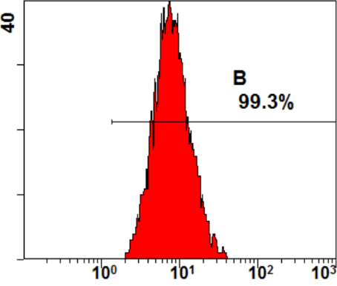
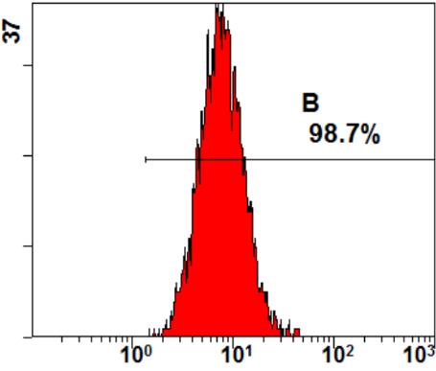
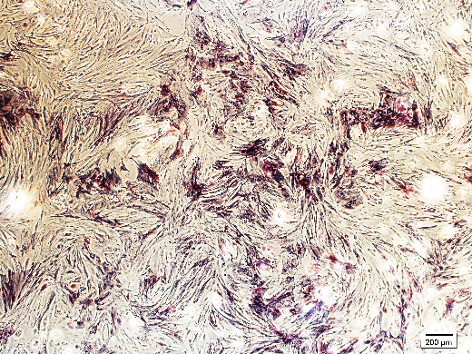
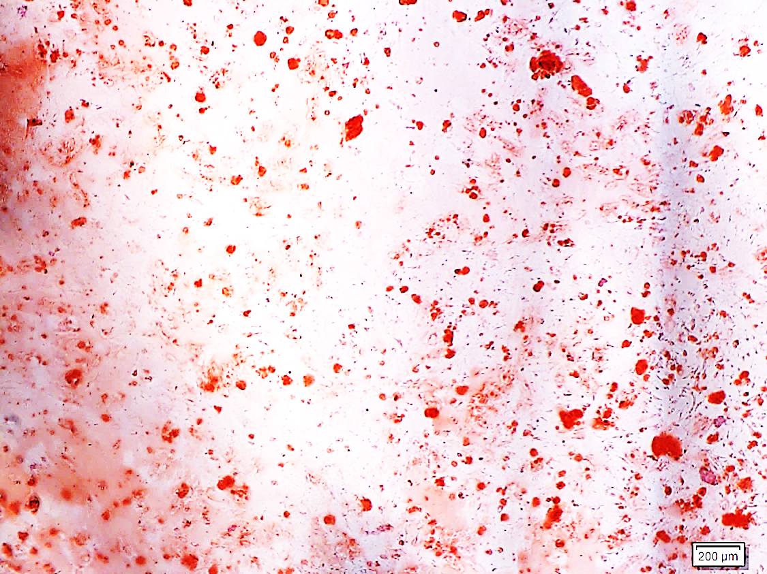
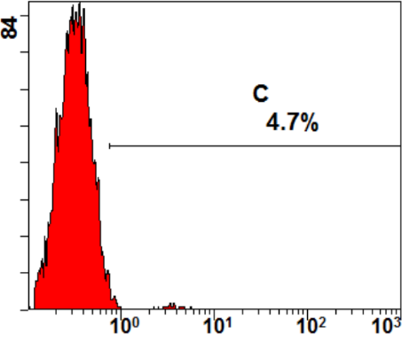
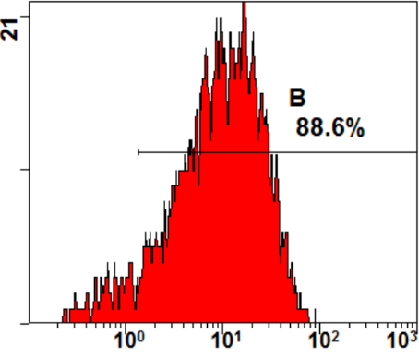
a
Normal
Oil red O
b
FITC-CD29+
FITC-CD44+
40*
c
ALP
ARS
PE-CD45+
FITC-CD90+
40*
c
Insulin
Exenatide
Fig. S1 Identification of BMSC and the optimal concentration of insulin and exenatide that best facilitates BMSC activity. a Normal morphology of BMSC and micrographs of oil red O, ALP and alizarin red staining. b Identification by flow cytometry. c Optimal concentrations of insulin and exenatide conducive to BMSC activity. (n = 3). Insulin-500nM vs. 800nM (p < 0.01).

