Slide 1
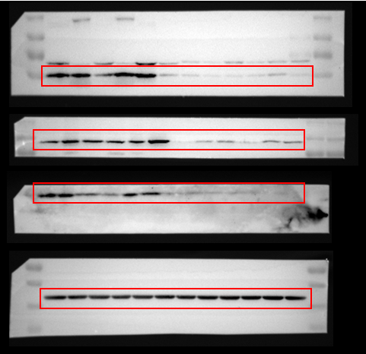
Figure 1c
Carcinoma
Para-Carcinoma
1 2 3 4 5 6
1 2 3 4 5 6
GLS
ALDH18A1
PYCR1
β-Actin

Slide 2
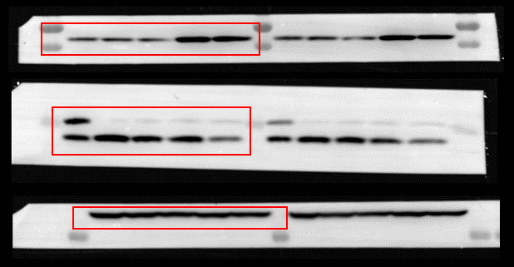
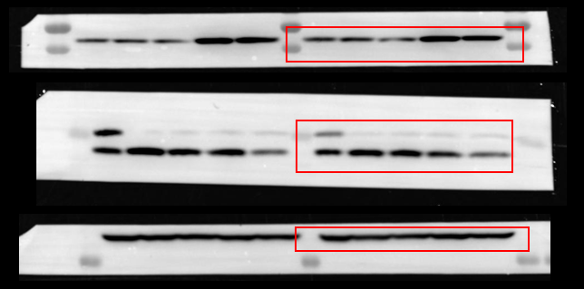
Figure 3c
SNU-398
Glucose (mM)
25
1
CB-839
-
-
-
-
-
+
+
-
+
+
Proline
P62
LC3A/B
β-Actin
SNU-398
Glucose (mM)
25
1
BPTES
-
-
-
-
-
+
+
-
+
+
Proline
P62
LC3A/B
β-Actin

Slide 3
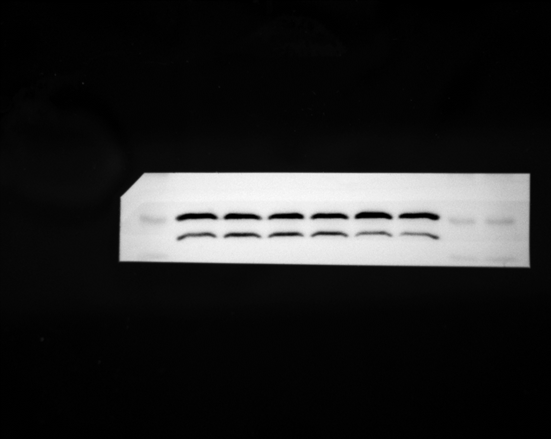
Figure 3c
Huh7
Glucose (mM)
25
1
CB-839
-
-
-
-
-
+
+
-
+
+
Proline
P62
LC3A/B
β-Actin
Huh7
Glucose (mM)
25
1
BPTES
-
-
-
-
-
+
+
-
+
+
Proline
P62
LC3A/B
β-Actin

Slide 4
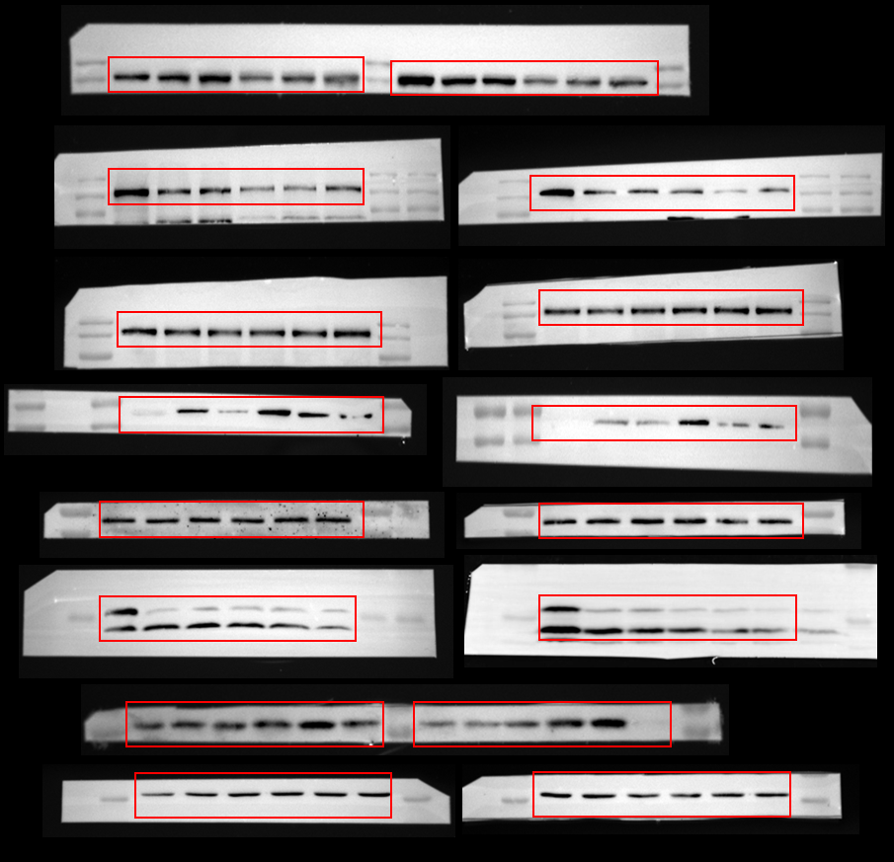
Figure 6a
SNU-398
SNU-398
25
1
Glucose (mM)
25
1
Glucose (mM)
BPTES
Proline
NAC
CB-839
Proline
NAC
-
-
-
-
-
-
-
+
-
+
-
-
+
+
-
+
-
+
-
-
-
-
-
-
-
+
-
+
-
-
+
+
-
+
-
+
p-ULK(Ser317)
p-ULK(Ser638)
ULK
p-AMPK (Thr172)
AMPK
LC3A/B
P62
β-Actin

Slide 5
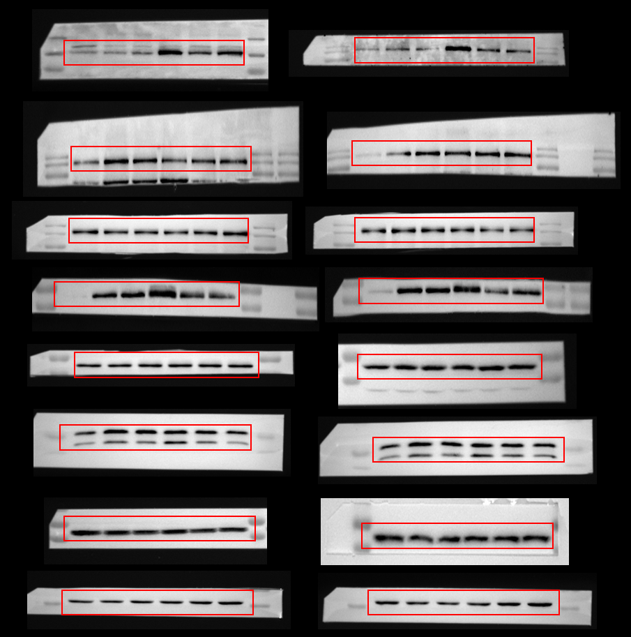
Figure 6b
Huh7
Huh7
25
1
Glucose (mM)
25
1
Glucose (mM)
BPTES
Proline
NAC
CB-839
Proline
NAC
-
-
-
-
-
-
-
+
-
+
-
-
+
+
-
+
-
+
-
-
-
-
-
-
-
+
-
+
-
-
+
+
-
+
-
+
p-ULK(Ser317)
p-ULK(Ser638)
ULK
p-AMPK (Thr172)
AMPK
LC3A/B
P62
β-Actin

