Slide 1
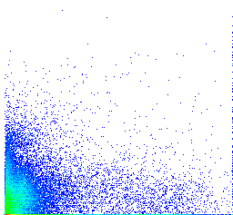
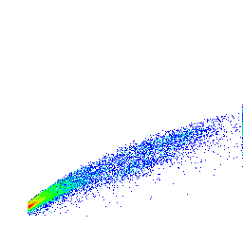
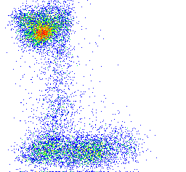
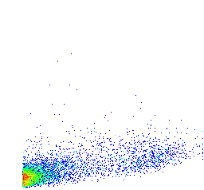
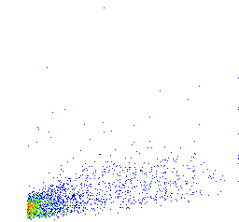
10⁵
250K
200K
10⁴
150K
P2
TO-PRO-3
FSC-H
10³
P1
100K
10²
50K
0
0
50K
100K
150K
200K
250K
0
50K
100K
150K
200K
250K
FSC-A
FSC-A
10⁵
10⁴
mCherry
10³
P3
10²
P4
0
0
10³
10⁴
10⁵
eGFP
250K
P3
250K
P4
200K
200K
150K
150K
SSC-A
P5
P6
SSC-A
100K
100K
P8
50K
50K
P7
0
50K
100K
150K
200K
250K
0
50K
100K
150K
200K
250K
FSC-A
FSC-A
Notes:
Fluorescent activated cell sorting of testicular germline cell suspensions.
Flow cytometric isolation of cells for single cell sequencing, presented as pseudocolour FlowJo dot plots, based on TO-PRO-3 iodide and FSC-A (P1) to exclude dead cells and small sized debris, FSC-H and FSC-A to include only singlets (P2) and mCherry and eGFP fluorescence intensity of live cells to include only cells positive for either mCherry (P3) or eGFP (P4) fluorescence. Positive for mCherry (P3) or eGFP (P4) cells were additionally gated for cell size based on FSC-A and SSC-A and sorted into two populations each, representing smaller (P5 or P7, respectively) and larger cells (P6 or P8, respectively).

