Slide 1
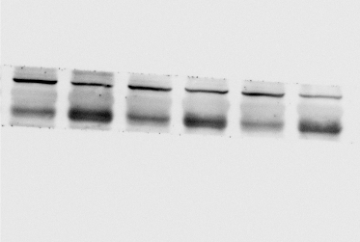
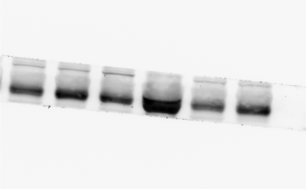
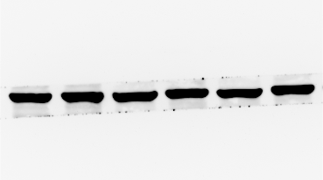
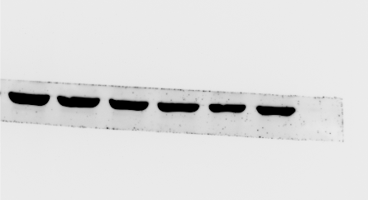
FIGURE1D Western blot protein detection of the ESCO2 expression levels in adjacent normal tissues and paired cancer tissues, including ccRCC and bladder cancer.
CCRCC
Bladder Cancer
P1
P2
P3
P1
P2
P3
N
T
N
T
N
T
N
T
N
T
N
T
ESCO2 (68kDa)
ESCO2 (68kDa)
β-actin (42kDa)
β-actin (42kDa)

Slide 2


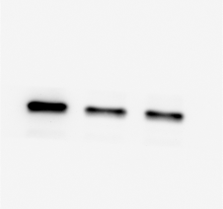
FIGURE6E Western blot results manifested the down‐regulated expression of CDK1 compared with the si‐con group in A498 cells.
si-ESCO2-1
si-ESCO2-2
si-ESCO2-1
si-ESCO2-2
si-ESCO2-1
si-ESCO2-2
si-NC
si-NC
si-NC
ESCO2 (68kDa)
β-actin (42kDa)
CDK1 (34kDa)

Slide 3


FIGURE9A A498 cells were transfected with si-ESCO2#1 and si-ESCO2#2, the level of ESCO2 was evaluated by Western blot.
si-ESCO2-1
si-ESCO2-2
si-ESCO2-1
si-ESCO2-2
si-NC
si-NC
ESCO2 (68kDa)
β-actin (42kDa)

