Slide 1


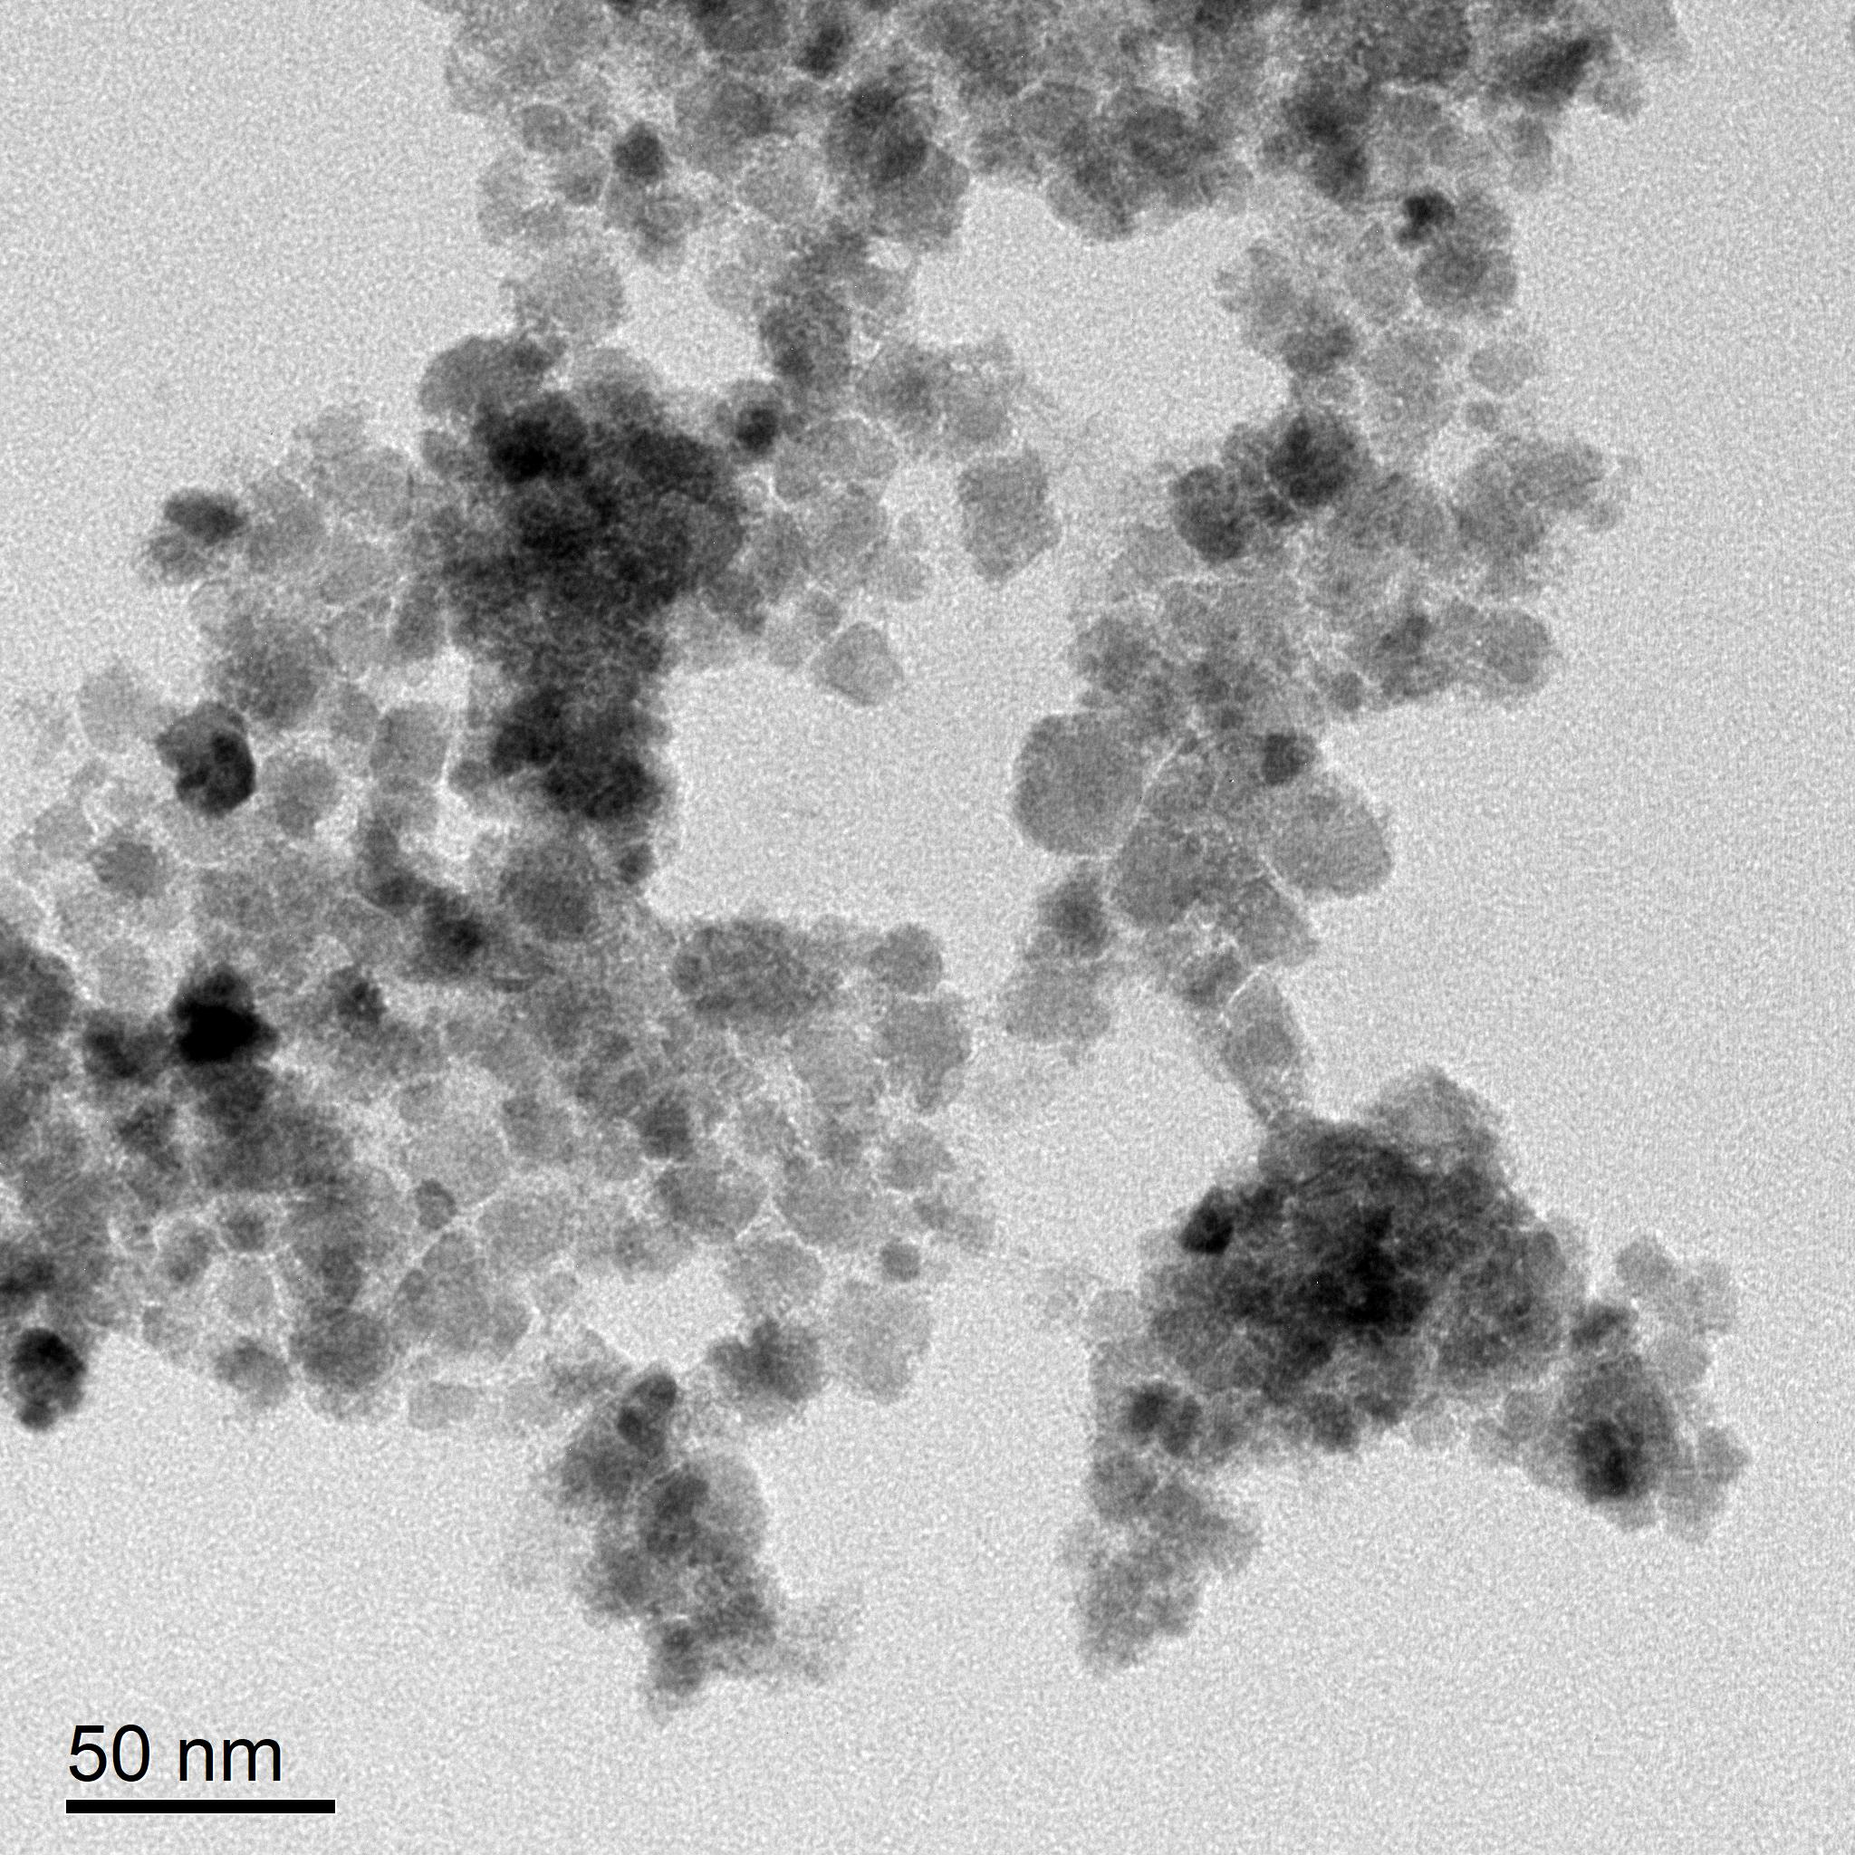
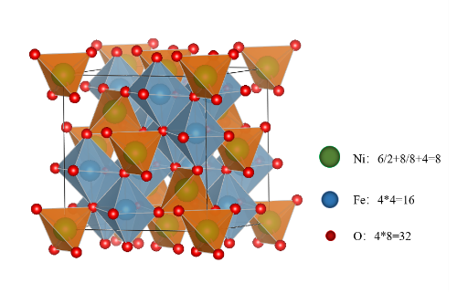
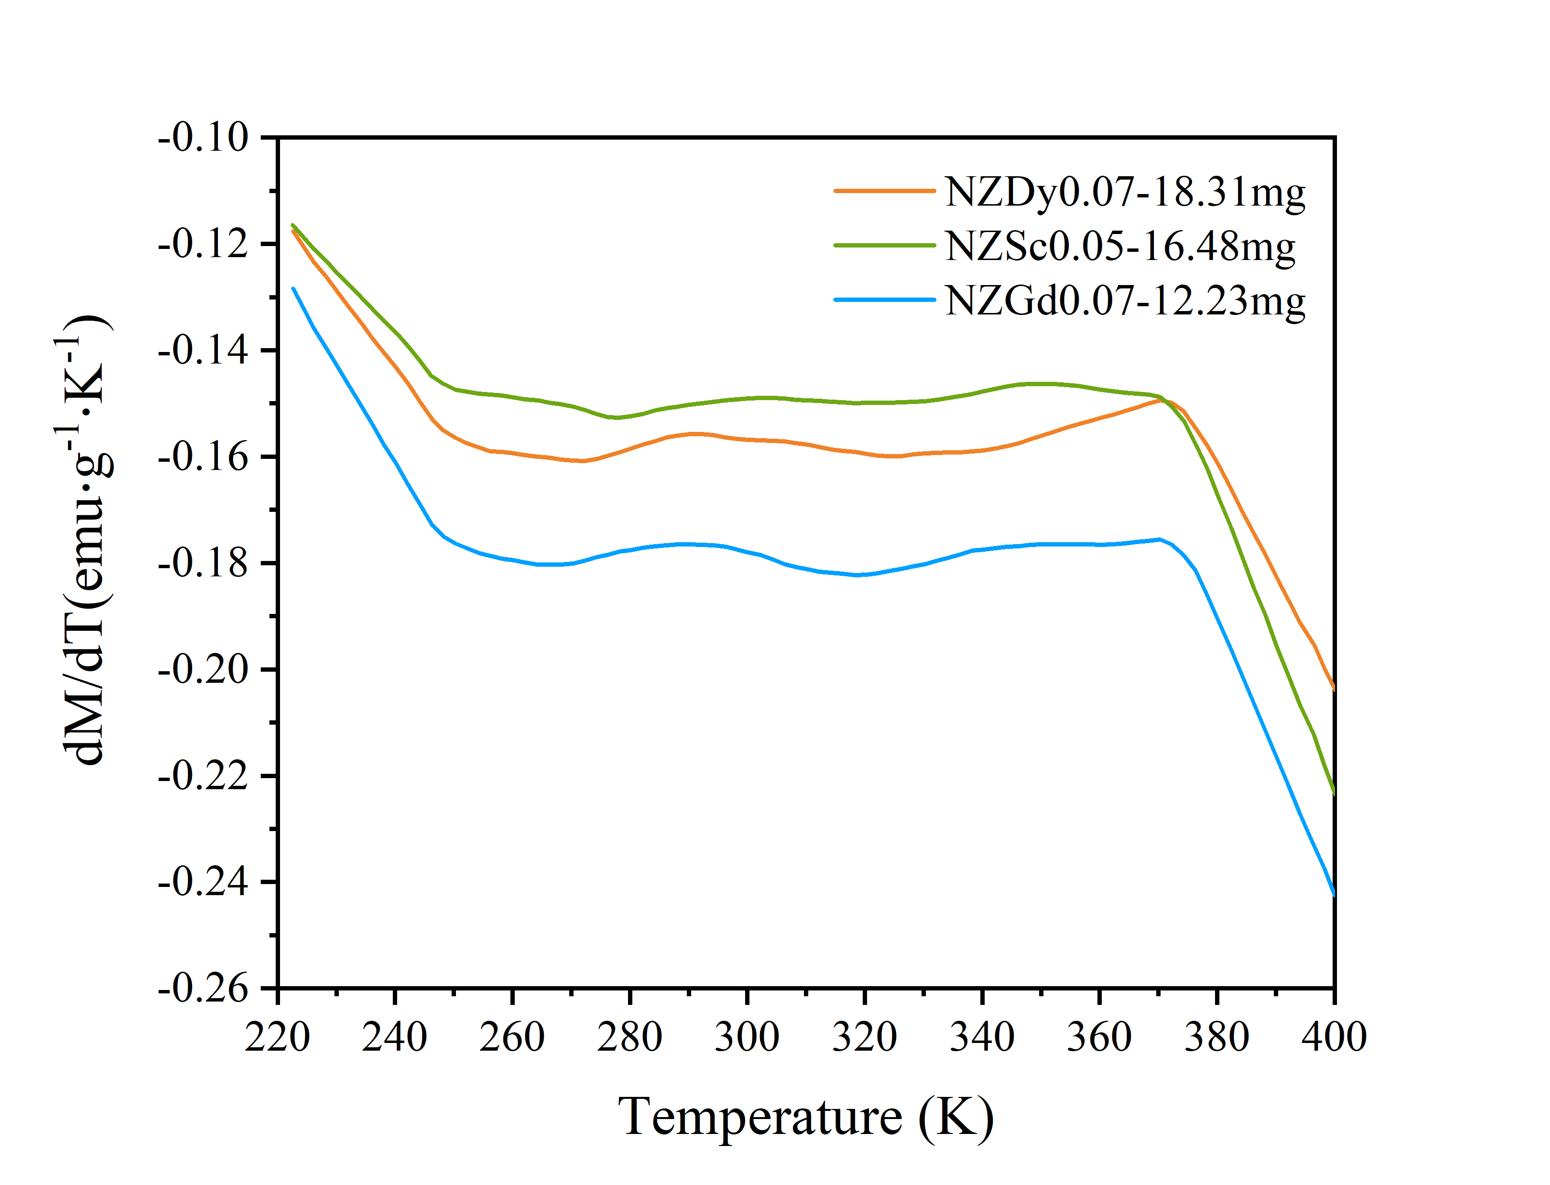
_{Add NaOH to adjust pH=10-11}
Heat to 80℃ and stirring for 2h
ScCl₃
Wash and dry then grind
NiCl₂
Ferrite power
TEM
ZnCl₂
FeCl₃·6H₂O
Temperature
Sensitive
Ferrite
Crystallographic texture of Nickel spinel ferrite

