Slide 1
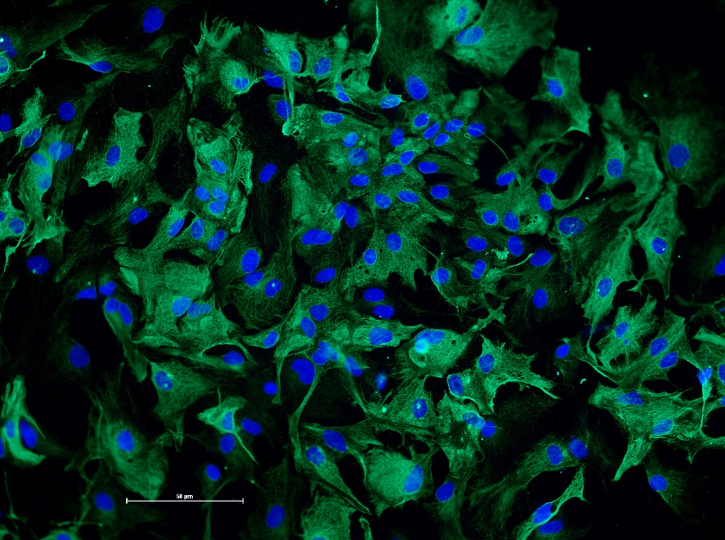
DAPI:GFAP
Supplementary 1
A.
DAPI:GFAP
B.
C.
DAPI:GFAP
D.
Notes:
Supplementary figure 1: Immunofluorescence of primary culture of cortical glial cells. Cells were stained with nuclear marker DAPI (blue) and with anti-GFAP (green); A, B and C are representative pictures of three different cell cultures. D. Statistical analysis of primary cell culture of cortical astrocytes composition. The percentage of astrocytes in the culture was calculated dividing total DAPI colocalized with GFAP by total DAPI counted. Results indicate an astrocytic population of more than 90%. Test-T Student, n=6 independent cell cultures.

Slide 2
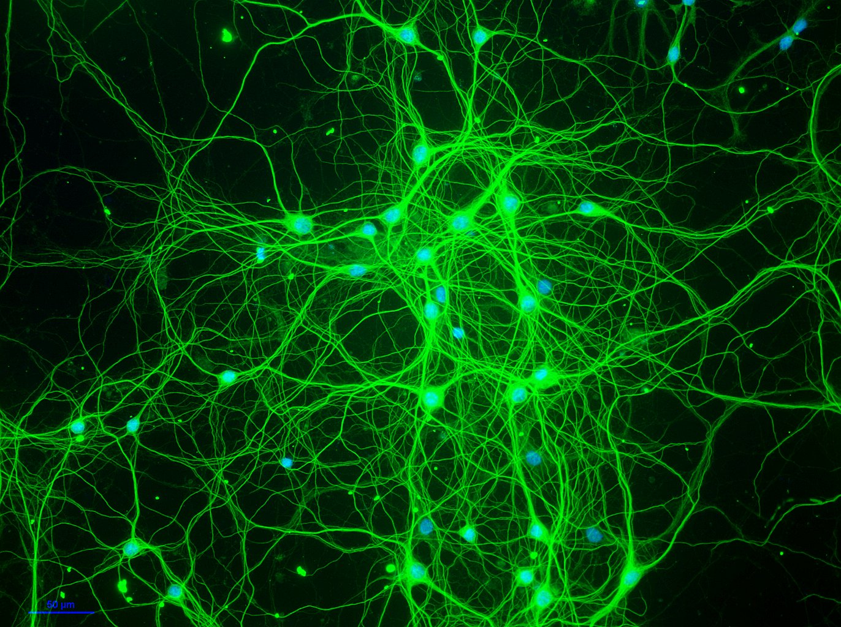
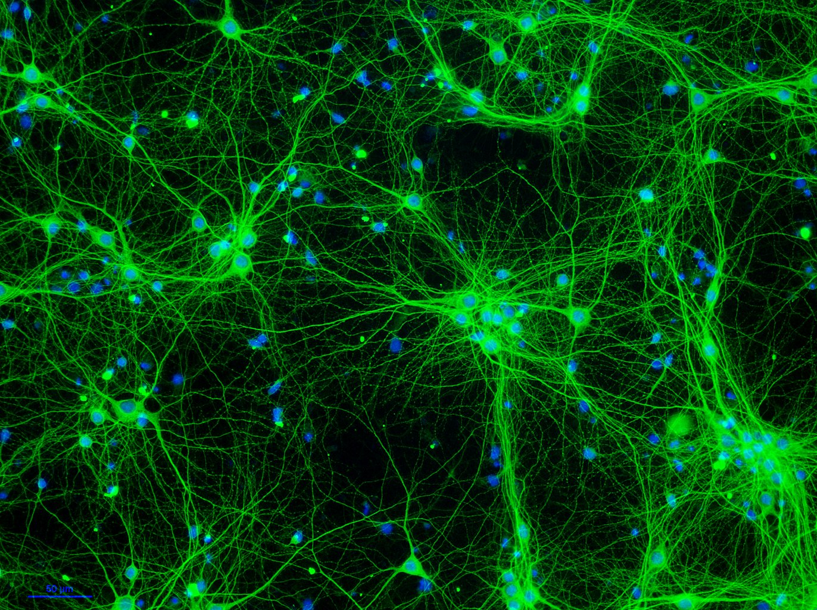
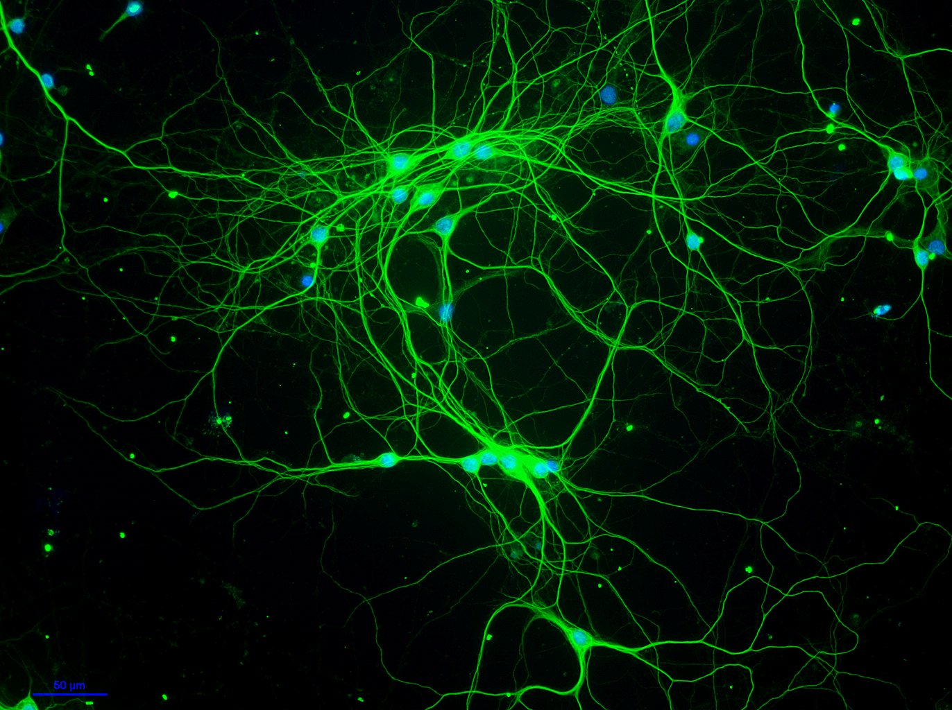
A.
DAPI:MAP2
B.
DAPI:MAP2
Supplementary 2
DAPI:MAP2
D.
C.
Notes:
Supplementary figure 2: Immunofluorescence of primary culture of cortical neuronal cells. Cells were stained with nuclear marker DAPI (blue) and with anti-MAP2 (green); A, B and C are representative pictures of three different cell cultures. D. Statistical analysis of primary cell culture neuronal composition. The percentage of neurons in the culture was calculated dividing total DAPI colocalized with MAP2 by total DAPI counted. Results indicate a neuronal population of more than 70%. Test-T Student, n=6 independent cell cultures [t=13.05; df=10; R squared= 0.9445]. *** p<0.0001.

