Slide 1
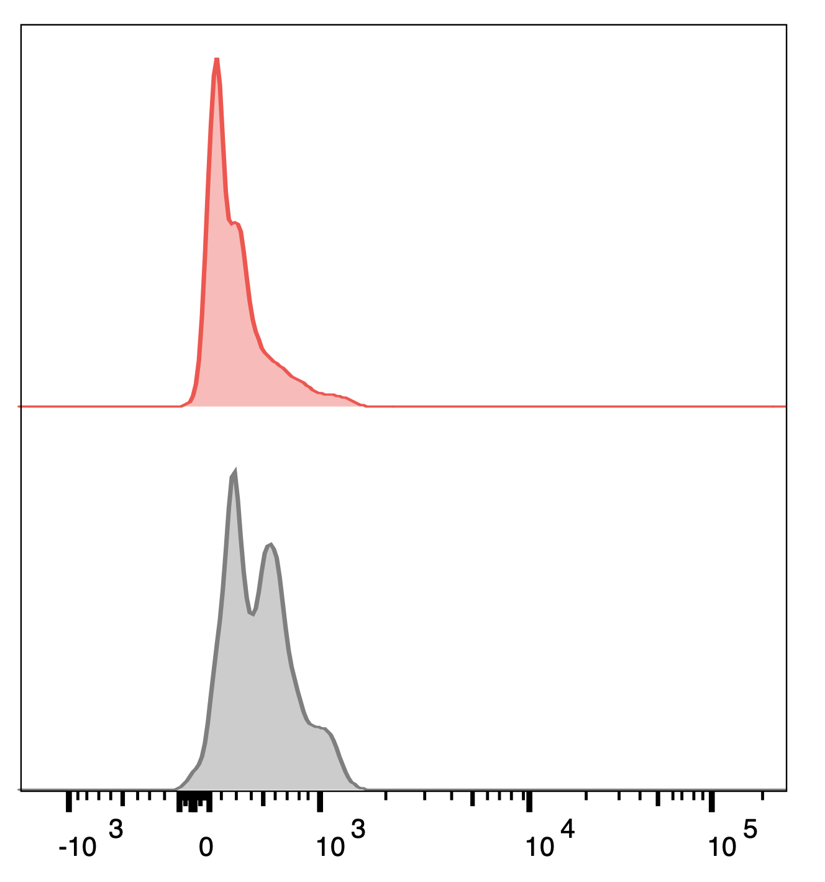
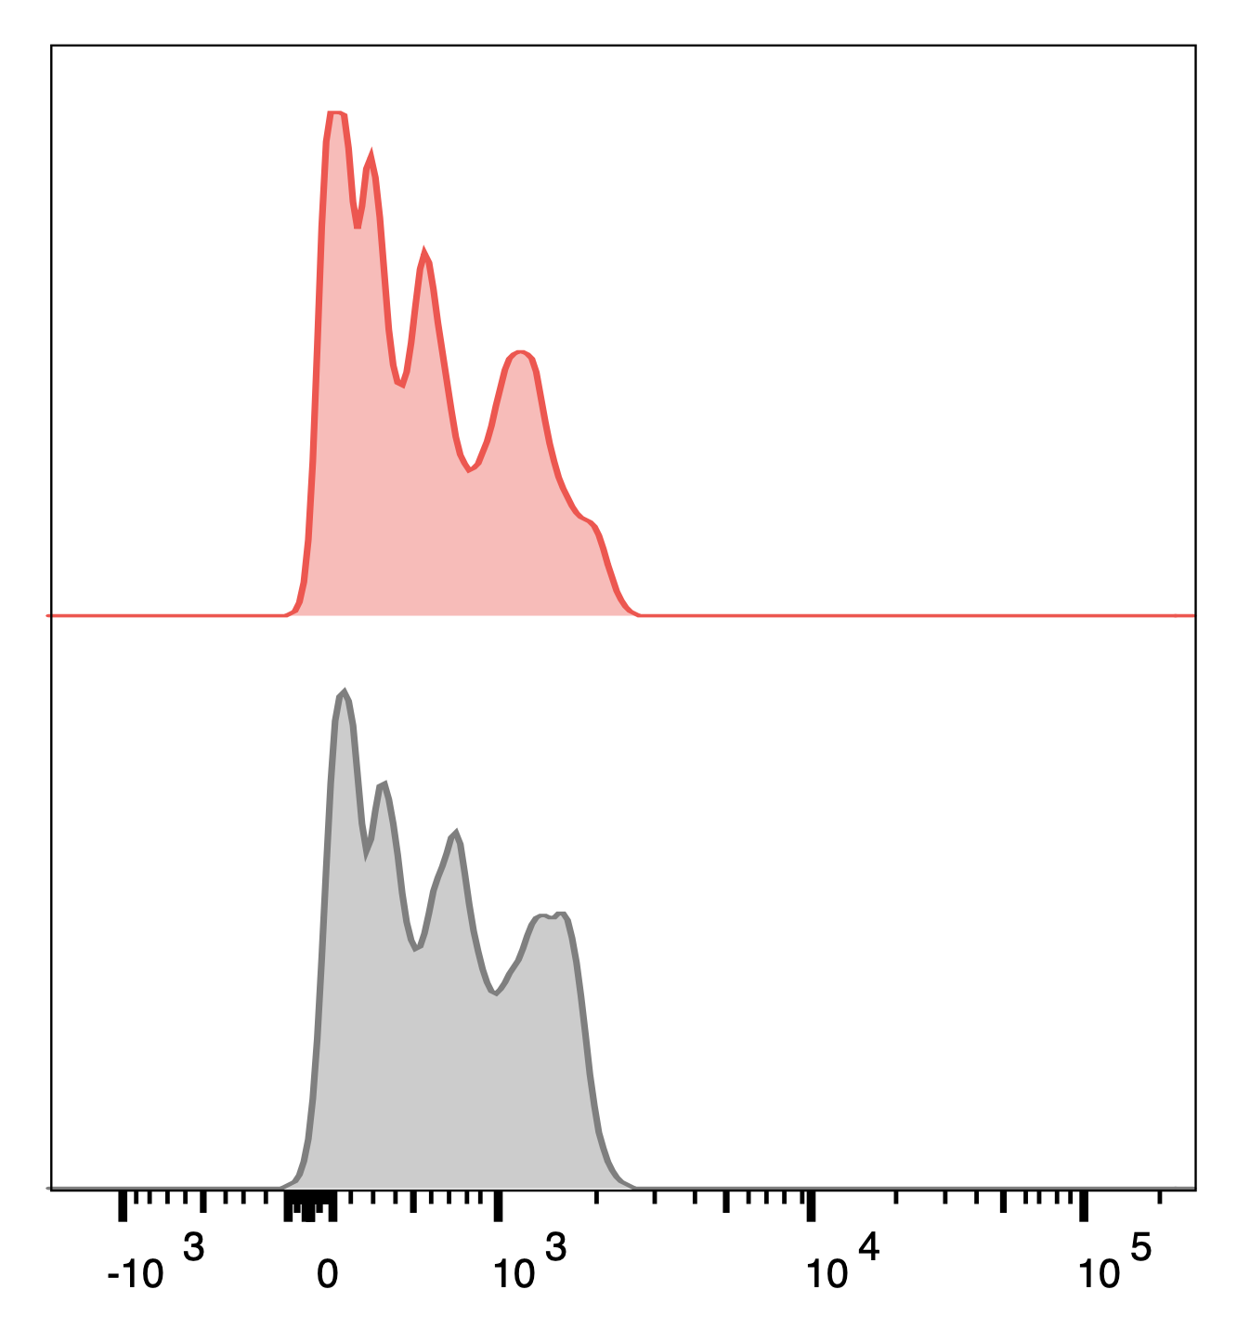
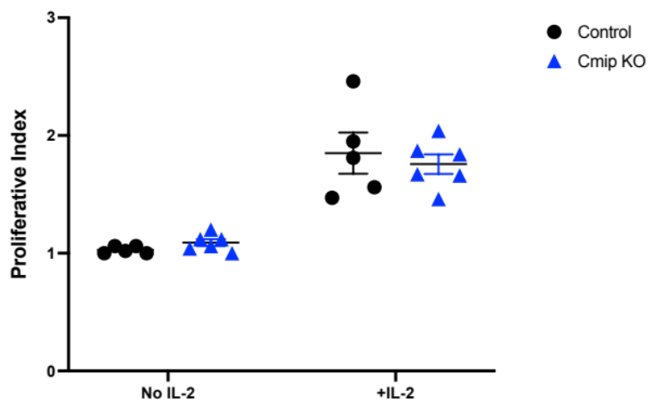
aCD3 (2 ug/ml)
aCD28 (1 ug/mL)
aCD3 (2 ug/ml)
aCD28 (1 ug/mL)
NO IL-2
+IL-2 (10ng/mL)
Control
Control
Cmip KO
Cmip KO
Cell Trace Violet

