Slide 1
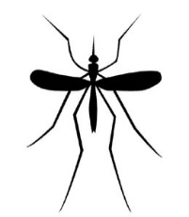
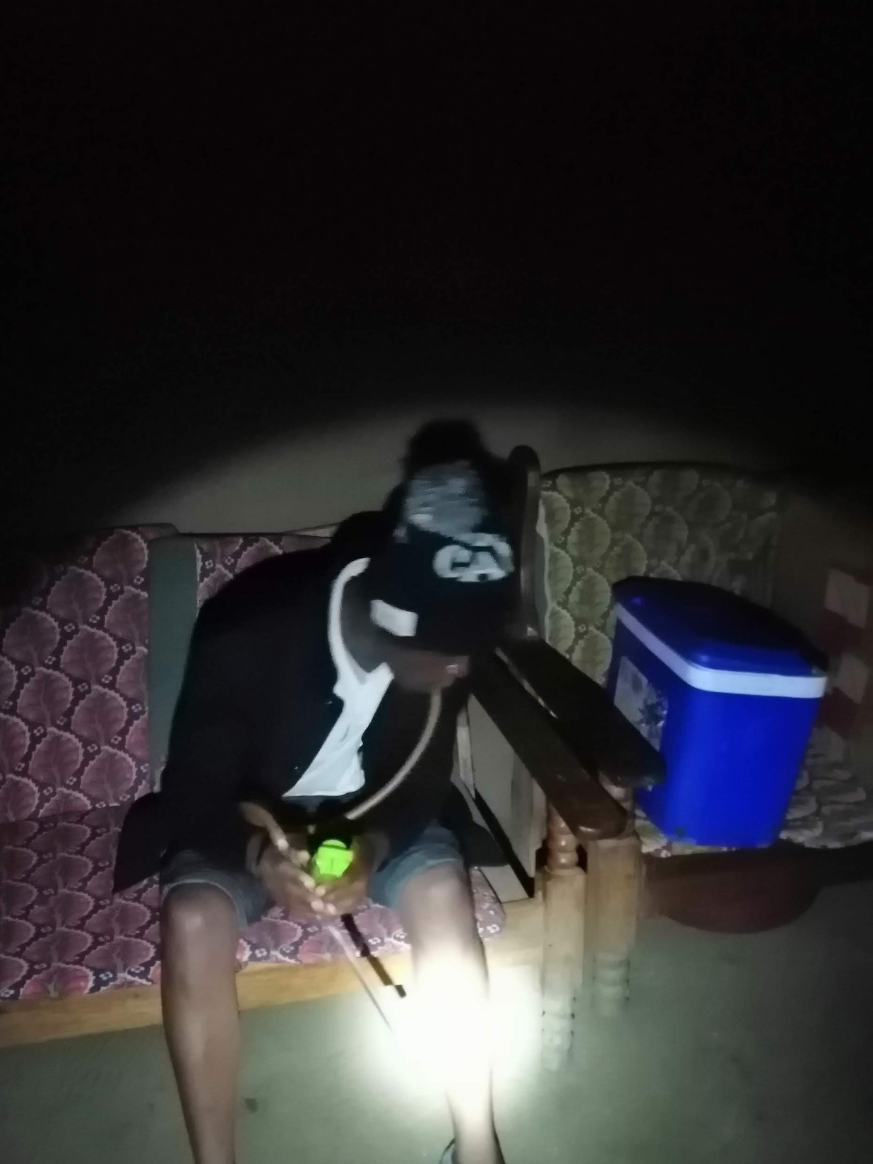


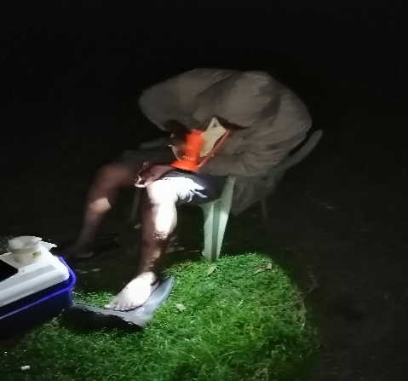
Host seeking mosquitoes
Human Host
Mosquito biting patterns and Human nocturnal behavior

