Slide 1
Table S1. Key inclusion and exclusion criteria.
Key inclusion criteria
Patients with esophageal cancer newly diagnosed during the search span
Pathology: esophageal squamous cell carcinoma
Clinical stage: I (cT1b) - IVA or IVB (cM1-lym)
Patients treated with dCRT for the first line treatment
Regimen: low dose nedaplatin + 5-fluorouracil (with radiation)
Key exclusion criteria
Patients with simultaneous multiple malignant tumor
Total radiation dose in dCRT < 10 Gy
Patients whose response to dCRT was uncertain (because of immediate dropout after dCRT)
Patients whose biopsy samples before dCRT did not exist in our hospital
(i.e. existed only in previous hospital and could not be used for immunohistochemistry analysis in this study)
Abbreviations: cT1b, tumor invasion to the submucosa; cM1-lym, distant lymph node metastasis; dCRT, definitive chemoradiotherapy.

Slide 2
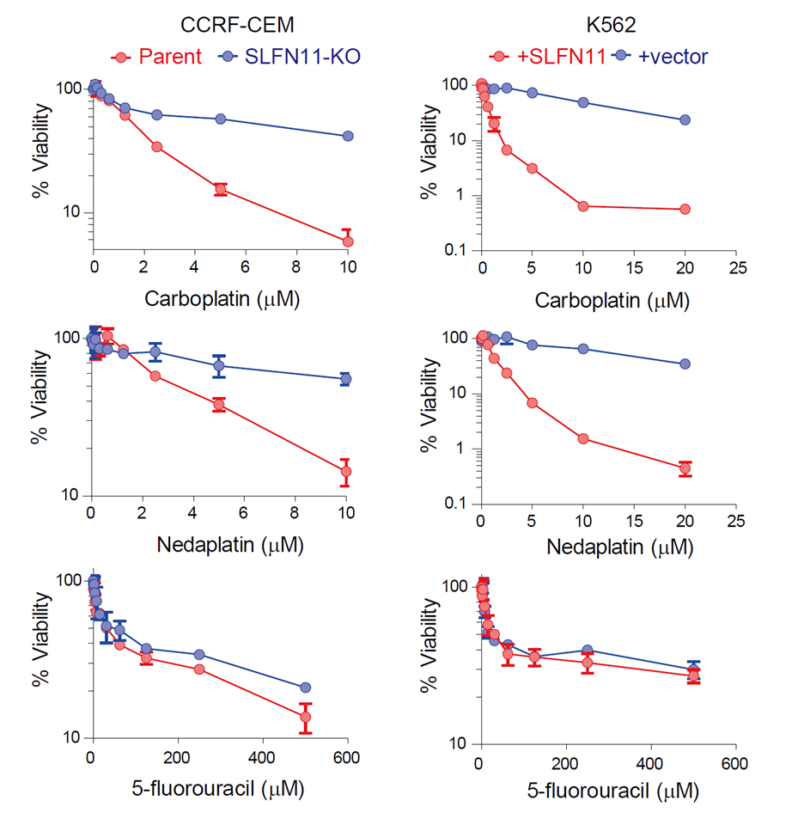
Figure S1
(A)
(B)
(C)
SLFN11 sensitizes cancer cells to nedaplatin and carboplatin but not 5-fluorouracil.
(A–C) Viability curves of the indicated cell lines after continuous treatment for 72 hours with the indicated agents (carboplatin, nedaplatin, and 5-fluorouracil). ATP concentration was measured to estimate cell viability. The viability of untreated cells was defined as 100%. Error bars represent standard deviation (n = 3). Human leukemia CCRF-CEM SLFN11-proficient [parent] and -deficient [SLFN11-KO], and K562 SLFN11-deficient [K562+vector] and -proficient [K562+SLFN11] cell lines were established previously (6, 8, 31).

Slide 3
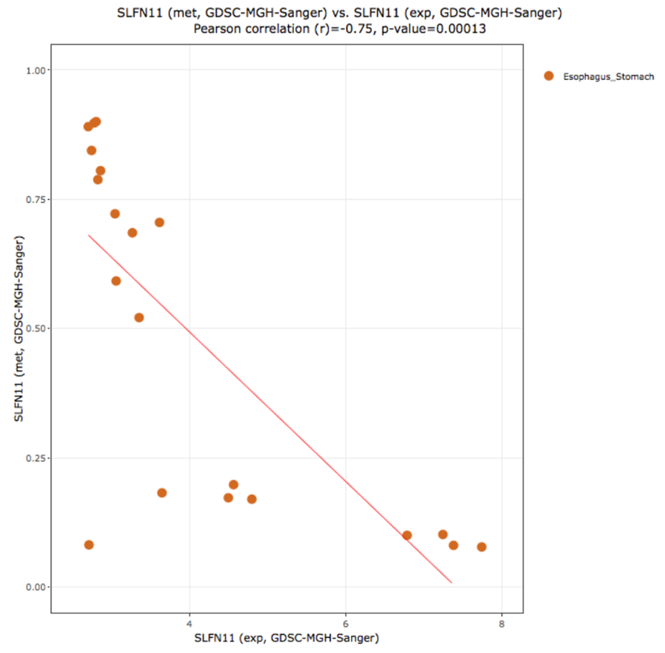
Figure S2
Inverse correlation between DNA methylation and transcripts of SLFN11.
Scatter plot shows the level of SLFN11 methylation in the promoter region (y-axis) and its mRNA expression level (Log2, x-axis) in esophageal squamous cell carcinoma cell lines within the dataset Sanger/MGH GDSC (http://discover.nci.nih.gov/cellminercdb). Pearson's correlation coefficient (r) and two-sided P value (p) are shown above the chart.

