Slide 1
Supplementary Figure 3. Representative maps of the chloroplast genome of A. Amaranthus retroflexus , B. Bassia muricata, C. Bienertia cycloptera, D. B. sinuspersici, E. Haloxylon ammodendron, F. Suaeda aralocaspica, G. S. eltonica, and H. S. maritima. Genes shown outside the outer circle are transcribed clockwise whereas those represented inside are transcribed counterclockwise. Large single copy (LSC), small single copy (SSC), and inverted repeats (IRa, IRb) regions are indicated.

Slide 2
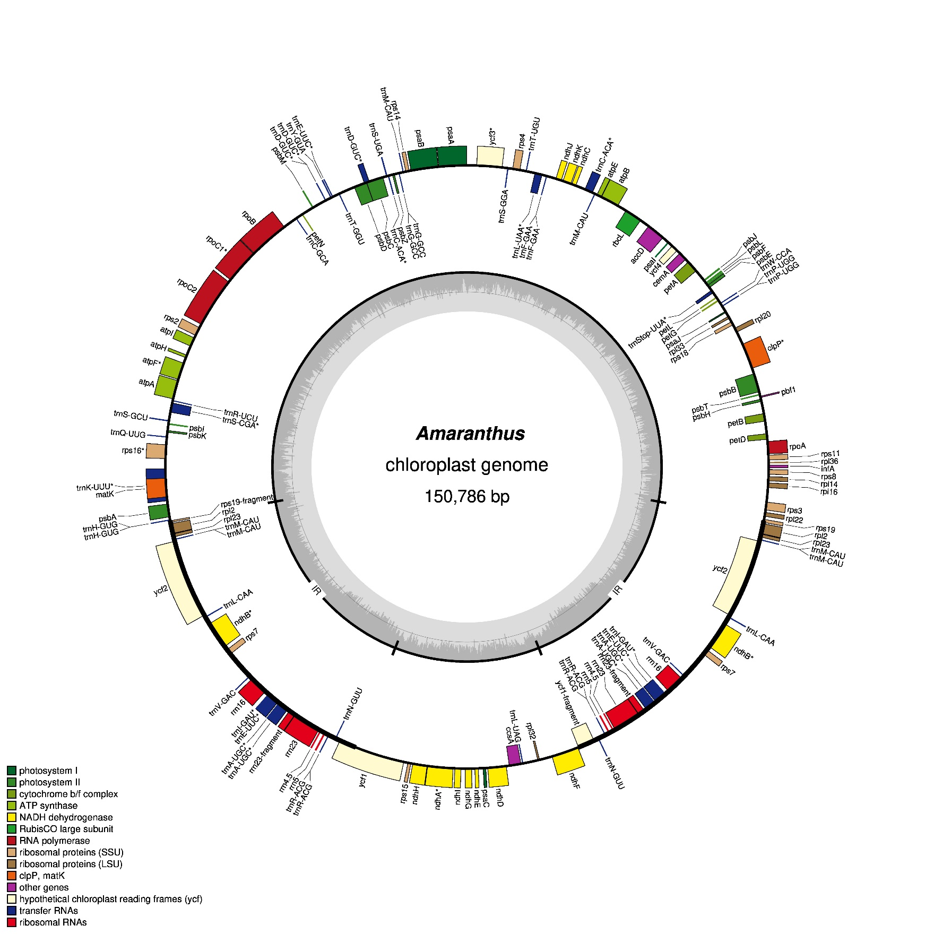
A
Amaranthus retroflexus

Slide 3
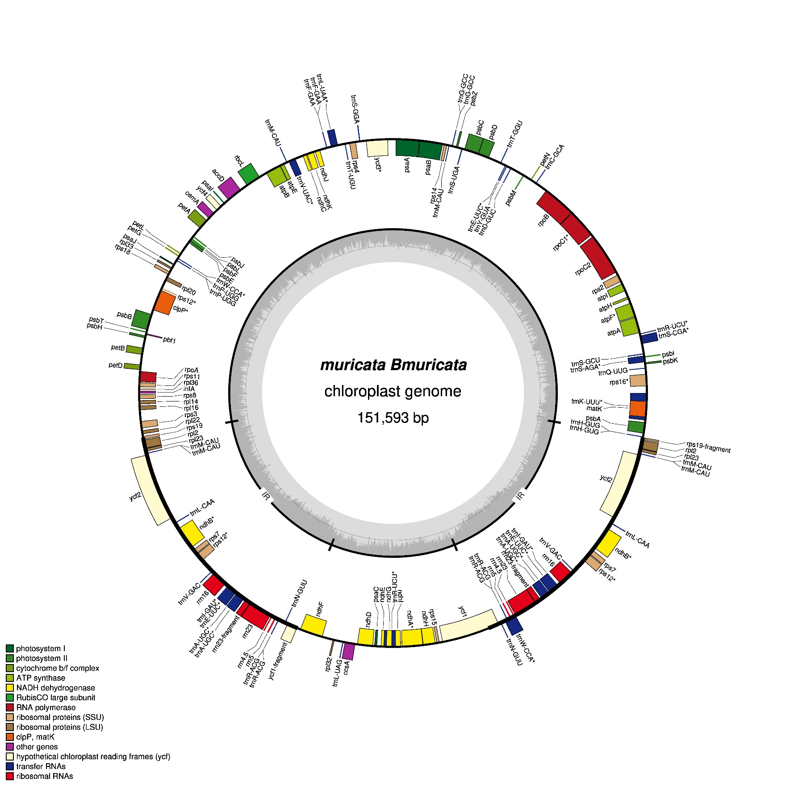
B
Bassia muricata

Slide 4
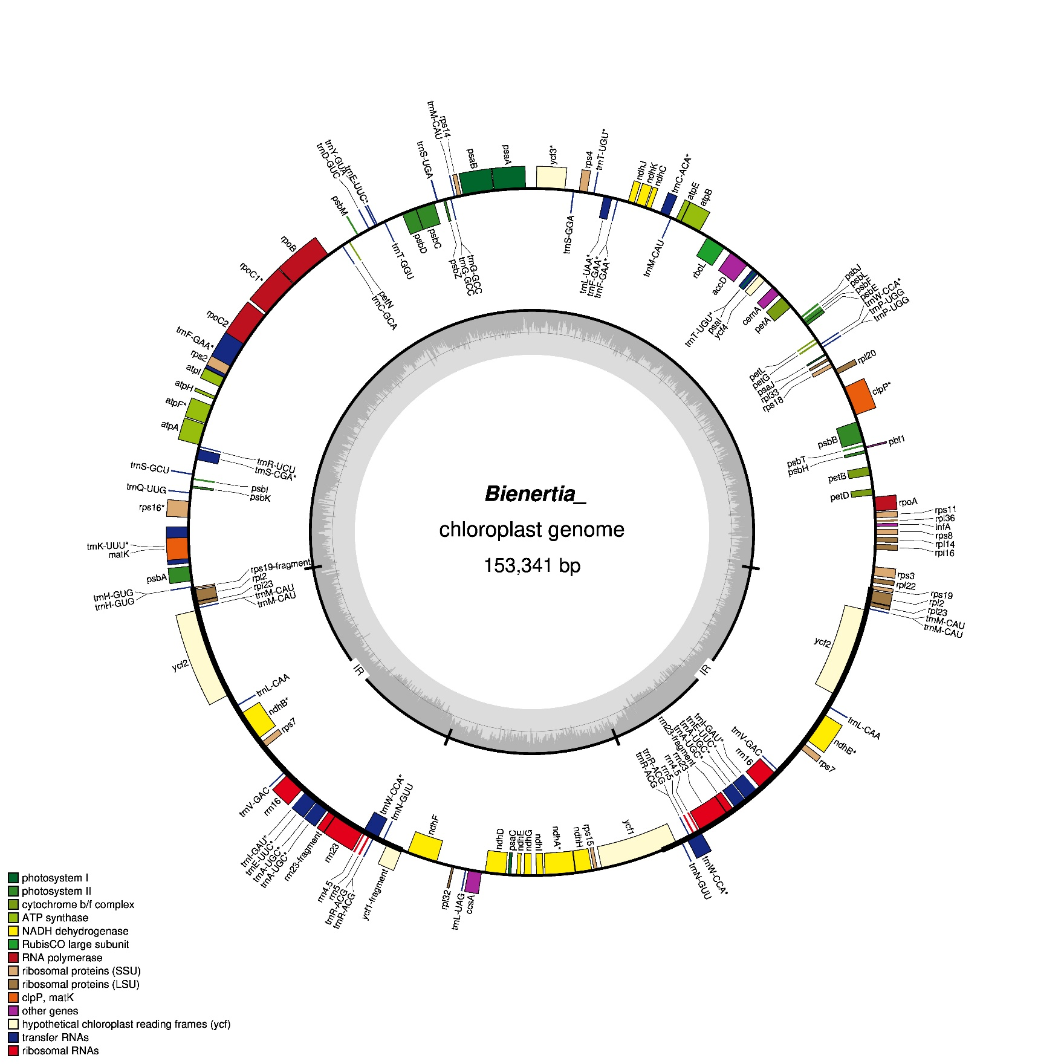
C
Bienertia cycloptera

Slide 5
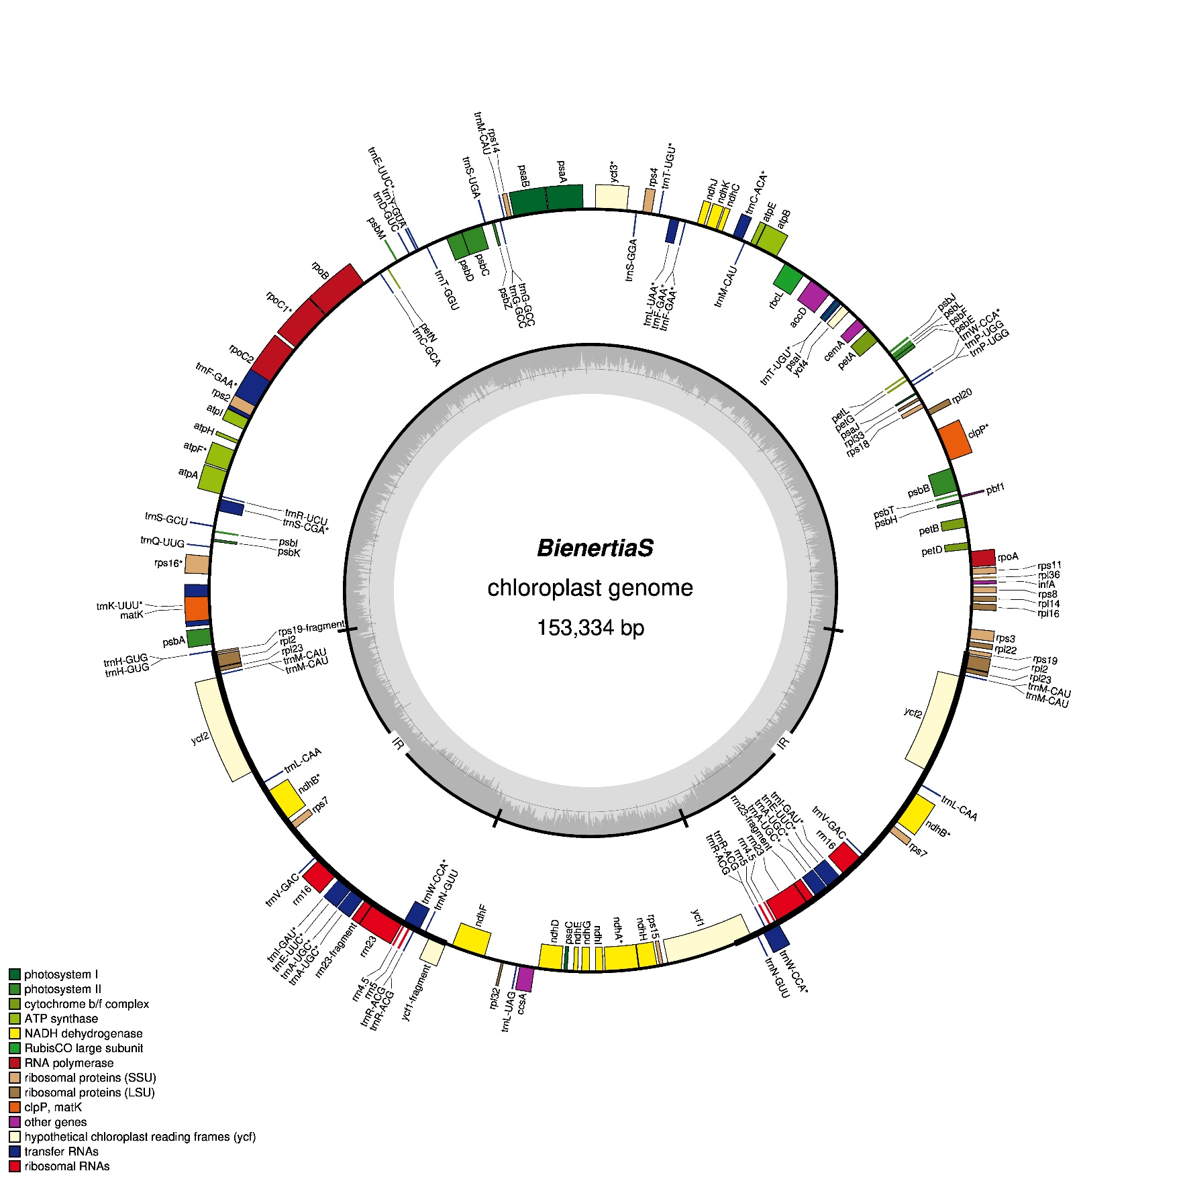
D
Bienertia sinuspersici

Slide 6
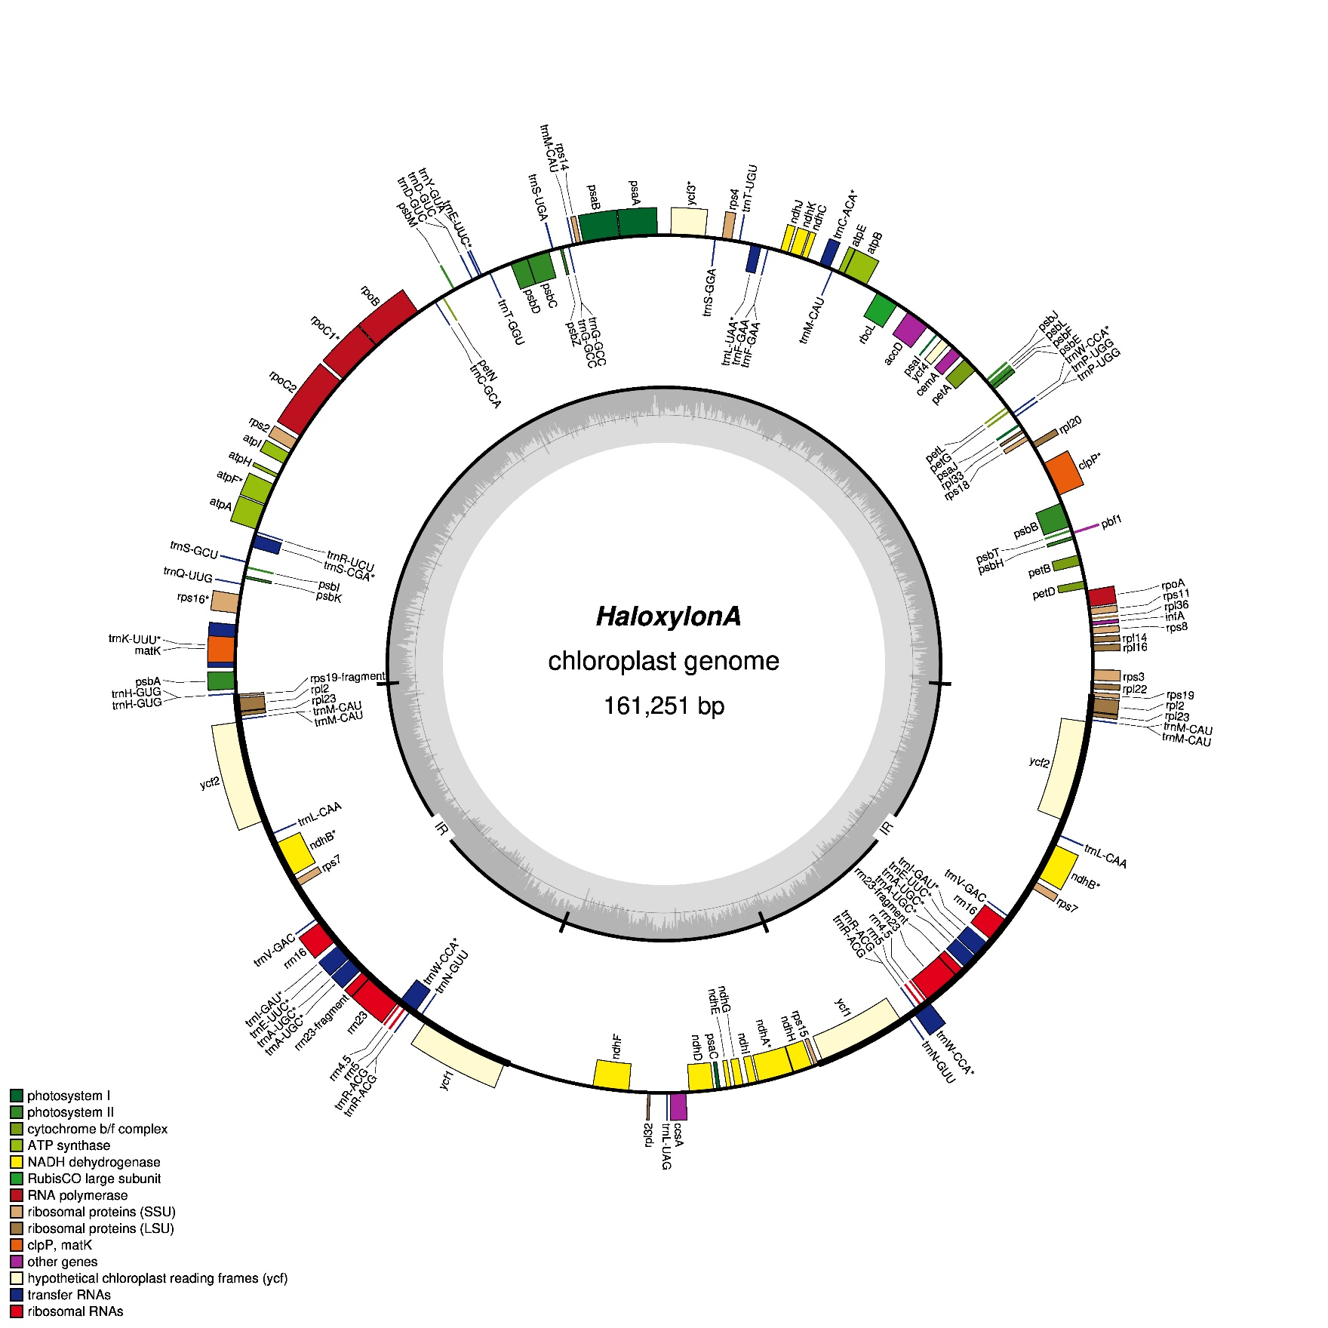
E
Haloxylon
ammodendron

Slide 7
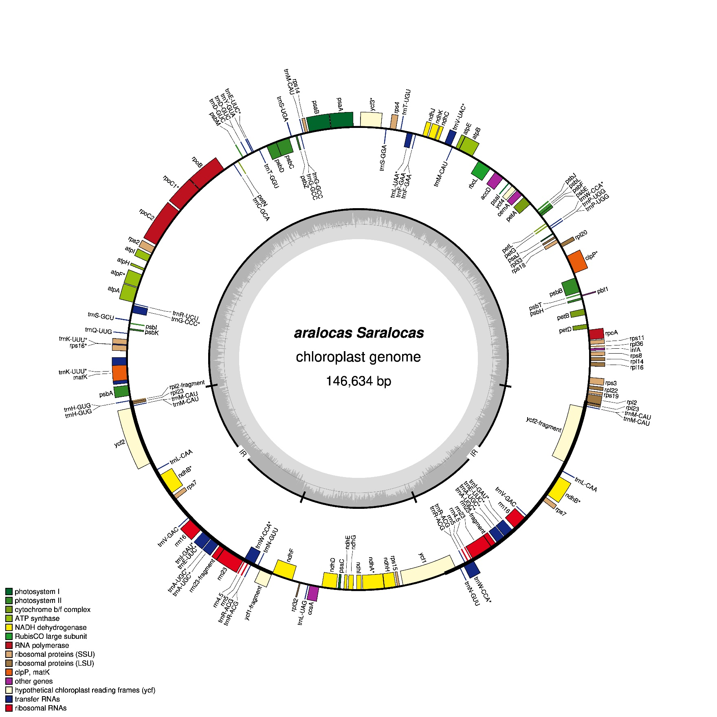
F
Suaeda
aralocaspica

Slide 8
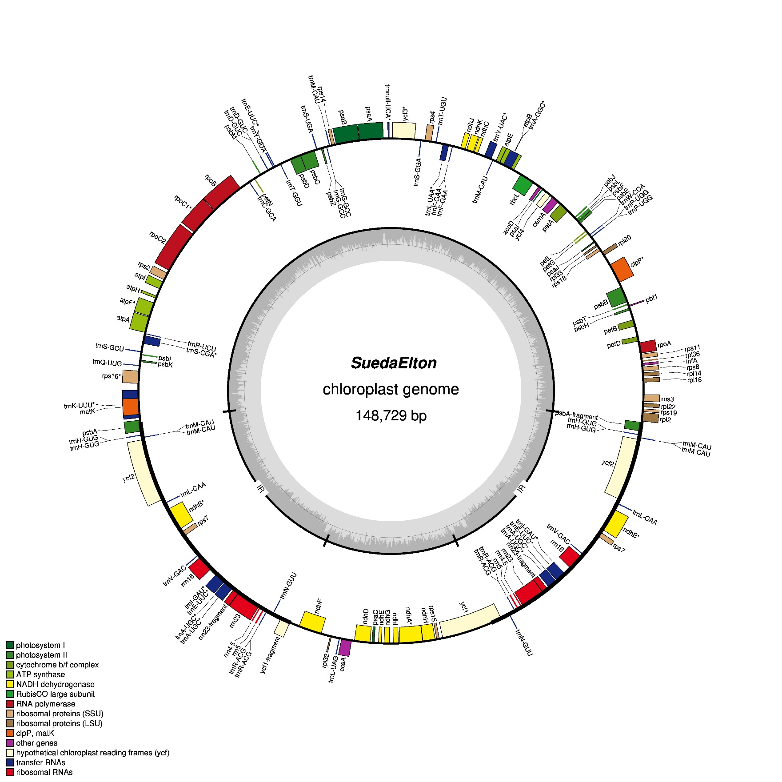
G
Suaeda eltonica

Slide 9
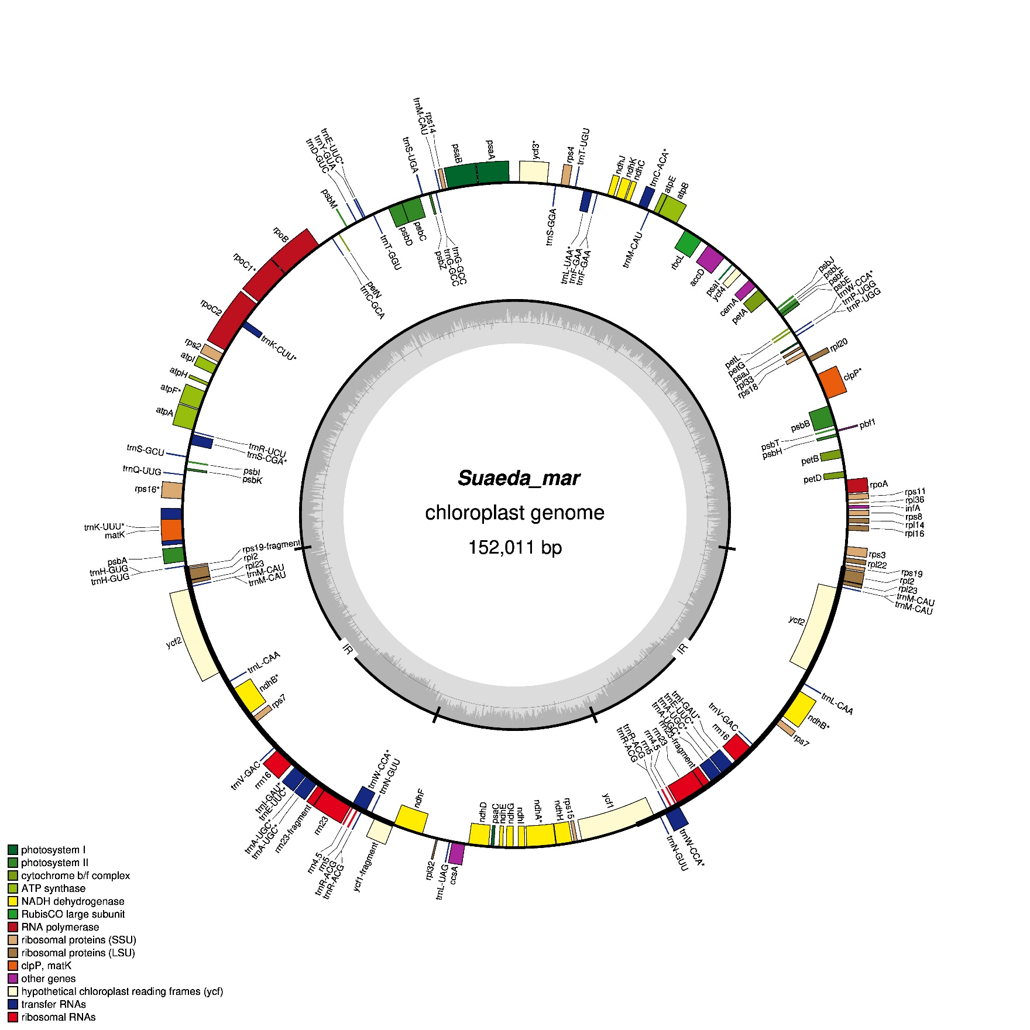
H
Suaeda maritima

