Slide 1
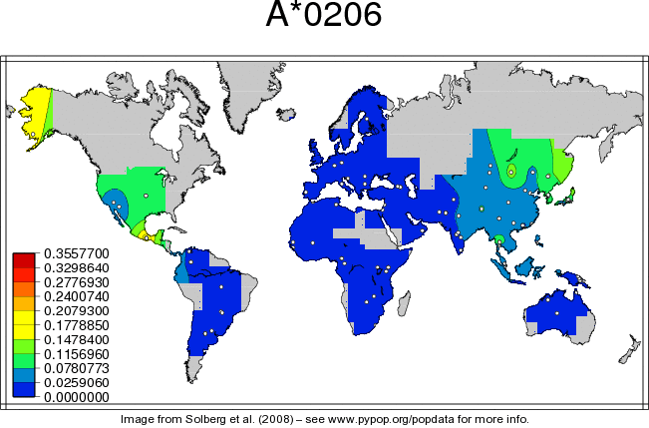
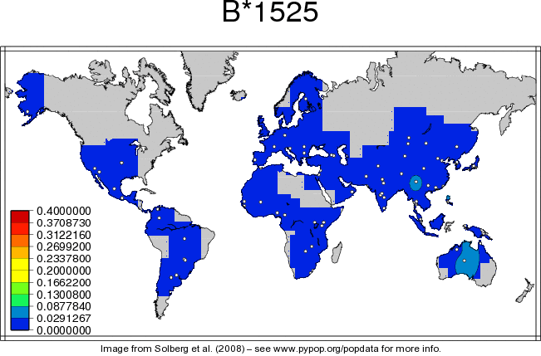
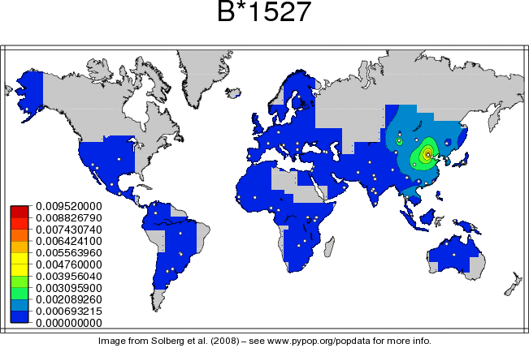
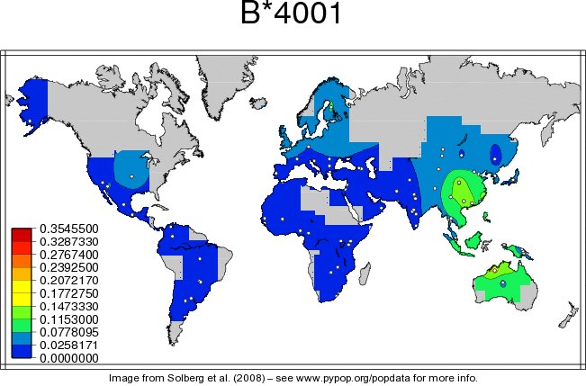
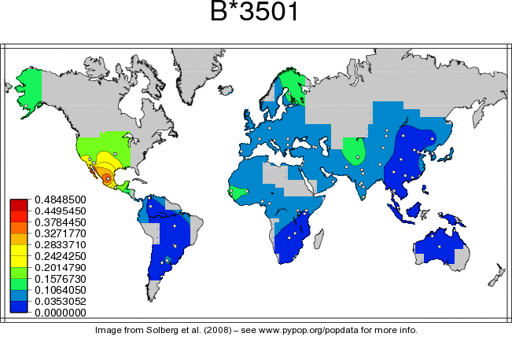

Supplementary Figure 3
A
B
1 Projected population coverage
2 Average number of epitopes hits/HLA combinations recognized by the population
3 Minimum number of epitopes hits/HLA combinations recognized by 90% of the population

