Slide 1
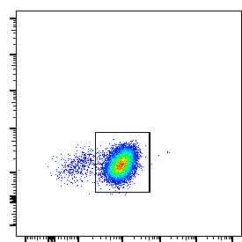
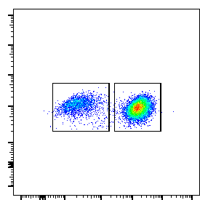
Supplementary Figure 2
A
8 days after in vitro expansion
B
C
L/D
99%
CD3
22%
78%
CD3
CD8
D

