Slide 1
Inequality of opportunities and beliefs about economic outcomes in the Western Balkans
Presentation for the 9th REDETE Conference 2022
“Present and future challenges in regional development in the Adriatic-Ionian Region”
Ancona, 15 – 16 September 2022
Authors:
Elvisa Drishti and Nevila Mehmetaj
University of Shkodra “Luigj Gurakuqi” and CERGE - EI, Prague
Notes:
Good afternoon everyone!
Thank you to the organizers and sponsors for providing an opportunity for presenting my paper at this conference.
Also, thank you to the previous presenters for the very interesting presentations.
My name is Elvisa Drishti. I am a full-time staff at the University of Shkodra, Albania. Today, I am going to present a paper titled “Active political engagement, political patronage, and local labour markets – the example of Shkoder.

Slide 2
Inequality of Opportunity (IOp)
A measure of deprivation (income, health, primary goods, etc.) attributable to luck in the distribution of
  Initial conditions at birth (biological, demographic)
    Gender
    Being born in a rural/urban area
    Ethnicity
    Etc.
  And/or social origins
    parental occupational status
    Parental education
    Parental income/wealth
    Parental political (power) affiliations
Notes:
I am going to start with a brief definition of ‘Inequality of Opportunity’.
What is Inequality of Opportunity?
It is generally conceptualized as a measure of deprivation in income, health, basic goods, etc. that descends from initial conditions at birth and/or social origins that are not controlled by the individual. Therefore, are more a matter of luck than of effort

Slide 3
Inequality of Opportunity (IOp)
Uncontrolled / Luck
Demographic endowment
  Ethnicity
  Urban or rural place of birth
Biological endowment
  Gender
Socio-economic origins
  Parental occupation/education
  Parental income/wealth
  Parental
Political/Power
  Parental affiliation in political parties
Inequality of Opportunity
Unfair share (%) of Inequality
Inequality of:
Income
Health
Primary goods
Etc.
Beliefs about unfair life and labour market outcomes
Controlled / Effort
Hard work
Human and social capital
Intelligence
Skills
Performance
Fair share (%) of Inequality
Notes:
This is a visual description of IOp and it divides inequality (of income, health, primary goods, etc.) in two parts:
UNFAIR due to luck
FAIR due to effort
In this study, we are interested in the ‘Unfair share of inequality’ - the one explained by initial factors at birth and social origins - which is morally arbitrary and uncontrolled by the individual in comparison to effort which is controlled by the individual and hence fair.
Unfair IOp is important because it has an effect on beliefs about important economic outcomes such as labour market and overall life success. On the other hand, beliefs play a crucial role when it comes to important decisions such as whether to attend university, migrate, open a business, participate in voting process, etc.
Therefore we seek to identify the shares of unfair IOp for the case of the Western Balkans, a context rather under-researched in the topic of inequality in particular and social indicators in genera.

Slide 4
Western Balkans context
Western Balkans countries (WB6)
  Albania
  Bosnia and Herzegovina
  Kosovo
  Montenegro
  North Macedonia
  Serbia
Post-communist countries
  Less affluent
    Corruption
    Weak rule of law
    Lack of welfare state
Non-EU
  Aspiring for EU membership
  EU convergence agenda

Slide 5
Government effectiveness

Slide 6
Regulatory quality

Slide 7
Rule of law

Slide 8
Control of corruption

Slide 9
Hypotheses
H1
All other things being equal, specific subgroups of individuals:
  Young people more likely than other age groups
  women more likely than men
  Those born in rural areas
  Those whose social status is lower (vs. Middle and higher)
  And those who have unemployed familiars (as a signal for lower family social origin)
Will be more likely to report to report higher levels of IOp.

Slide 10
Hypotheses
H2
All other things being equal, those with higher (vs. lower) levels of IOp will be more likely to report beliefs about unfair (vs. fair) economic outcomes.

Slide 11
Data
Unique and updated database
  Public Opinion
    Collected within the framework of the Balkan Barometer
      Regional Cooperation Council
      https://www.rcc.int/balkanbarometer/results/2/public
  2017 – 2021 waves
  6,000 citizens throughout the WB region
    1000 for each country
    Representative and random
  Allows cross-country comparisons

Slide 12
Modelling strategy
We estimate a two-stage least squares linear model of individual responses within each of the WB6 countries
  First stage
    We decompose inequality of access to primary goods based on the person’s
      Initial conditions (circumstances) at birth
      Social origin
      And a residual term
  Second stage
    We estimate the effects of IOp on beliefs about unfair outcomes in terms of
      Life success
      And labour market success

Slide 13
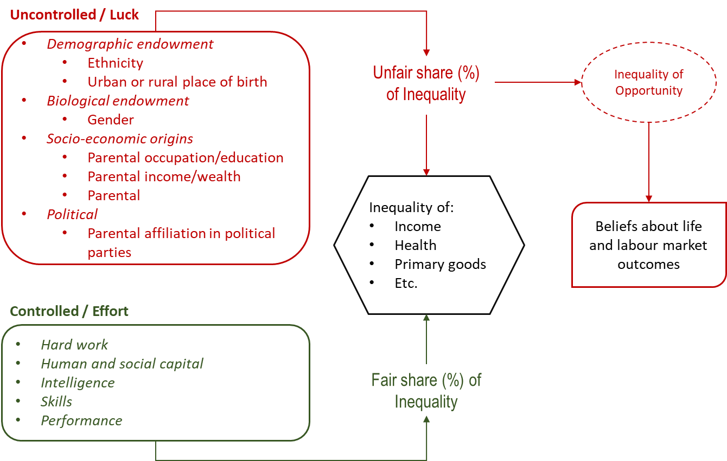
Inequality of Opportunity (IOp)
STAGE 1
STAGE 2
Notes:
This is a visual description of IOp and it divides inequality (of income, health, primary goods, etc.) in two parts:
UNFAIR due to luck
FAIR due to effort
In this study, we are interested in the ‘Unfair share of inequality’ - the one explained by initial factors at birth and social origins - which is morally arbitrary and uncontrolled by the individual in comparison to effort which is controlled by the individual and hence fair.
Unfair IOp is important because it has an effect on beliefs about important economic outcomes such as labour market and overall life success. On the other hand, beliefs play a crucial role when it comes to important decisions such as whether to attend university, migrate, open a business, participate in voting process, etc.
Therefore we seek to identify the shares of unfair IOp for the case of the Western Balkans, a context rather under-researched in the topic of inequality in particular and social indicators in genera.

Slide 14
Measure of IOp
Income data is measured in incompatible income segments (local currency across the WB6) and cannot be standardized or unified
  As even within countries the segments change along the years.
Therefore we use access to household basic goods as a measure of unfair IOp

Slide 15
Measures of unfair outcomes in life
Dependent variable
  Beliefs about unfair economic outcomes
    About getting ahead in life
      Questionnaire item 1: What do you think is the most important for getting ahead in life?
        1 if ‘Knowing the right people’, 0 ‘otherwise’
      Questionnaire item 2: What do you think is the most important for getting ahead in life?
        1 if ‘Being lucky’, 0 ‘otherwise’
      Questionnaire item 3: What do you think is the most important for getting ahead in life?
        1 if ‘Belonging to a wealthy family’, 0 ‘otherwise’

Slide 16
Measures of unfair outcomes in the labour market
Dependent variable
  Beliefs about unfair economic outcomes
    In the labour market
      Public sector
        Questionnaire item 1: In public sector, most people can succeed if they are willing to work hard
        Questionnaire item 2: Hard work is no guarantee of success in public sector as for most people it is more a matter of connections.
        The response scale is binary, 1 if ‘disagree’, 0 if ‘agree’.
      Public and private sector
        Questionnaire item 1: In your opinion, which two assets are most important for finding a job today?
          1 if ‘Personal contacts’, 0 ‘otherwise’
        Questionnaire item 2: In your opinion, which two assets are most important for finding a job today?
          1 if ‘Network of family and friends’, 0 ‘otherwise’

Slide 17
Control variables
We controlled for participants’
  Individual characteristics
    Curvilinear effects of age (in years)
    gender
    highest achieved level of education (measured in three categories: ISCED 1-2; ISCED 3-4; ISCED 5-6)
    labour market status is included as dummy variables.
  Household characteristics living with a partner (as a dummy)
    expectations about national economy and own income.
  Year fixed effects are also included

Slide 18
Findings
Ranking of countries based on the IOp generated by individual (micro) level data
  Albania (36.5%)
  Serbia (27.8%)
  Kosovo (25.5%)
  North Macedonia (24.5%)
  Montenegro (21.6%)
  Bosnia and Herzegovina (19.5%)

Slide 19
Findings
What is interesting to see is the fact that
  being born in a rural region of birth
  and self-perceiving your family origin from a lower socio-economic status
Are the main determinants of IOp across the WB6.
So almost 1/5 to 1/3 of the variance in access to a bundle of primary/basic goods is explained by exogenous factors (and not effort) which are not controlled by the individual.

Slide 20
Findings
IOp reinforces the beliefs that successful outcomes in public sector career are not driven by hard work and that it is more a matter of connections
The same rationale is applicable to beliefs about unfair outcomes in life in general
IOp contributes positively towards beliefs about the unfair distribution of outcomes in the sense of a successful life (which rely on connections, luck, and being born in wealthy family) and towards the most important factors of finding a job at present

Slide 21
Thank you, questions?

