Slide 1
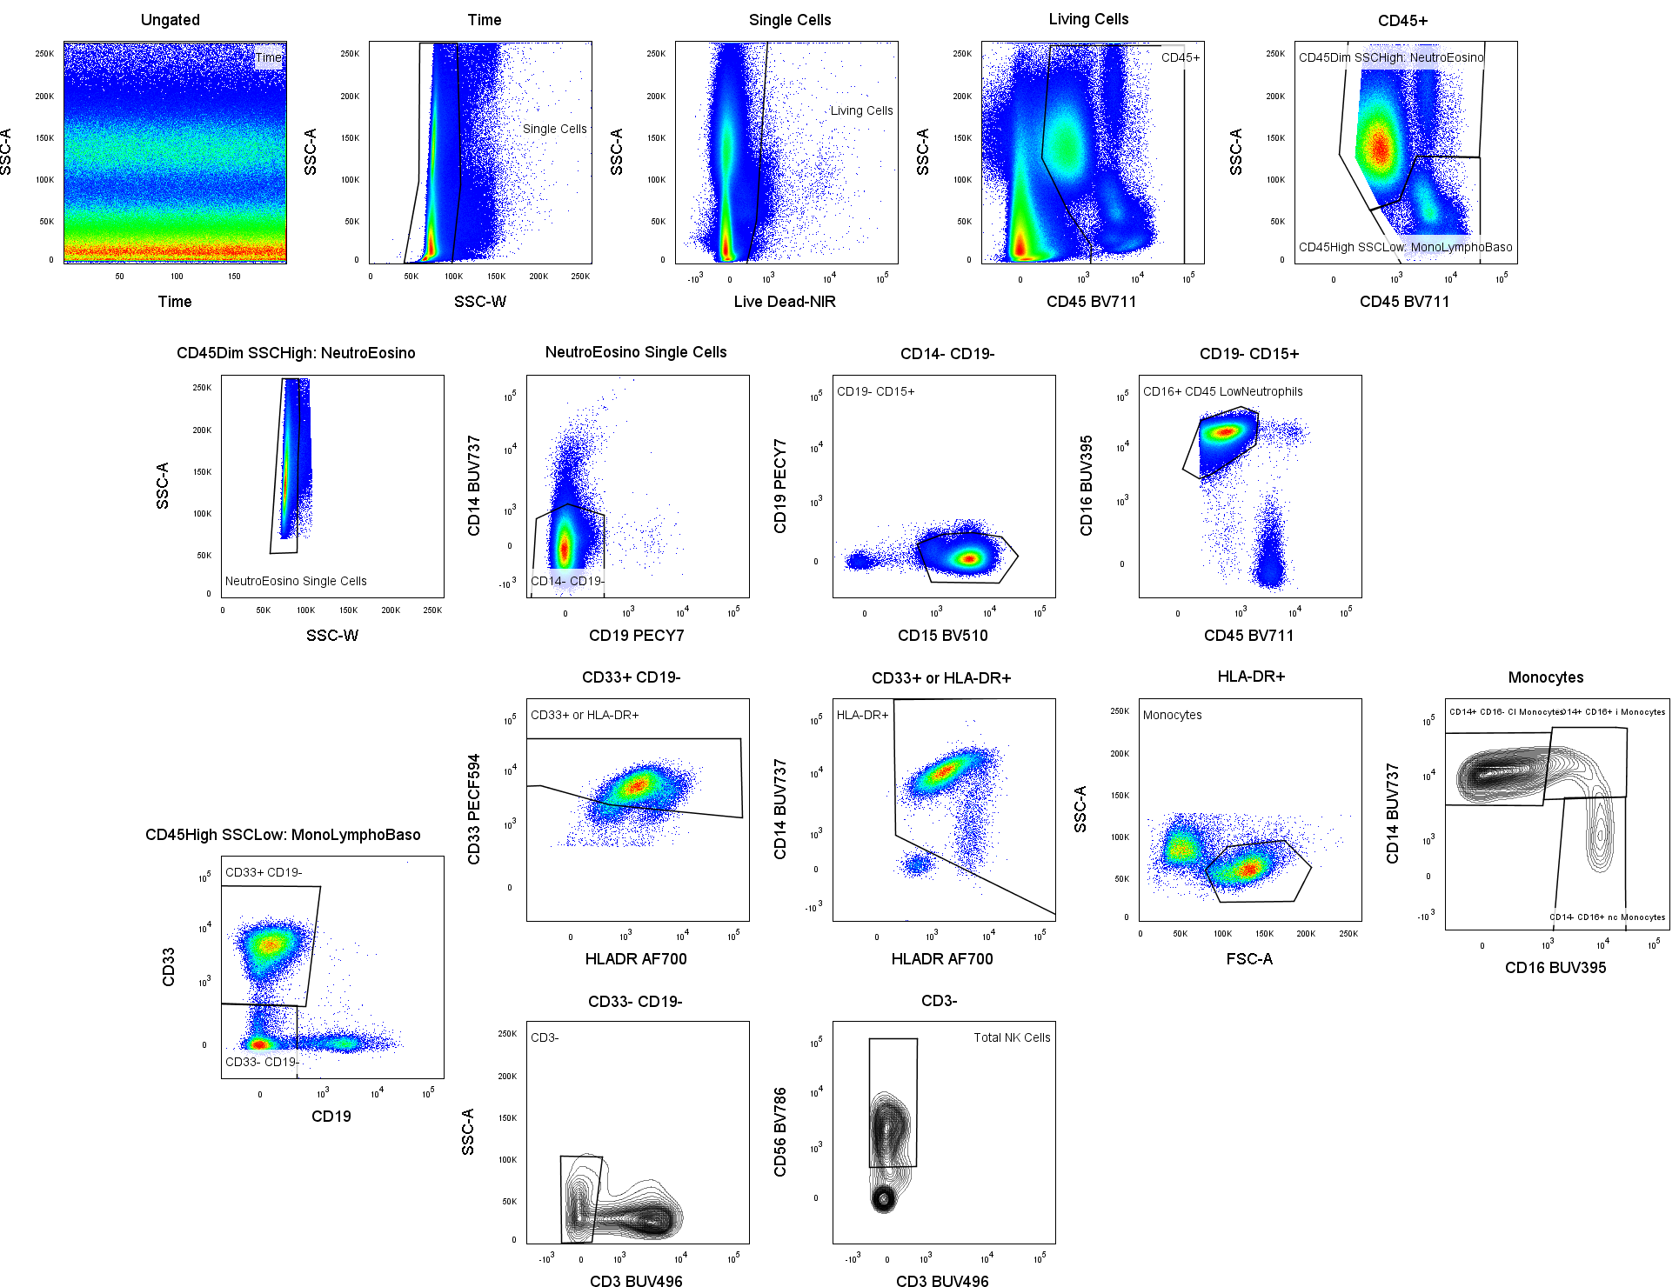
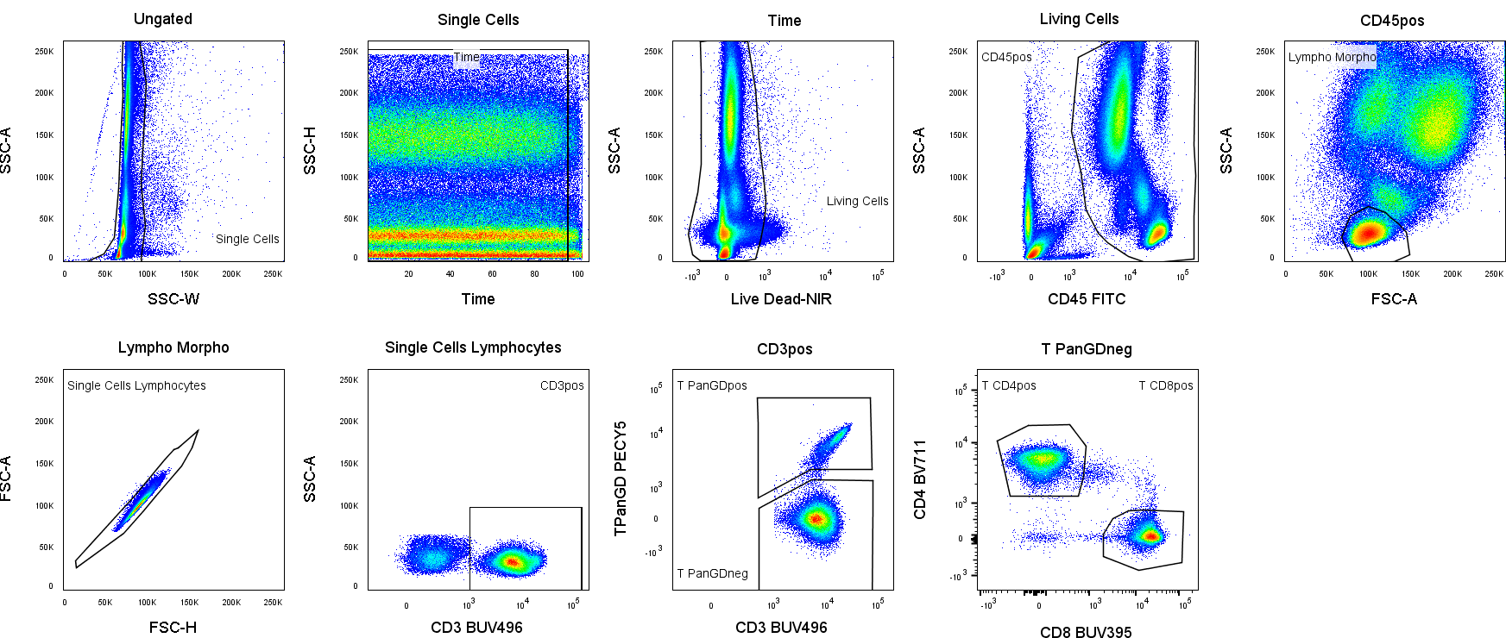
Gating Stategy - Panel1: Neutrophils, Monocytes and NK cells
Gating Stategy – Panel 2: CD4 and CD8 T cells

