Slide 1
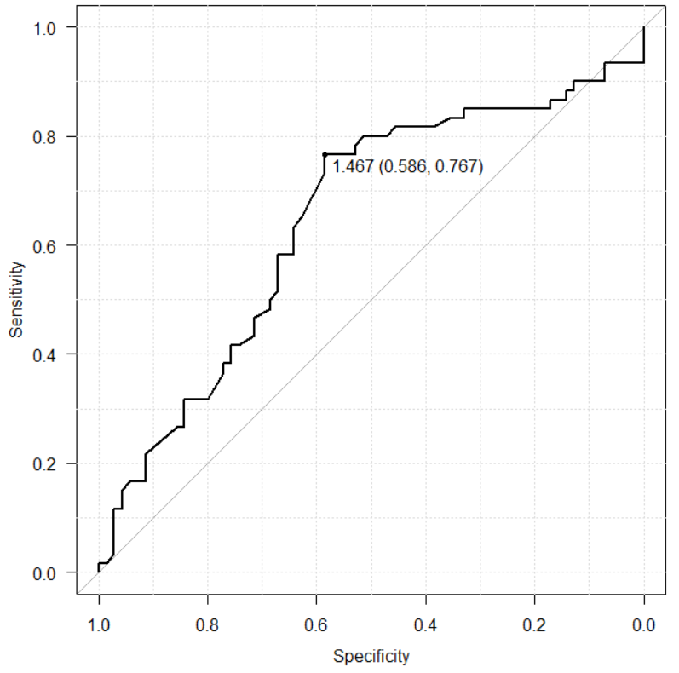
Supplemental figure 1. ROC curve for overall survival after the diagnosis of prostate cancer shown by AST/ALT ratio.
The optimal cutoff value for AST/ALT ratio was determined to be 1.467 (area under the curve 0.646, sensitivity 0.767, specificity 0.586).
AUC=0.646
95% CI 0.548-0.743

