Slide 1
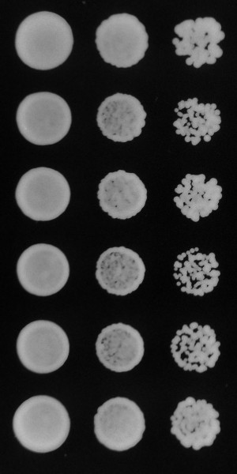
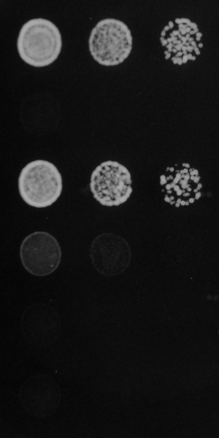
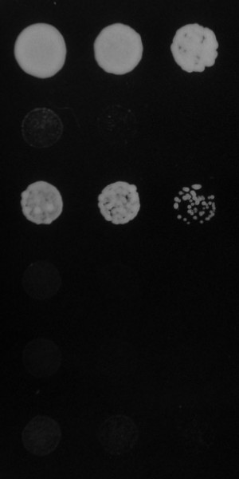
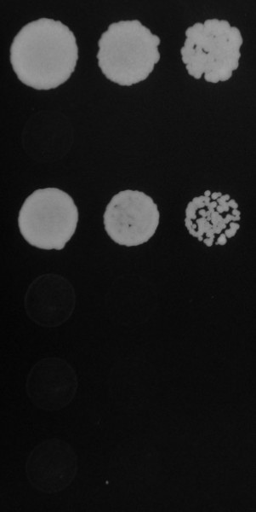
Supplemental Fig. 1, Takenaka et al.
Control
+1.2 M KCl
+0.2 M CaCl₂
+0.1 µM LatA
Wild type
pka1∆
pka1∆ rst2∆
pka1∆ tfs1∆
pka1∆ mca1∆
pka1∆ moc3∆

