Slide 1
 | Poa infirma (PiA) | Poa annua’s A subgenome (PaA) | Poa annua’s B subgenome (PaB) | Poa supina (PsB)
Genome length (Mb) | 1,125.5 | 1,115.9 | 662.1 | 636.5
BUSCO of genome assembly (%) | C:98.8[D:3.0] | C:98.4[D:2.9] | C:98.7[D:3.2] | C:97.0[D:4.1]
Repetitive sequence (%) | 81.2 | 74.5 | 62.9 | 64.6
Number of genes | 39,420 | 37,123 | 39,536 | 37,935
BUSCO of gene annotations (%) | C:95.6[D:10.0] | C:89.0[D:9.4] | C:89.0[D:10.8] | C:90.7[D:10.8]
Mean gene length | 4,534 | 4,191 | 4,135 | 5,451
Mean cds length | 1,233 | 1,181 | 1,186 | 1,220
Mean exon length | 333 | 367 | 369 | 310
Number of genes with both UTRs | 18,458 | 19,994 | 20,509 | 18,998
Mean 5’ UTR length | 357 | 539 | 511 | 304
Mean 3’ UTR length | 611 | 964 | 930 | 528
long noncoding RNAs (lncRNAs) | 14,743 | 14,394 | 15,057 | 13,963
Supplementary Table 1 | Features of genome assembly and annotations. Parental species, Poa infirma (PiA) and Poa supina (PsB), relative to the subgenomes of Poa annua (PaA and PaB). Values correspond to the seven pseudomolecules. BUSCOs are n=1,614.
Notes:
Supplementary Table 1 | Features of genome assembly and annotations. Parental species, Poa infirma (PiA) and Poa supina (PsB), relative to the subgenomes of Poa annua (PaA and PaB). Values correspond to the seven pseudomolecules. BUSCOs are embryophyta (n=1,614).

Slide 2
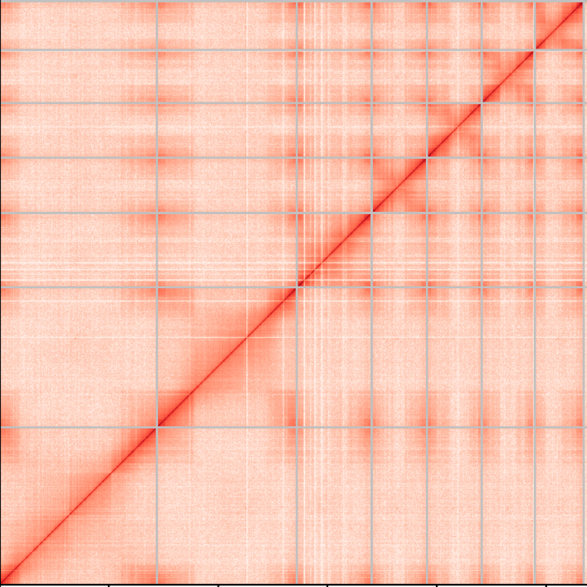
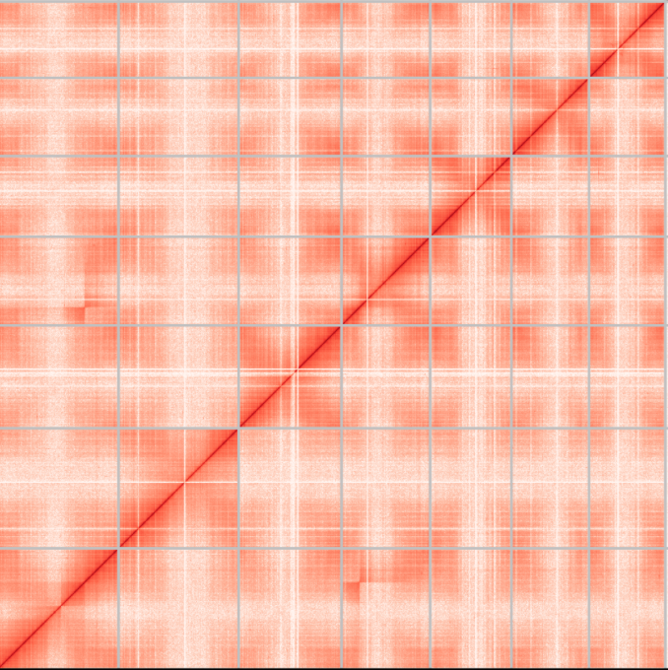
1 2 3 4 5 6 7
2 5 1 3 7 6 4
Poa infirma chromosomes
Poa supina chromosomes
Supplementary Fig. 1 | Linked density histograms of the Poa infirma and Poa supina genomes. The Omni-C plot represents long-range cis information using proximity ligation and mapping position of paired-end data. Red indicates the number of read pair interactions within each bin.
Notes:
Supplementary Fig. 1 | Linked density histograms of the Poa infirma and Poa supina genomes. The Omni-C plot represents long-range cis information using proximity ligation and mapping position of paired-end data. Red indicates the number of read pair interactions within each bin.

Slide 3
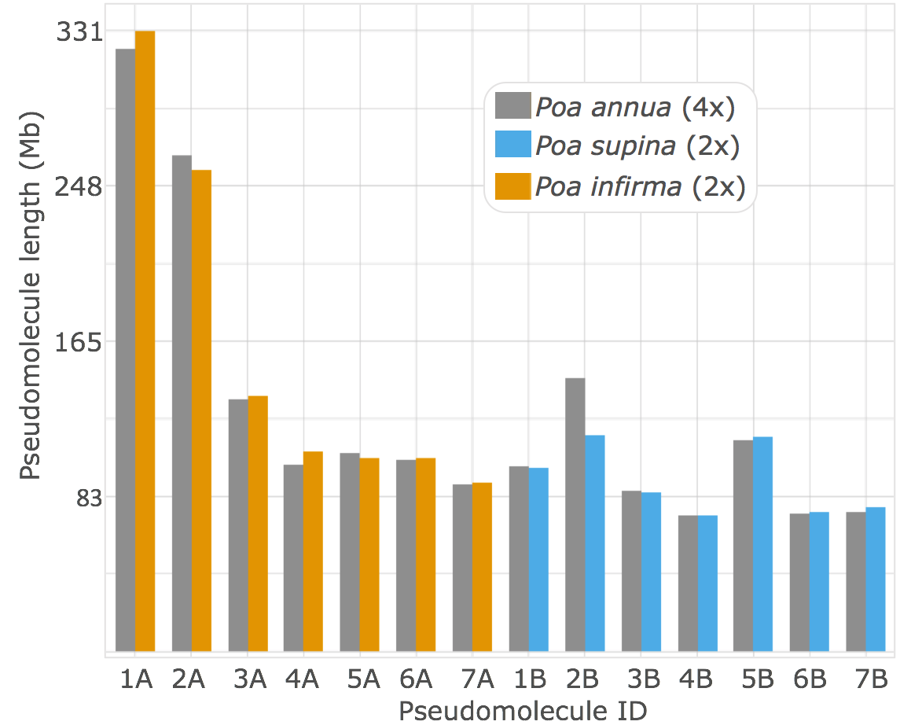
b
85
a
Common ancestor
98%
98%
95%
95%
90
Gap-compressed sequence identity (%)
Divergence / speciation
95
100
PaA to PiA PaB to PsB PaB to PaA PsB to PiA
Alignment Comparison
c
Hybridization
Poa infirma (PiA)
Poa annua
(PaA & PaB)
Poa supina (PsB)
Homoeologs
Orthologs
Supplementary Fig. 2 | The homoeologous and orthologous sequences of Poa annua and its diploid parents, Poa infirma and Poa supina. (a) The evolutionary pathway and chromosomal relationships within and between the homologous sequences of Poa annua and its diploid progenitors. (b) The distribution of sequence identity measured by the gap-compressed sequence identity of full-genome sequence alignments. Percentages above violin plot indicate the median. (c) Chromosome lengths of the genome assemblies of all three species.
Notes:
Supplementary Fig. 2 | The homoeologous and orthologous sequences of Poa annua and its diploid parents, Poa infirma and Poa supina. (a) The evolutionary pathway and chromosomal relationships within and between the homologous sequences of Poa annua and its diploid progenitors. (b) The distribution of sequence identity measured by the gap-compressed sequence identity of full-genome sequence alignments. Percentages above violin plot indicate the median. (c) Chromosome lengths of the genome assemblies of all three species.

Slide 4
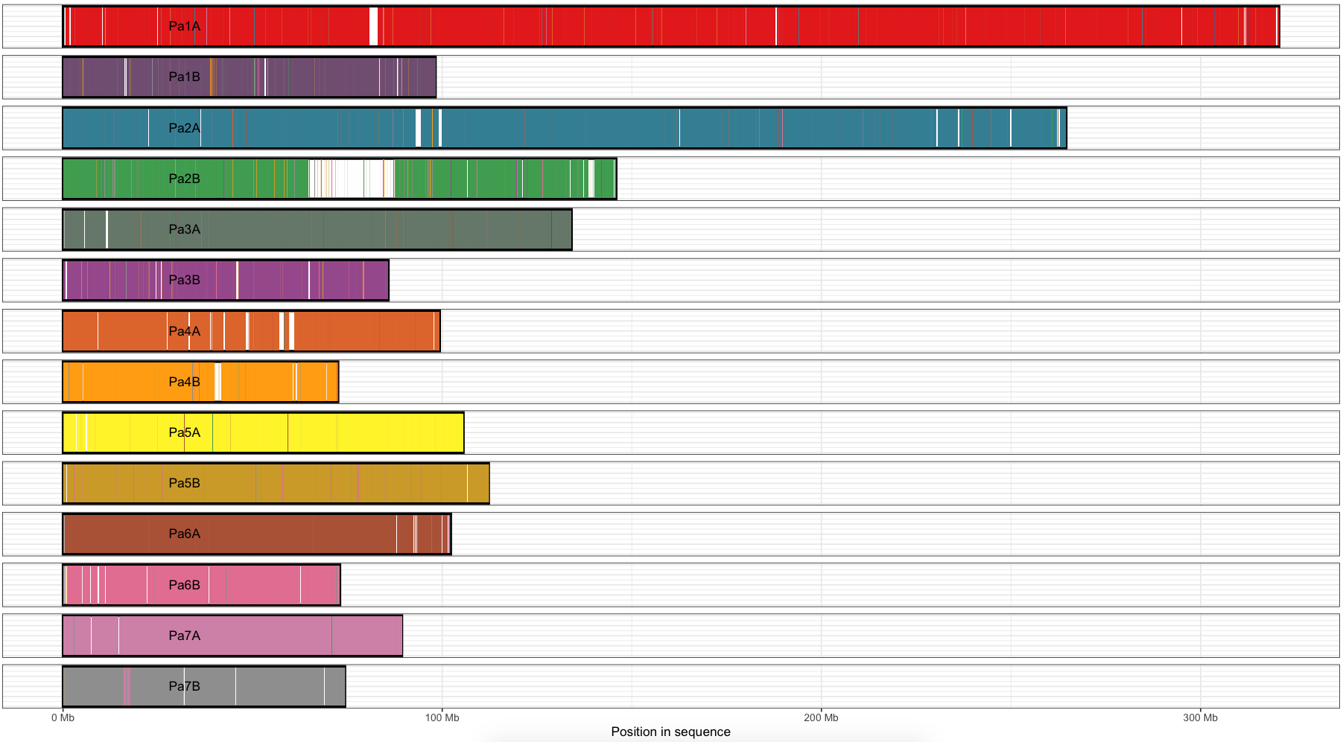
Query name
Pi1A
Ps1B
Pi2A
Ps2B
Pi3A
Ps3B
Pi4A
Ps4B
Pi5A
Ps5B
Pi6A
Ps6B
Pi7A
Ps7B
Supplementary Fig. 3 | Whole-genome sequence alignment depicts the primary mapping of parental chromosomes (PiA & PsB) to the derived allotetraploid, Poa annua (PaA & PaB). The black arrow over Pa2B highlights 30 Mb of novel sequence in the tetraploid genome assembly, mostly composed of repetitive DNA (22.7Mb).
Notes:
Supplementary Fig. 3 | Whole-genome sequence alignment depicts the primary mapping of parental chromosomes (PiA & PsB) to the derived allotetraploid, Poa annua (PaA & PaB). The black arrow over Pa2B highlights 30 Mb of novel sequence in the tetraploid genome assembly, mostly composted of repetitive DNA (22.7Mb).

Slide 5
21,479
20,000
15,000
Intersection Size
10,000
5,000
4,273
4,061
1,254
755
739
557
476
390
370
367
351
269
263
175
0
PsB
PaA
PaB
PiA
Supplementary Fig. 4 | The distribution of shared orthologous clusters (gene families) between A and B genomes of Poa infirma (PiA), Poa supina (PsB), and Poa annua (PaA & PaB). Single-copy gene clusters are not depicted.
Notes:
Supplementary Fig. 4 | The distribution of shared orthologous clusters (gene families) between A and B genomes of Poa infirma (PiA), Poa supina (PsB), and Poa annua (PaA & PaB). Black arrows highlight two orthologous clusters that further illustrate that P. annua’s B subgenome is more similar to A sequences than P. annua’s A subgenome is to the B sequences. Single-copy gene clusters are not depicted.

Slide 6
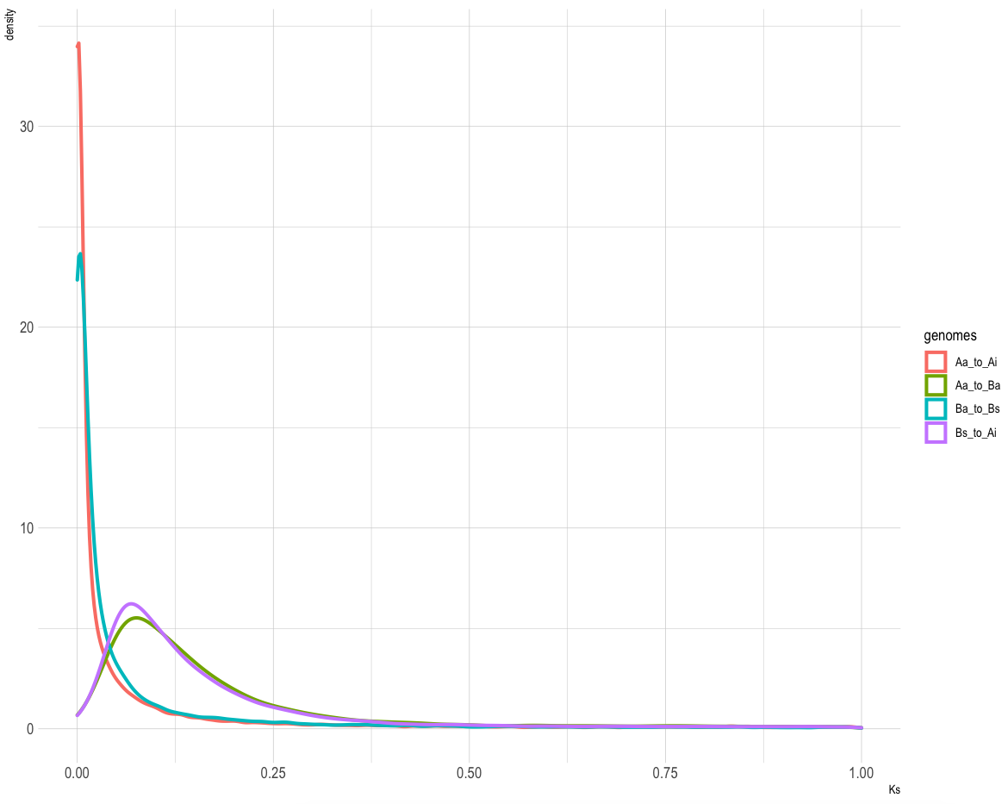
30
Comparisons
Hybridization
0.005871
PaA to PaB
PsB to PiA
PaA to PiA
20
PaB to PsB
Density
0.06458
10
0.07632
Divergence
0
0.25
0.50
0.75
1
Synonymous substitution rate (Ks)
Supplementary Fig. 5 | Estimated molecular divergence between the PaA and PaB subgenomes of P. annua and corresponding diploid parents (PiA and PsB). Arrows and corresponding values highlight the peak density of synonymous substitutions.
Notes:
Supplementary Fig. 5 | Estimated molecular divergence between the PaA and PaB subgenomes of P. annua and corresponding diploid parents (PiA and PsB). Arrows and corresponding values highlight the peak density of synonymous substitutions.

Slide 7
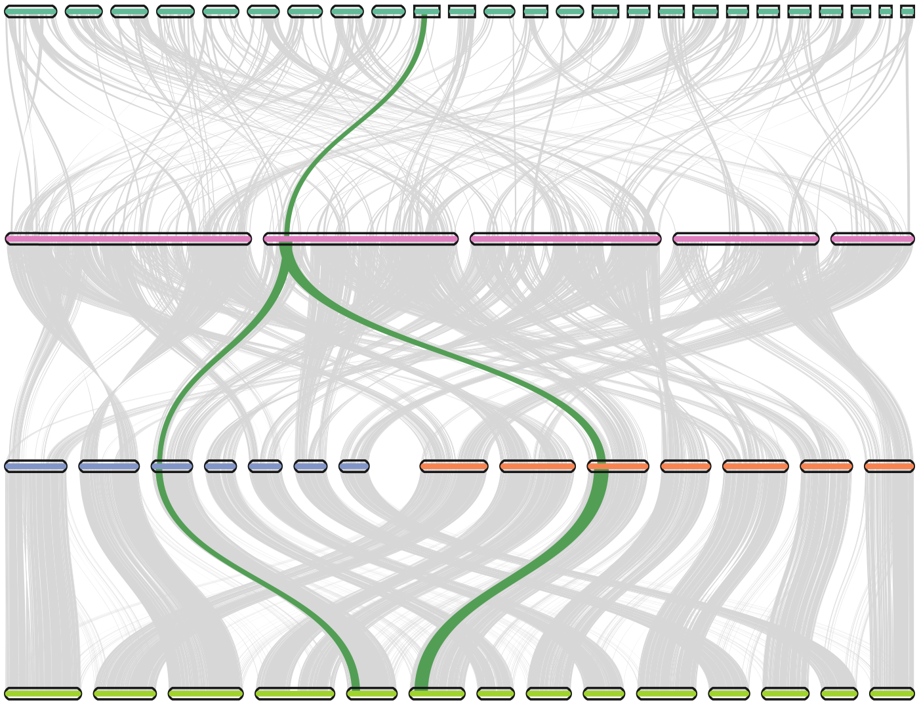
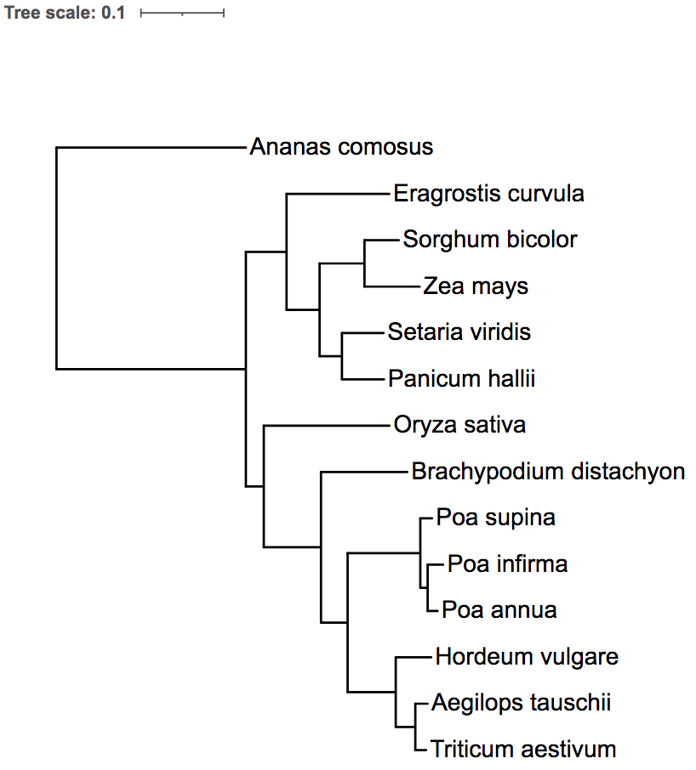
b
A. comosus
a
⍴
B. distachyon
46%
⍴
P. infirma
P. supina
42%
41%
P. annua
3%
Supplementary Fig. 6 | Sequence alignment of five model monocots spans two whole-genome duplications. (a) A species-level phylogenetic tree distinguishing variable sequence evolution between homologs using branch length. Pineapple (Ananas comosus) serves as outgroup since its speciation from BOP and PACMAD clades of grasses predates the most recent of the ancestral Poaceae WGD events, rho (ρ). (b) Genomic alignment between monocots Ananas comosus, Brachypodium distachyon, Poa infirma, Poa supina, and Poa annua. Percentages in red show the ratio of 1:1 orthogroups relative to A. comosus. The syntenic block highlighted in green shows the colinear evolution of a cluster of genes.
Notes:
Supplementary Fig. 6 | Sequence alignment of five model monocots spans two whole-genome duplications. (a) A species-level phylogenetic tree distinguishing variable sequence evolution between homologs using branch length. Pineapple (Ananas comosus) serves as outgroup since its speciation from BOP and PACMAD clades of grasses predates the most recent of the ancestral Poaceae WGD events, rho (ρ). (b) Genomic alignment between monocots Ananas comosus, Brachypodium distachyon, Poa infirma, Poa supina, and Poa annua. Percentages in red show the ratio of 1:1 orthogroups relative to A. comosus. The syntenic block highlighted in green shows the colinear evolution of a block of genes.

Slide 8
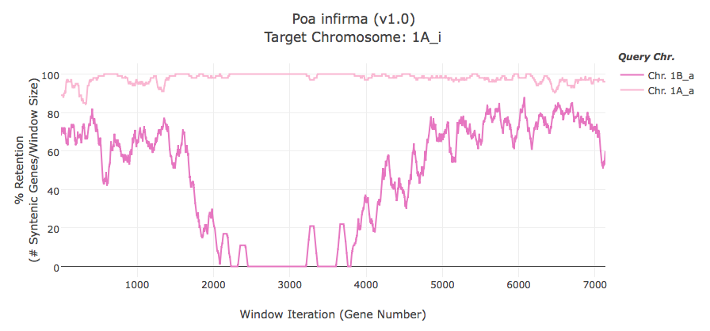
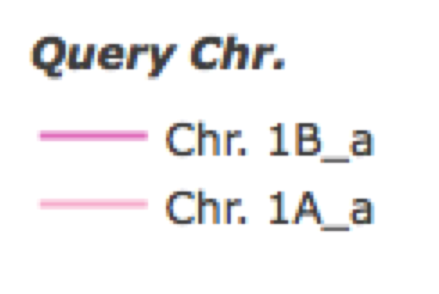
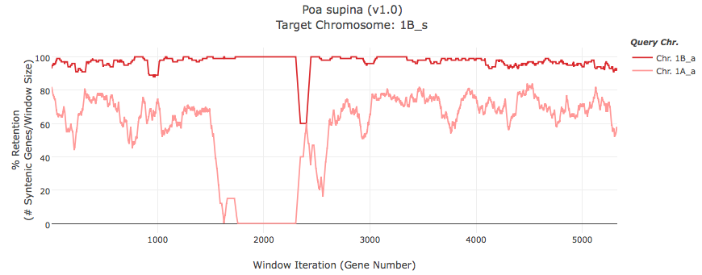
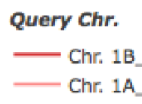
100
Pi1A
80
% Gene Retention
60
40
Query Chr.
Pa1B
20
Pa1A
0
1000
2000
3000
4000
5000
6000
7000
Window Iteration
Ps1B
100
80
% Gene Retention
60
40
Query Chr.
Pa1B
20
Pa1A
0
1000
2000
3000
4000
5000
Window Iteration
Supplementary Fig. 7 | Retention of Poa annua genes across the parental chromosomes of Poa infirma and Poa supina. PiA to PaA and PsB to PaB have elevated gene retention (~97%) across chromosomes and reflects minimal gene loss (fractionation) since polyploidization. PiA to PaB and PsB to PaA have lower gene retention (~61%) and reflects the quantity of genes retained since the divergence of the two parental lineages from their common ancestor. Red arrow highlights the largest homoeologous exchange in the P. annua genome.
Notes:
Supplementary Fig. 7 | Retention of Poa annua genes across the parental chromosomes of Poa infirma and Poa supina. A to A and B to B have elevated gene retention (~97%) across chromosomes and reflects minimal gene loss (fractionation) since hybridization. A to B and B to A have lower gene retention (~61%) and reflect the quantity of genes retained since the divergence of the two parental lineages from their common ancestor. Red arrow highlights the largest homoeologous exchange in the P. annua genome.

Slide 9
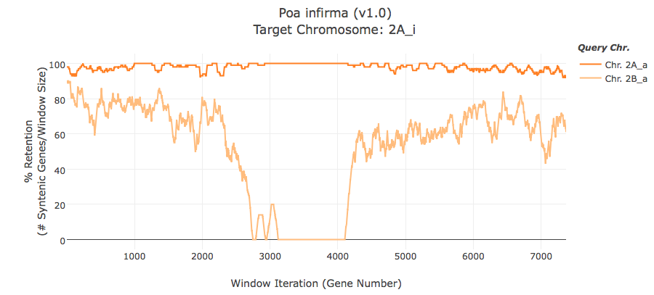
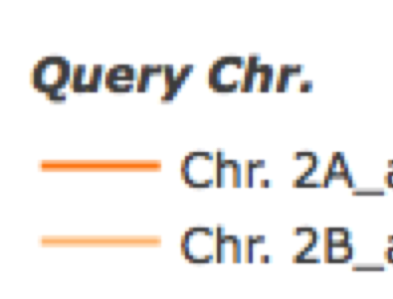
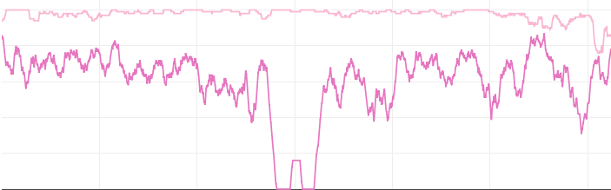
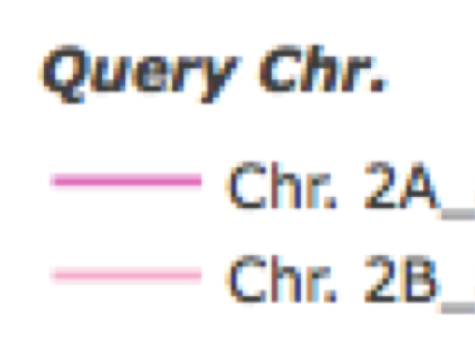
Supplementary Fig. 7 | Continued.
Pi2A
100
80
60
% Gene Retention
40
Query Chr.
20
Pa2A
Pa2B
0
1000
2000
3000
4000
5000
6000
7000
Window Iteration
Ps2B
100
80
60
% Gene Retention
40
Query Chr.
20
Pa2A
Pa2B
0
1000
2000
3000
4000
5000
6000
Window Iteration
Notes:
Supplementary Fig. 7 | Continued.

Slide 10
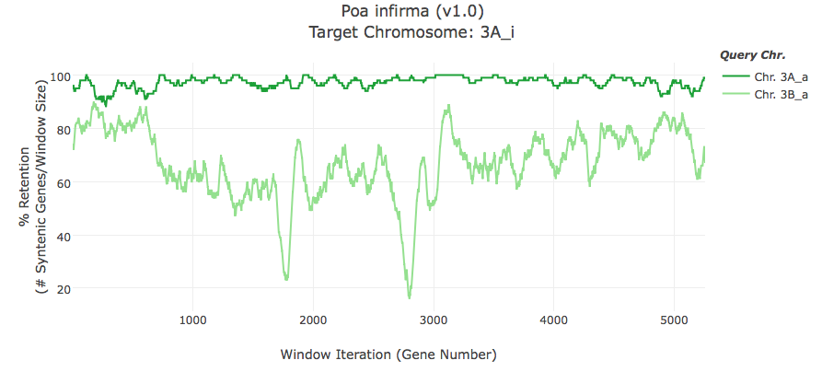
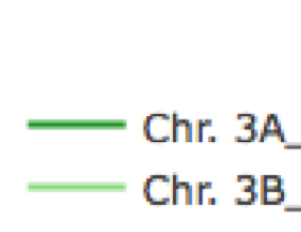
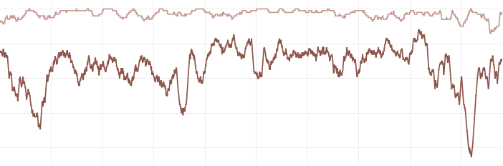
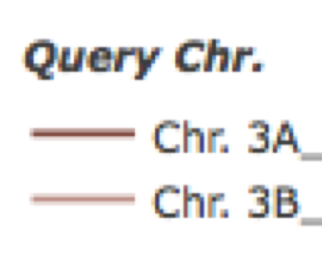
Supplementary Fig. 7 | Continued.
Pi3A
100
80
% Gene Retention
60
Query Chr.
40
Pa3A
Pa3B
20
0
1000
2000
3000
4000
5000
Window Iteration
Ps3B
100
80
60
% Gene Retention
40
Query Chr.
Pa3A
20
Pa3B
0
1000
2000
3000
4000
Window Iteration
Notes:
Supplementary Fig. 7 | Continued.

Slide 11
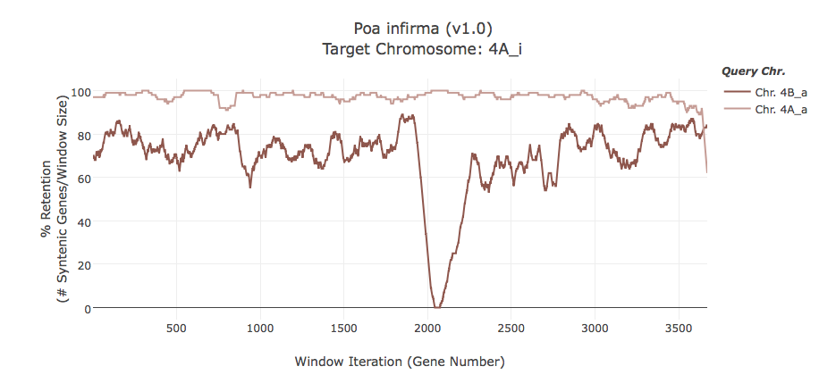
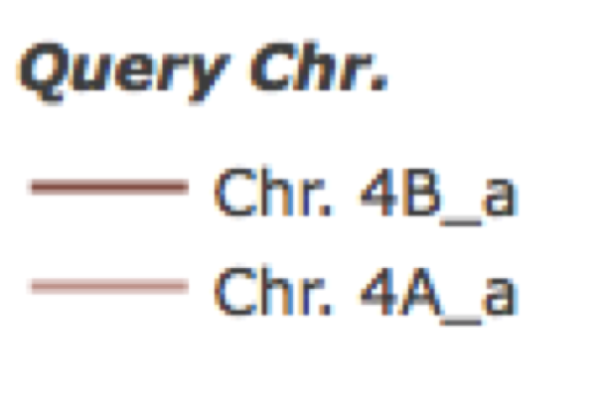
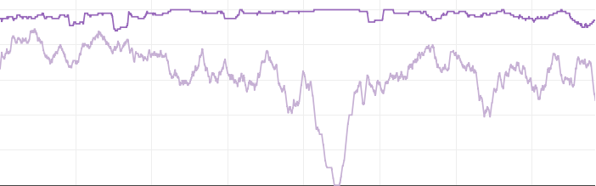
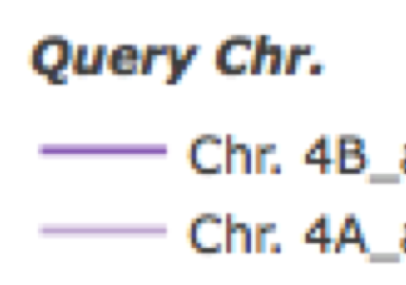
Supplementary Fig. 7 | Continued.
Pi4A
100
80
60
% Gene Retention
40
Query Chr.
Pa4B
20
Pa4A
0
1000
2000
3000
Window Iteration
Ps4B
100
80
% Gene Retention
60
40
Query Chr.
20
Pa4B
Pa4A
0
1000
2000
3000
Window Iteration
Notes:
Supplementary Fig. 7 | Continued.

Slide 12
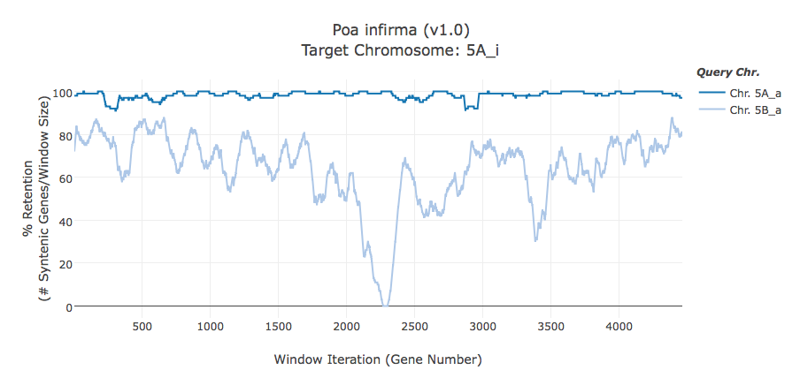
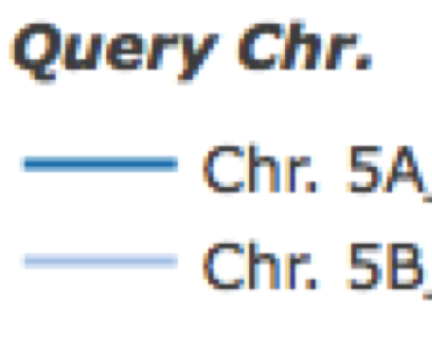
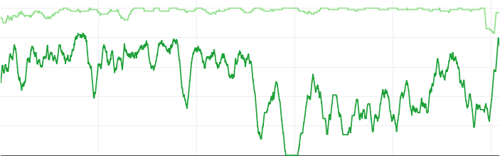
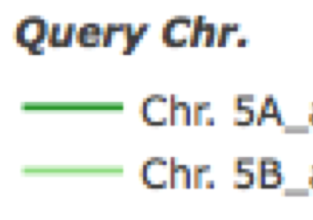
Supplementary Fig. 7 | Continued.
Pi5A
100
80
% Gene Retention
60
40
Query Chr.
20
Pa5A
Pa5B
0
1000
2000
3000
4000
Window Iteration
Ps5B
100
80
% Gene Retention
60
40
Query Chr.
20
Pa5A
Pa5B
0
1000
2000
3000
4000
5000
Window Iteration
Notes:
Supplementary Fig. 7 | Continued.

Slide 13
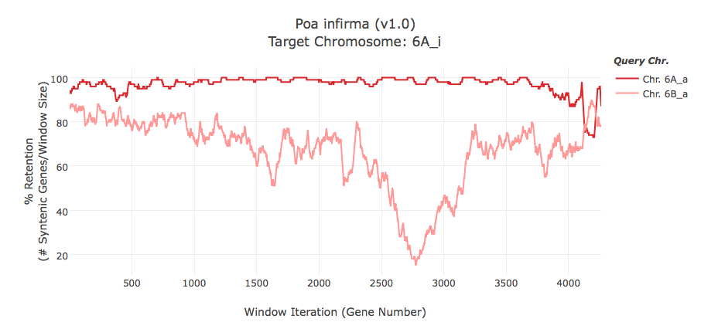
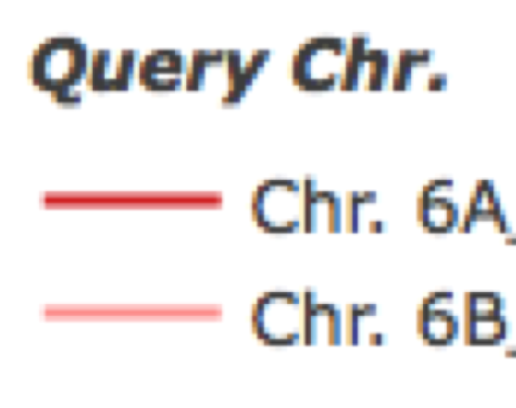
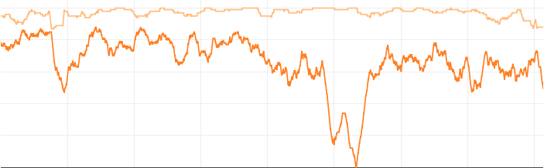
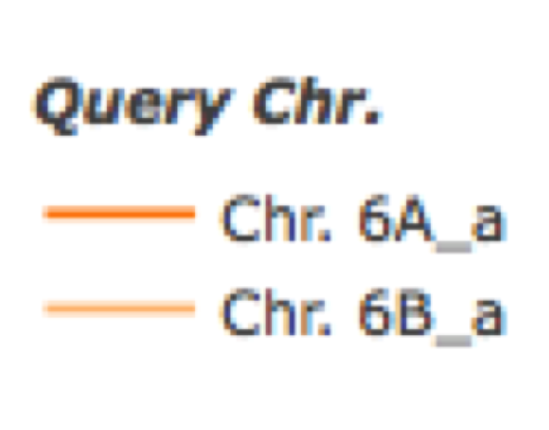
Supplementary Fig. 7 | Continued.
Pi6A
100
80
% Gene Retention
60
40
Query Chr.
Pa6A
20
Pa6B
0
1000
2000
3000
4000
Window Iteration
Ps6B
100
80
% Gene Retention
60
40
Query Chr.
20
Pa6A
Pa6B
0
1000
2000
3000
4000
Window Iteration
Notes:
Supplementary Fig. 7 | Continued.

Slide 14
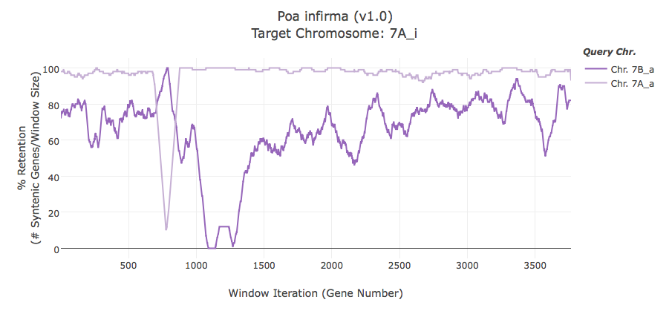
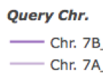
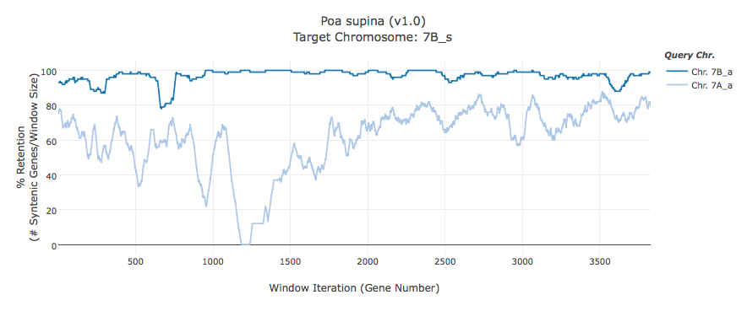
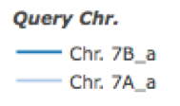
Supplementary Fig. 7 | Continued.
100
Pi7A
80
60
% Gene Retention
40
Query Chr.
Pa7B
20
Pa7A
0
500
1000
1500
2000
2500
3000
3500
Window Iteration
100
Ps7B
80
60
% Gene Retention
40
Query Chr.
Pa7B
20
Pa7A
0
500
1000
1500
2000
2500
3000
3500
Window Iteration
Notes:
Supplementary Fig. 7 | Continued.

Slide 15




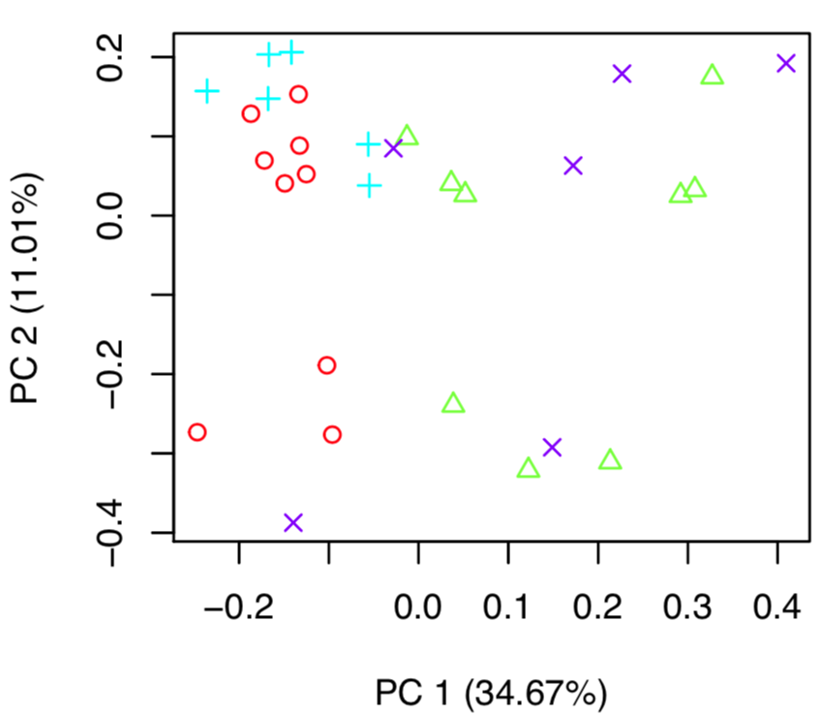
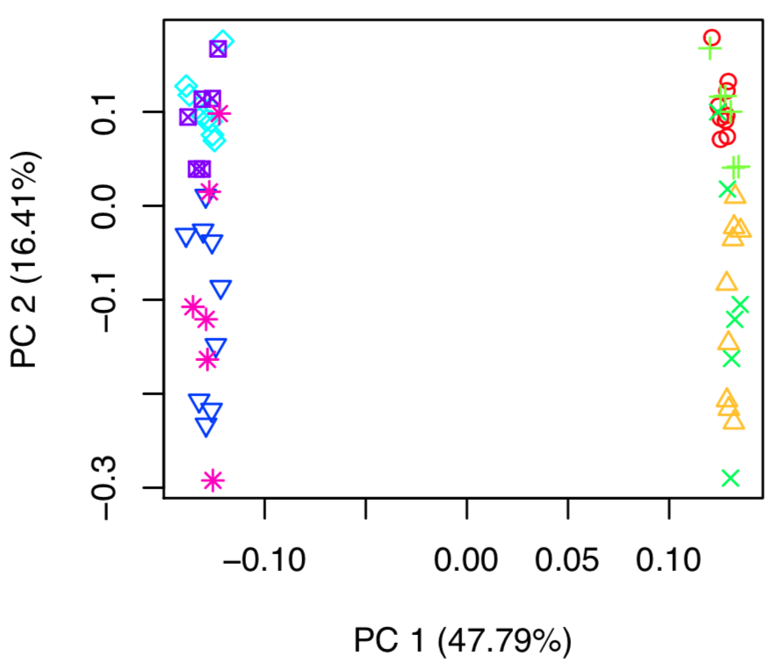
Wild mowed A
Wild mowed B
Wild unmowed A
Wild unmowed B
Dwarf mowed A
Dwarf mowed B
Wild mowed A
Dwarf mowed A
Dwarf ummowed A
Dwarf ummowed B
Wild unmowed A
Dwarf ummowed A
Supplementary Fig. 8 | Principal component analysis compares the gene expression profiles of 30 Poa annua samples. On the right, a PCA including all samples, with variables being subgenome (A or B), treatment (mowed or unmowed), and biotype (dwarf-type or wild-type). On the left, a PCA of the A subgenome illustrates that sample treatments separate but biotypes nested.
Notes:
Supplementary Fig. 8 | Principal component analysis of the differential expression profiles of Poa annua samples. On the right, a PCA including all samples, with variables being subgenome (A or B), treatment (mowed or unmowed), and biotype (dwarf-type or wild-type). On the left, a PCA of the A subgenome illustrates that sample treatments separate but biotypes nested.

Slide 16



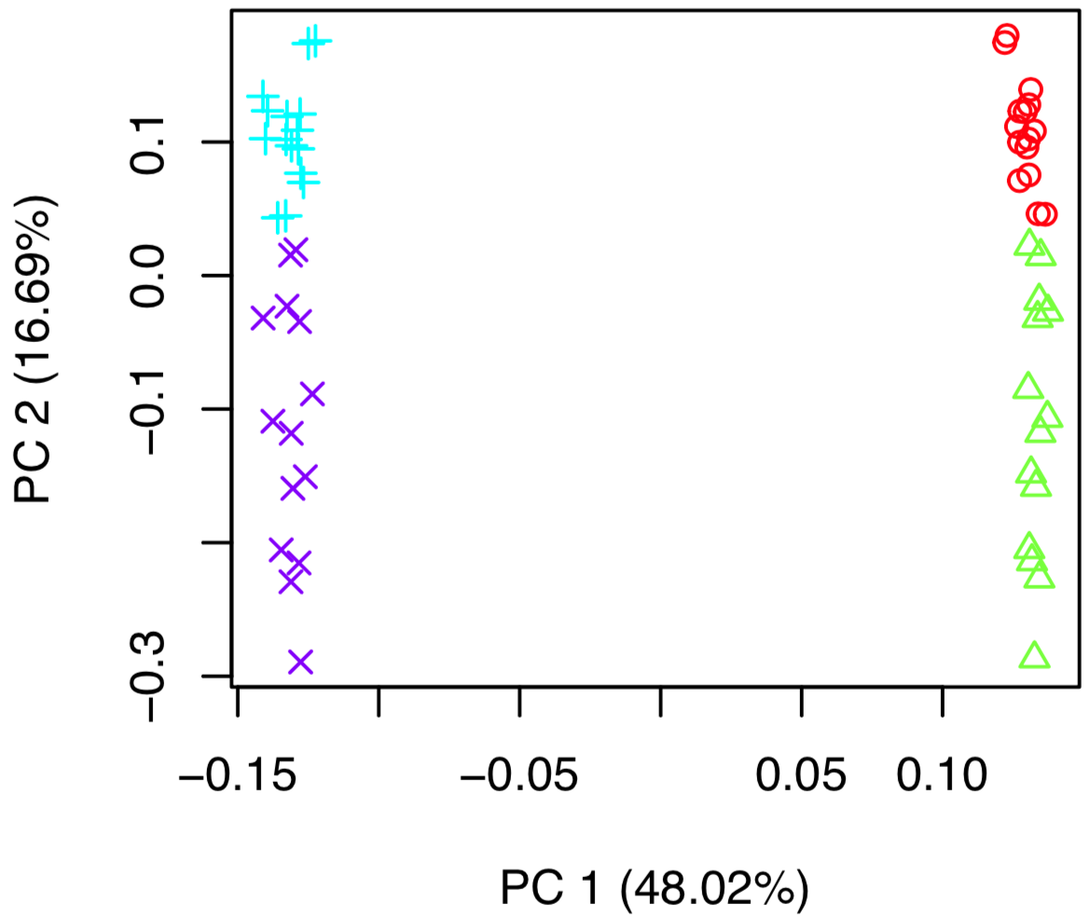
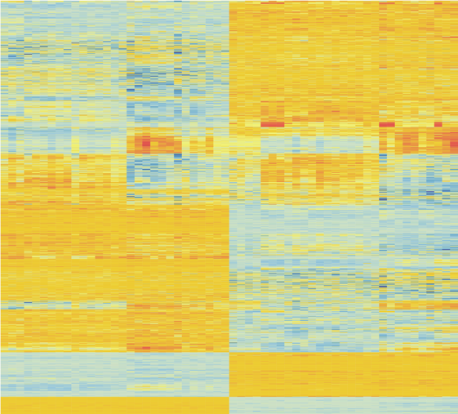
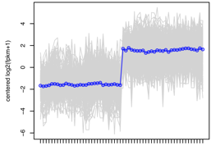
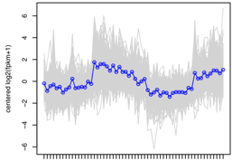
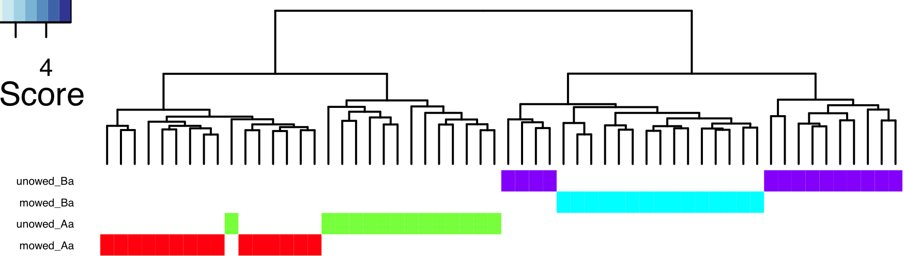
a
Mowed A
Mowed B
b
Unmowed A
Unmowed B
c
Centered log2(fpkm+1)
Centered log2(fpkm+1)
Supplementary Fig. 9 | Differential gene expression analysis across the A and B subgenomes of Poa annua. (a) Principal component analysis of the differential expression profiles of Poa annua samples with biotypes (dwarf-type or wild-type) removed from the analysis. (b) A heatmap of the DEGs across subgenome and treatment. Blue genes are upregulated and orange are downregulated. (c) Clusters of genes with similar expression profiles. On the left, a cluster of genes upregulated in the B subgenome. On the right, a cluster upregulated in unmowed plants. In the DEG hierarchal cluster and dendrogram, red=B_mowed, green=B_unmowed, purple=A_unmowed, blue=A_mowed.
Notes:
Supplementary Fig. 9 | Differential gene expression analysis across the A and B subgenomes of Poa annua. (a) Principal component analysis of the differential expression profiles of Poa annua samples with biotypes (dwarf-type or wild-type) removed from the analysis. (b) A heatmap of the DEGs across subgenome and treatment. Blue genes are upregulated and orange are downregulated. (c) Clusters of genes with similar expression profiles. On the left, a cluster of genes upregulated in the B subgenome. On the right, a cluster upregulated in unmowed plants. In the DEG hierarchal cluster and dendrogram, red=B_mowed, green=B_unmowed, purple=A_unmowed, blue=A_mowed

Slide 17
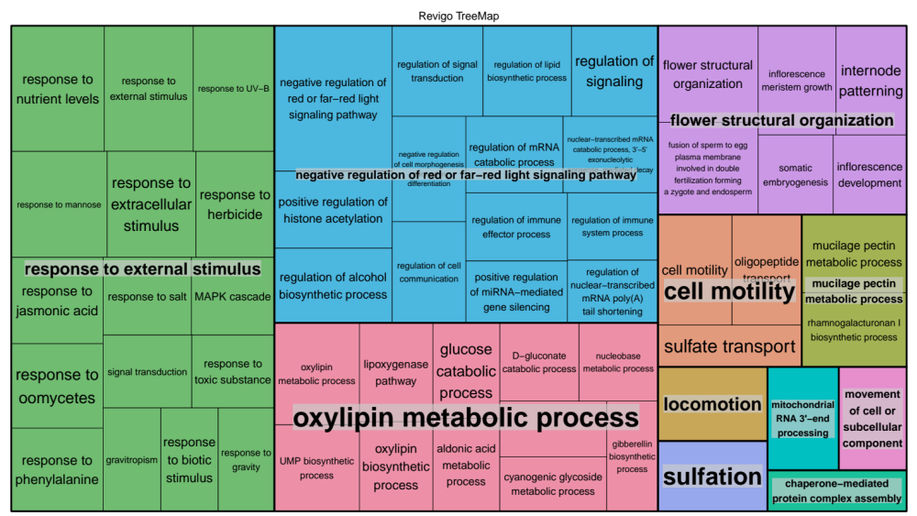
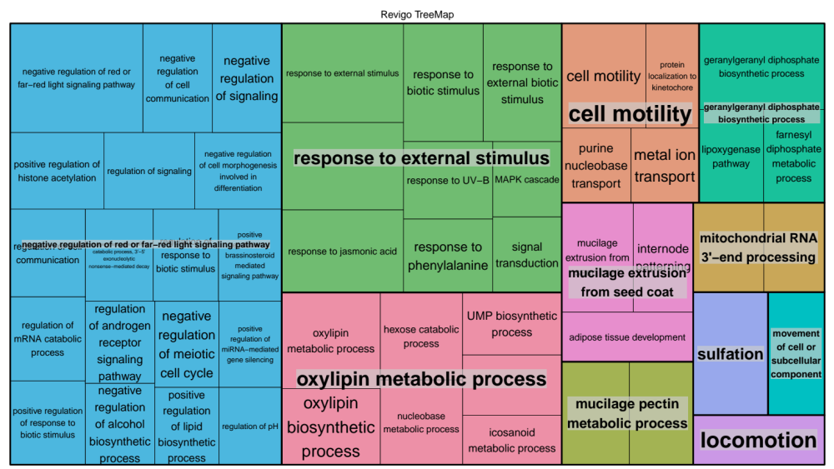
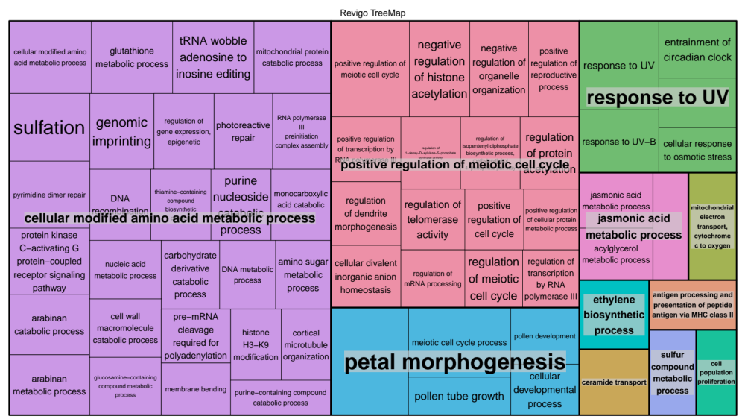
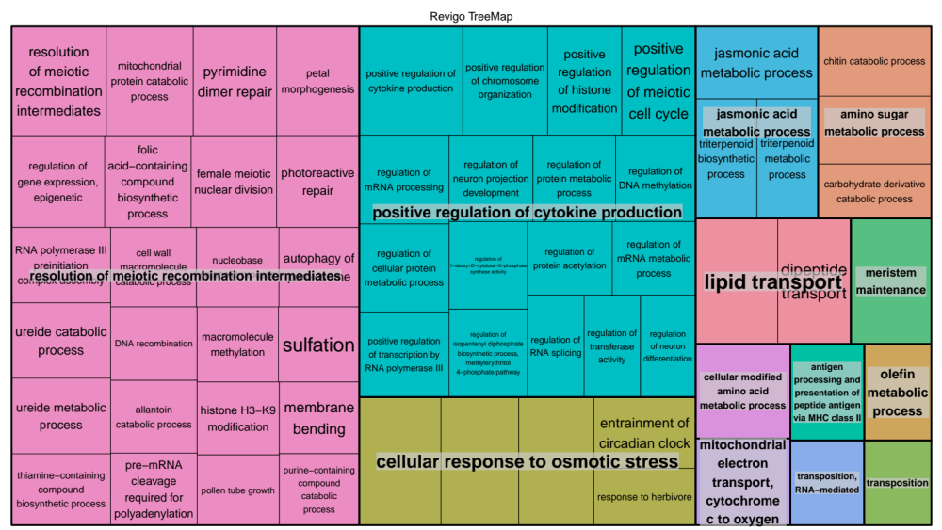
Unmowed
Mowed
A
A
B
B
Supplementary Fig. 10 | Treemap clusters enriched gene ontologies in the subgenome (A vs B) and treatment (mowed vs unmowed) comparisons based on semantic similarity of enriched terminology.
Notes:
Supplementary Fig. 10 | Treemap clusters enriched gene ontologies in the subgenome (A vs B) and treatment (mowed vs unmowed) comparisons based on semantic similarity of enriched terminology.

Slide 18
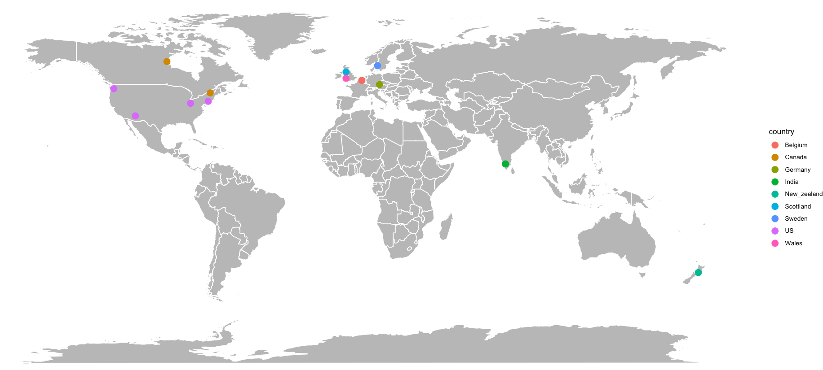
Supplementary Fig. 11 | Geographic distribution of 13 sequenced Poa annua genotypes. Two additional plants (PA-14 dwarf and Pa-14 WT) were also sequenced but not depicted on the map.
Notes:
Supplementary Fig. 11 | Geographic distribution of 13 sequenced Poa annua genotypes. Two additional plants (PA-14 dwarf and Pa-14 WT) were also sequenced but not depicted on the map.

Slide 19
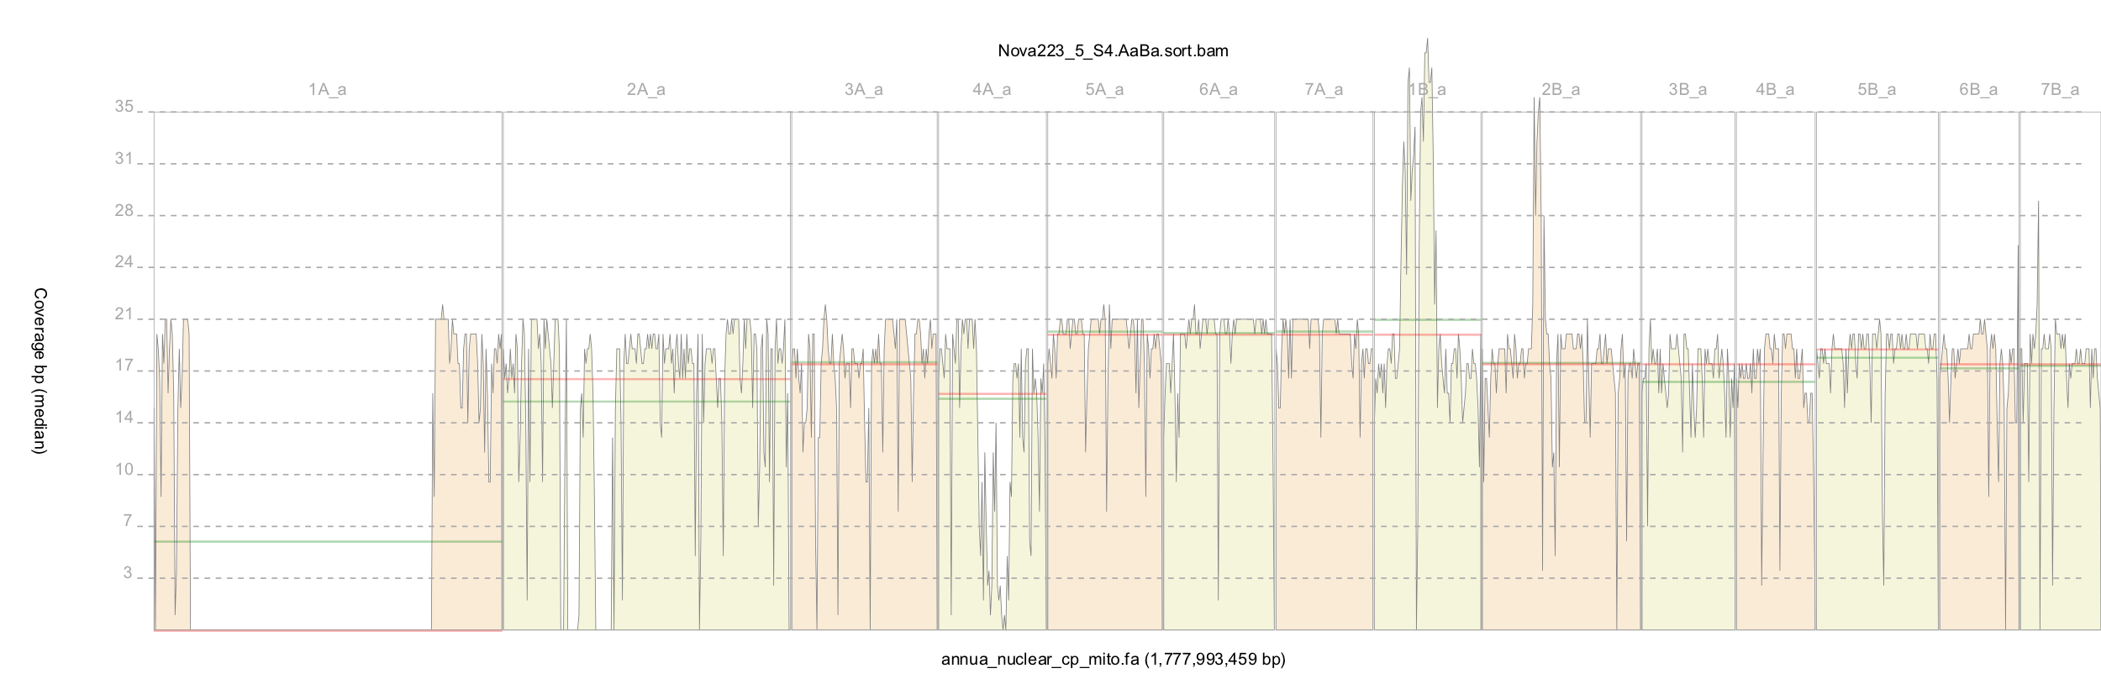
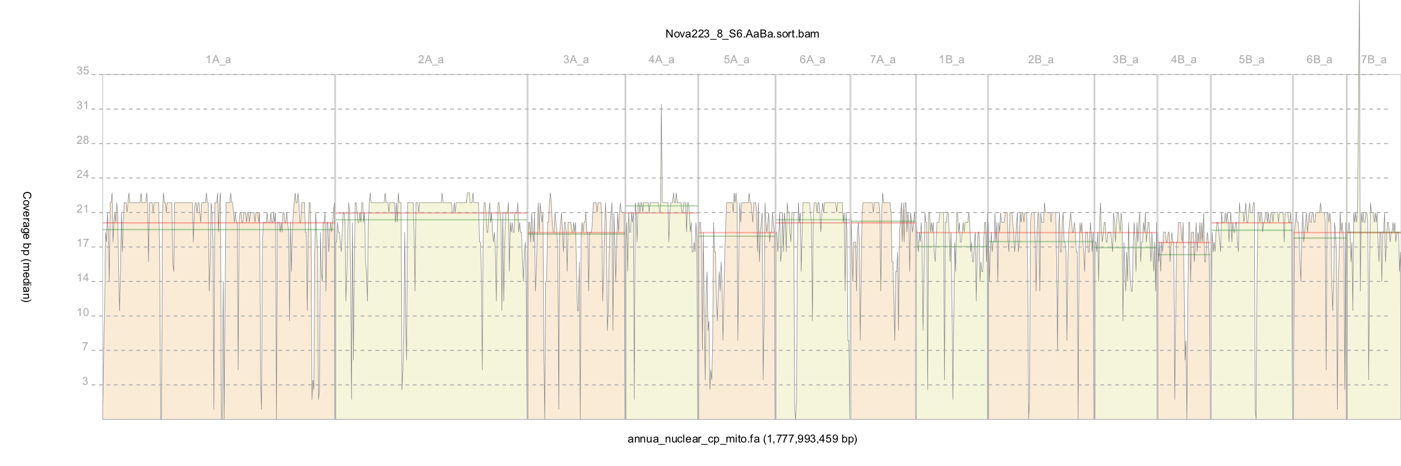
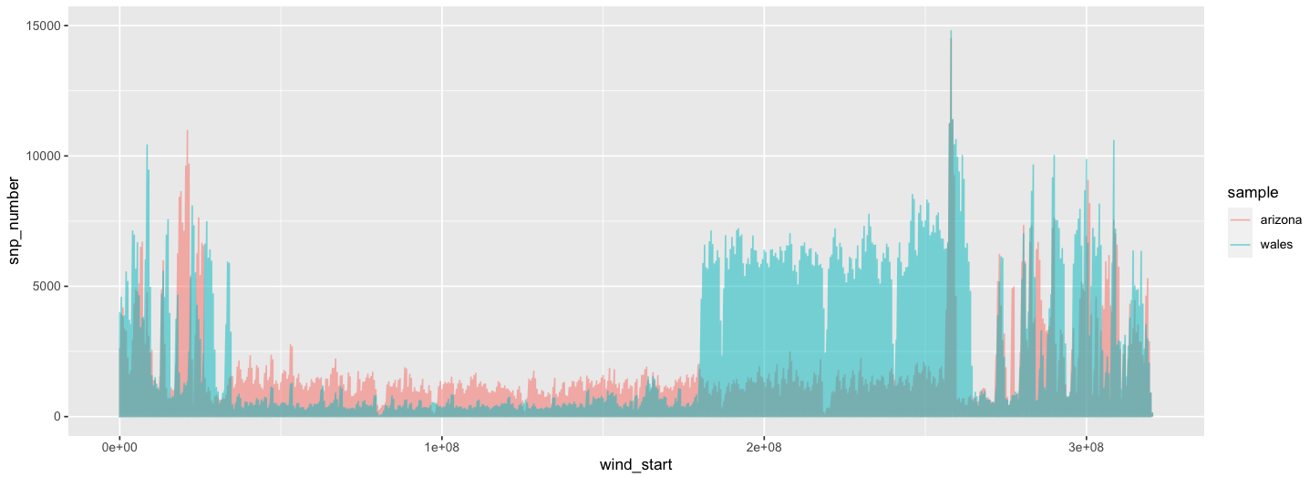













Arizona
Wales
15,000
SNP density
10,000
5,000
1A 2A 3A 4A 5A 6A 7A 1B 2B 3B 4B 5B 6B 7B
Supplementary Fig. 12 | SNP density across a 1Mb sliding window demonstrates variability in sequence identity between Poa annua ecotypes and across chromosomes. Pink is sample ‘Arizona’ and blue is sample ‘Wales’. Coverage plots of both samples are included for reference.
Notes:
Supplementary Fig. 12 | SNP density across a 1Mb sliding window demonstrates variability in sequence identity between Poa annua ecotypes and across chromosomes. Pink is sample ‘Arizona’ and and blue is sample ‘Wales’. Coverage plots of both samples are included for reference.

Slide 20

75,000
Number of Core Genes
Dispensable Genes
70,000
1 2 3 4 5 6 7 8 9 10 11 12 13 14 15
Number of Genotypes
Supplementary Fig. 13 | The core Poa annua genome. Of the 76,541 gene annotations in the Poa annua reference genome, 68,733 are present in all 15 sequenced genotypes. 7,808 genes are dispensable and absent in at least one genotype.
Notes:
Supplementary Fig. 13 | The core Poa annua genome. Of the 76,541 gene annotations in the Poa annua reference genome, 68,733 are present in all 15 sequenced genotypes. 7,808 genes are dispensable and absent in at least one genotype.

Slide 21









Supplementary Fig. 14.
Reads mapped to Poa annua’s A subgenome
Reads mapped to Poa annua’s B subgenome
Chromosomes: 1A 2A 3A 4A 5A 6A 7A 1B 2B 3B 4B 5B 6B 7B
Washington
Scotland
New Zealand
Quebec
Wales
Notes:
Supplementary Fig. 14 | Depth of coverage plotted along the Poa annua reference genome suggests large-scale structural modification in Poa annua chromosomes.

Slide 22










Supplementary Fig. 14 | Continued.
Reads mapped to Poa annua’s A subgenome
Reads mapped to Poa annua’s B subgenome
Chromosomes: 1A 2A 3A 4A 5A 6A 7A 1B 2B 3B 4B 5B 6B 7B
Belgium
Sweden
India
Canada
Pa-33 New York
Notes:
Supplementary Fig. 14 | Continued.

Slide 23
Supplementary Fig. 14 | Depth of coverage plotted along the Poa annua reference genome suggests large-scale structural modification in Poa annua chromosomes.

Slide 24



Germany
Ohio
Ohio
Arizona
Pa1A:33,433,466-33,433,525
Pa1B:24,552,636-24,552,695
Arizona/Ohio
Germany/Ohio
Supplementary Fig. 15 | Homoeolog-specific markers and Sanger sequencing verifies the composition of a large-scale chromosomal rearrangement in Poa annua. Alignment of the homoeologous sequences of Pa1A and Pa1B span the breakpoint of a large-scale chromosomal rearrangement in re-sequenced genotype ‘Arizona’ but not ‘Germany’. Sample ‘Ohio’ has both a rearranged and non-rearranged chromosome, verifying the haplotype specificity of chromosome rearrangements in some individuals. Black arrows highlight SNPs on either side of the breakpoint.
Notes:
Supplementary Fig. 15 | Homoeolog-specific markers and sanger sequencing verifies the composition of a large-scale chromosomal rearrangement in Poa annua. Alignment of the homoeologous sequences of Pa1A and Pa1B span the breakpoint of a large-scale chromosomal rearrangement in re-sequenced genotype ‘Arizona’ but not ‘Germany’. Sample ‘Ohio’ has both a rearranged and non-rearranged chromosome, verifying the haplotype specificity of chromosome rearrangements in some individuals. Black arrows highlight SNPs on either side of the breakpoint.

Slide 25



Wales
Tacoma
Arizona
Wales
Tacoma
Arizona
Supplementary Fig. 16 | Sequence alignment of three samples to the Poa annua reference genome illustrates recombination hotspots. Arrows point to alignment breakpoints at the 224 Mb deletion. Black arrows point to breakpoints that occur on the same sequence coordinates for both parental haplotypes. Red arrows point to haplotype-specific breakpoints.
Notes:
Supplementary Fig. 16 | Sequence alignment of three samples to the Poa annua reference genome illustrates recombination hotspots. Arrows point to alignment breakpoints at the 224 Mb deletion. Black arrows point to breakpoints that occur on the same sequence coordinates for both parental haplotypes. Red arrows point to haplotype-specific breakpoints.

Slide 26





Arizona
Pa-14 Dwarf
Pa-14 wild type
New Zealand
Arizona
Pa-14 Dwarf
1.53 Mb
Pa-14 wild type
New Zealand
Supplementary Fig. 17 | Sequence alignments at chromosome 1A illustrates local variability at crossover ‘hotspots’. Black arrows indicate positions where both pairs of chromosomes break at the same locations and red arrows point to breakpoints at a single chromosome pair.
Notes:
Supplementary Fig. 17 | Sequence alignments at chromosome 1A illustrates local variability at crossover ‘hotspots’. Black arrows indicate positions where both pairs of chromosomes break at the same locations and red arrows point to breakpoints at a single chromosome pair.

Slide 27










ajg15317
ajg73723
Arizona
Sweden
Wales
Pa-14_D
Supplementary Fig. 18 | Sequence alignment of four geographically distinct genotypes of Poa annua shows structural variation at its two EPSP homoeologs. ajg15317 and ajg73723 are EPSP synthases on chromosomes Pa5A and Pa5B, respectively. Blue boxes at the top depicts the genes exons (boxes) and introns (lines connecting boxes). The ajg15317 transcript is 3,891bp in length, while ajg73723 is 9,092bp. Grey boxes are reads that aligned to the reference genome as proper pair. Open boxes are reads that mapped equally well to five or more locations in the genome. Pairs of reads highlighted in red have longer than anticipated insert lengths and depict putative indels at ajg73723’s longest introns. Sample ‘Sweden' is heterozygous for a 2,738 deletion at the second intron, while ‘Wales’ and breeding line ‘Pa-14 dwarf’ are homozygous for the deletion. Only the breeding line sample, ‘Pa-14 dwarf’ contained a 2,954 deletion at the 7th intron. Purple alignments in ajg15317 show reads with mates that map to the other subgenome homoeolog (ajg73723), within the indel at the second intron.
Notes:
Supplementary Fig. 18 | Sequence alignment of four geographically distinct genotypes of Poa annua shows structural variation at it’s two EPSP homoeologs. ajg15317 and ajg73723 are EPSP synthases on chromosomes Pa5A and Pa5B, respectively. Blue boxes at the top depicts the genes exons (boxes) and introns (lines connecting boxes). The ajg15317 transcript is 3,891bp in length, while ajg73723 is 9,092bp. Grey boxes are reads that aligned to the reference genome as proper pair. Open boxes are reads that mapped equally well to five or more locations in the genome. Pairs of reads highlighted in red have longer than anticipated insert lengths and depict putative indels at ajg73723’s longest introns. Sample ‘Sweden' is heterozygous for a 2,738 deletion at the second intron, while ‘Wales’ and breeding line ‘Pa-14 dwarf’ are homozygous for the deletion. Only the breeding line sample, ‘Pa-14 dwarf’ contained a 2,954 deletion at the 7th intron. Purple alignments in ajg15317 show reads with mates that map to the other subgenome homoeolog (ajg73723), within the indel at the second intron.

Slide 28


Heterozygous peak
Poa infirma (2x; self-pollinated)
Poa supina (2x; cross-pollinated)
Supplementary Fig. 19 | Linear K-mer profile and fitted models of Poa infirma and Poa supina. Black lines show the fit of the model to the distribution of K-mer frequencies (blue). Sequencing errors are identified by low coverage k-mers shown in orange. The P. infirma and P. supina models follow a diploid distribution with low and high heterozygosity, respectively.
Notes:
Supplementary Fig. 19 | Linear K-mer profile and fitted models of Poa infirma and Poa supina. Black lines show the fit of the model to the distribution of K-mer frequencies (blue). Sequencing errors are identified by low coverage k-mers shown in orange. The P. infirma and P. supina models follow a diploid distribution with low and high heterozygosity, respectively.

Slide 29




a
b
Supplementary Fig. 20 | The chloroplast sequences of Poa infirma and Poa supina. (a) Chloroplast maps for Poa supina and Poa infirma. (b) Sequence alignment of chloroplasts show that Poa annua’s maternal parent is Poa infirma.
Notes:
Supplementary Fig. 20 | The chloroplast sequences of Poa infirma and Poa supina. (a) Chloroplast maps for Poa supina and Poa infirma. (b) Sequence alignment of chloroplasts show that Poa annua’s maternal parent is Poa infirma.

