Slide 1
Fig. Supplement-1

Slide 2
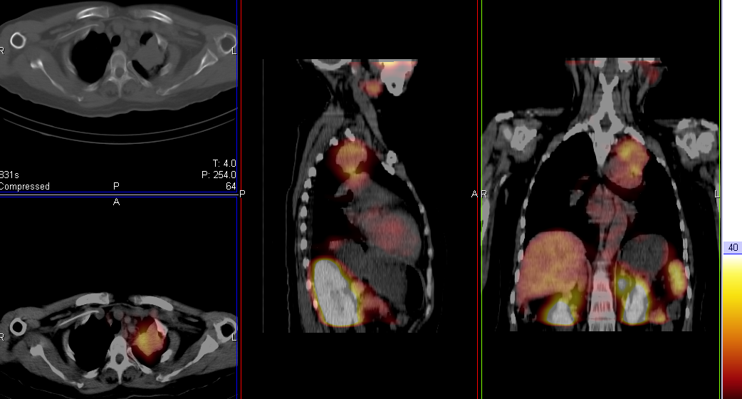
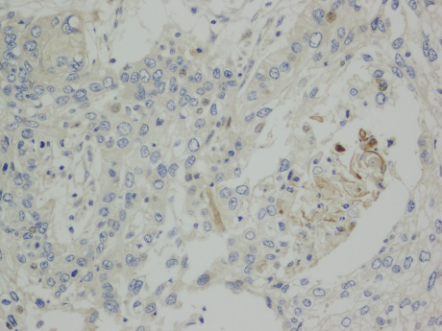
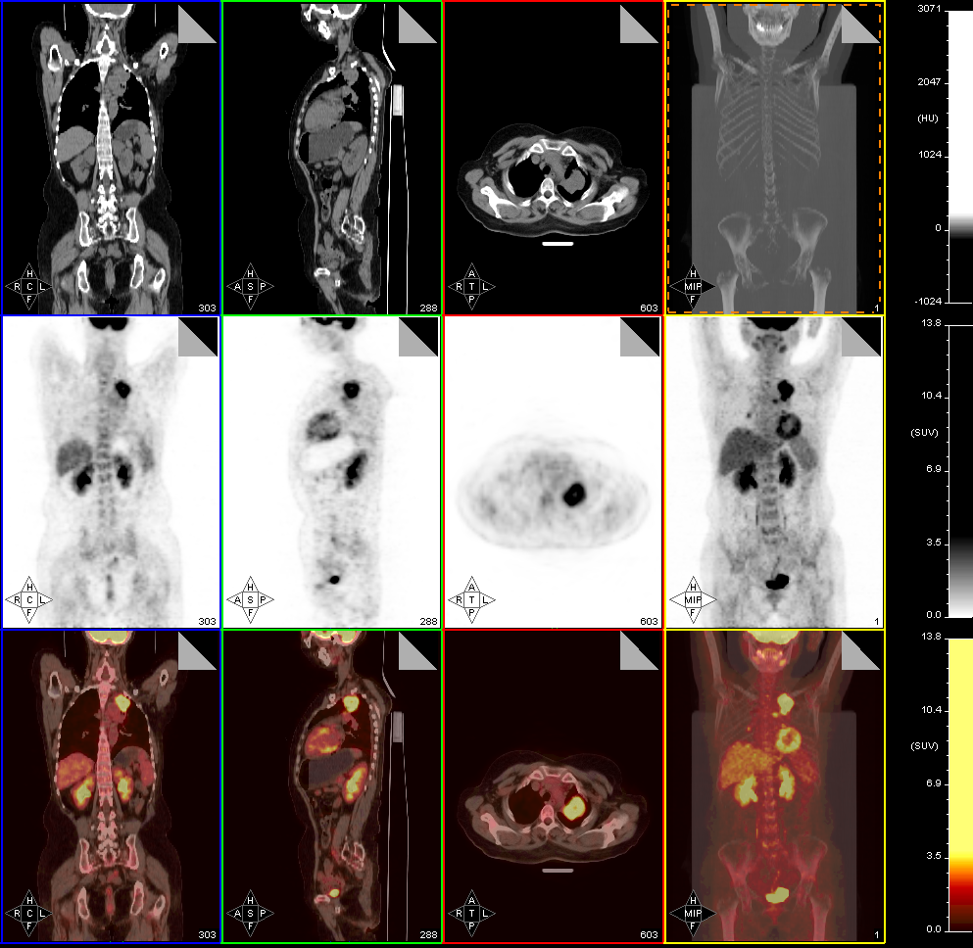
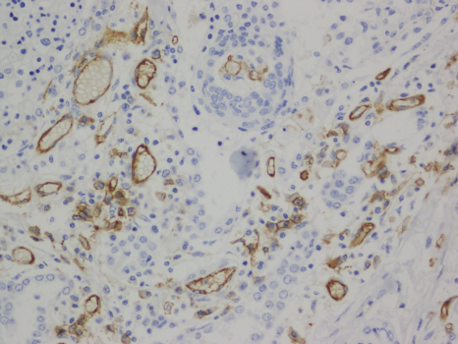
A
C
D
H
RGD
B
α_{v}β₃
E
F
G
I
FDG
CD31
Fig. Supplement-2
FDG
Notes:
韩

Slide 3
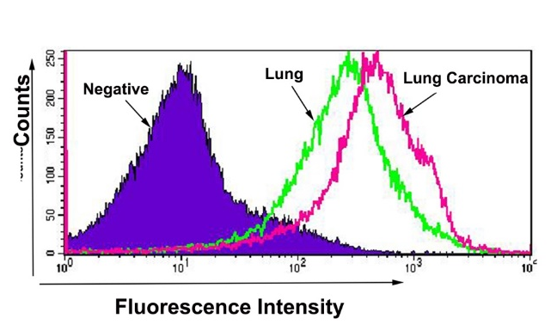
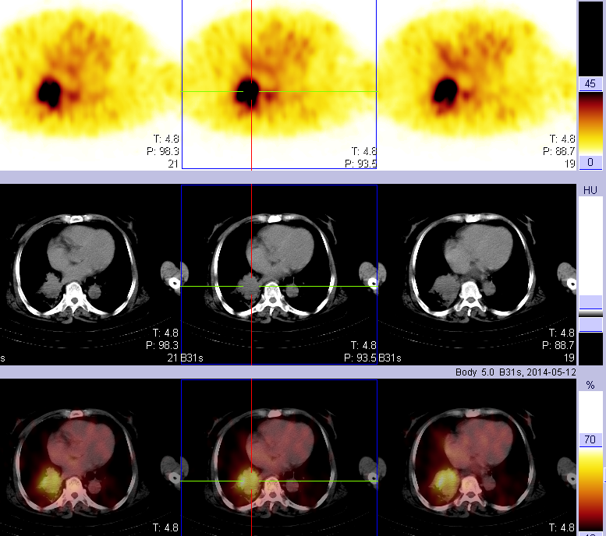

A
D
B
F
E
C
G
Fig. Supplement-3
Notes:
査全凤-adenocarcinoma

