Slide 1
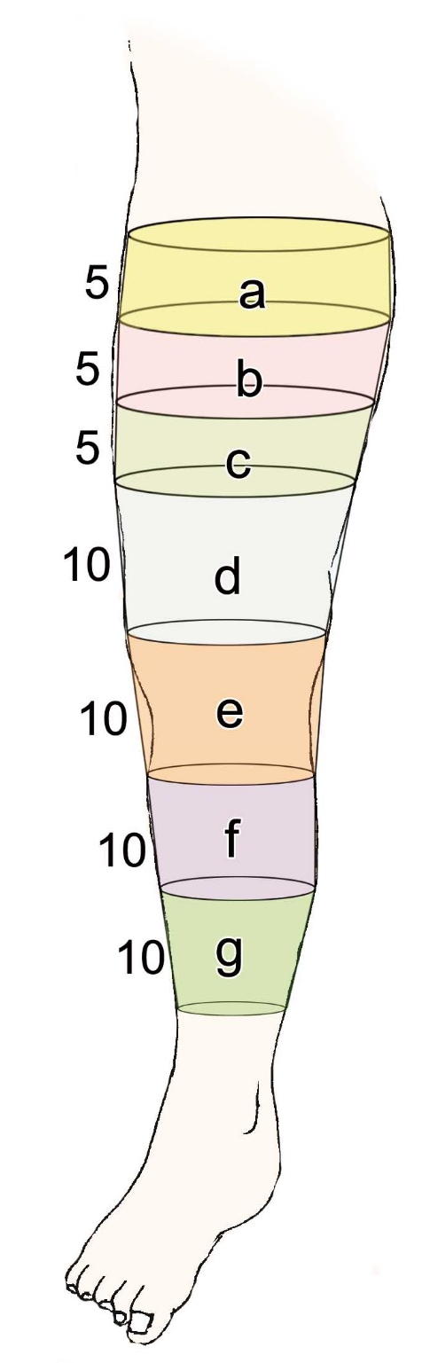
Supplemental data 1. Volume calculation of lower limb.
The circumference of the lower limbs was measured at 10 cm, 15 cm, 20 cm, and 25 cm above a point through the center of the patella and at 10 cm, 20 cm, and 30 cm below it. Furthermore, these were simulated limbs assumed to be cylinders and were divided into seven fractions from above (a, b, c, d, e, f, and g). The volumes of parts a-d were included in the thigh volume and those of parts e-g were included in the lower leg volume.

