Slide 1
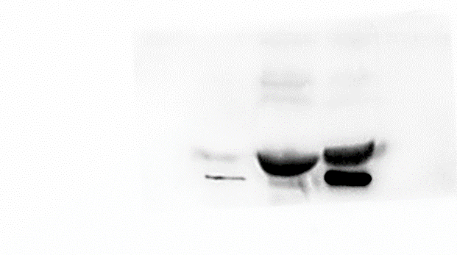
Western Blot Instructions and Original Images
Plasma-exo
Plasma-exo
MSC-exo
Urine-exo
MSC-exo
Urine-exo
Maker
Maker
TSG101
45kDa
CD 63
30-60 kDa
Plasma-exo
MSC-exo
Maker
Urine-exo
Plasma-exo
MSC-exo
Urine-exo
Maker
CD 9
CD 81
25kDa
24kDa

