Slide 1
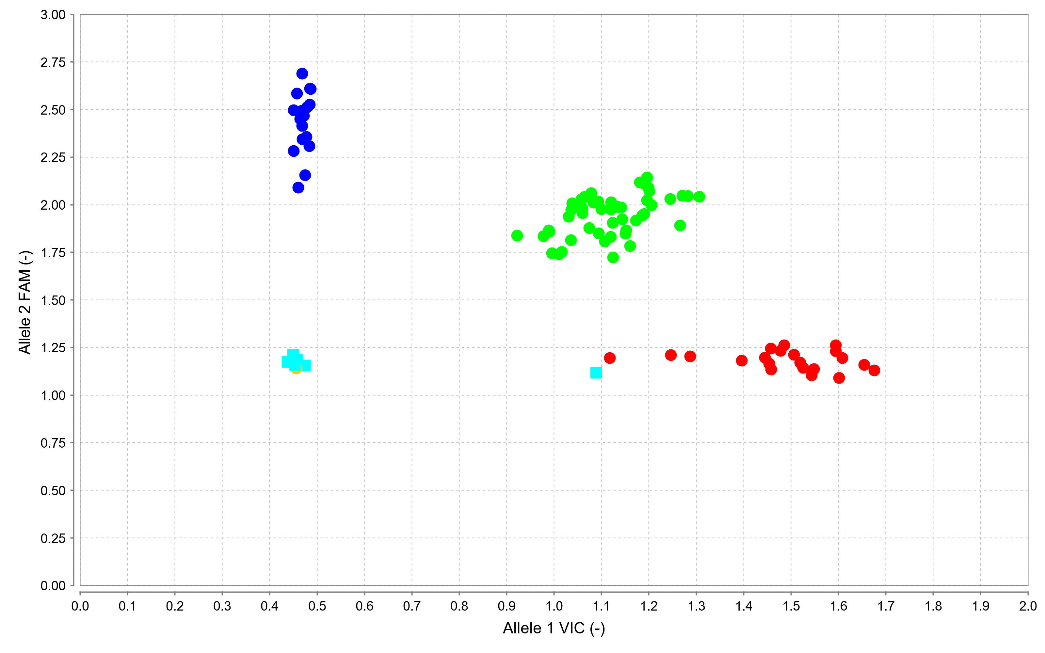
Scatter (Allelic discrimination) plot for KIF6 Trp719Arg gene variant using TaqMan genotyping assay.
Ligands
● AA
● GG
● AG
◼︎ NTC

Slide 2
Scatter (Allelic discrimination) plot for KIF6 Trp719Arg gene variant using TaqMan genotyping assay. [Allele-1 (A) labeled with VIC; Allele-2 (G) labeled with FAM]. The red cluster represents Homozygous AA, the Green cluster represents Heterozygous AG, the blue cluster represents Homozygous GG, and the Sky blue square represents NTC. Genotype calls of N>95% quality were scored using TaqMan Genotyper software version 1.6 provided by Thermo Fisher Scientific Cloud (USA).

