Slide 1
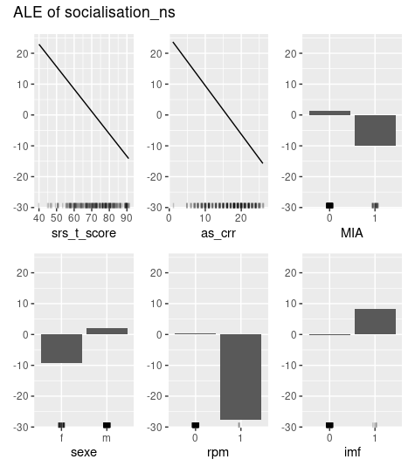
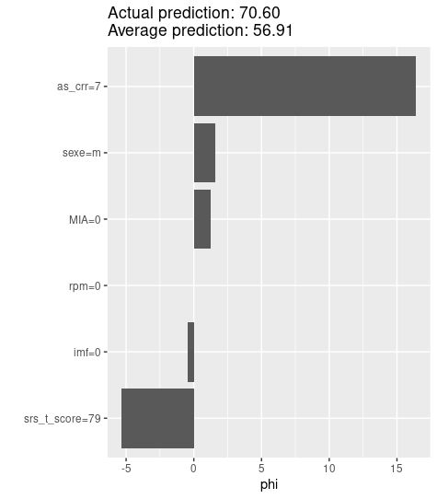
Supplementary figure 4: Learning parameters. A) Feature effects: computes the effects for all given features on the model prediction. B) Shapley Values: computes feature contributions for single predictions with the Shapley value.

