Slide 1
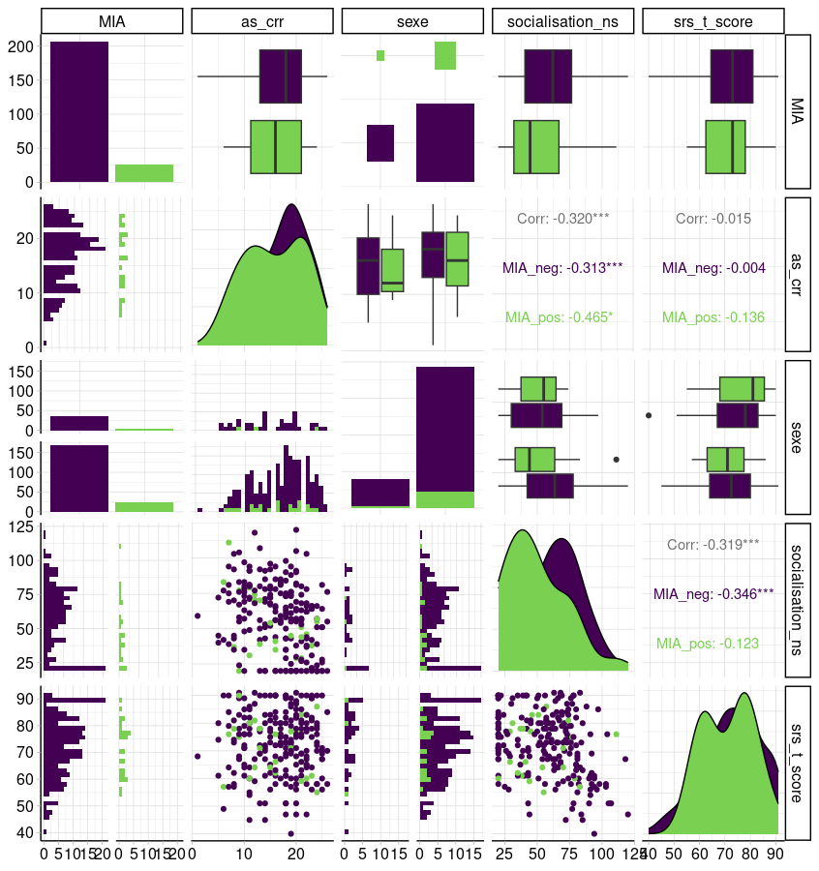
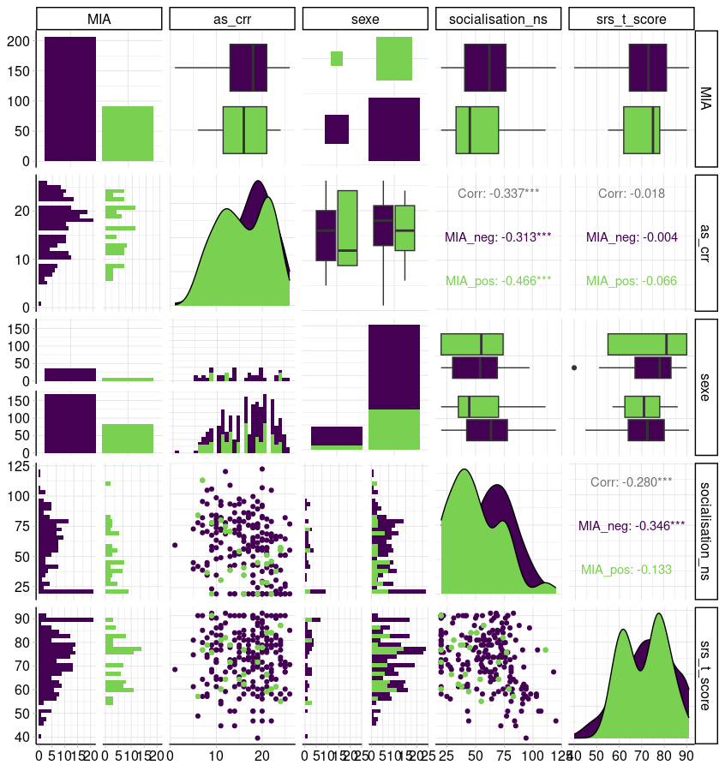
A
B
Supplementary Figure 1: Characteristics of the population. A) Before ; B) After the oversampling (ratio 3,5)

