Slide 1
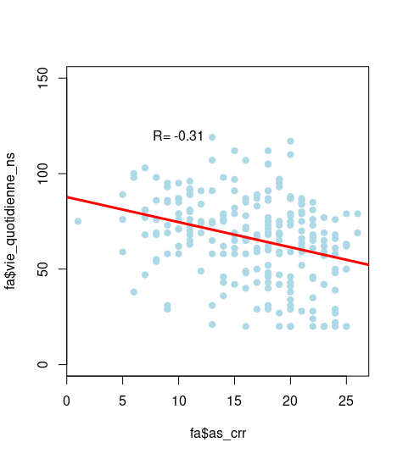
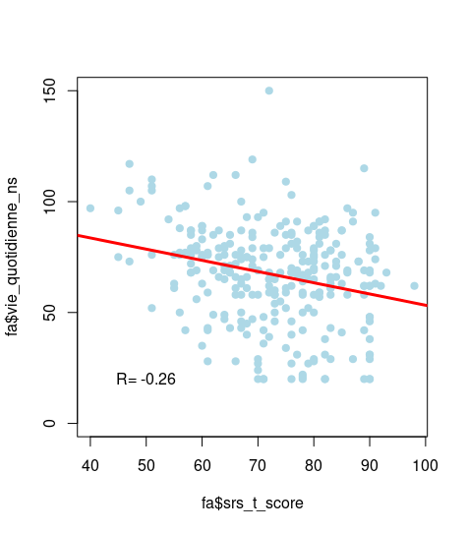
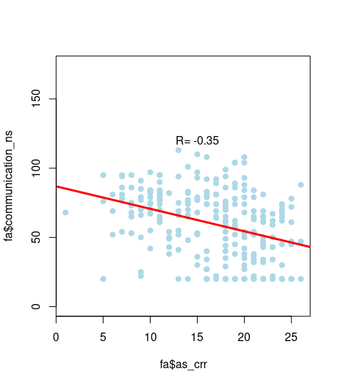
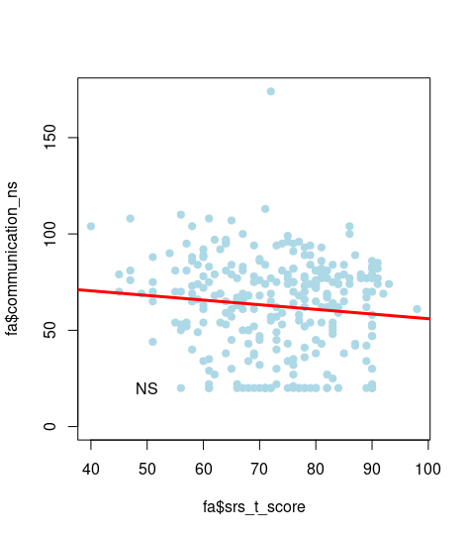
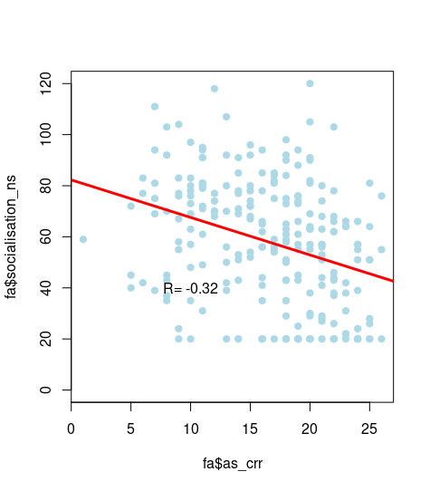
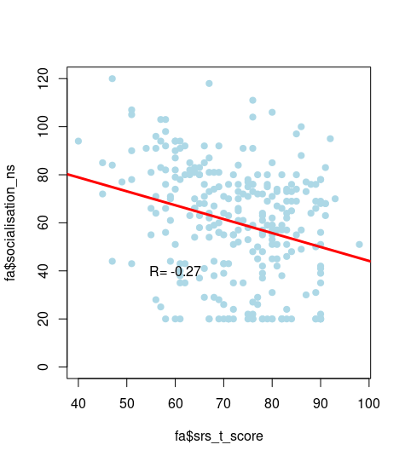
B
A
spearman | ADOS | SRS
DLS | -0,33 | -0,23
Communication | -0,38 | NS
Socialization | -0,34 | -0,26
C
Supplementary figure 3: Correlation of ASD severity with Vineland II subscores.
A) Spearman correlation coefficient between ADOS, SRS and sub-score of the Vineland II. B) Regression curve for the DSL sub- score. C) Regression curve for the communication sub- score. D) Regression curve for the socialization sub- score.
D

