Slide 1
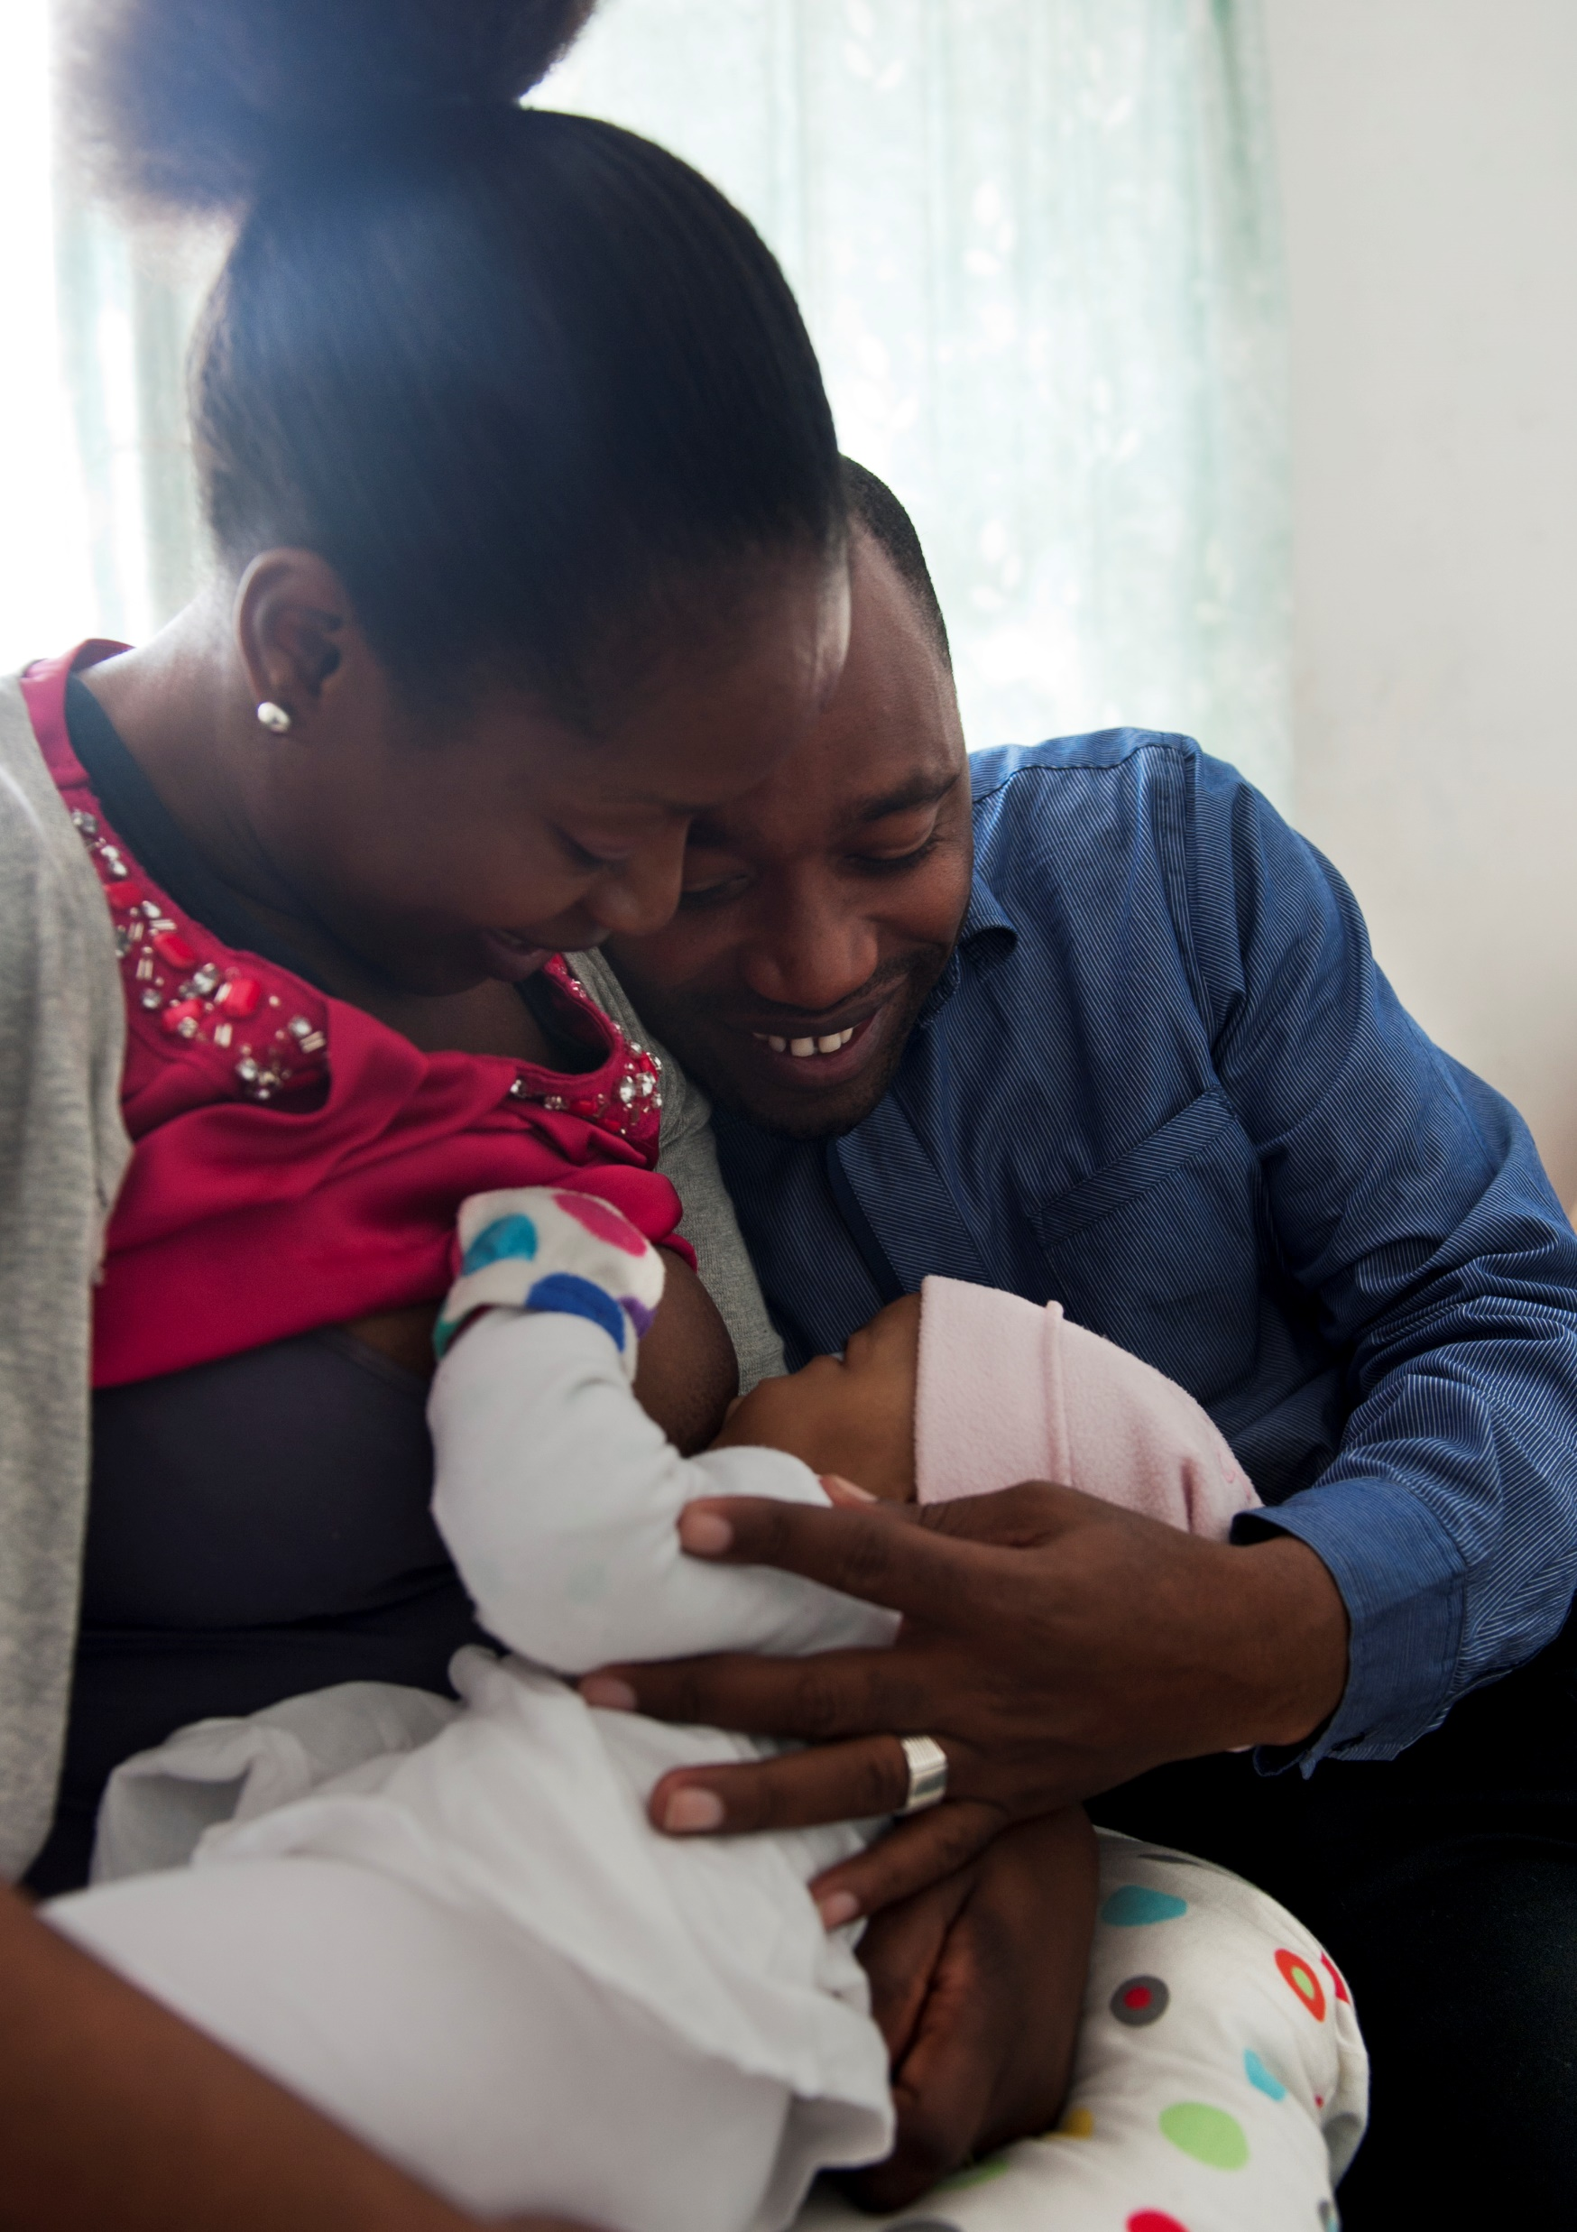
TALKING ABOUT SKIN-TO-SKIN AND BREASTFEEDING IN ANTENAL CARE
The evidence-based picture and conversation material for mothers
The evidence-based picture and conversation material used by midwives during antenatal care: They used empathetic, reflective listening with open-ended questions, reflected and summarised. Healthcare professionals explore what the breastfeeding family already knows about breastfeeding, ask for permission to provide information and offer information.
Figure 1. Supporting information
Foto: Elisabeth Ubbe

Slide 2
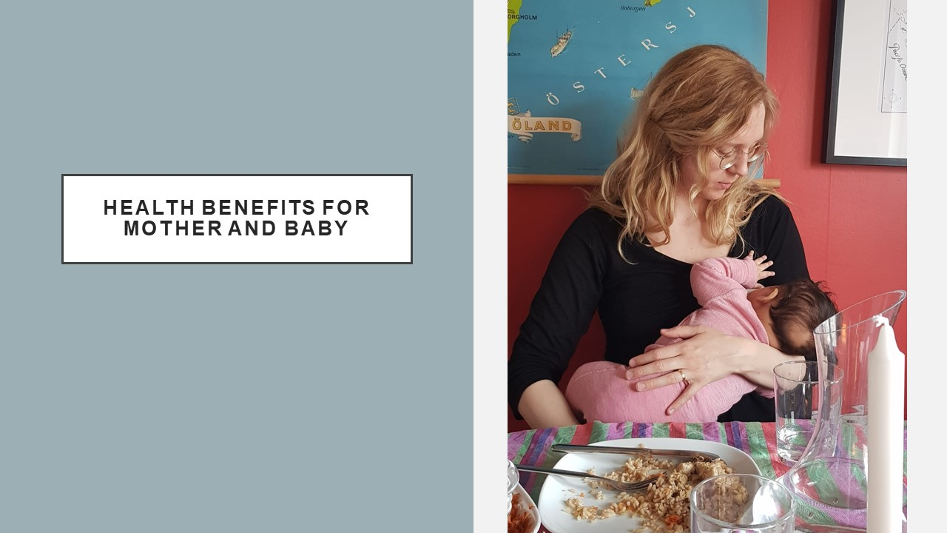
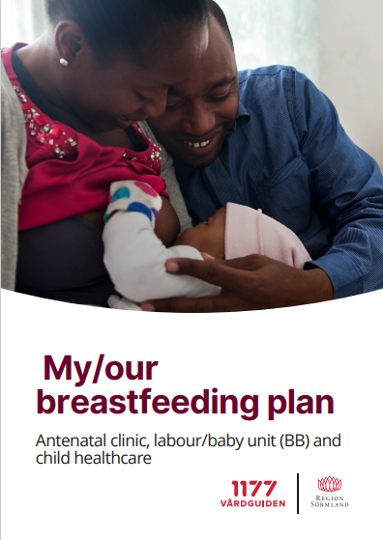
At the antenatal care visit during pregnancy week 28
Health benefits for mother and baby
Parents receive the breastfeeding plan, and the midwife fills in where to get help with breastfeeding during the breastfeeding period
Parents’ self-studies
The midwife encourages parents to read and fill in the breastfeeding plan together and to watch the short online breastfeeding lectures for parents in the breastfeeding plan before the visit in pregnancy week 32
Foto: Elisabeth Ubbe

Slide 3
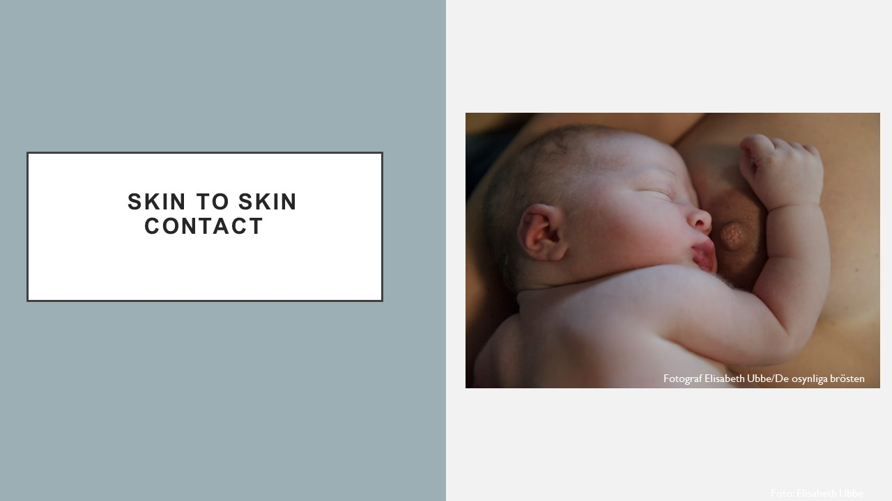
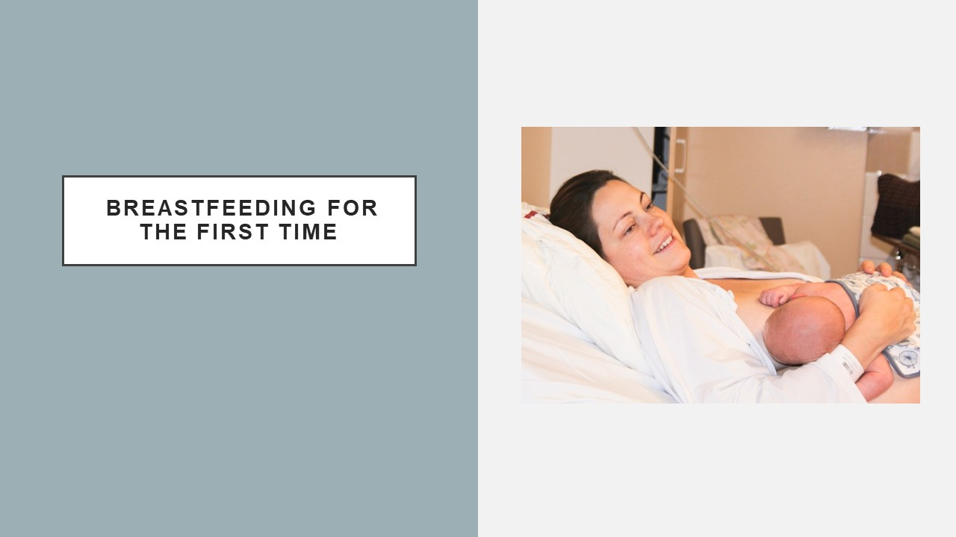
At the antenatal care visit during pregnancy week 32
Skin-to-skin contact and breastfeeding for the first time
Go through the breastfeeding plan with parents:
-Pregnant mothers' intentions
-Parents' experiences
-Parents’ expectations
-What kind of breastfeeding support parents want from their family and healthcare professionals
Foto: Elisabeth Ubbe

Slide 4
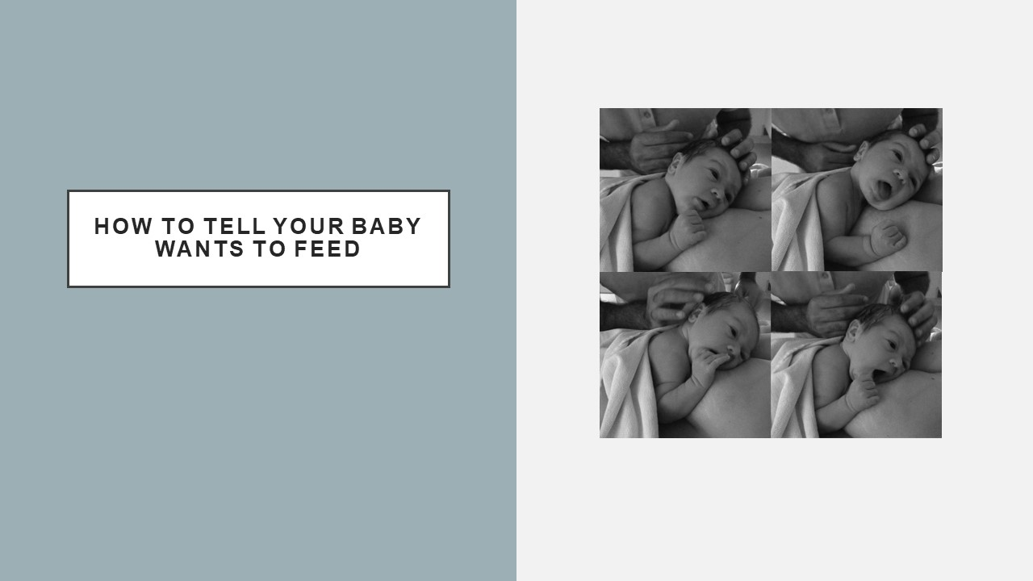
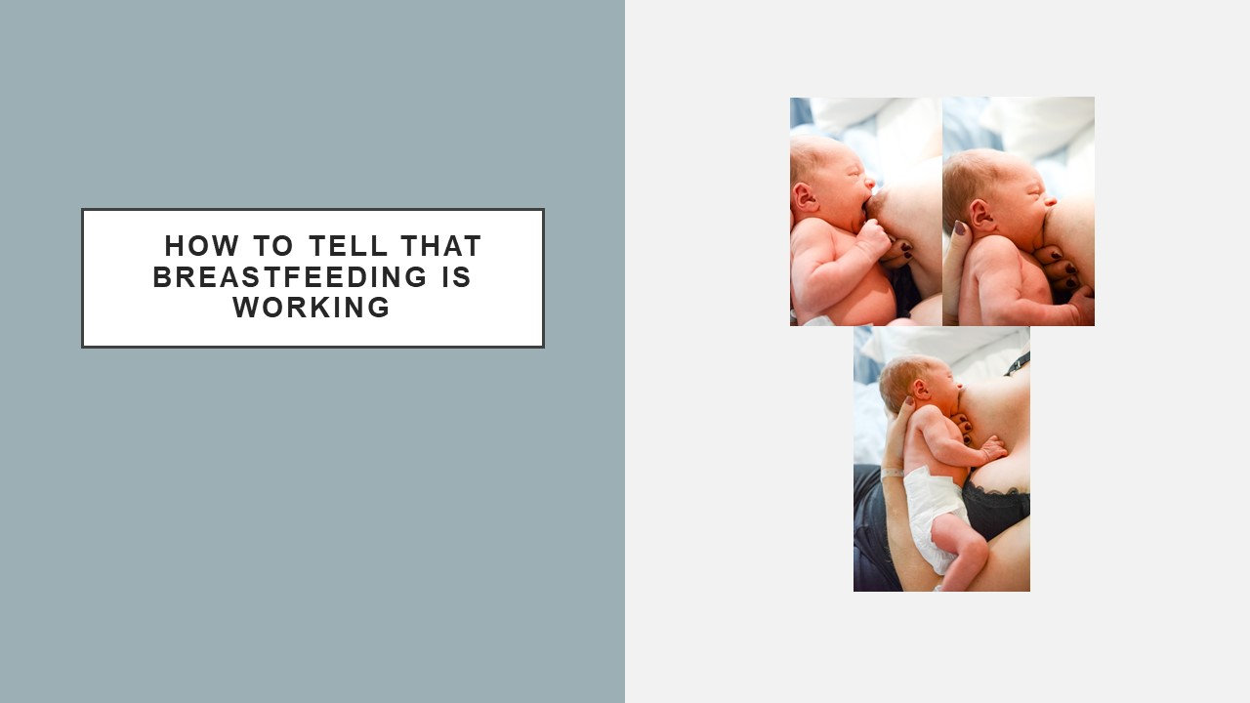
At the antenatal care visit during pregnancy week 38
How to tell when your baby wants to feed, and that breastfeeding is working
Foto: Elisabeth Ubbe

Slide 5
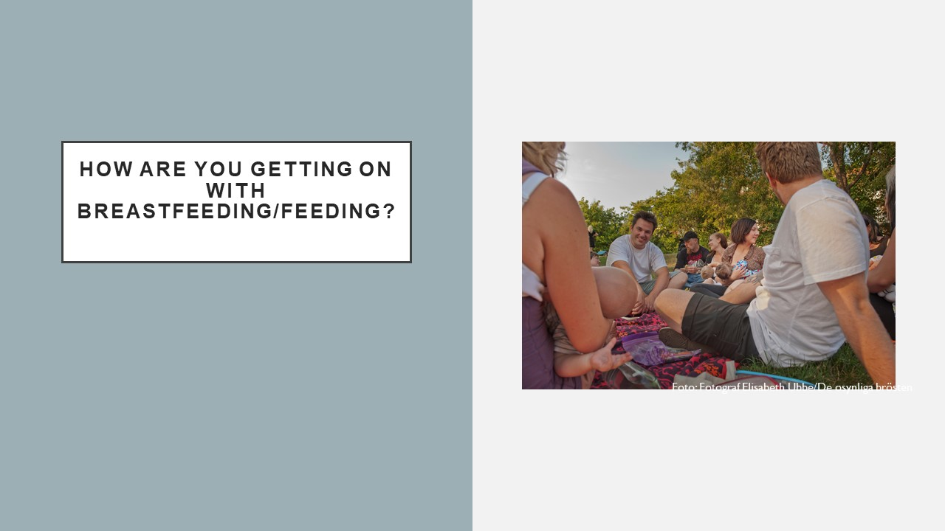
Follow-up after birth, as well as 2 and 8 weeks after birth
Mothers' intentions, parents' experiences and expectations and what kind of breastfeeding support parents want from their family and healthcare professionals
If mothers need more breastfeeding support, professionals should help them to contact the breastfeeding outpatient clinic
Foto: Elisabeth Ubbe

Slide 6
TALKING ABOUT CONTINUED CLOSENESS AND BREASTFEEDING IN the child health Centre
The evidence-based picture and conversation material at the child health centre
The evidence-based picture and conversation material used by child healthcare nurses at the child health centre: They used empathetic, reflective listening with open-ended questions, reflected and summarised. Healthcare professionals explore what the breastfeeding family already knows about breastfeeding, ask for permission to offer information and offer information.
Foto: Elisabeth Ubbe

Slide 7
Follow-up at every visit during the breastfeeding period
Mothers' intentions, parents' experiences and expectations and what kind of breastfeeding support parents want from their family and healthcare professionals
If mothers need more breastfeeding support, professionals should help them to contact the breastfeeding outpatient clinic
Foto: Elisabeth Ubbe

Slide 8
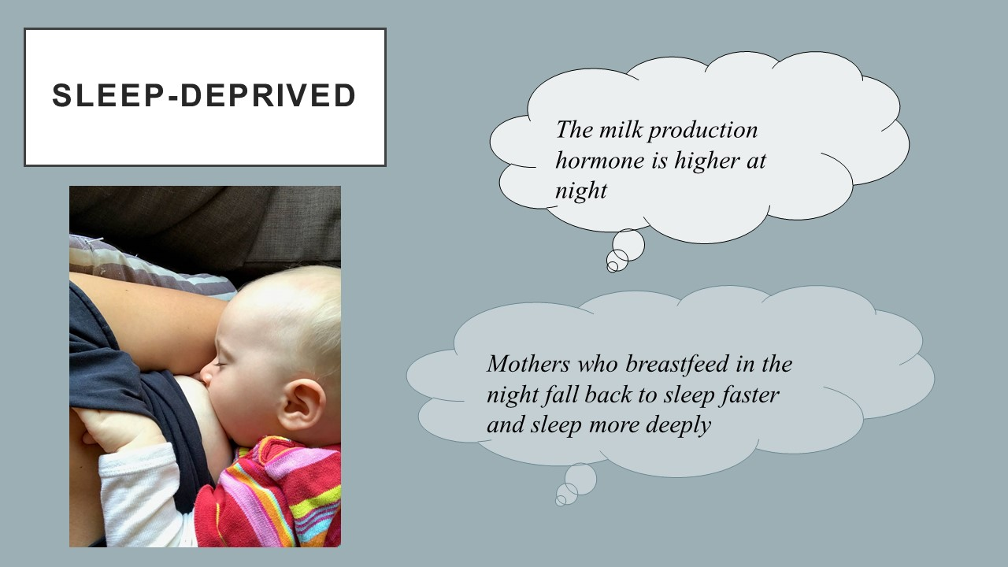
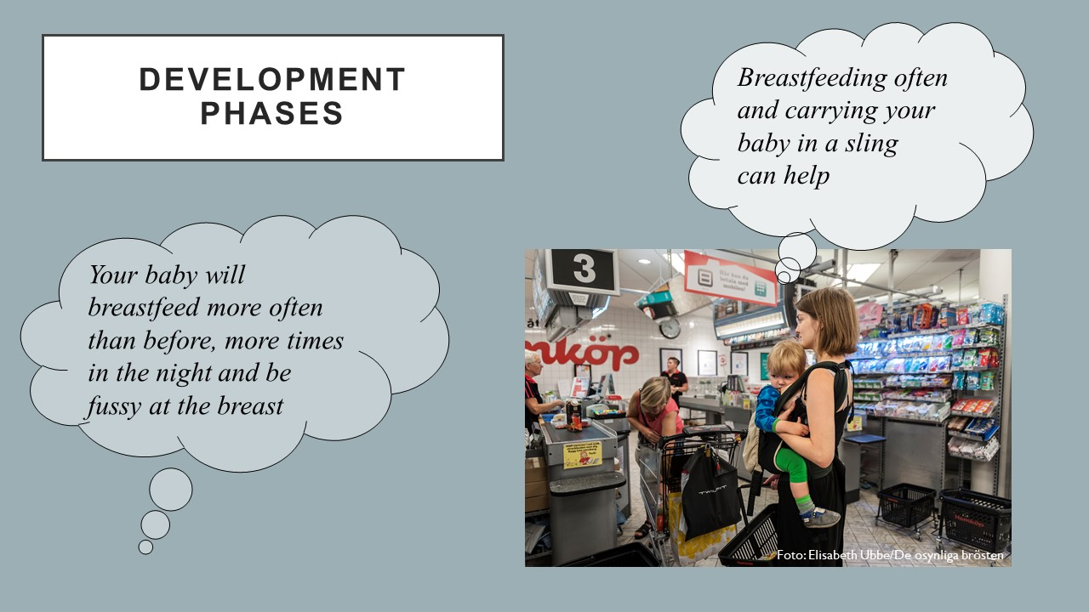
Two to four weeks after birth
Sleep-deprived
Six to eight weeks after birth
Development phases
Foto: Elisabeth Ubbe

Slide 9

Breastfeeding plan
Where to get help with breastfeeding during the whole breastfeeding period
Advantages of learning about breastfeeding before the baby is born
Self-studies for parents during pregnancy weeks 28-32: Talk with the partner, family, friends and healthcare professionals about breastfeeding: thoughts, experiences and expectations about breastfeeding
Self-studies for parents during pregnancy weeks 28-32: Talk with the partner, family and healthcare professionals about what kind of support they need from each other, professionals and their family
Self-studies for parents during pregnancy weeks 28-32: Fill in the breastfeeding plan during pregnancy: mothers' intentions about breastfeeding, parents' experiences and expectations and what kind of breastfeeding support parents want from their family and healthcare professionals
Self-studies for parents during pregnancy weeks 32-38: Care routines that can make breastfeeding easier. For example, demand feeding
Self-studies for parents during pregnancy weeks 32-38: Mothers’ own breastfeeding plan about breastfeeding after birth
QR-codes for 4 short online breastfeeding lectures for parents in the following languages: Swedish, English, Somali and Arabic- Are there any benefits of breastfeeding? How do you know if breastfeeding is working? How can the mother experience breastfeeding? How could the mother continue to breastfeed?
For parents who want to know more about breastfeeding: QR-codes for 2 leaflets, only in Swedish: Breastfeeding - a good start Breastfeeding and sleeping well
Fill in the breastfeeding plan before visiting the child health centre during the breastfeeding period: mothers' intentions about breastfeeding, parents' experiences and expectations and what kind of breastfeeding support parents want from their family and healthcare professionals.
Foto: Elisabeth Ubbe

Slide 10
Text
Code
Subcategory
Generic category
But there is probably a greater tendency to simply feel more left out
Higher tendency of feeling left out
I feel left out, the mother and child have a different bond
When they're little, you're not worth as much as the father
Not worth so much as the father
Feeling left out from the family
The downside is a bit like I told you before. That it is my partner who gets to mostly comfort the child
Downside, my partner gets to comfort the child
Frustrating not being able to comfort the child
I guess I didn't really understand that, that I would be so...like...uh...powerless if she got hungry quickly. That I can't...like I can't do anything
Powerless if she were to get hungry quickly
Figure 2. Example of the initial coding process

Slide 11
Generic category
Combined sub-categories
Main category
The child has two parents who are in agreement
We are a family, and everyone is involved
The mother makes the final decision about breastfeeding
Valuable to give expressed breast milk
The family makes decisions about breastfeeding and supplementing together
Striving to be a part of the family and important that the family’s everyday life is well-functioning
Own decisions about supplementation
I cannot participate in conversations about breastfeeding
Feeling excluded
Feeling left out from the family
Figure 3. Example of the analysis process for the generic category, combined sub-categories and main category
Notes:
Main category kanaldrig bestå av bara en generic category
En main category kan aldrig ha samma namn som en generic categor

Slide 12
Main category: “Striving to be a part of the family and that the family functions well in everyday life”
Combined sub-categories
We are a family, and everyone is involved IG n*=59, CG n*=3 | Feeling excluded IG n*=11, CG n*=22
It is safe to receive guidance from healthcare IG n*=40, CG n*=1 | We did not receive support IG n*=10, CG n*=26
Breastfeeding made everyday life easier for the family IG n*=22, CG n*=2 | Formula made everyday life easier for the family IG n*=13, CG n*=29
Breastfeeding has benefits IG n*=30, CG n*=19 | Babies who are not breastfed feel well IG n*=1, CG n*=2
Breastfeeding works, the baby grows IG n*=14, CG n*=11 | It is not easy for all infants to breastfeed IG n*=10, CG n*=13
The cultural norm is that the mother should breastfeed IG n*=24, CG n*=16 | It is uncomfortable to see someone breastfeeding . IG n*=6, CG n*=8
Figure 4. Main category and combined sub-categories
*n=The number of codes in the combined sub-categories

