Slide 1

Noise filtering
Pulse detection
Bout grouping
Filter out non-biological background noise from recording equipment which varies across time, space, and recorders
Obtain the spectral profile of local background noise in each recording file
Find pulses above the background noise level which varies across time, space, and recorders
Obtain the local lower amplitude threshold for each recording file
Group detected pulses into biologically meaningful bouts
Obtain the local threshold of time interval to group pulses into the most likely bouts

Slide 2
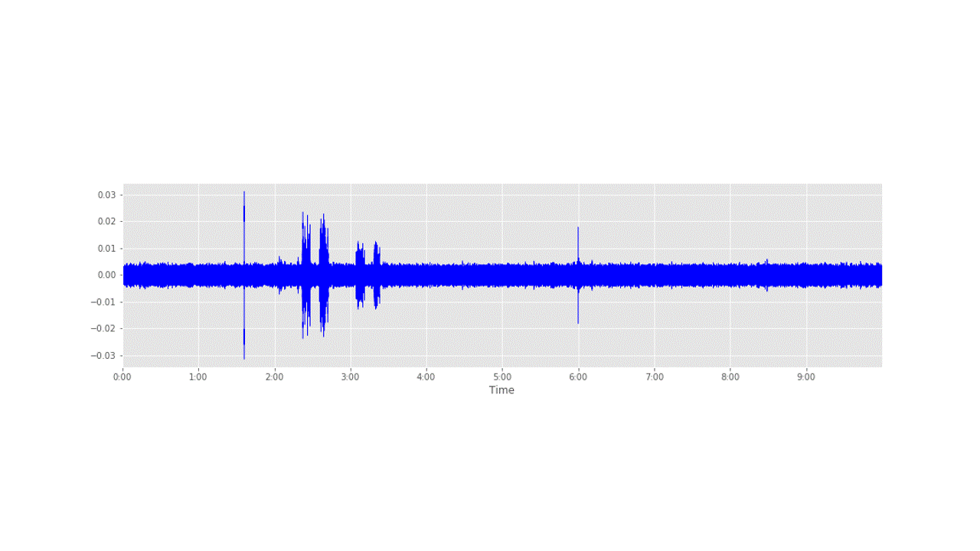
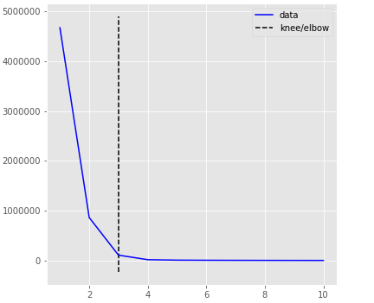

Noise filtering
$$A_{Th}= Med\left(A\right)+ α∗ σ(A)$$
Find the best alpha for sigma clipping method by the comparison of the number of samples above the amplitude threshold across the range of alphas
Elbow (knee) detection method to estimate the best alpha
Find the longest ‘silence’ below the amplitude threshold and obtain the spectral profile by fast Fourier transformation (FFT)
Adapt the noise filter to the raw recording file
Best alpha
Samples above threshold
alpha

Slide 3
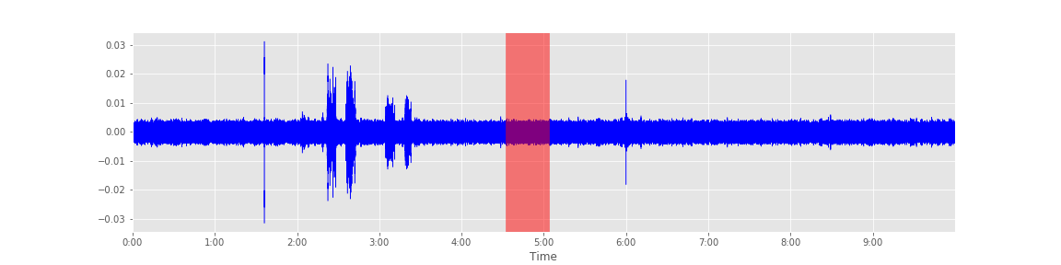
Noise filtering
Longest ‘silence’
Find the best alpha by the comparison of the number of samples above the amplitude threshold across the range of alphas for sigma clipping methods
Elbow (knee) detection method to estimate the best alpha
Find the longest ‘silence’ below the amplitude threshold and obtain the spectral profile by fast Fourier transformation (FFT)
Adapt the noise filter to the raw recording file
Best alpha
Samples above threshold
alpha

Slide 4
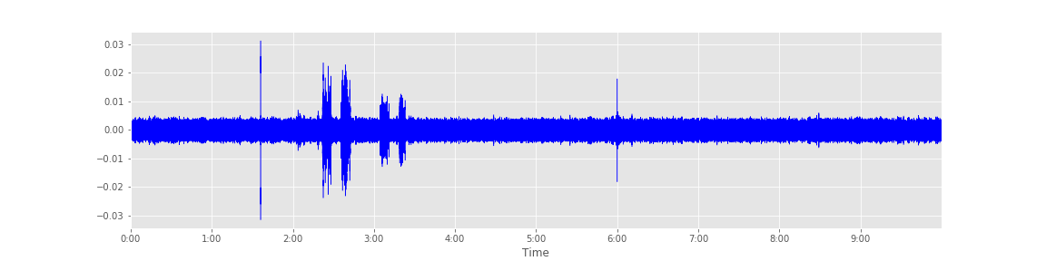
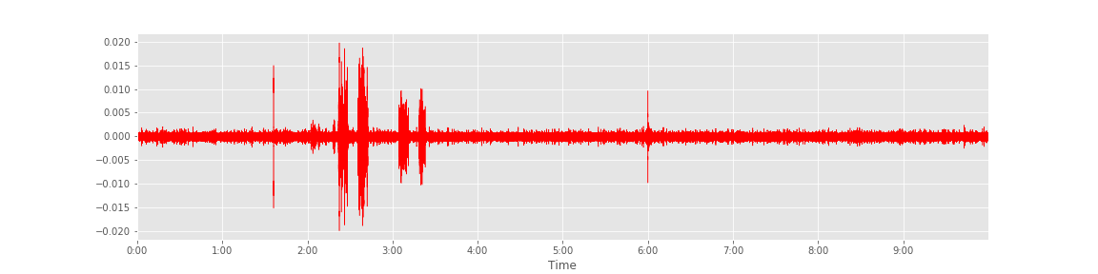

Noise filtering
Find the best alpha by the comparison of the number of samples above the amplitude threshold across the range of alphas for sigma clipping methods
Elbow (knee) detection method to estimate the best alpha
Find the longest ‘silence’ below the amplitude threshold and obtain the spectral profile by fast Fourier transformation (FFT)
Adapt the noise filter to the raw recording file
Before filtering
After filtering

Slide 5
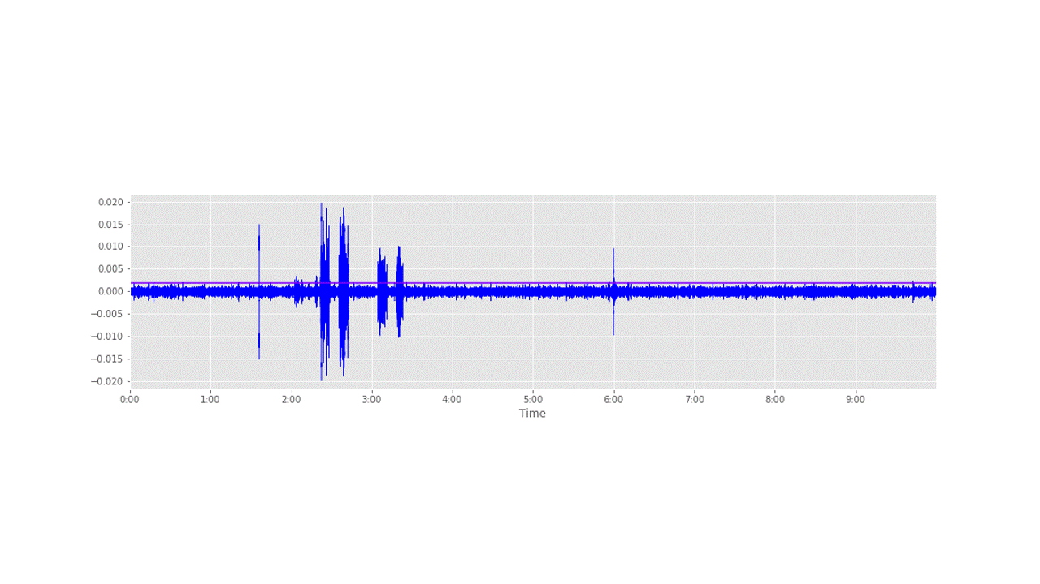
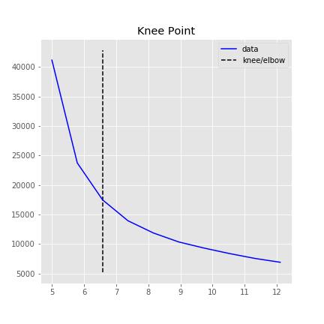
Pulse detection
$$A_{Th}= Med\left(A\right)+ α∗ σ(A)$$
Best alpha
Find the best alpha by the comparison of the number of samples above the amplitude threshold across the range of alphas for sigma clipping method
Elbow (knee) detection method to estimate the best alpha
Record the amplitude and time of the samples (pulse) above the amplitude threshold
Samples above threshold
alpha

Slide 6
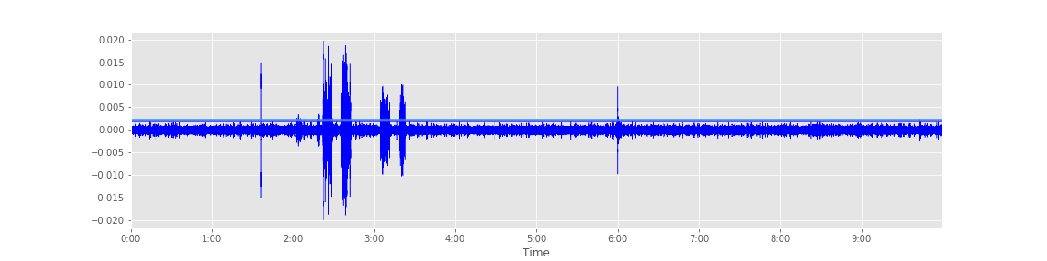

Bout Grouping
231 pulses detected
Calculate the time intervals between adjacent pulses detected by pulse detection
Find the optimal numbers of Gaussian distributions of time intervals between adjacent pulses by the comparison of Akaike Information Criterion (AIC) among multiple Gaussian mixture models
If the time interval between adjacent pulses belongs to the Gaussian distribution with the largest median values, starts a new bout from the later pulse
p(x)
$$\log{dT}$$
…

Slide 7
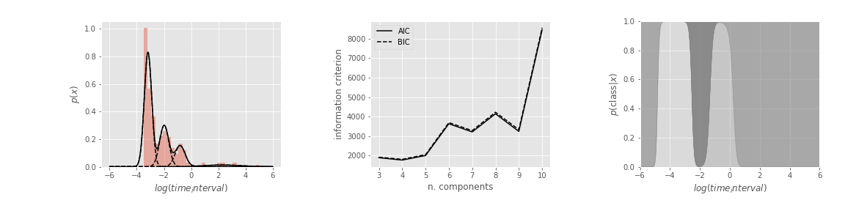
Bout Grouping
Calculate the time intervals between adjacent pulses detected by pulse detection
Find the optimal numbers of Gaussian distributions of time intervals between adjacent pulses by the comparison of Akaike Information Criterion (AIC) among multiple Gaussian mixture models
If the time interval between adjacent pulses belongs to the Gaussian distribution with the largest median values, starts a new bout from the later pulse
p(x)
$$\log{dT}$$
…

Slide 8
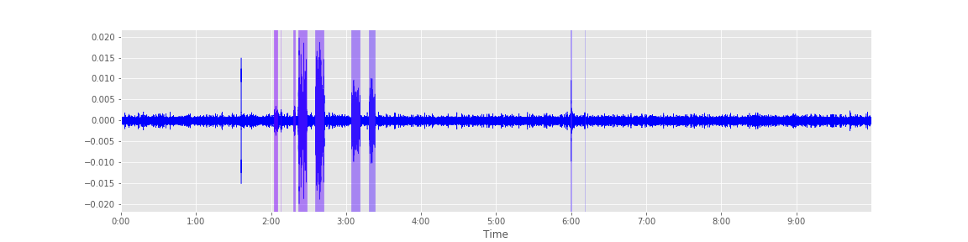
Bout Grouping
Calculate the time intervals between adjacent pulses detected by pulse detection
Find the optimal numbers of Gaussian distributions of time intervals between adjacent pulses by the comparison of Akaike Information Criterion (AIC) among multiple Gaussian mixture models
If the time interval between adjacent pulses belongs to the Gaussian distribution with the largest median values, starts a new bout from the later pulse
p(x)
$$\log{dT}$$
…

Slide 9
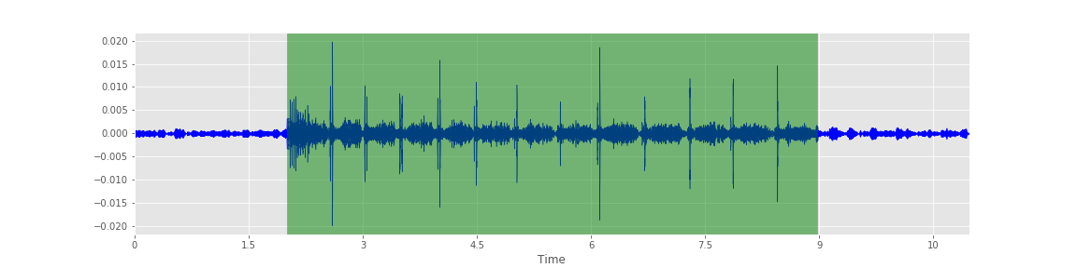
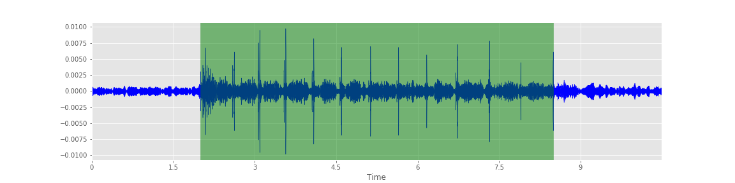
Bout Grouping
Calculate the time intervals between adjacent pulses detected by pulse detection
Find the optimal numbers of Gaussian distributions of time intervals between adjacent pulses by the comparison of Akaike Information Criterion (AIC) among multiple Gaussian mixture models
If the time interval between adjacent pulses belongs to the Gaussian distribution with the largest median values, starts a new bout from the later pulse

