Slide 1
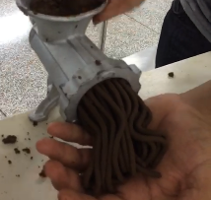
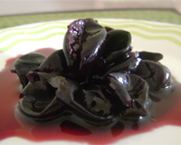
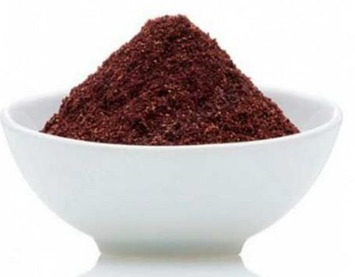
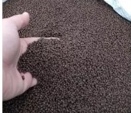
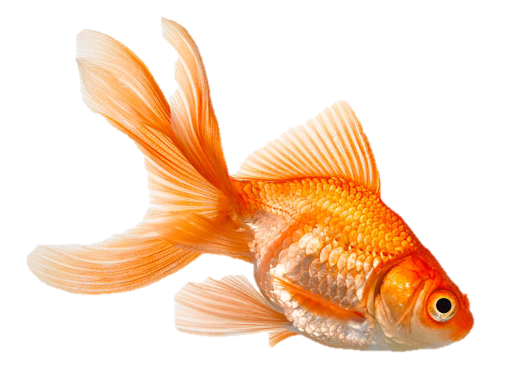
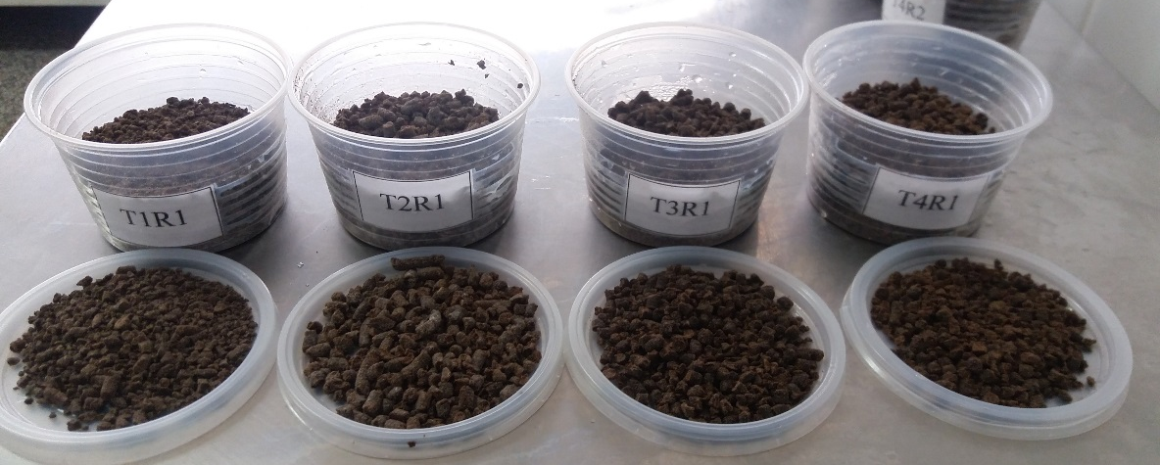
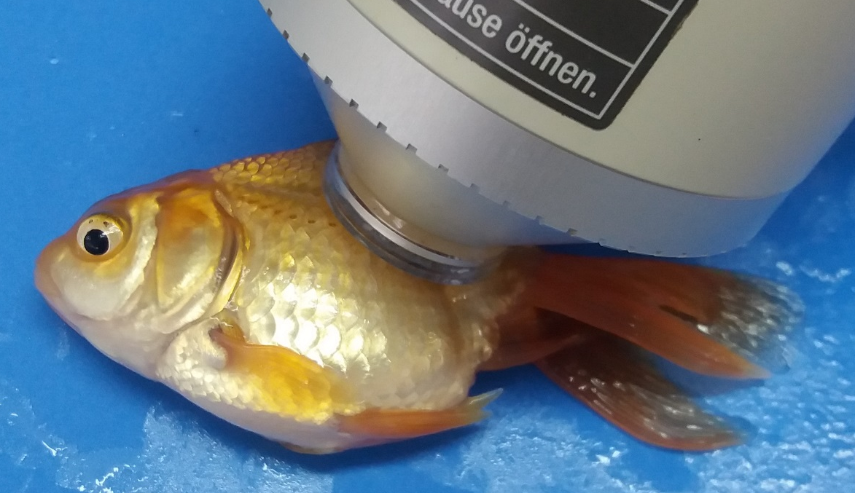
0.0; 1.00; 1,50; 2.00% of flour of jabuticaba peel incorporated in diet
Natural photoperiod
(12h of light:12h of dark)
It is concluded that the incluision of jabuticaba husk flour is eficiente as a food aditive and that its inclusion is effective at the level of up to 1.5% in order to increase the luminosity of Carassius auratus besides presenting hepatoprotective effect.

