Slide 1
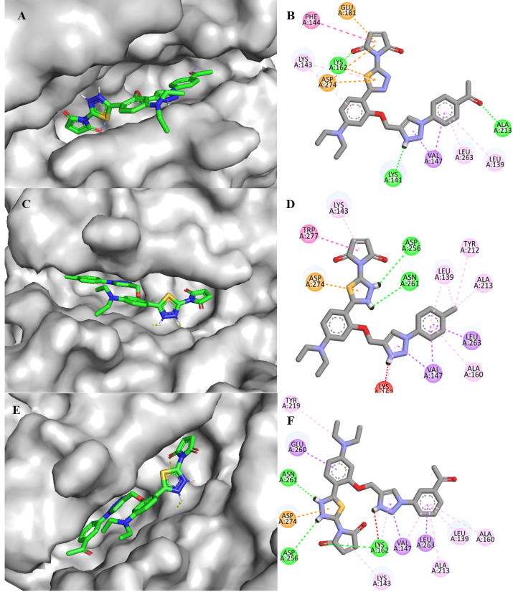
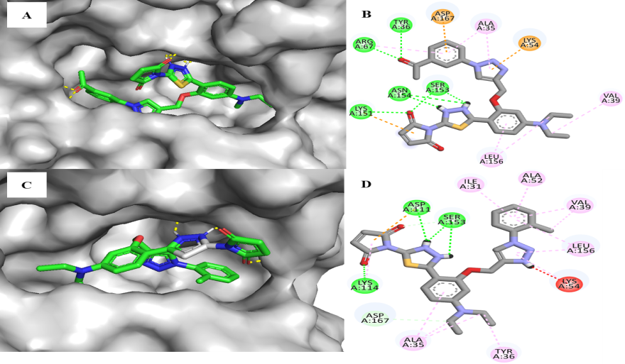
Graphical Abstract
Aurora kinase-A (ARK-A)
Extracellular regulated kinase-2(ERK2)
Morphology
Anticancer activity
Cancer cell lines
KYSE-450
MIA paca-2
Molecular Docking
Kinase inhibition (ARK1 & ERK2)

