Slide 1
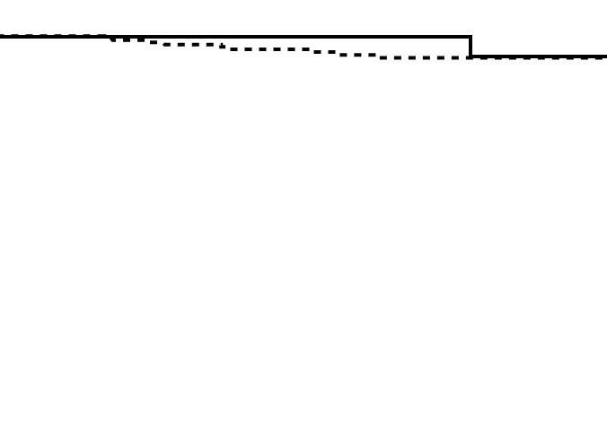
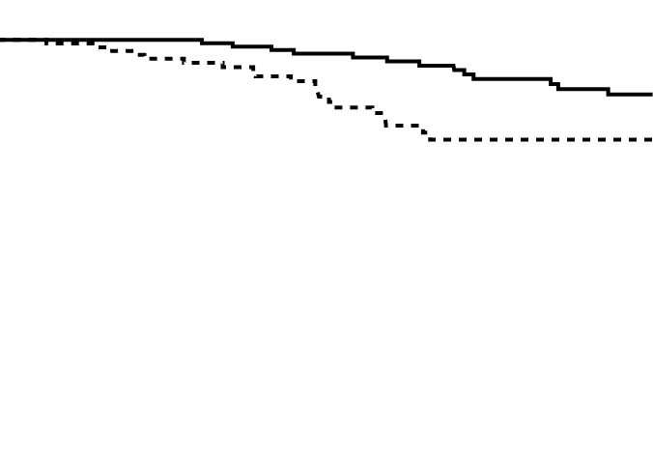
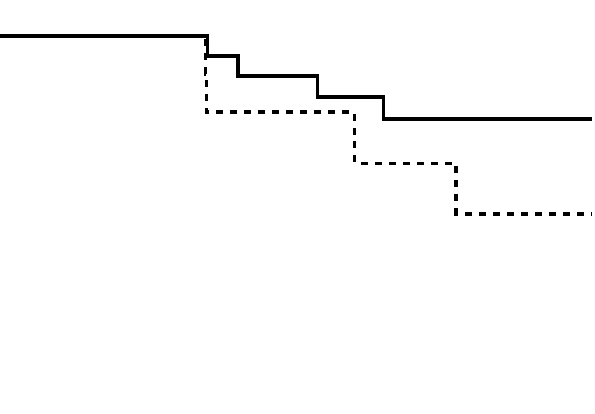
Supplementary Figure 5
A
High-risk stage II
B
Stage III
C
Stage IV
Cancer-specific survival
Cancer-specific survival
Cancer-specific survival
p=0.69
p=0.009
p=0.20
AC (+)
AC (+)
AC (+)
AC (-)
AC (-)
AC (-)
Time since surgery (months)
Time since surgery (months)
Time since surgery (months)
No. at risk
No. at risk
No. at risk
AC (+): 32 31 27 24 19 12
AC (+): 145 139 120 100 83 58
AC (+): 23 23 19 16 13 11
AC (-): 211 188 159 124 102 72
AC (-): 119 107 83 53 40 30
AC (-): 14 13 8 6 4 1

