Slide 1
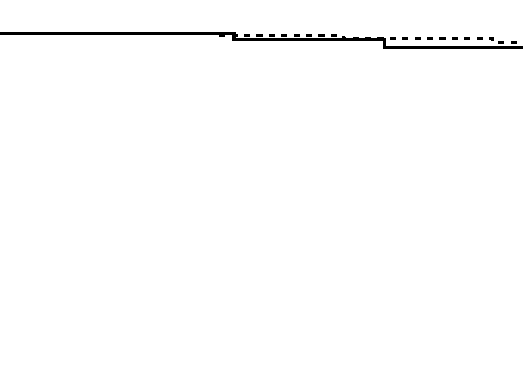
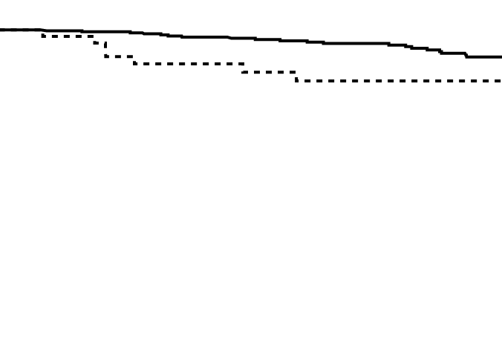
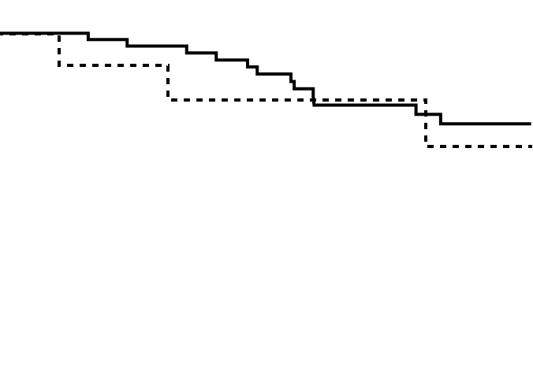
Supplementary Figure 4
A
High-risk stage II
B
Stage III
C
Stage IV
Cancer-specific survival
Cancer-specific survival
Cancer-specific survival
p=0.56
p=0.019
p=0.61
AC (+)
AC (+)
AC (+)
AC (-)
AC (-)
AC (-)
Time since surgery (months)
Time since surgery (months)
Time since surgery (months)
No. at risk
No. at risk
No. at risk
AC (+): 74 67 57 53 38 27
AC (+): 353 328 279 239 199 146
AC (+): 56 54 47 34 29 23
AC (-): 151 145 134 126 107 80
AC (-): 53 48 38 32 25 17
AC (-): 12 11 9 8 7 3

