Slide 1
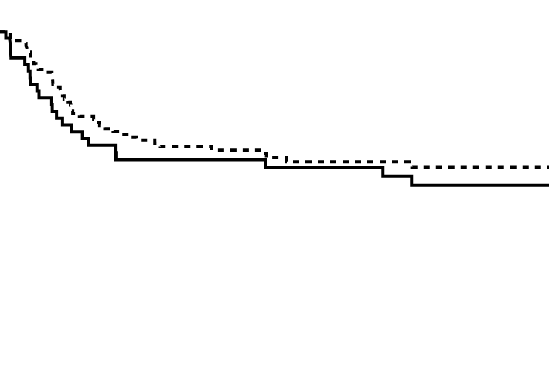
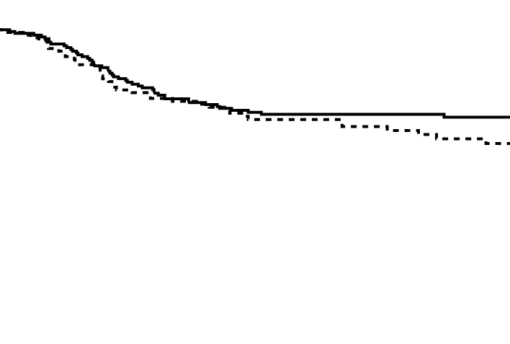
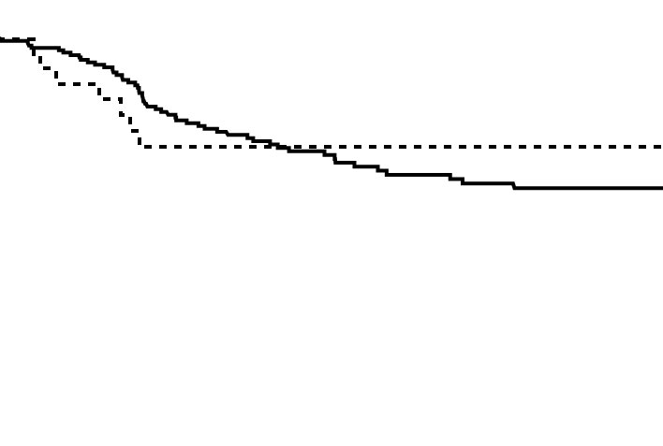
Supplementary Figure 3
A
No adjuvant chemotherapy
B
Oral 5-FU analogue
C
Oxaliplatin-including regimen
Relapse-free survival
Relapse-free survival
Relapse-free survival
p=0.28
p=0.90
p=0.45
<70 years
<70 years
<70 years
≥70 years
≥70 years
≥70 years
Time since surgery (months)
Time since surgery (months)
Time since surgery (months)
No. at risk
No. at risk
No. at risk
<70 years: 53 33 28 25 20 12
<70 years: 177 153 127 111 93 65
<70 years:176 143 97 67 54 47
≥70 years:119 82 65 45 35 25
≥70 years: 117 99 81 68 55 37
≥70 years: 28 21 11 8 7 4

