Slide 1
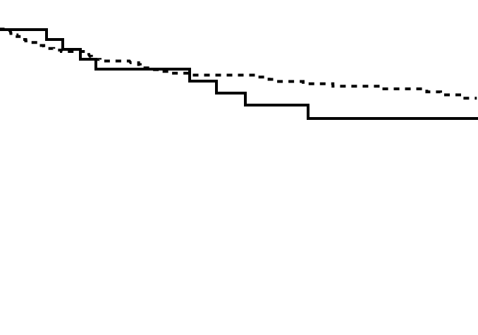
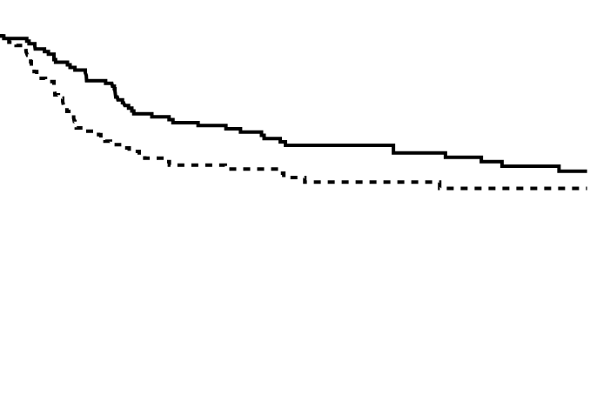
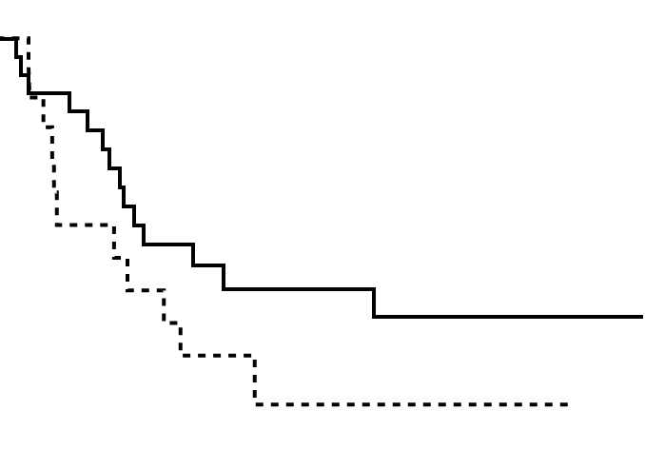
Supplementary Figure 2
A
High-risk stage II
B
Stage III
C
Stage IV
Relapse-free survival
Relapse-free survival
AC (+)
Relapse-free survival
AC (-)
p=0.44
p=0.15
p=0.12
AC (+)
AC (+)
AC (-)
AC (-)
Time since surgery (months)
Time since surgery (months)
Time since surgery (months)
No. at risk
No. at risk
No. at risk
AC (+): 32 29 23 19 15 10
AC (+): 145 119 91 75 61 41
AC (+): 23 14 8 6 5 3
AC (-): 211 176 146 112 93 67
AC (-): 119 82 64 45 35 25
AC (-): 14 7 2 2 2 1

