Slide 1
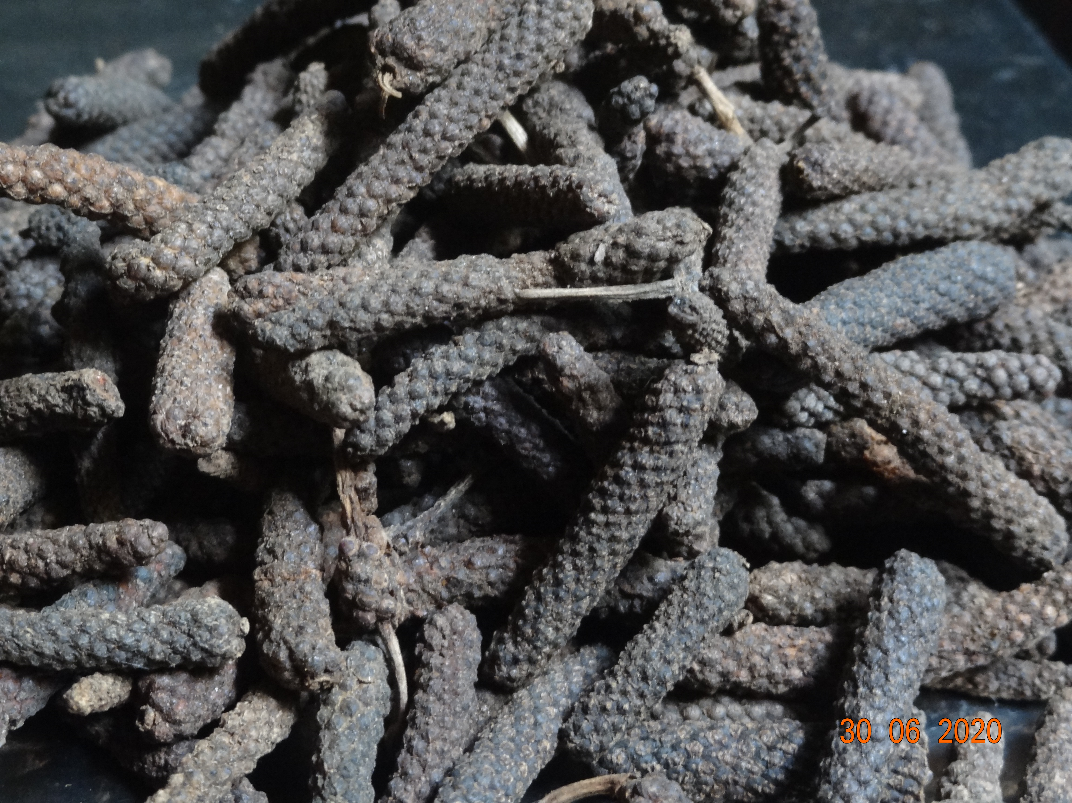
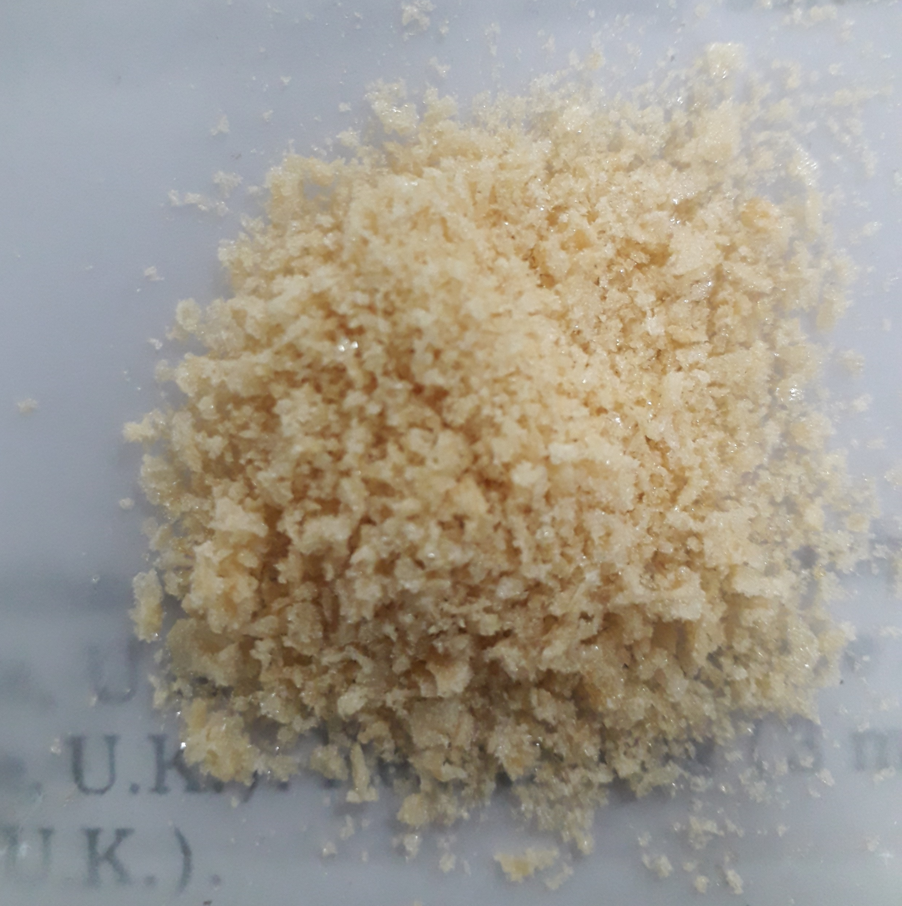
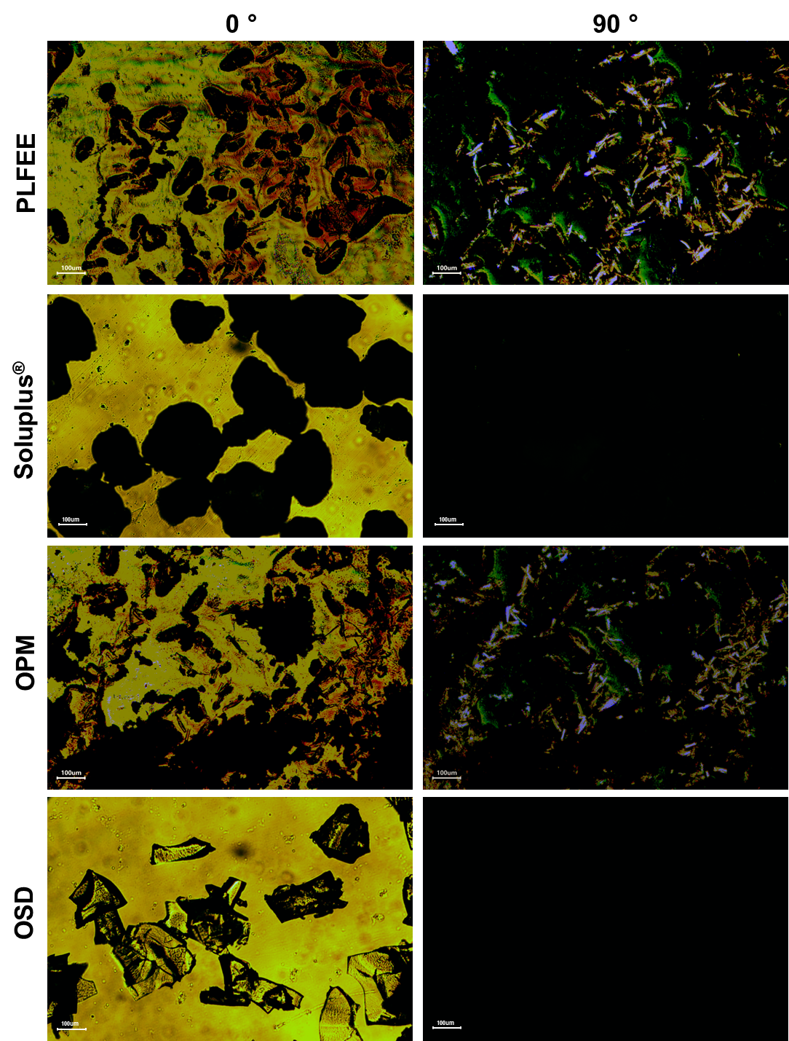
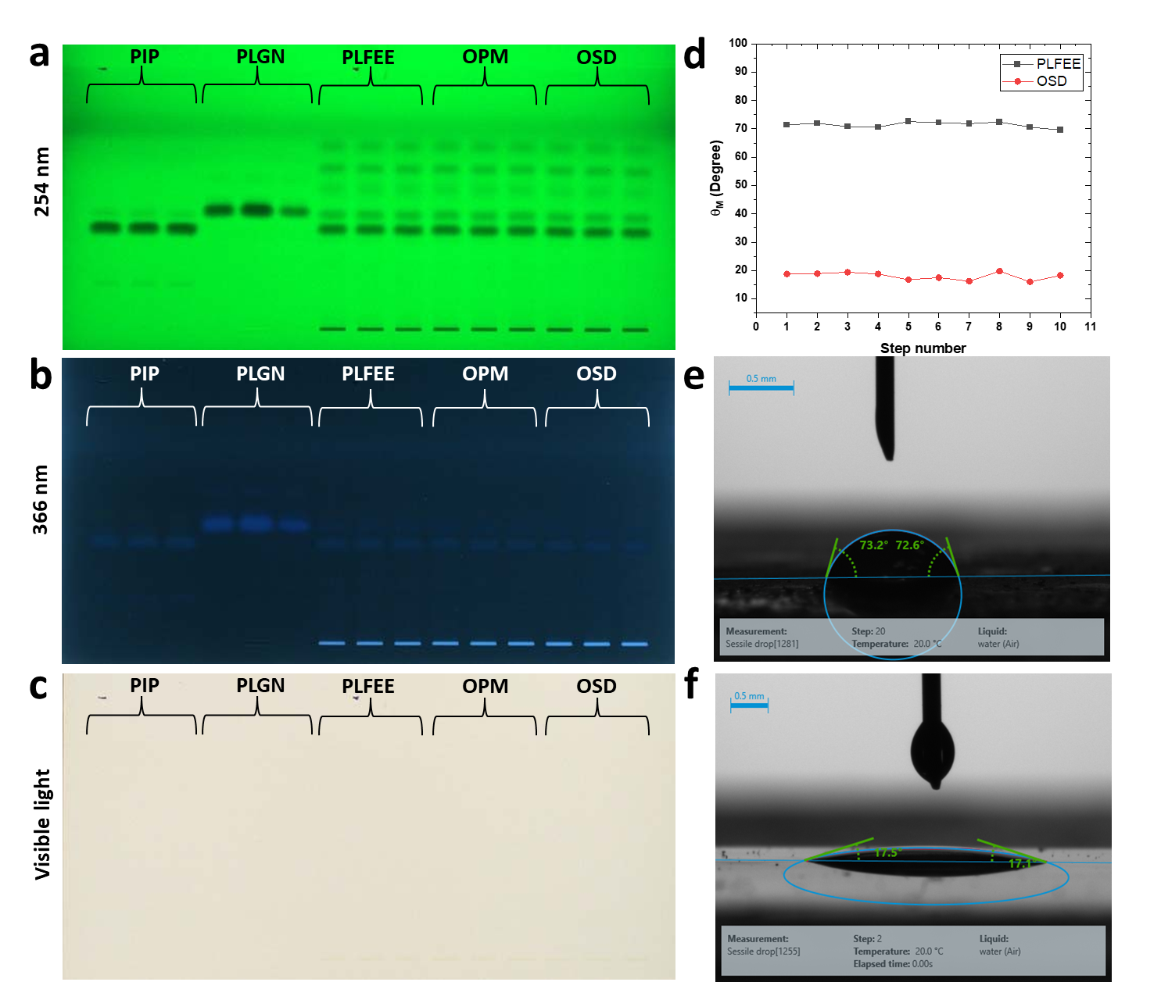
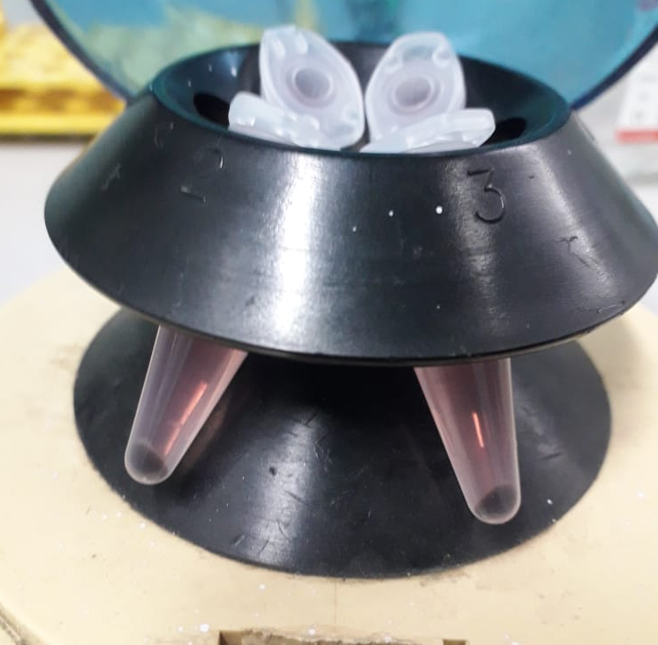
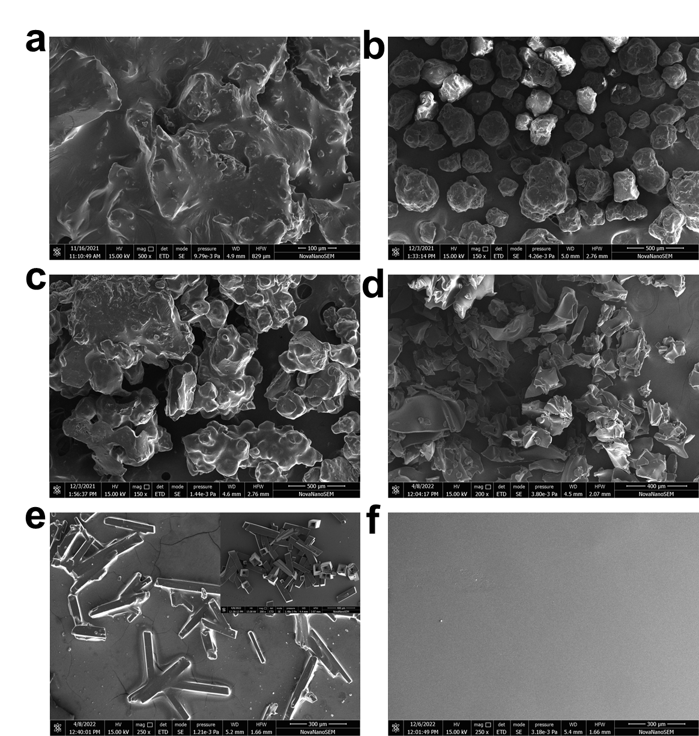
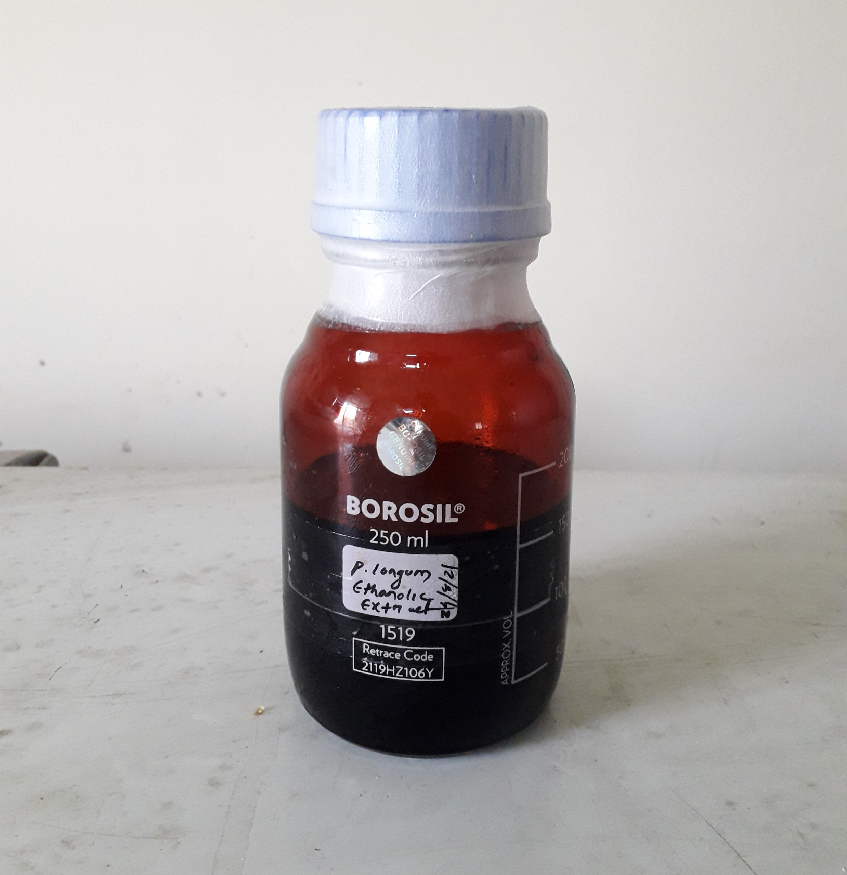
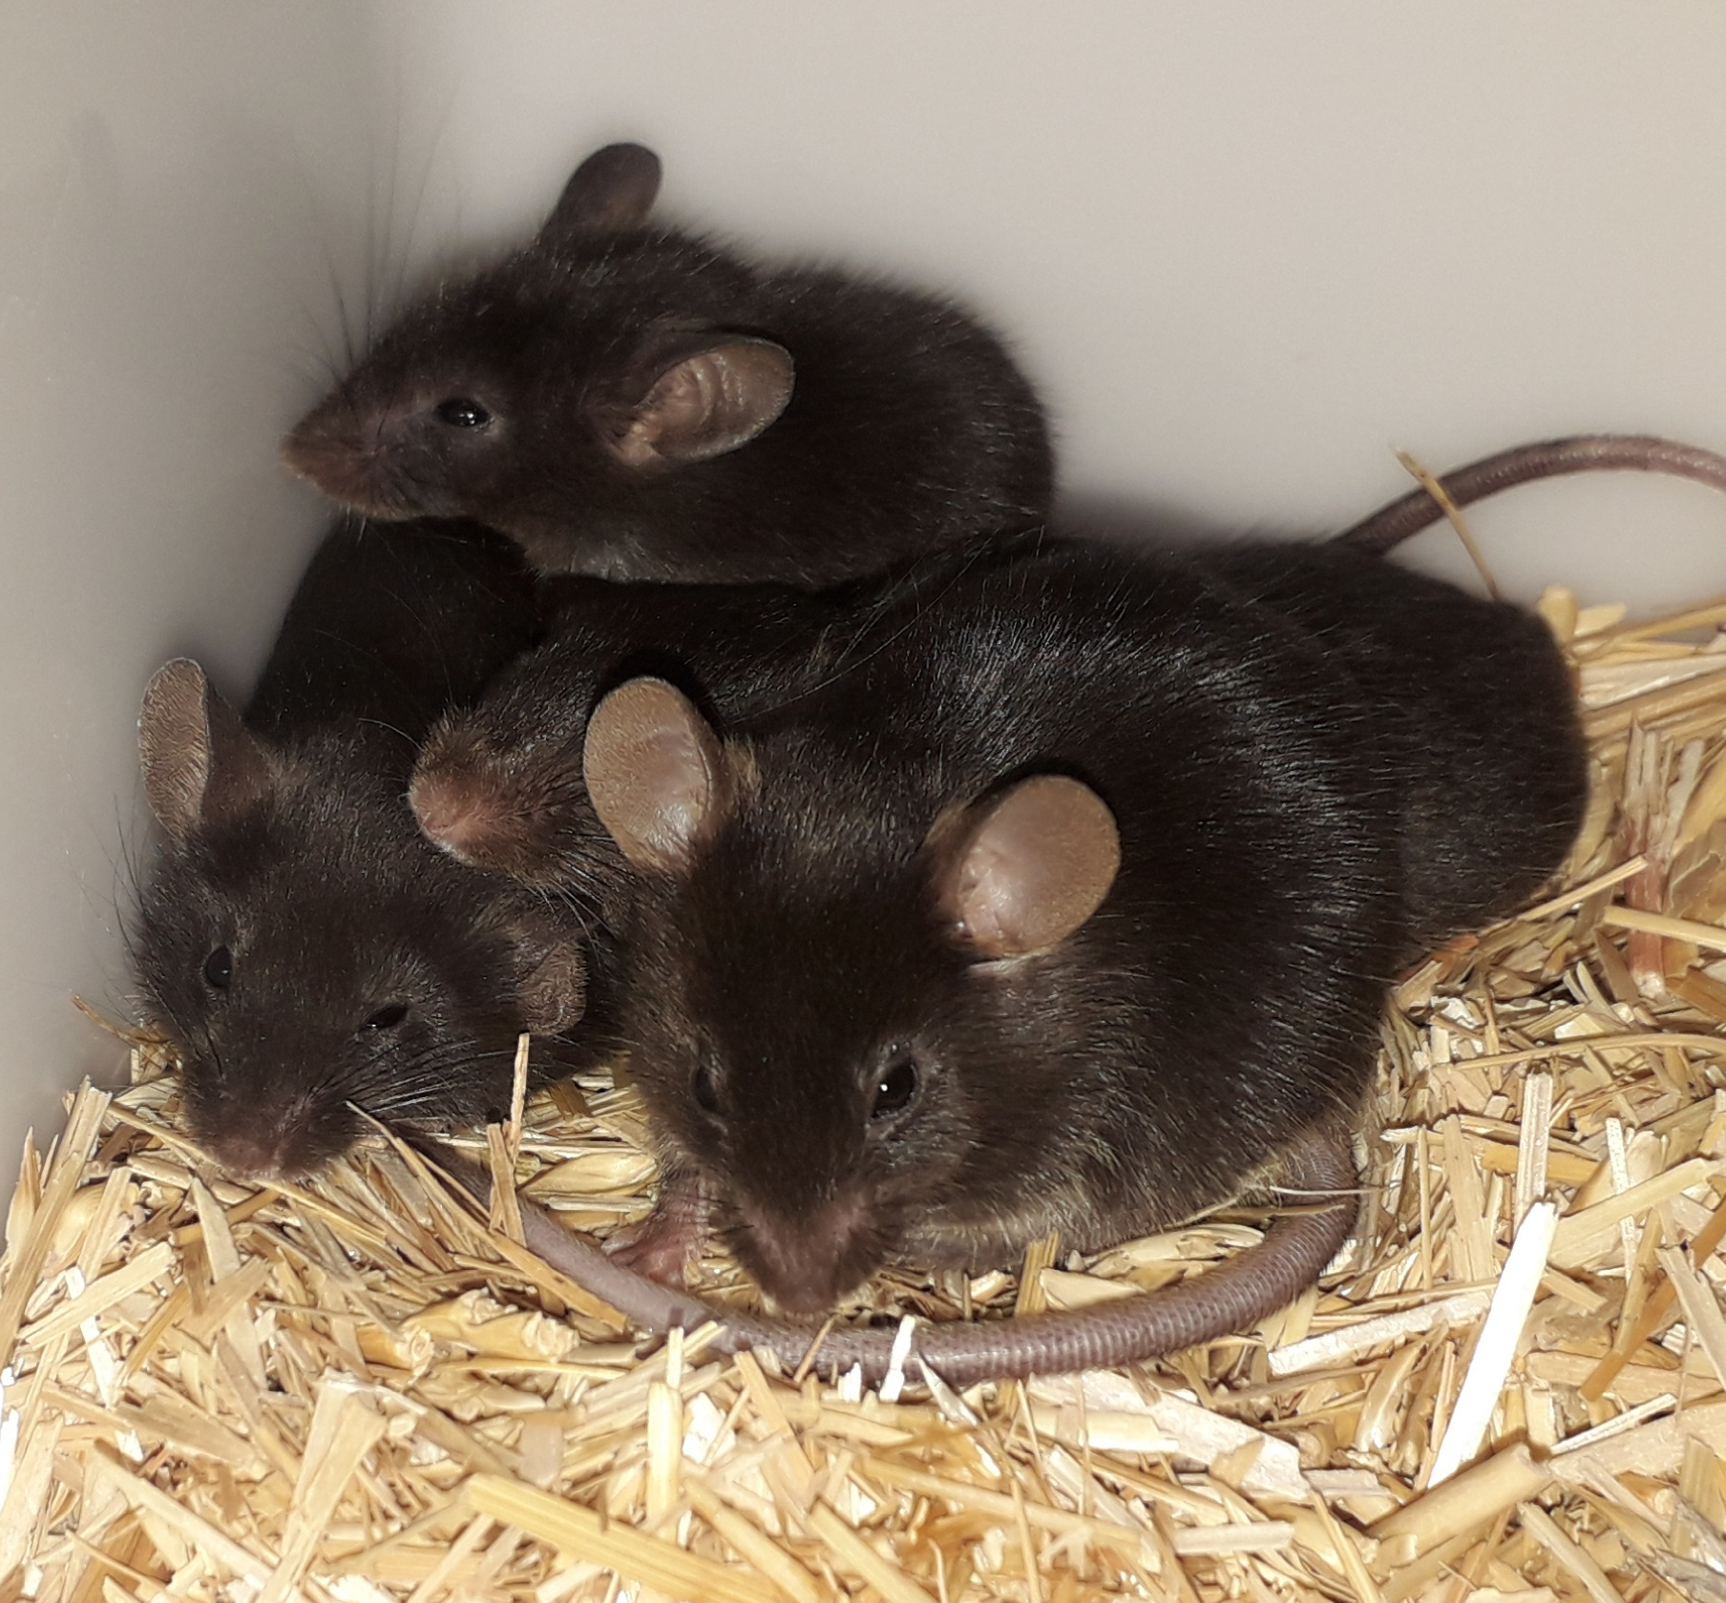
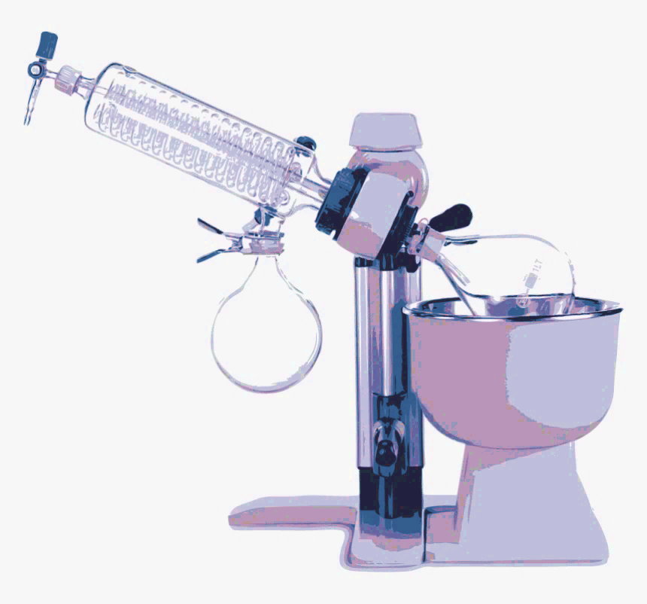
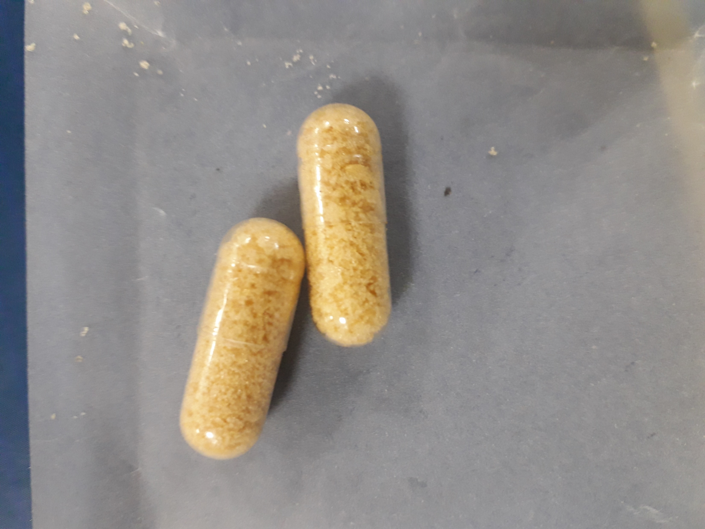
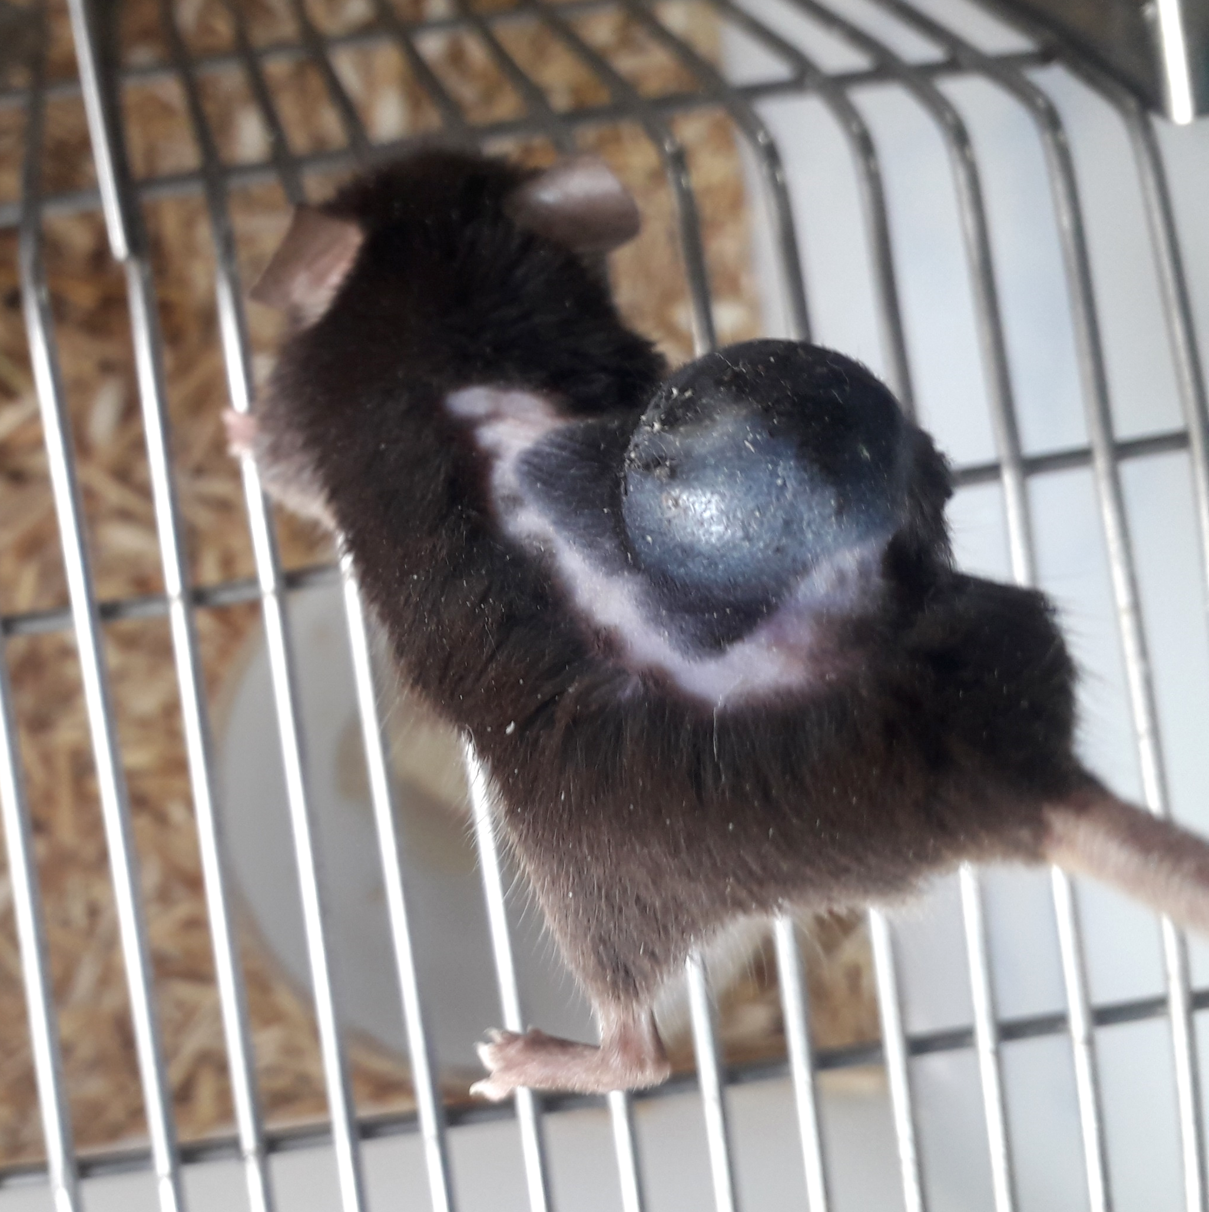
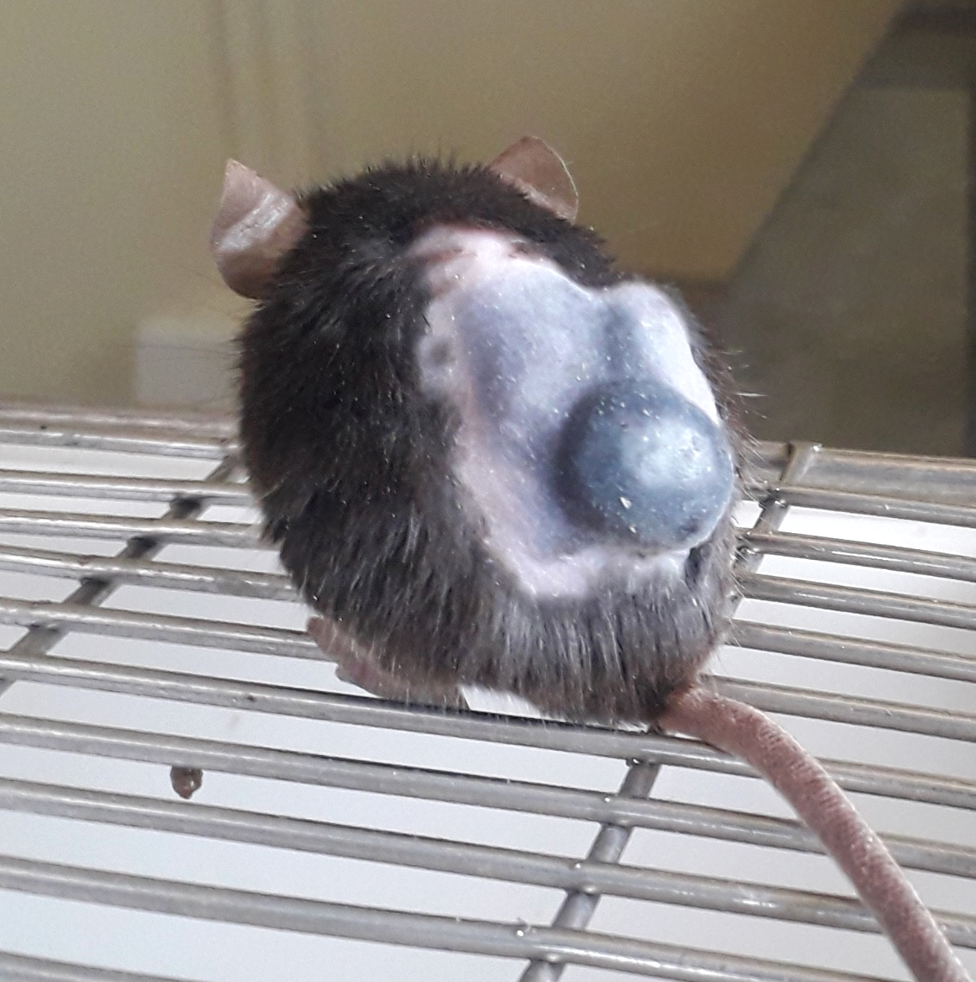
XRD
PLM
HRTEM & SAED
ATR-FTIR
HPTLC and Contact angle
DSC
Dried fruit of
Piper longum
Powder of optimized Solid Dispersion (SD)
Optimization
B16F10
TGA
HR-SEM
Improved Dissolution
Standardized
Piper longum fruits ethanolic extract (PLFEE)
C57BL/6 mice
Thin Film Hydration
Encapsulated SD
Tumor control
SD Treated
Improved oral bioavailability

