Slide 1
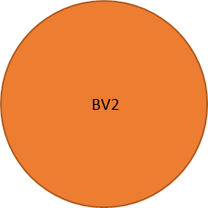
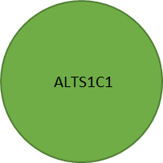
Supplement figure 1
a
Co-culture condition
(12-well plate)
Total cell seeding number
3x10⁵ 6x10⁶ 1.2x10⁶
Average cell-cell distance
21 μm
9 μm
1 μm
Low
Medium
Cell-cell proximity
High
Cell density
Low
Medium
High
Figure S1. (a) The table of different co-culture seeding conditions in a 12-well dish.

Slide 2
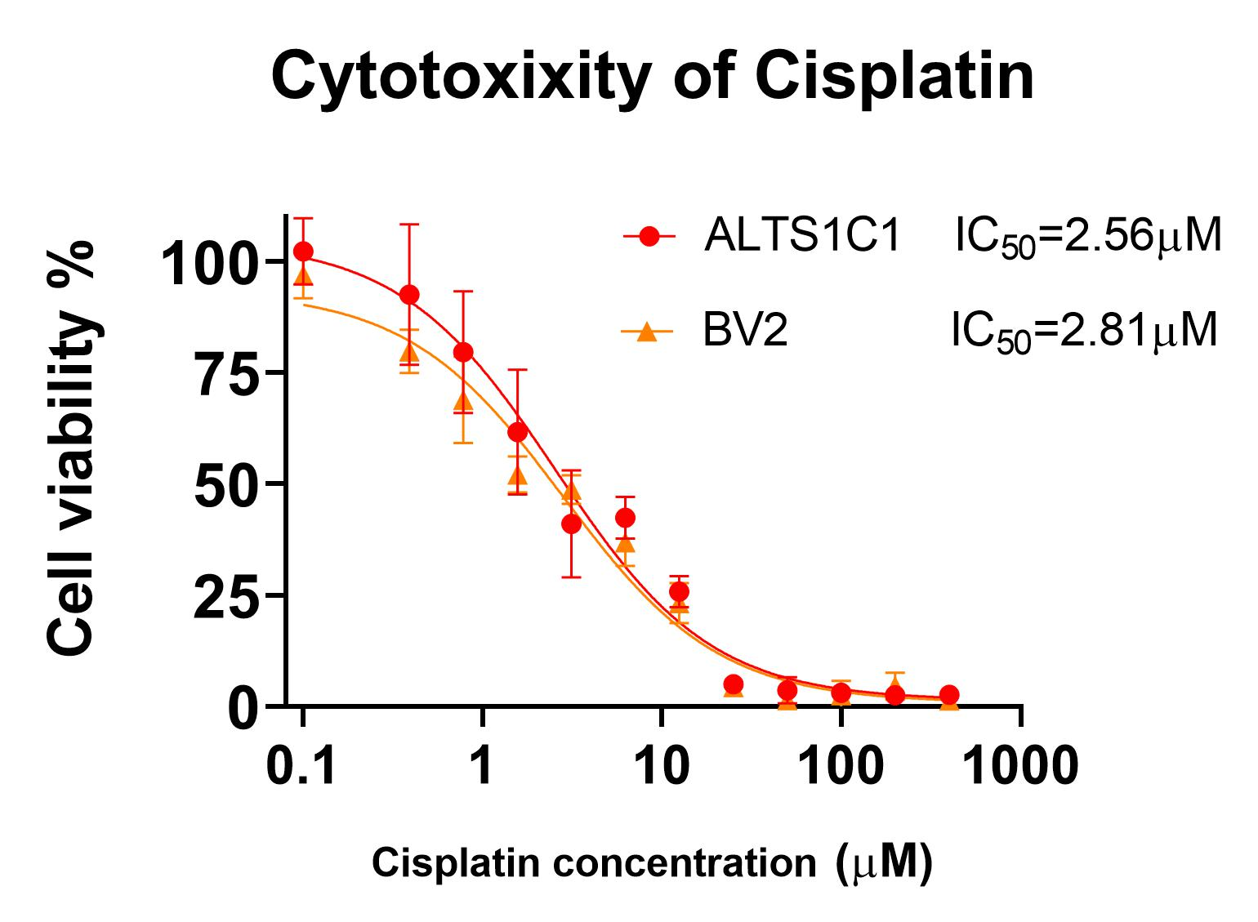
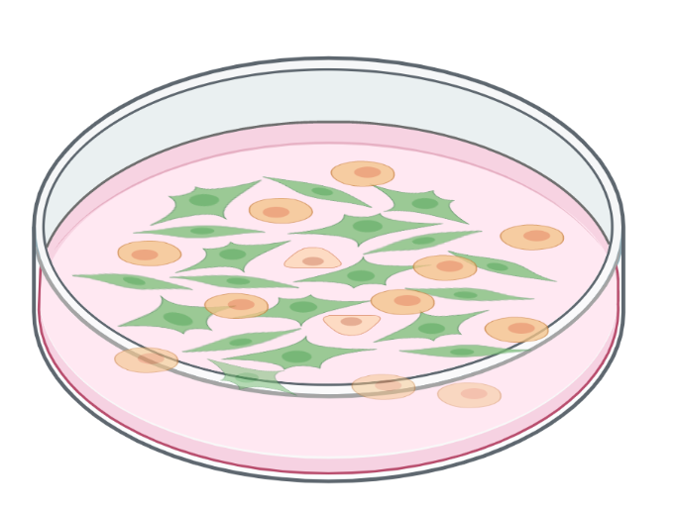
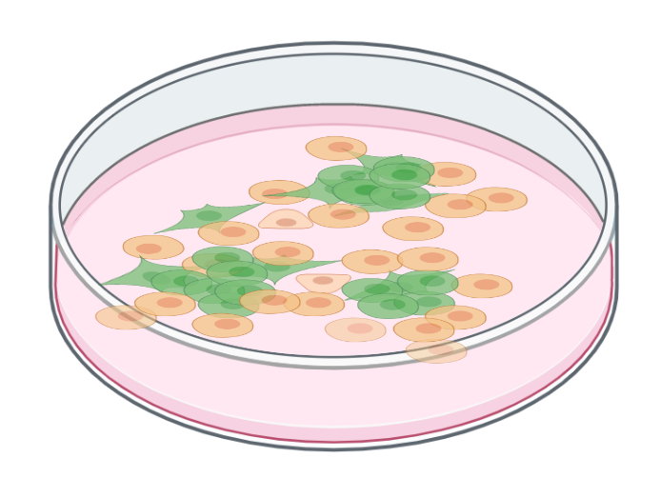
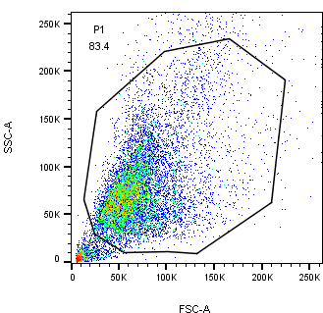
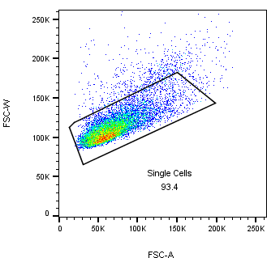
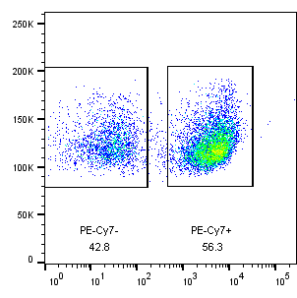
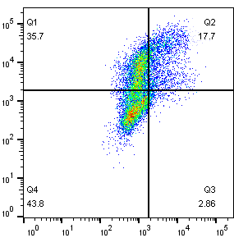
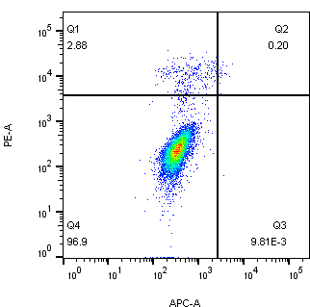
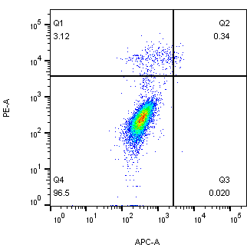
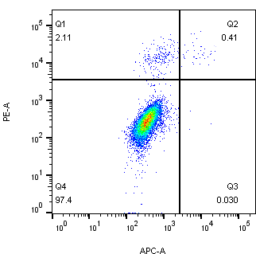
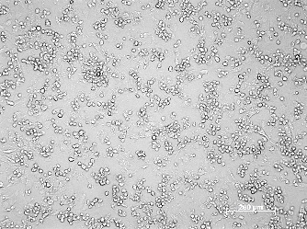
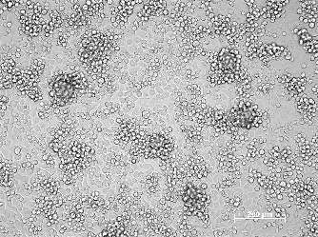
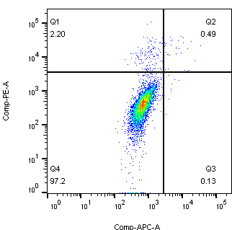
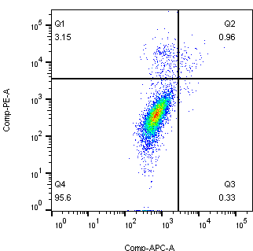
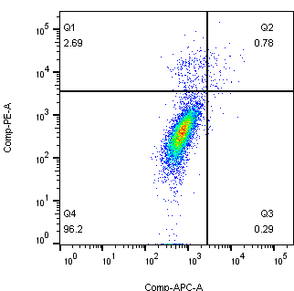
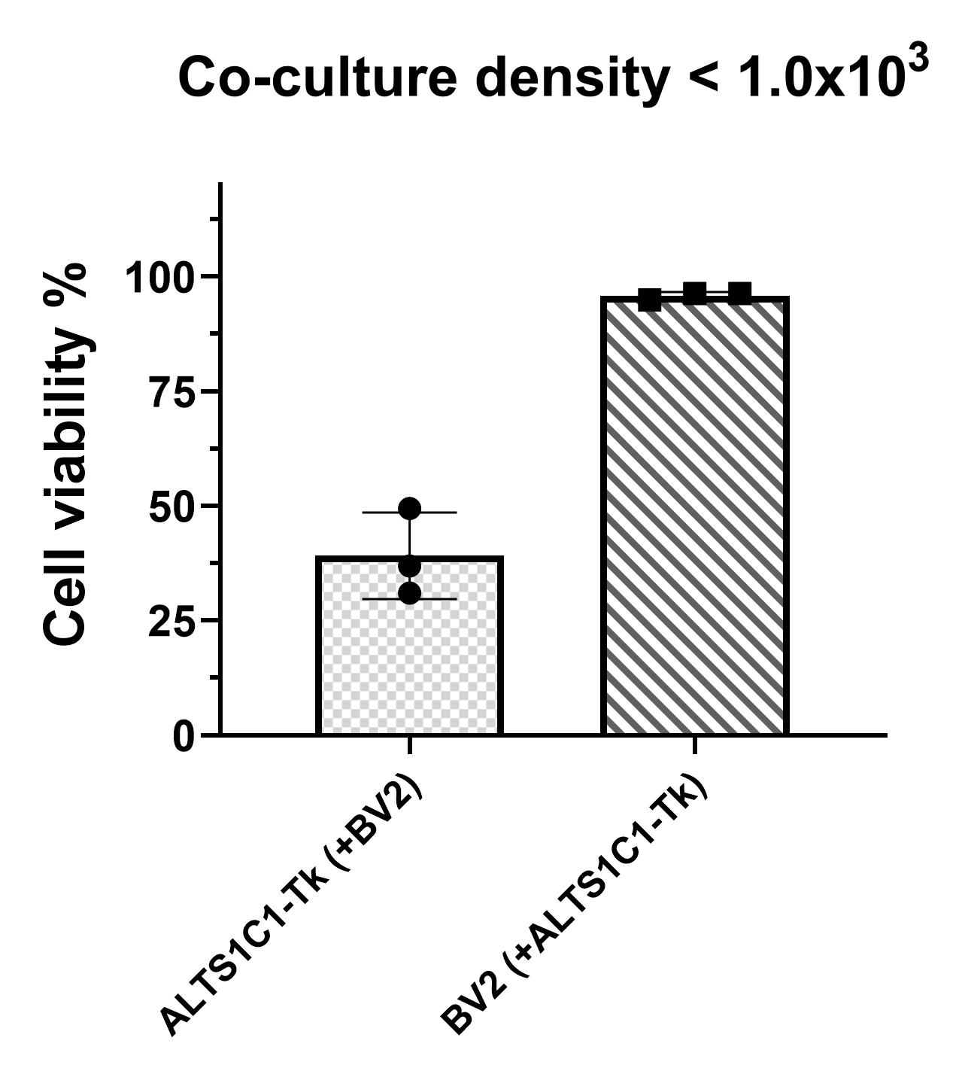
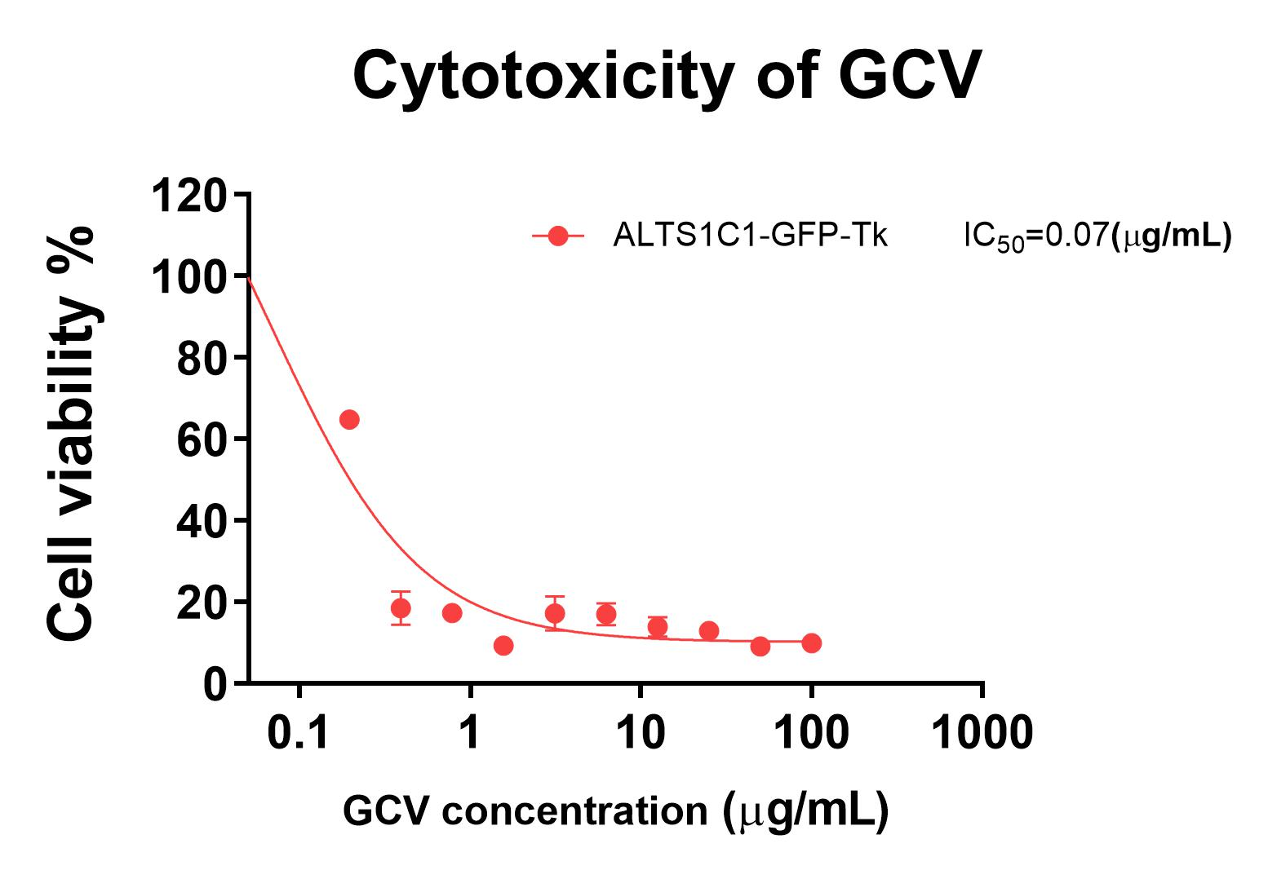
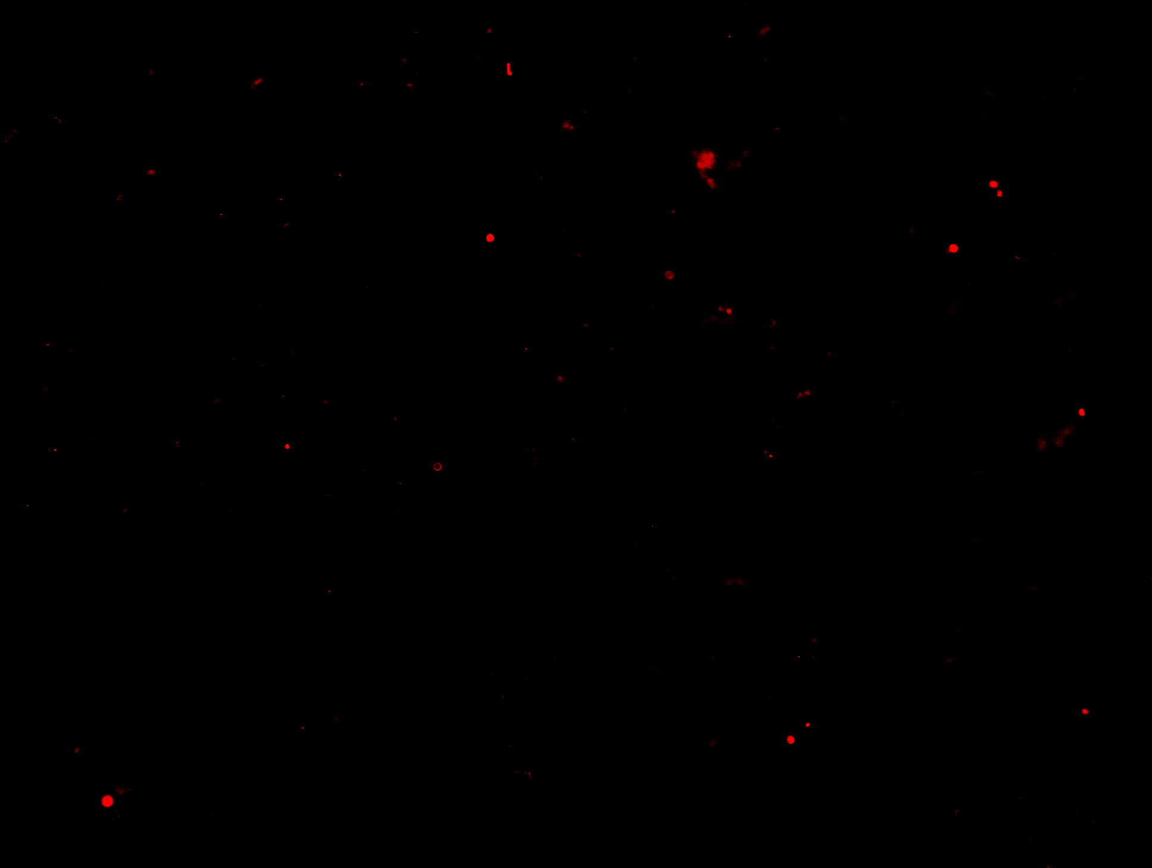
Supplement figure 2
a
b
ALTS1C1-Tk co-culture with BV2 for 24 hours
GCV treat for 24 or 36 hours
FACS analysis
FACS gating
ALTS1C1-Tk
PI
BV2
Single cells
Un-apoptosis live cells
Pe-Cy7 CD45
Annexin V
c
d
PI
0 hour
24 hour
36 hour
ALTS1C1-Tk only
ALTS1C1-Tk(+BV2)
BV2
GCV treated 36 hours
e
BV2 (+ ALTS1C1-Tk)
f
Annexin V-APC
g
BV2 only
CD11b
Caspase3+
CD11b+Caspase3+ cells

Slide 3
Figure S2. Chemo-resistance of astrocytoma after co-culturing with BV2. (a) MTT assay of Cisplatin on ALTS1C1 and BV2 cell lines. (b) Experimental scheme of chemo-apoptosis assay and the flow cytometry gating strategy. (c) Representative dot plot FACs images of the co-culture chemo-apoptosis assay of 10 μg/mL pro-drug GCV on BV2 only or ALTS1C1 co-cultured group for 0, 24, 36 hours of treatment. (d) Representative images of 36 hours of GCV treated ALTS1C1-Tk and co-cultured group, images were taken before chemo-apoptosis assay. Scale bar = 200 μm. (e) Quantification of 24 hour GCV chemo-apoptosis assay for co-culture density < 1x10³. (f) MTT assay of pro-drug GCV on ALTS1C1-GFP-Tk cell line. (g) Representative caspase-3 staining images of BV2 treated with GCV for 24 hours. Scale bar = 200 μm.

Slide 4
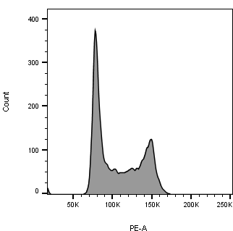
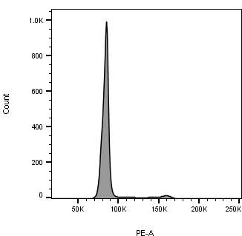

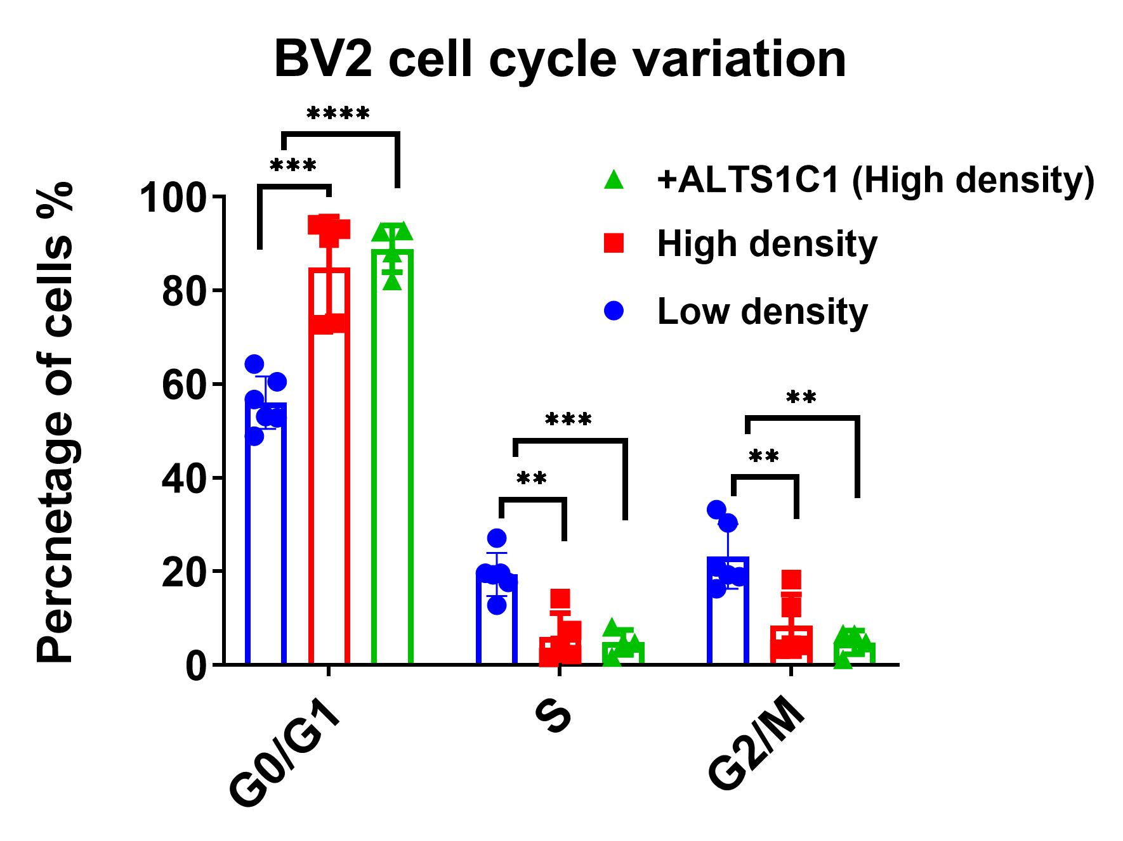
Supplement figure 3
a
Low density
High density
+ALTS1C1 (High density)
BV2
Figure S3. (a) The cell cycle analysis on BV2 of different culturing conditions (Low density, High density, and co-cultured with ALTS1C1 on high density). A two-tailed unpaired t-test was used to compare every two groups. *: P <0.05, **: P <0.01.

Slide 5
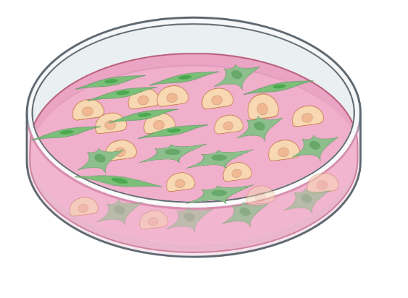
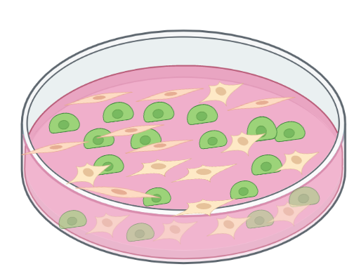

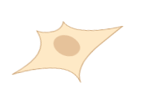
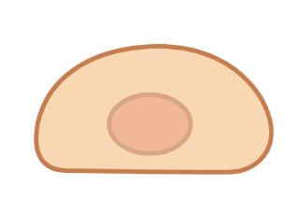

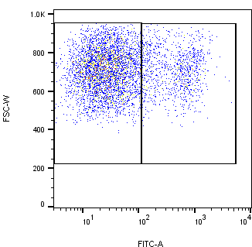
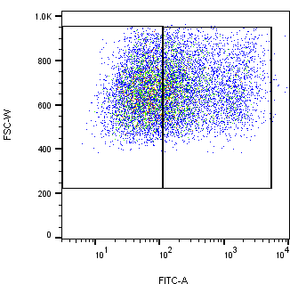
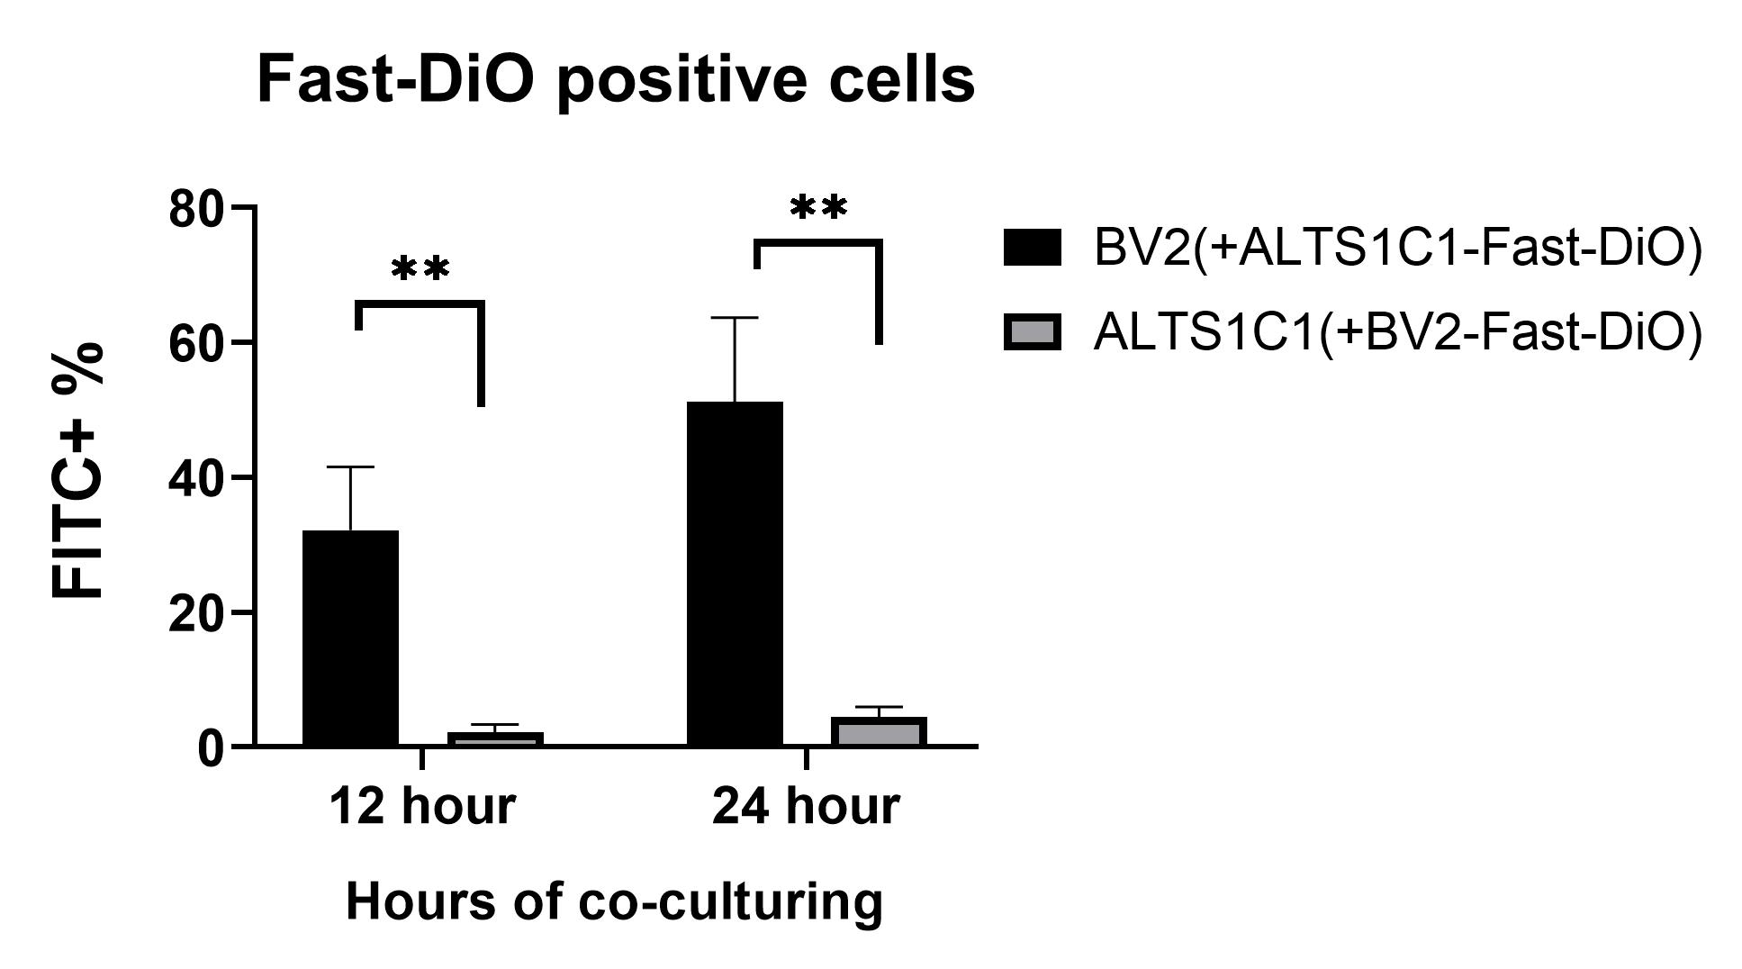
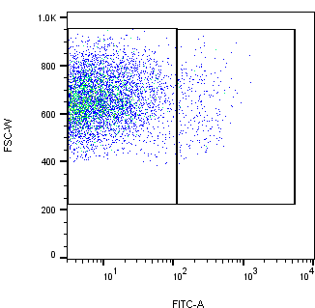
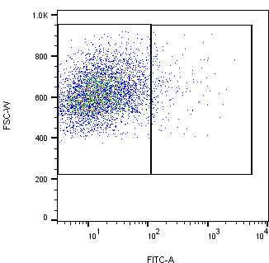
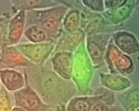
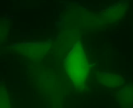

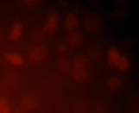
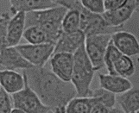
Supplement figure 4
a
Co-culture for 12, 24 hours
ALTS1C1 (Pretreat with Fast-DiO)
ALTS1C1
BV2
BV2 (Pretreat with Fast-DiO)
b
c
12 hours
24 hours
BV2(+ALTS1C1-Fast-DiO)
Fast-DiO-
Fast-DiO-
Fast-DiO+
Fast-DiO+
ALTS1C1(+BV2-Fast-DiO)
Fast-DiO-
Fast-DiO+
Fast-DiO-
Fast-DiO+
d
25 μm
BV2 cell
DOX ALTS1C1-GFP
Figure S4. BV2 hijack drugs from ALTS1C1 through direct contact. (a) Experimental scheme on Fast-DiO transfer test between the ALTS1C1 and BV2 cells. (b) Representative flow images of FITC-positive cell percentages indicating Fast-DiO-positive cells. (c) The quantification of Fast-DiO-positive cells after co-culturing for 12, and 24 hours. (d) The time-lapse video, Video link: https://www.youtube.com/watch?v=J9v2FsAB_bY. A two-tailed unpaired t-test was used to compare every two groups. **: P <0.01.

