Slide 1
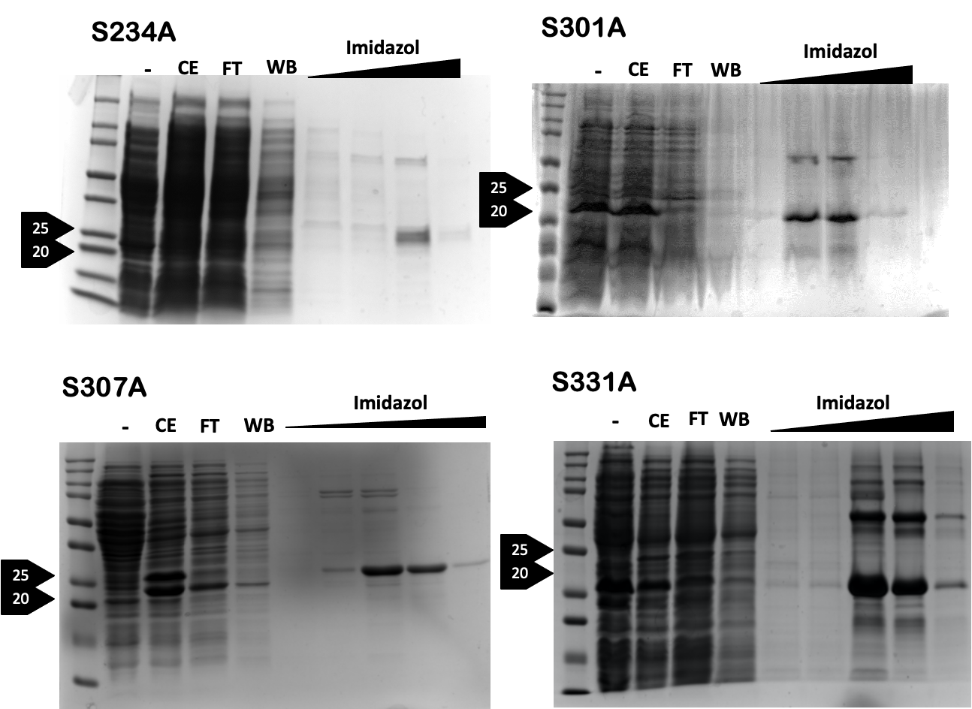
Supplementary Figure 1. In vitro kinase assay in FOXA1 mutants and Luciferase signal. A FOXA1 mutant protein vectors were expressed and purified from soluble fraction of BL21 E. coli. The mutants created: serine 234 mutated into arginine 234 (S234A), serine 301 mutated arginine 301 (S301A), serine 307 mutated arginine 307 (S307A) and serine 331 mutated arginine 331 (S331A). B We perfomed in vitro kinase assay as indicated at Figure 4b with FOXA1_FKH or FOXA1_mutants in presence of CDK4/Cyclin D1, CDK2/Cyclin E2 and CDK1/Cyclin B1. As a control we included CDK complex alone. N=3 independent biological replicates; data represent mean ± SD.
FOXA1 WT is phosphorylated by CDK4/cyclin D1 and CDK2/Cyclin but the phosphorylation is reduced with S234A, S307A and S331A mutants with these kinases. The phosphorylation of FOXA1 mutant S301A seems not to be reduced, indicating that CDK4 and CDK2 phosphorylate serine 234, 307 and 331. Moreover, the complex CDK1/Cyclin B1 phosphorylates FOXA1 WT but the phosphorylation is reduced with S307A and S331A mutants. The phosphorylation of FOXA1 mutants S234A and S301A seems not to be reduced, indicating that CDK1/Cyclin B1 phosphorylate ser 307 and 331.
A
B

Slide 2
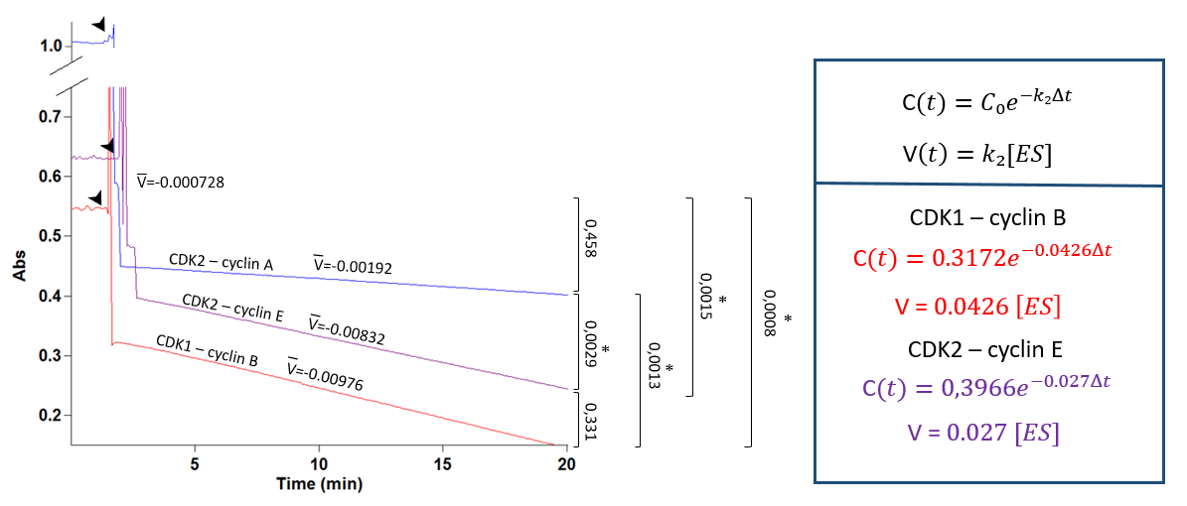
Supplementary figure 2. A Enrique de la Cruz and Michael Ostap kinase assay based on ADP formation monitored through time. Reactions were run at 30°C for 20 minutes for different CDK/cyclin complexes (blue: CDK2/cyclinA, purple: CDK2/cyclin E, red: CDK1/cyclin B). Arrows indicates when substrates were added. V shows the slope of the line, meaning average velocity. Slope were calculated as increment of signal divided by increment of time. Results are means ± S.E.M. for 2 independent experiments. P-value of two-two comparisons is shown on the right. (*) indicates significant values. Equations for reactive concentration and reaction velocity are shown. C: concentration of reactive, C₀: concentration at t=0, V: slope or average velocity, V velocity depending on reactive concentration, Δt: increment of time, k₂: constant of reaction ES→P+E, [ES]: concentration of enzyme-substrate complex.
A

Slide 3
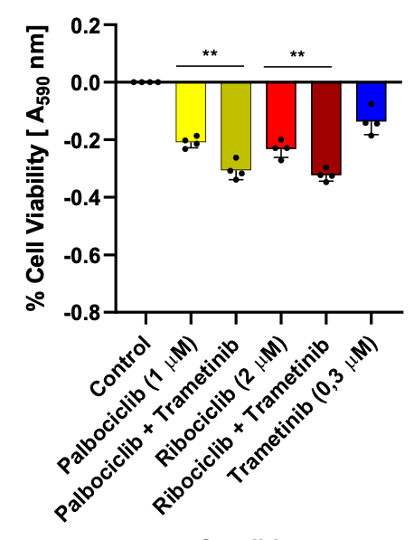
Supplementary figure 3. A Western Blot against total-RB and phosphorylated-RB levels in MCF7 and BT474 cell line after being cultured in full media with or without the treatment of 5μM of Palbociclib for 24h. The target phosphorylation site is Ser780, which is the site phosphorylated by CDK4-CyclinD1. Protein levels were quantified and 10μg were loaded in each well. β-Actin is blotted as a loading control. FOXA1 and ERα levels are also shown. B Heatmap in MCF7 cells differences in gene expressions for regions which are unique in control treatment, shared between both treatments or unique for Palbociclib treatment. When cells are treated with Palbociclib, some regions where FOXA1 is binding are lost (showed with a decrease of the intensity on unique control region) and different regions are gained (showed with an increase of the intensity in unique Palbociclib region). C Motif analysis of FOXA1 binding sites in MCF7 cells. In control FOXA1 binding and Palbociclib-induced regions AP-1 and AP-2-γ motives where found. D BT474 cells were untreated (Control), treated with CDK4 inhibitors Palbociclib or Ribociclib alone or in combination with MEK inhibitor Trametinib. Total cell growth was assessed. The data are the mean of independent replicates ± s.d. D MCF7 cells were untreated (Control), treated with CDK4 inhibitors Palbociclib or Ribociclib alone or in combination with MEK inhibitor Trametinib. Total cell growth was assessed. The data are the mean of independent replicates ± s.d.
A
D
E
B
C

