Slide 1
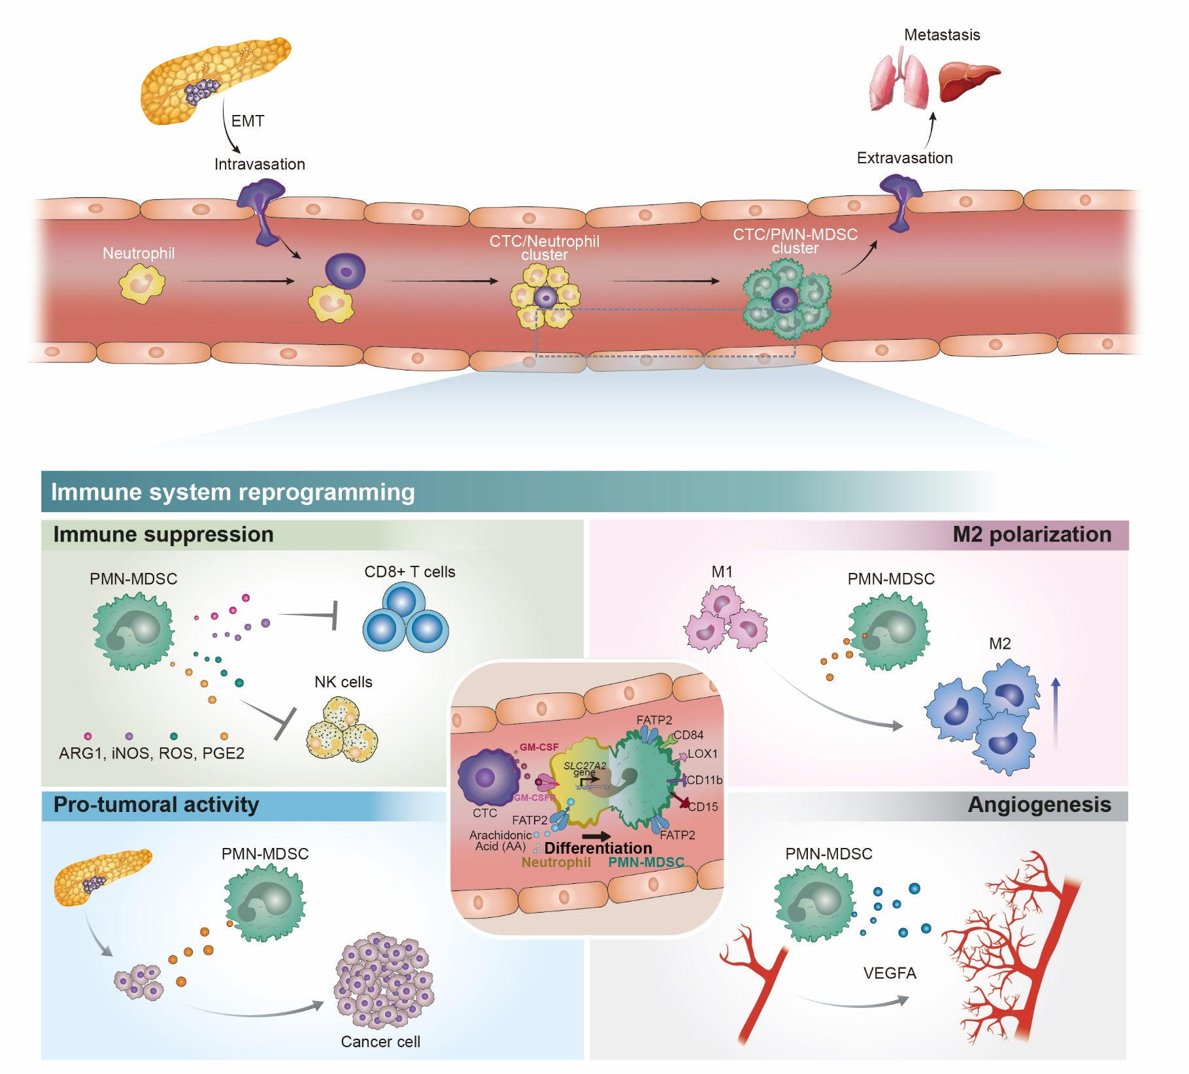
Supplementary figure 1. Suggested mechanism for immune system reprogramming in early phase of pancreatic cancer.
A
B

Slide 2
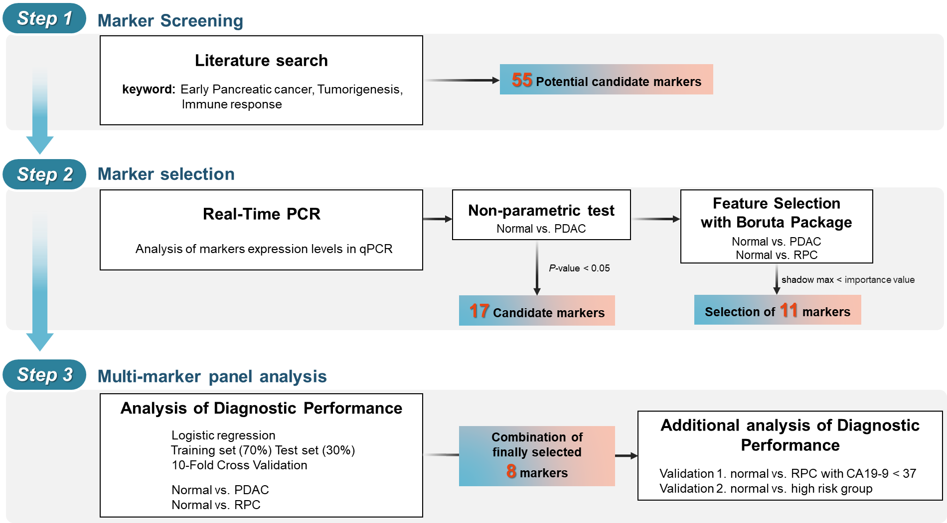
Supplementary figure 2. Summary of marker numbers in each step of the study scheme
A
B
C

