Slide 1
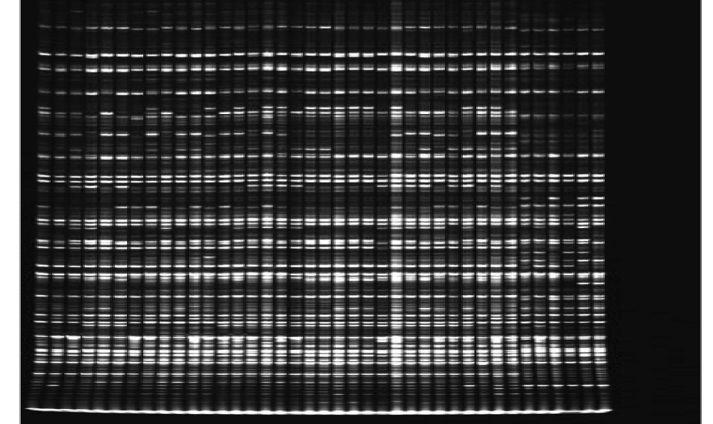
Figure S1: An original AFLP gel profile from LICOR 4300 of date palm using primer combination E-ACTxM-CG

