Slide 1
Figure. S1 The full-length gel of uncropped figure of Fig. 1B.

Slide 2
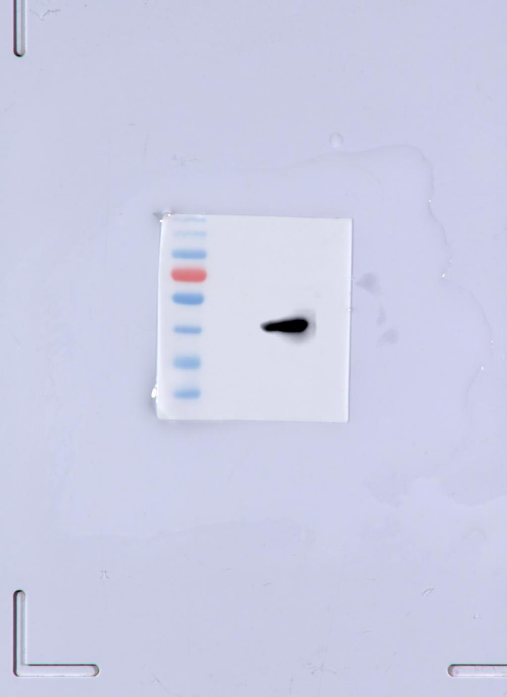
Figure. S2 The full-length blots of uncropped figure of Fig. 1C.

Slide 3
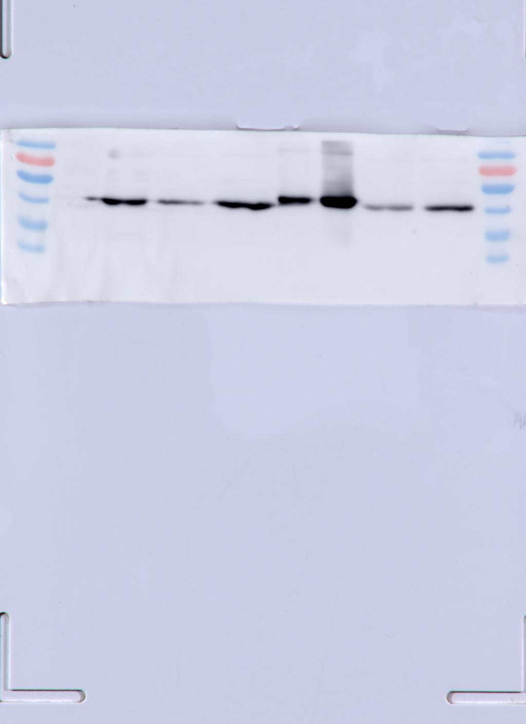
Figure. S3 The full-length blots of uncropped figure of Fig. 2B. The three bands from right to left, excluding pre-stained protein marker, are irrelevant to this article.

