Slide 1
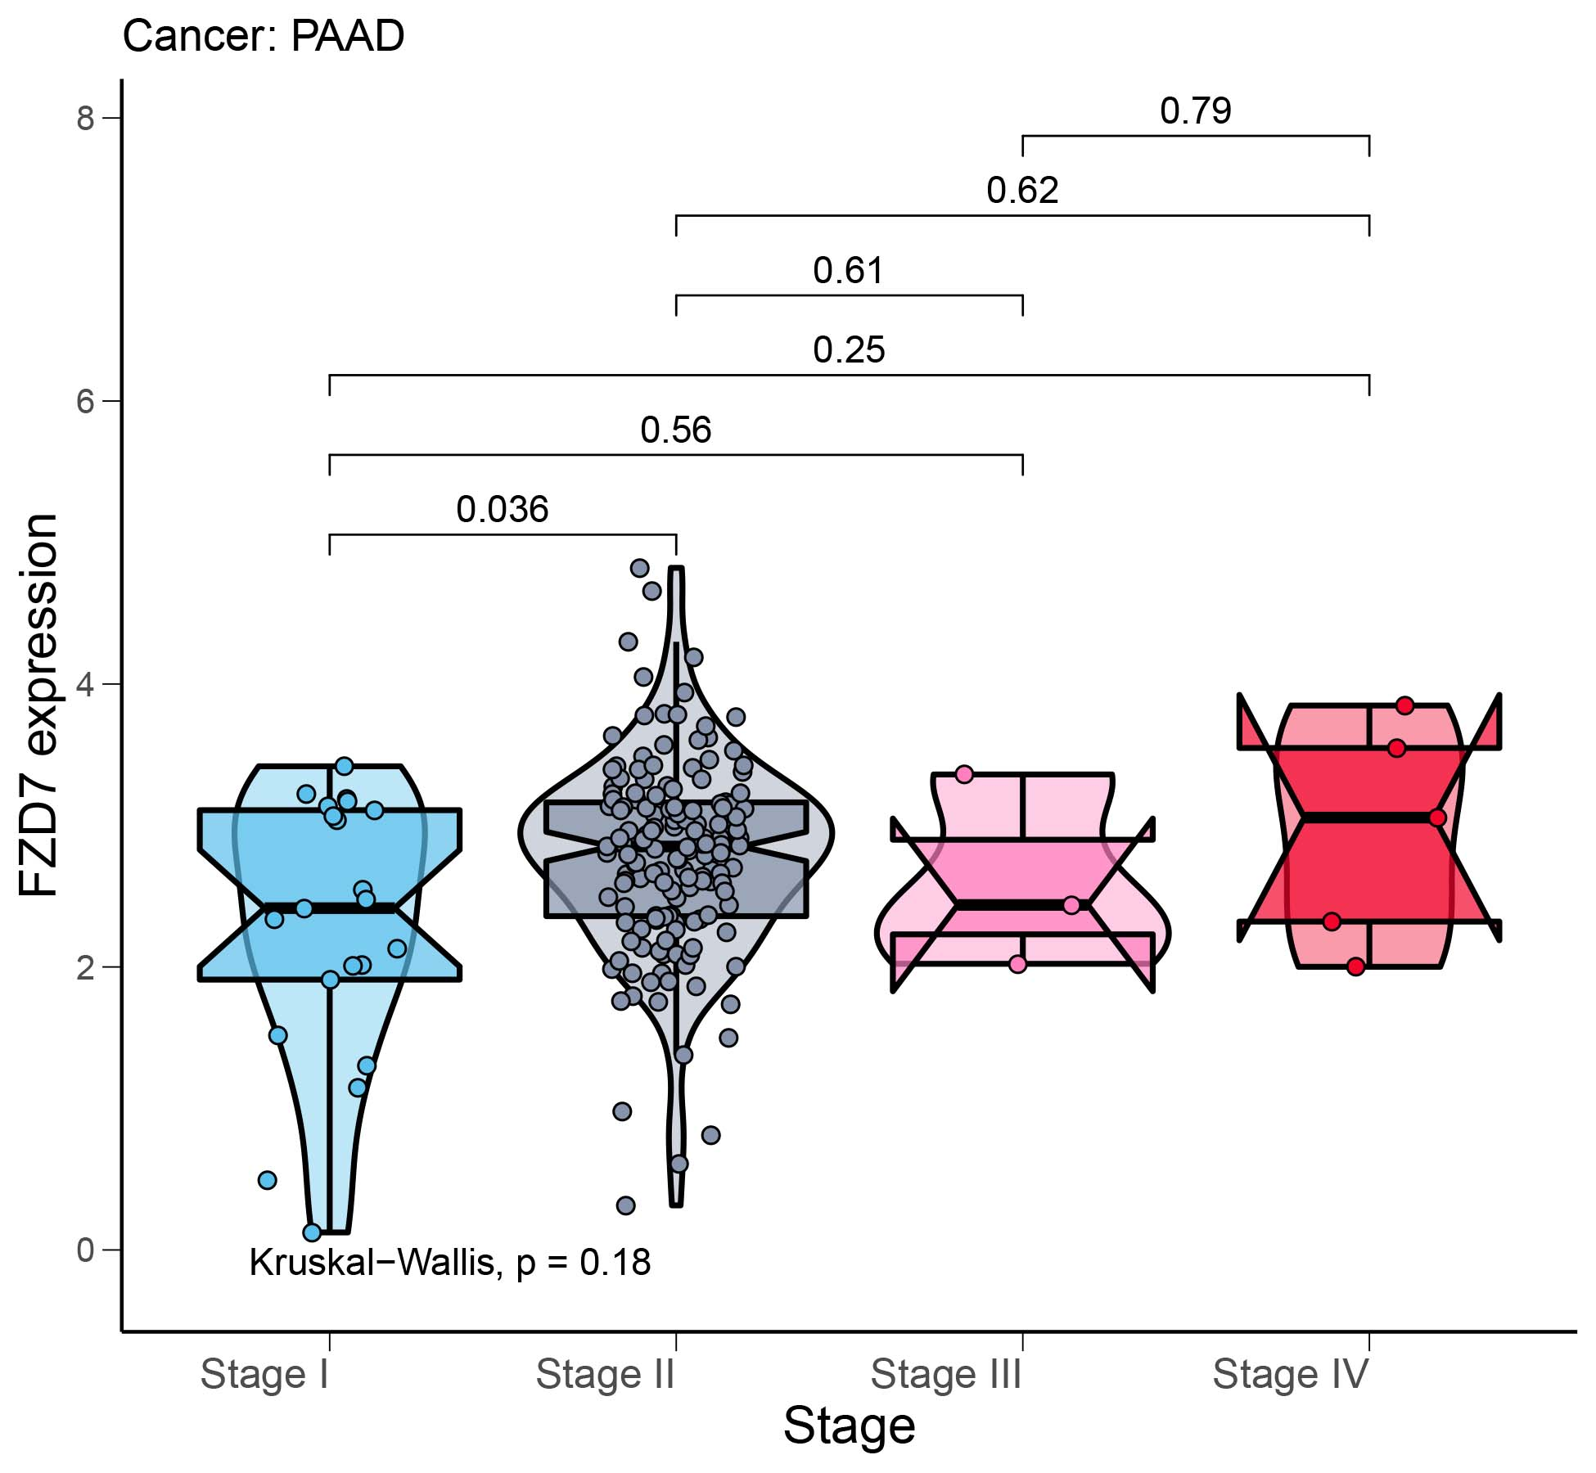
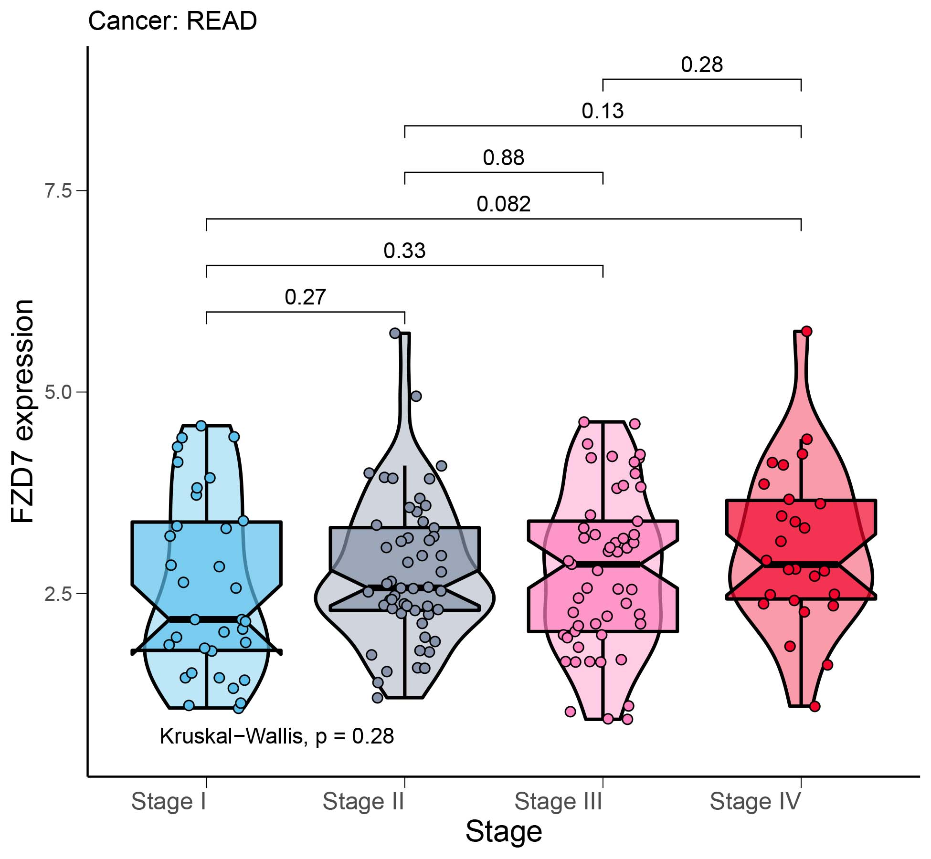
Figure S1
A
B
FZD7 expression
PAAD
FZD7 expression
READ
8.0
Kruskal−Wallis, P = 0.18
Kruskal−Wallis, P = 0.28
6.0
7.5
4.0
5.0
2.0
2.5
0.0
Stage I
0.0
Stage I
Stage II
Stage III
Stage II
Stage IV
Stage III
Stage IV

Slide 2
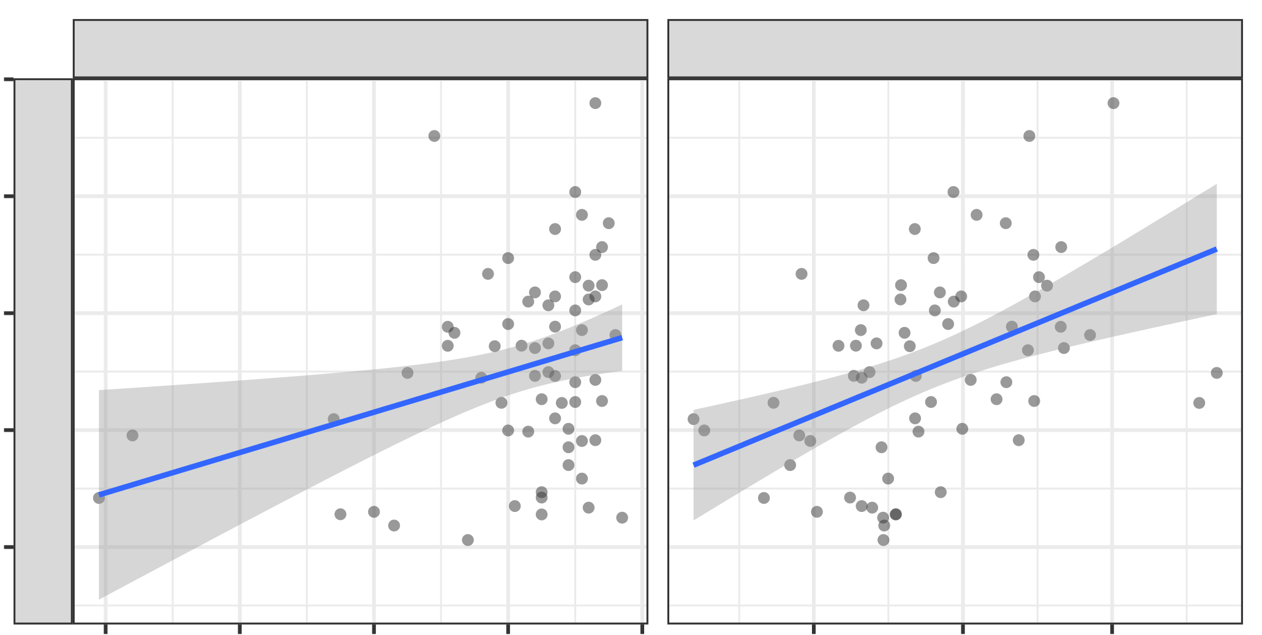
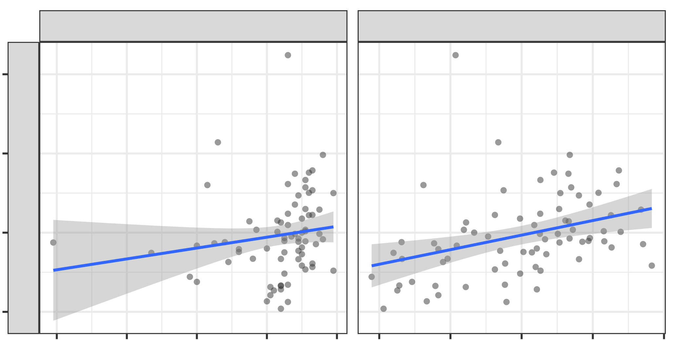
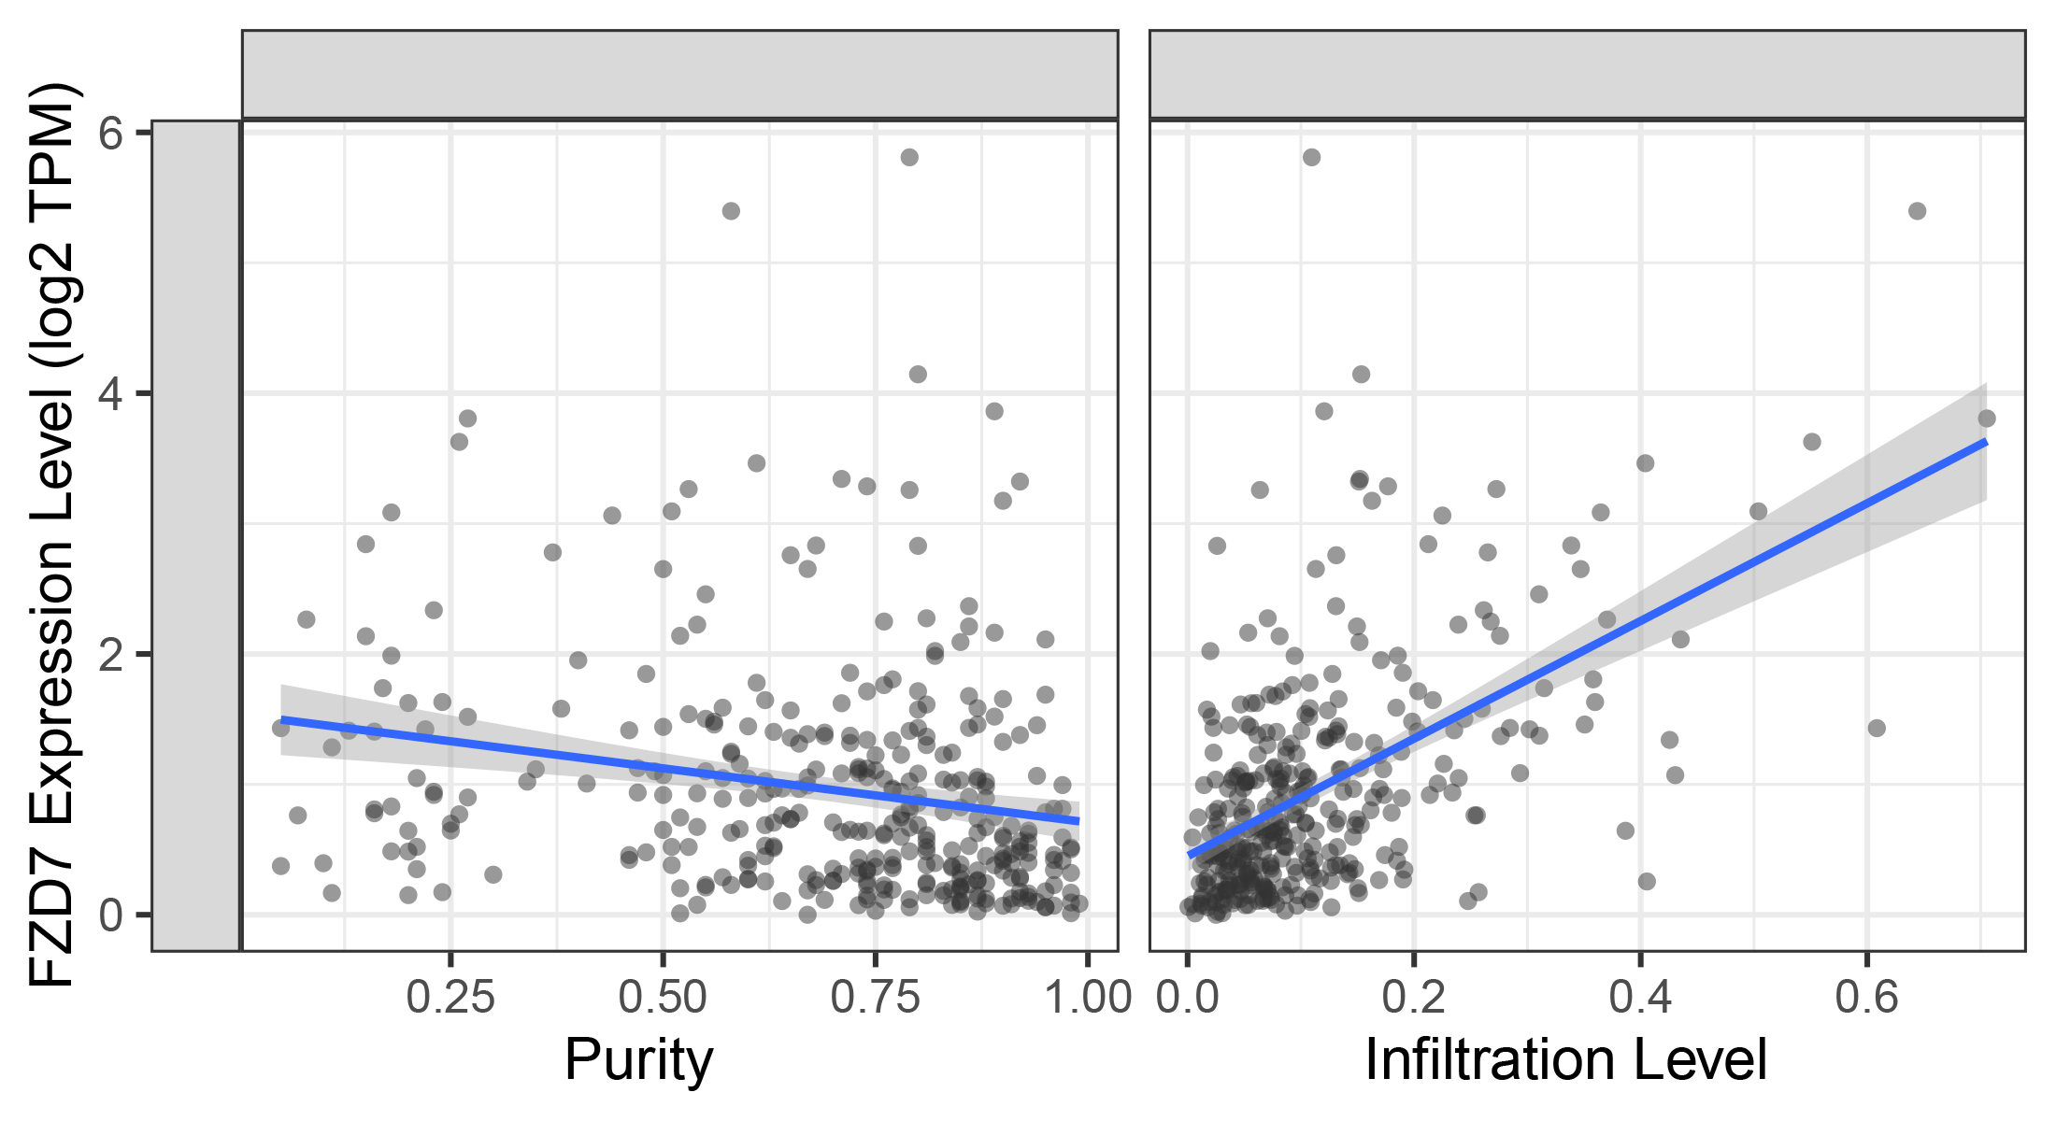
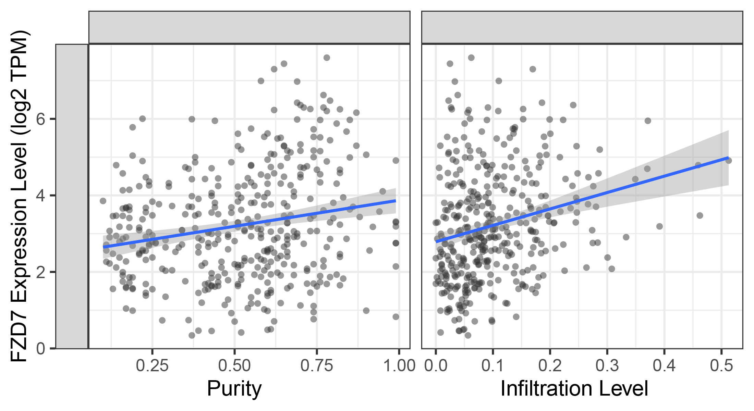
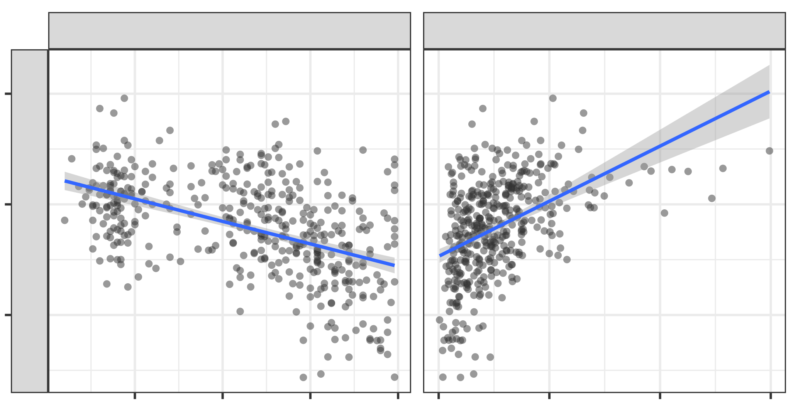
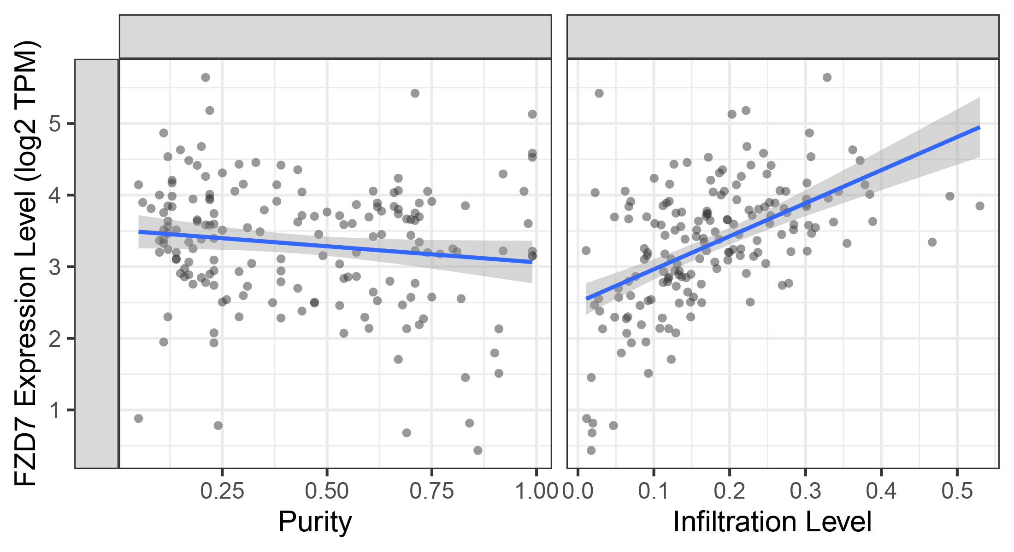
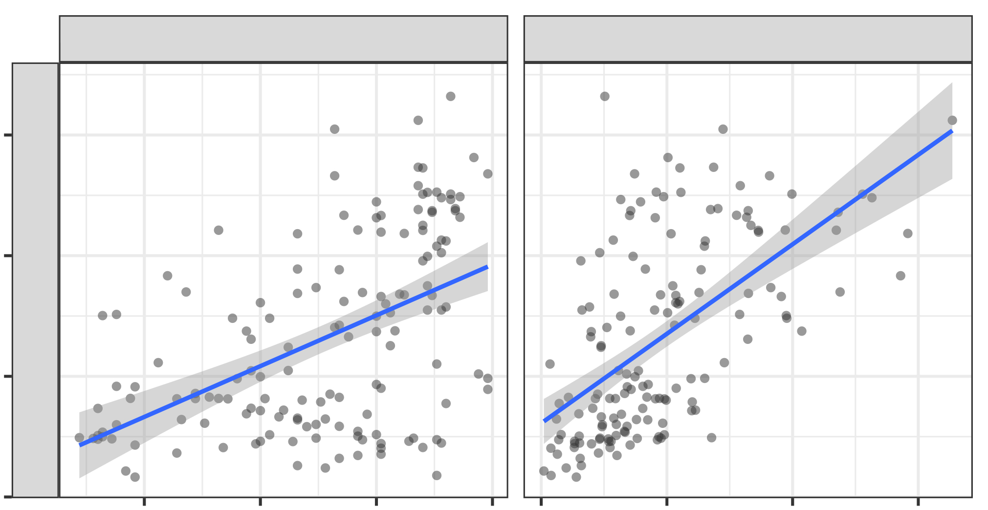
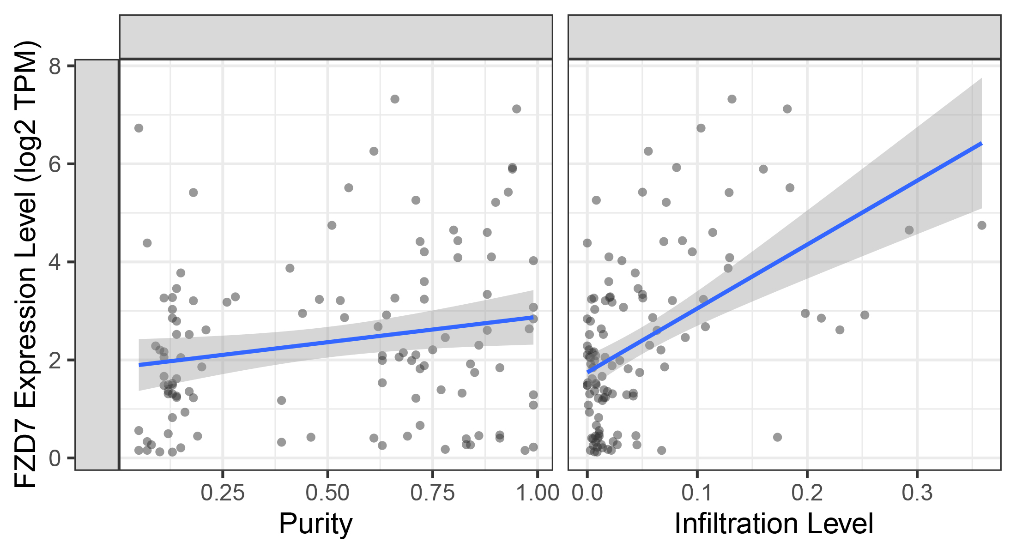
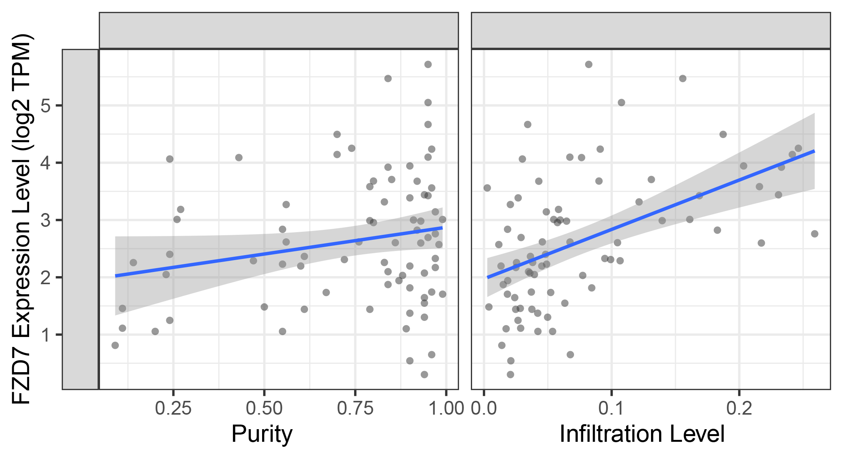
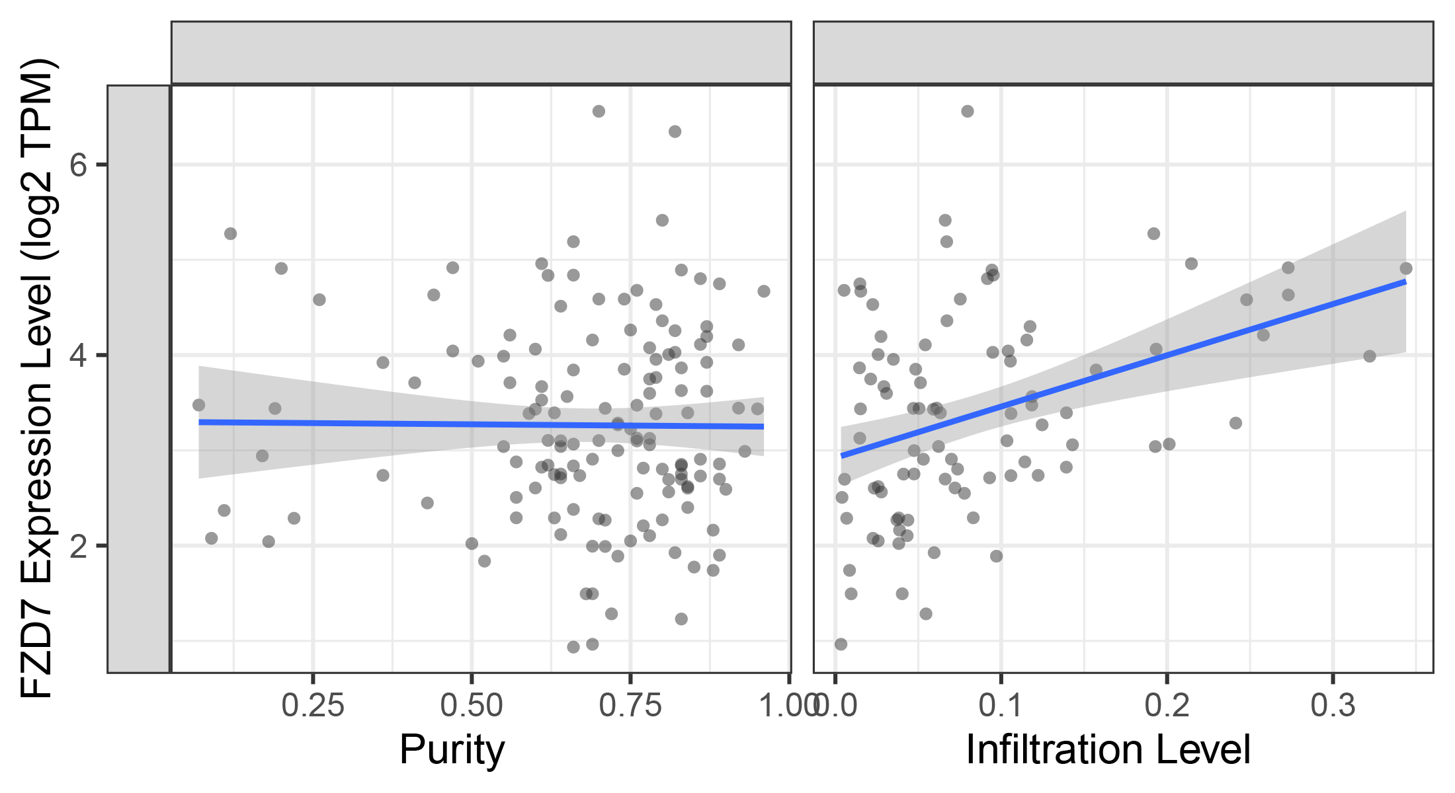
FZD7 expression level (log2 TPM)
FZD7 expression level (log2 TPM)
FZD7 expression level (log2 TPM)
FZD7 expression level (log2 TPM)
A
Figure S2
6
LIHC
Purity
MDSC_TIDE
ACC
Purity
MDSC_TIDE
Rho = 0.41
p = 6.95e−04
Rho = 0.33
p = 4.32e−03
Rho = 0.271
p = 2.76e−02
Rho = 0.351
p = 2.17e−03
6
4
4
FZD7 expression level (log2 TPM)
2
FZD7 expression level (log2 TPM)
2
0
0.2 0.4 0.6 0.8 1.0-0.2 -0.1 0 0.1 0.2
0
0.2 0.4 0.6 0.8 1.0 -0.2 -0.1 0 0.1 0.2
B
Purity
Infiltration Level
Purity
Infiltration Level
HNSC-HPV-
Purity
TAM_CIBERSORT−ABS
6
LIHC
Purity
TAM_CIBERSORT−ABS
Rho = 0.199
p = 5.81e−05
Rho = 0.41
p = 1.97e−15
Rho = 0.354
p = 2.93e−13
Rho = −0.293
p = 2.70e−08
4
6
2
4
FZD7 expression level (log2 TPM)
2
FZD7 expression level (log2 TPM)
0
0
0.25 0.50 0.75 1.00 0.0 0.1 0.2 0.3 0.4 0.5
0.25 0.50 0.75 1.00 0.0 0.2 0.4 0.6
Purity
Infiltration Level
PAAD
Purity
Infiltration Level
PRAD
Purity
TAM_CIBERSORT−ABS
Purity
TAM_CIBERSORT−ABS
Rho = −0.501
p = 7.91e−28
Rho = 0.383
p = 5.59e−16
Rho = −0.133
p = 8.17e−02
6
5
Rho = 0.533
p = 6.13e−14
4
4
3
2
FZD7 expression level (log2 TPM)
2
FZD7 expression level (log2 TPM)
1
0.25 0.50 0.75 1.00 0.0 0.1 0.2 0.3
0.25 0.50 0.75 1.00 0.0 0.1 0.2 0.3 0.4 0.5
Purity
Infiltration Level
THYM
Purity
Infiltration Level
Purity
TAM_CIBERSORT−ABS
Purity
TAM_CIBERSORT−ABS
TGCT
8
Rho = 0.49
p = 2.50e−10
Rho = 0.699
p = 7.86e−23
Rho = 0.433
p = 1.31e−06
7.5
6
Rho = 0.184
p = 4.80e−02
5.0
4
2.5
2
0
0.25 0.50 0.75 1.00 0.0 0.1 0.2 0.3
0
0.25 0.50 0.75 1.00 0.0 0.1 0.2 0.3
Purity
Infiltration Level
Purity
Infiltration Level
Purity
READ
Purity
TAM_CIBERSORT−ABS
UVM
TAM_CIBERSORT−ABS
Rho = 0
p = 9.99e−01
Rho = 0.537
p = 4.89e−07
Rho = 0.401
p = 9.03e−05
Rho = 0.157
p = 1.70e−01
5
6
4
4
3
2
2
1
0.25 0.50 0.75 1.00 0.0 0.1 0.2
0.25 0.50 0.75 1.00 0.0 0.1 0.2 0.3
Purity
Infiltration Level
Purity
Infiltration Level

Slide 3
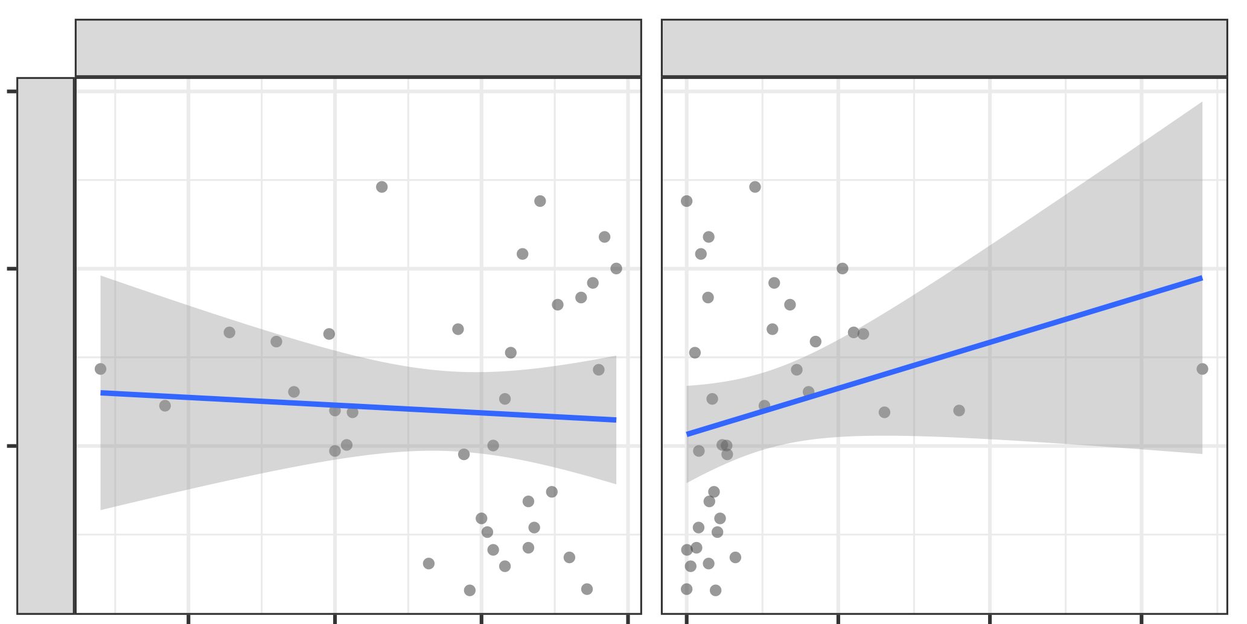
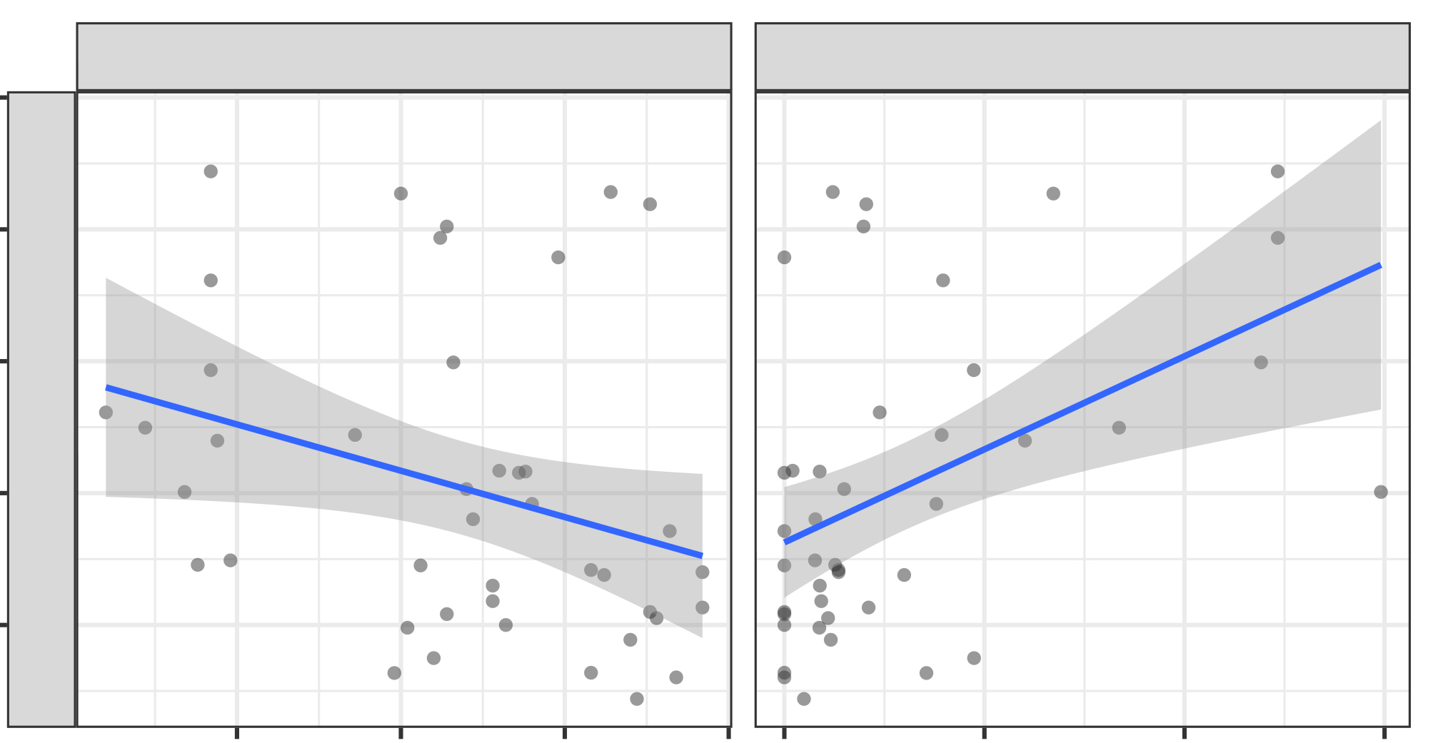
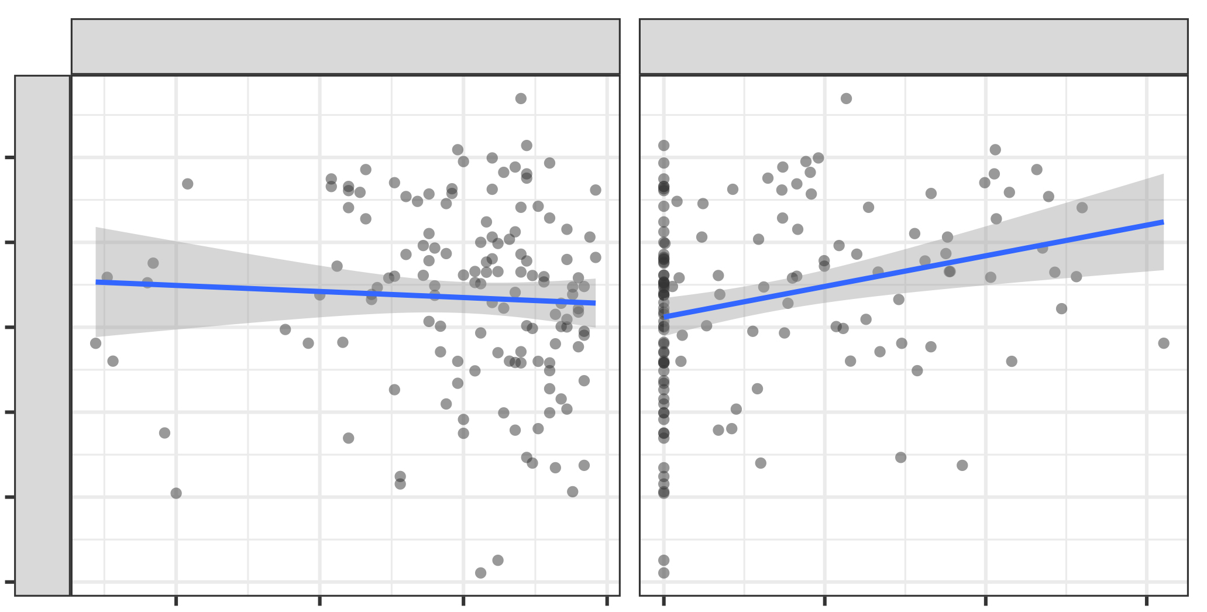
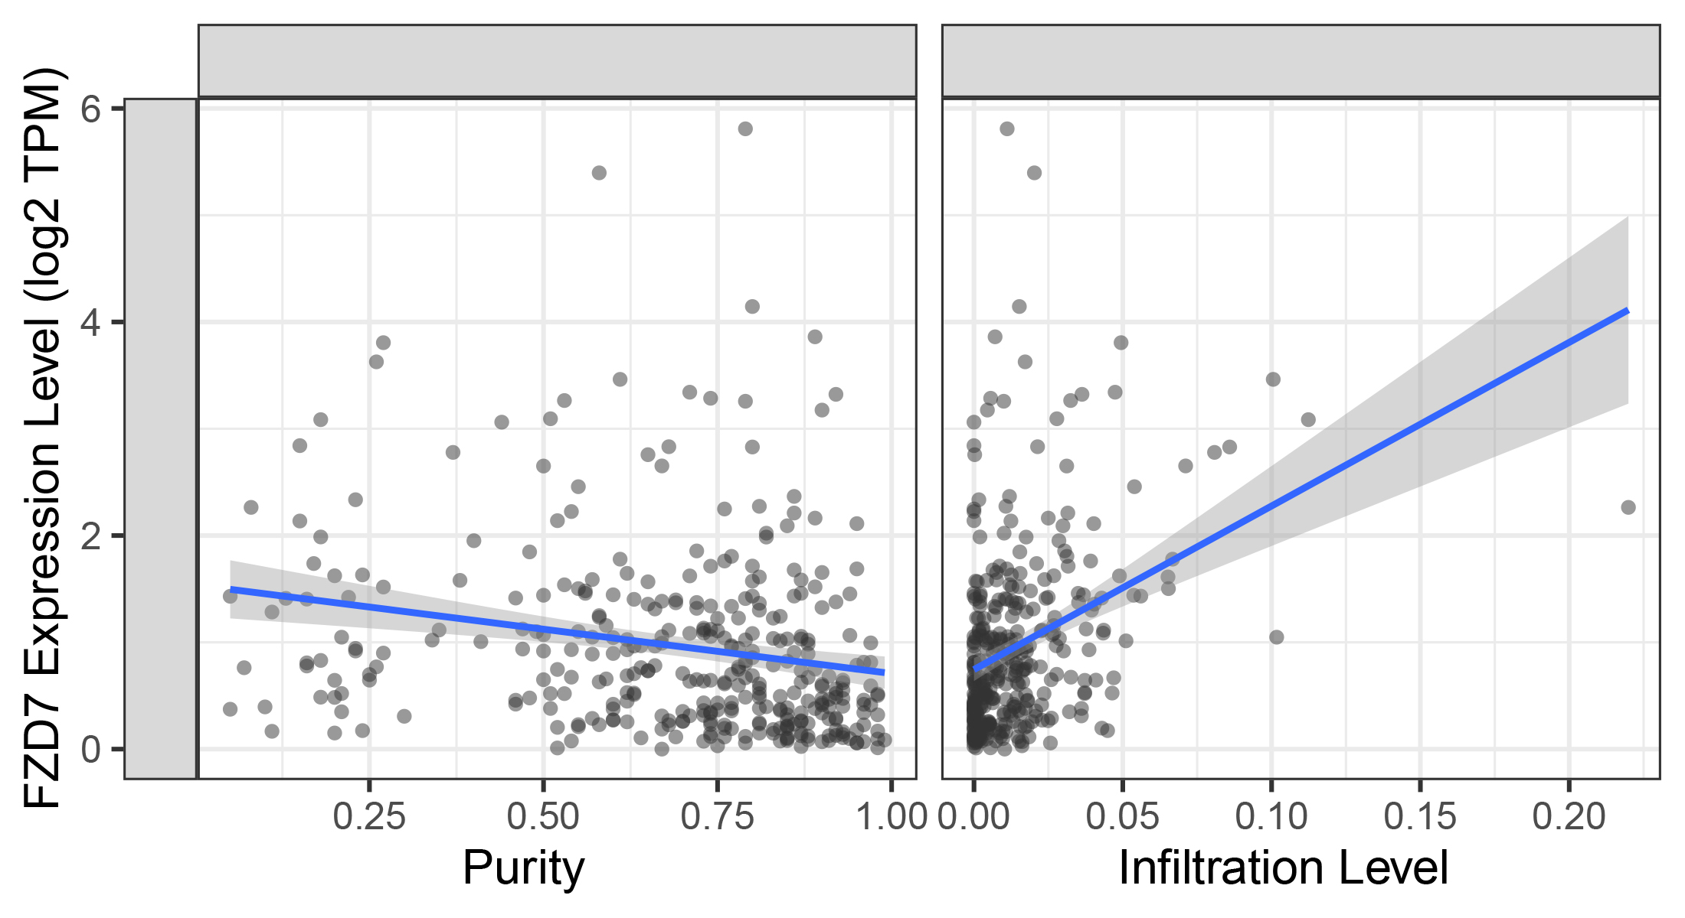
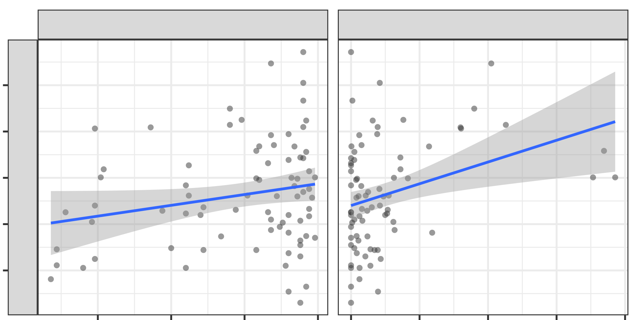
FZD7 expression level (log2 TPM)
FZD7 expression level (log2 TPM)
FZD7 expression level (log2 TPM)
FZD7 expression level (log2 TPM)
Figure S3
A
Purity
Tregs_CIBERSORT−ABS
DLBC
Purity
Tregs_CIBERSORT−ABS
6
CHOL
3.0
Rho = −0.376
p = 1.43e−02
Rho = 0.061
p = 7.23e−01
Rho = 0.359
p = 2.11e−02
Rho = 0.42
p = 1.21e−02
2.5
4
2.0
2
1.5
1.0
0.25 0.50 0.75 1.00 0.0 0.05 0.10 0.15
0.25 0.50 0.75 1.00 0.0 0.1 0.2 0.3
FZD7 expression level (log2 TPM)
Purity
Infiltration Level
Purity
Infiltration Level
GBM
Purity
Tregs_CIBERSORT−ABS
LIHC
Purity
Tregs_CIBERSORT−ABS
6
Rho = 0.3
p = 1.39e−08
6
Rho = −0.293
p = 2.70e−08
Rho = −0.15
p = 7.89e−02
5
Rho = 0.317
p = 1.64e−04
4
4
3
2
2
1
0
0.25 0.50 0.75 1.00 0.00 0.05 0.10 0.15 0.20
0.25 0.50 0.75 1.00 0.000 0.005 0.010 0.015
Purity
Infiltration Level
Purity
Infiltration Level
UVM
Purity
Tregs_CIBERSORT−ABS
Rho = 0.157
p = 1.70e−01
5
Rho = 0.34
p = 2.49e−03
4
3
2
1
0.25 0.50 0.75 1.00 0.00 0.01 0.02 0.03 0.04
Purity
Infiltration Level

Slide 4
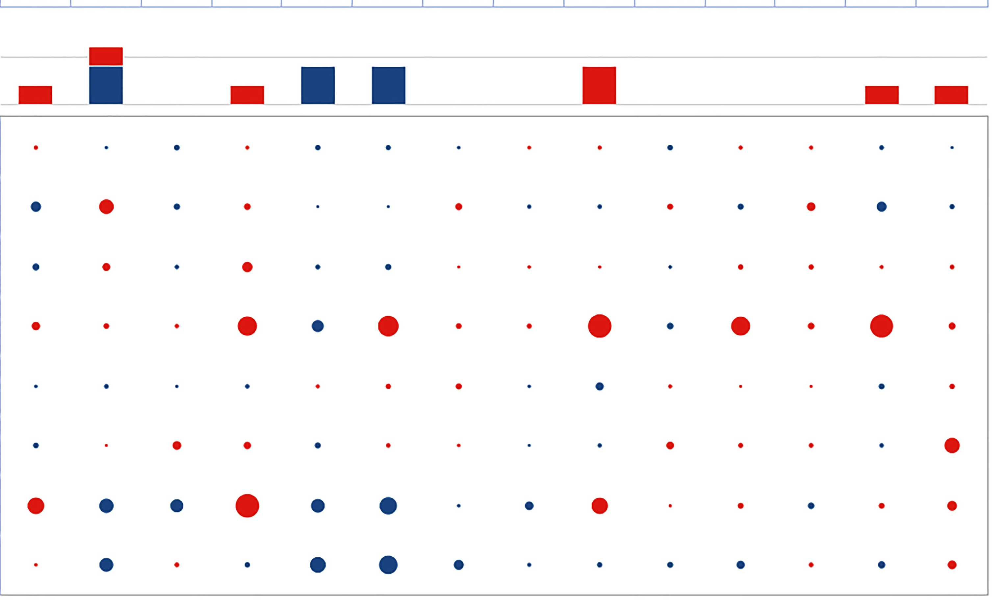
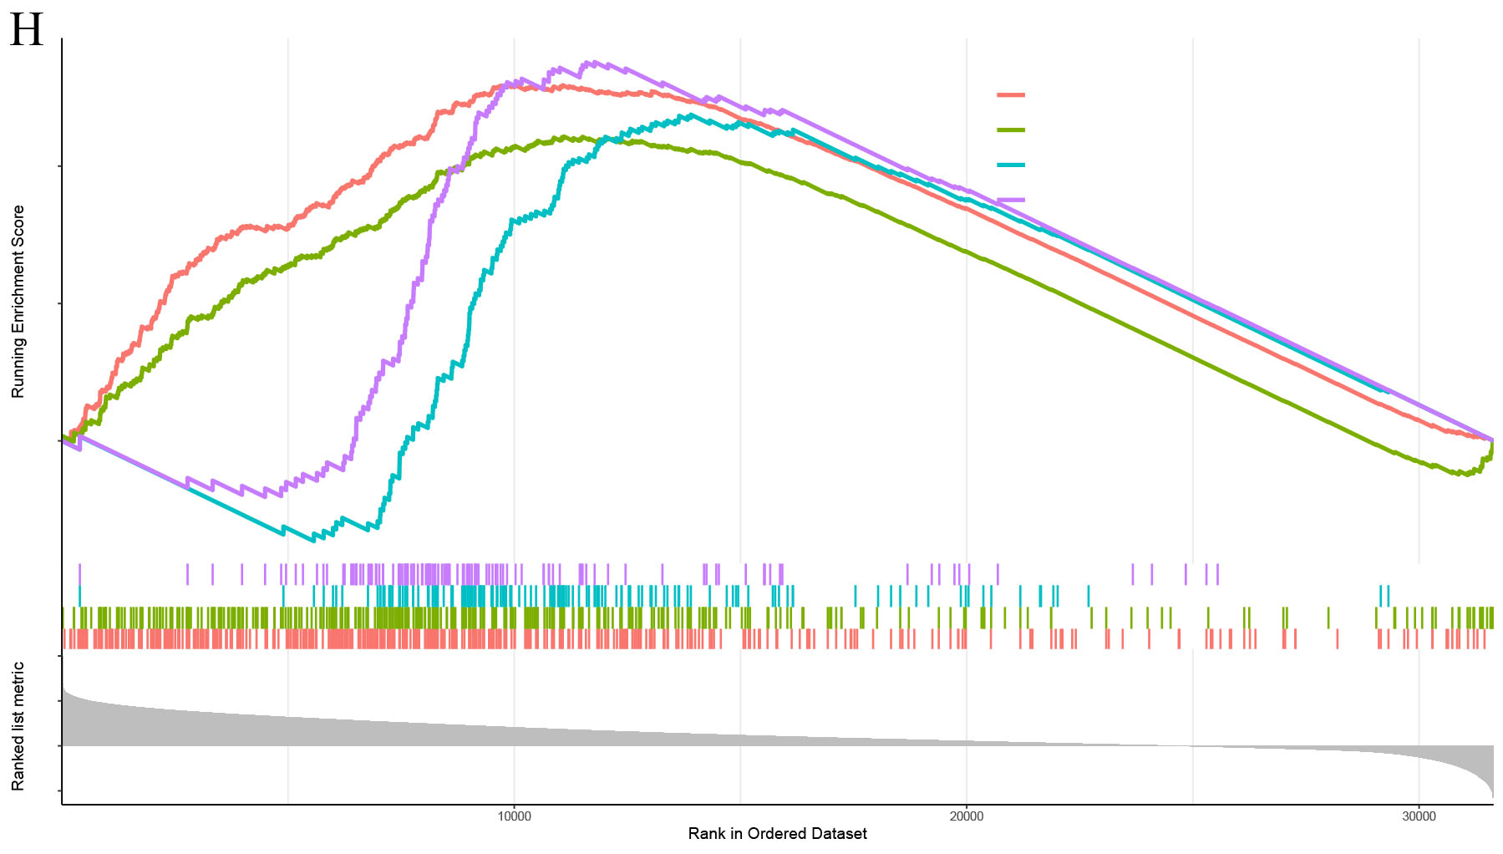
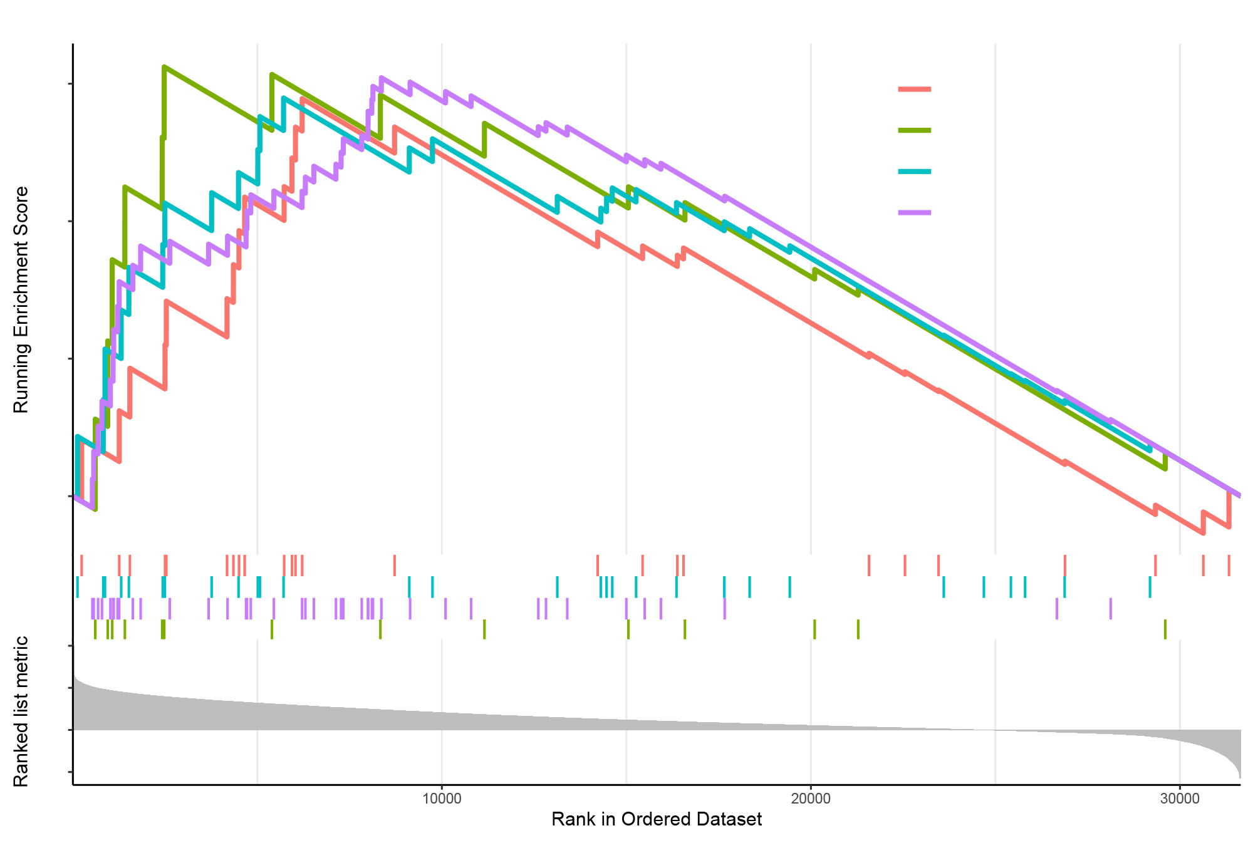
A
Figure S4
low−density lipoprotein particle receptor activity
Wnt−protein binding
category
frizzled binding
LRP12
G protein−coupled receptor binding
coreceptor activity
Wnt−protein binding
RYK
LRP6
low−density lipoprotein
particle receptor activity
SFRP1
coreceptor activity
ROR2
frizzled binding
protein self−association
WNT7A
beta−catenin binding
ACVR2A
G protein−coupled receptor binding
double−stranded RNA binding
DVL2
DVL3
DVL1
WNT5A
WNT3
WNT11
AMER1
TRIM32
beta−catenin binding
protein self−association
TCF7L1
VCL
ZNF639
DNA damage
Proliferation
DNA repair
Stemness
Angiogenesis
Inflammation
Differentiation
Hypoxia
EMT
Apoptosis
Invasion
Cell Cycle
Metastasis
B
Quiescence
ELAVL1
PRKRA
No.significant datasets
5
Positive
2.5
double−stranded RNA binding
0
Negative
-1.0
CNS/brain GBM
-1.0
LSM14A
Lung LUAD
-0.8
FXR1
Skin MEL
-0.8
-0.5
-0.5
-0.3
Kidney RCC
-0.3
0.0
Breast BRCA
0.0
Head neck HNSCC
Correlation
RB
Eye
C
UM
Enrichment plot GO terms
GOBP_IMMUNE_RESPONSE_REGULATING_SIGNALING_PATHWAY
Running Enrichment Score
GOBP_LYMPHOCYTE_MEDIATED_IMMUNITY
0.4
GOCC_IMMUNOGLOBULIN_COMPLEX
0.2
GOCC_T_CELL_RECEPTOR_COMPLEX
0.0
Ranked list metric
1.0
0.5
0.0
-0.5
10000
20000
30000
Rank in Ordered Dataset
Enrichment plot Transcription factor targets
0.6
HOXB7_TARGET_GENES
NFE2L3_TARGET_GENES
0.4
NKX6_1_TARGET_GENES
Running Enrichment Score
SOX11_TARGET_GENES
0.2
0.0
Ranked list metric
1.0
0.5
0.0
-0.5
10000
20000
30000
Rank in Ordered Dataset

Slide 5
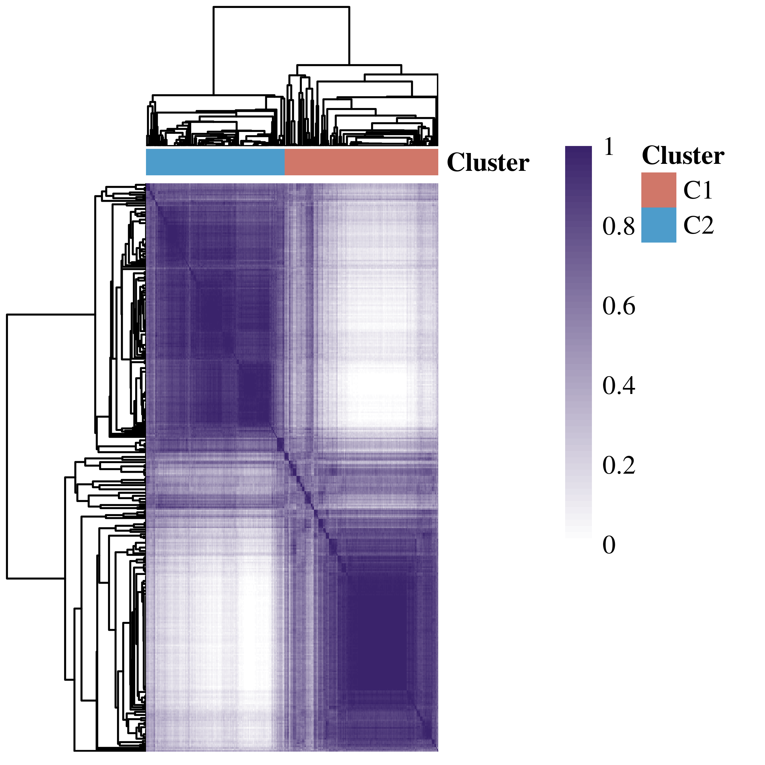
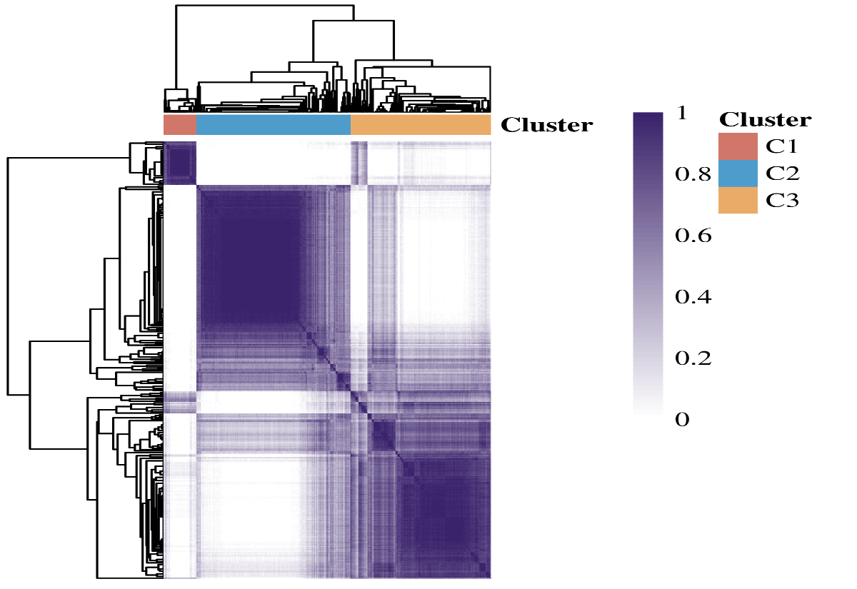
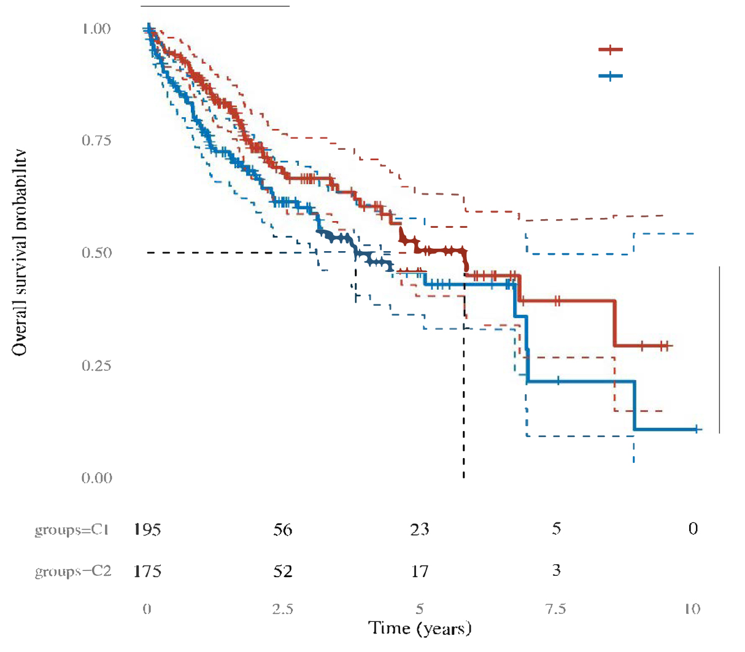
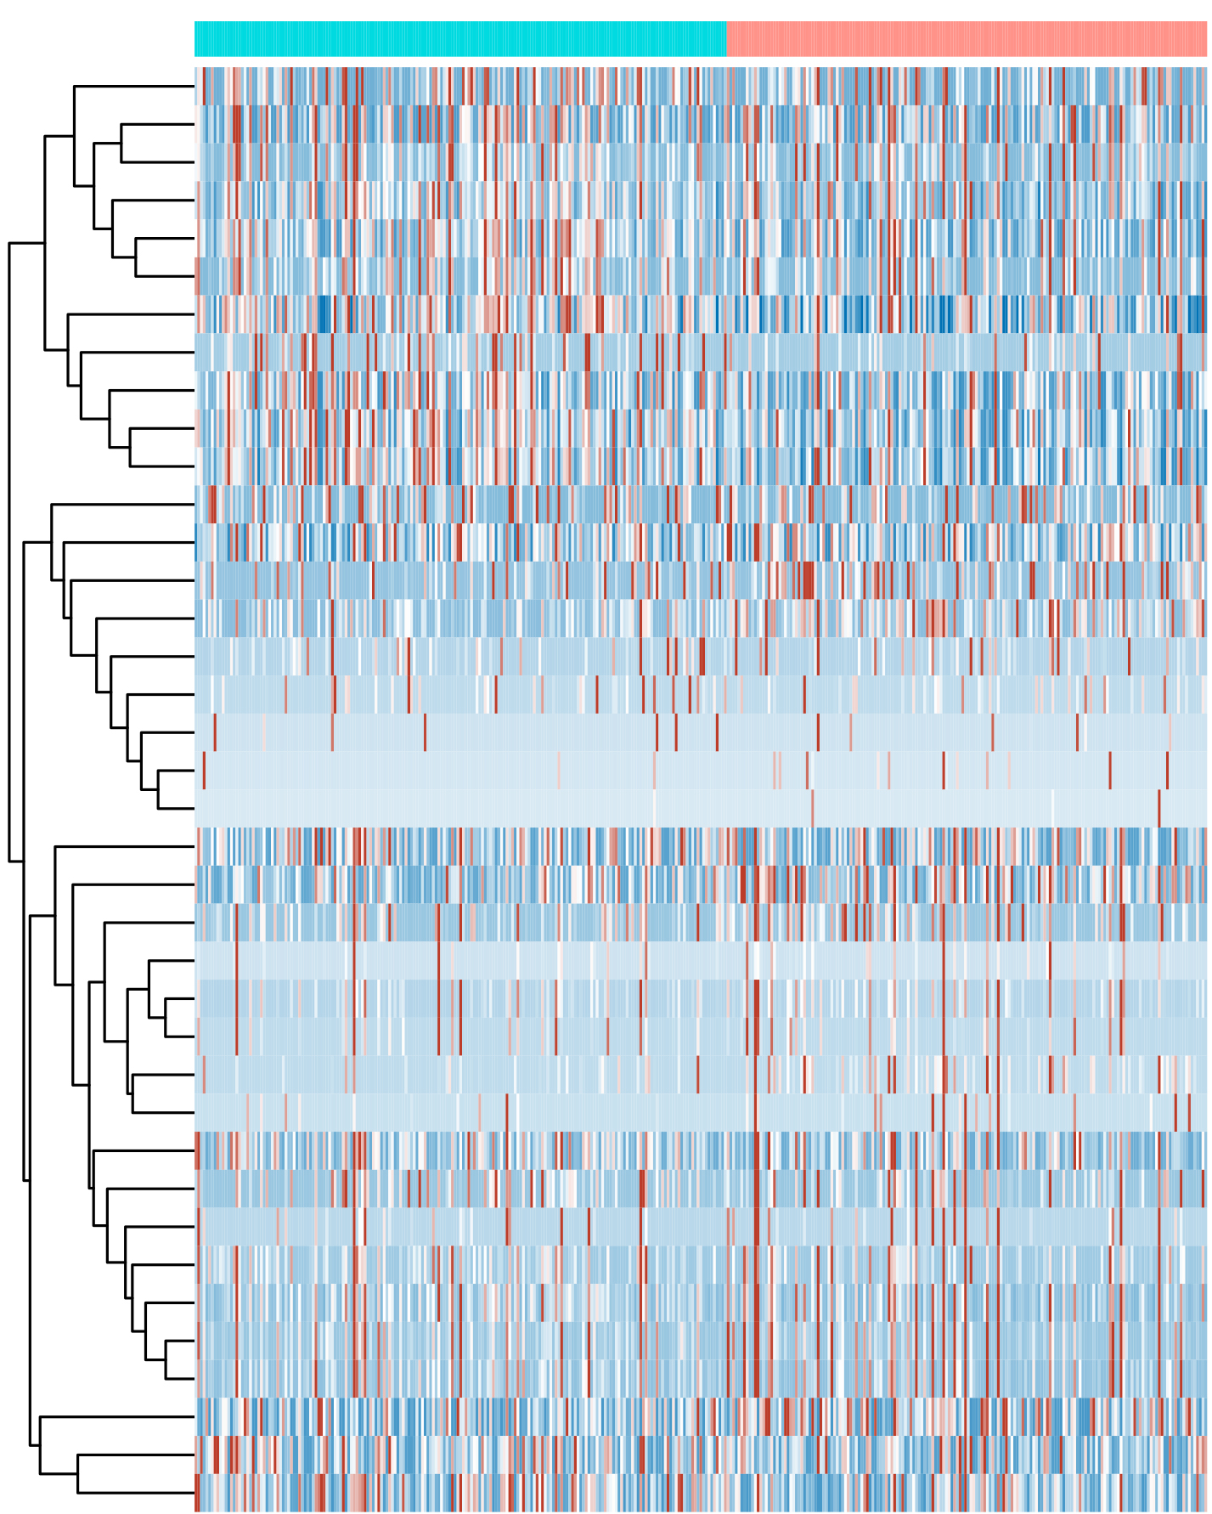
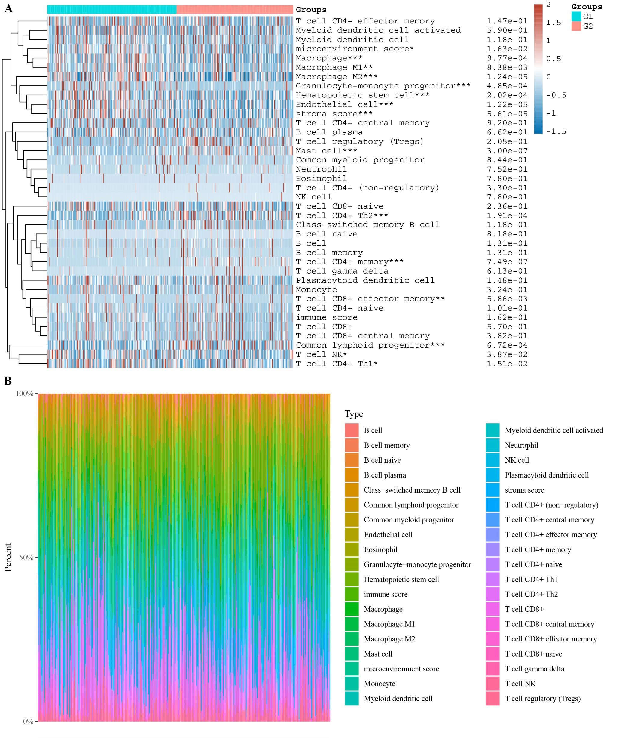
A
B
Figure S5
1.00
0.75
0.50
0.25
0.00
Cluster
Survival probability
C1
C2
1
0.8
0.6
0.4
0.2
0
C1
C2
P = 0.0448
C1
C2
195 56 23 5 0
C
175 52 17 3 0
Group
0 2.5 5 7.5 10
Time (years)
T cell CD4+ effector memory
Myeloid dendritic cell activated
Myeloid dendritic cell
Microenvironment score*
Macrophage***
Macrophage M1**
Macrophage M2***
Granulocyte-monocyte progenitor***
Hematopoietic stem cell***
Endothelial cell***
Stroma score***
T cell CD4+ central memory
B cell plasma
T cell regulatory
Mast cell***
Common myeloid progenitor
Neutrophil
Eosinophil
T cell CD4+(non-regulatory)
NK cell
T cell CD8+ naïve
T cell CD4+ Th2***
Class-switched memory B cell
B cell naïve
B cell
B cell memory
T cell CD4+ memory***
T cell gamma delta
Plasmacytoid dendritic cell
Monocyte
T cell CD8+ effector memory**
T cell CD4+ naïve
Immune score
T cell CD8+
T cell CD8+ central memory,
Common lymphoid progenitor***
T cell NK*
T cell CD4+ Th1*
2
1.5
1
0.5
-0.5
-1
-1.5
C1
C2

Slide 6
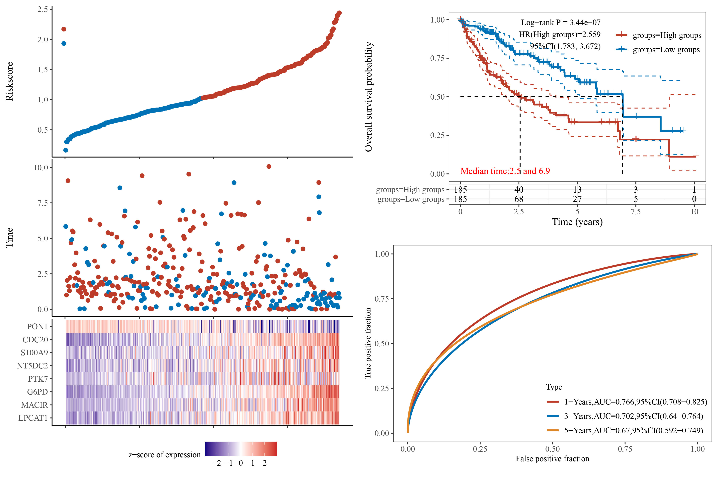
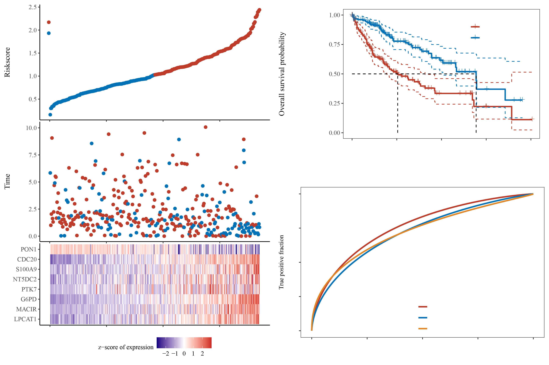
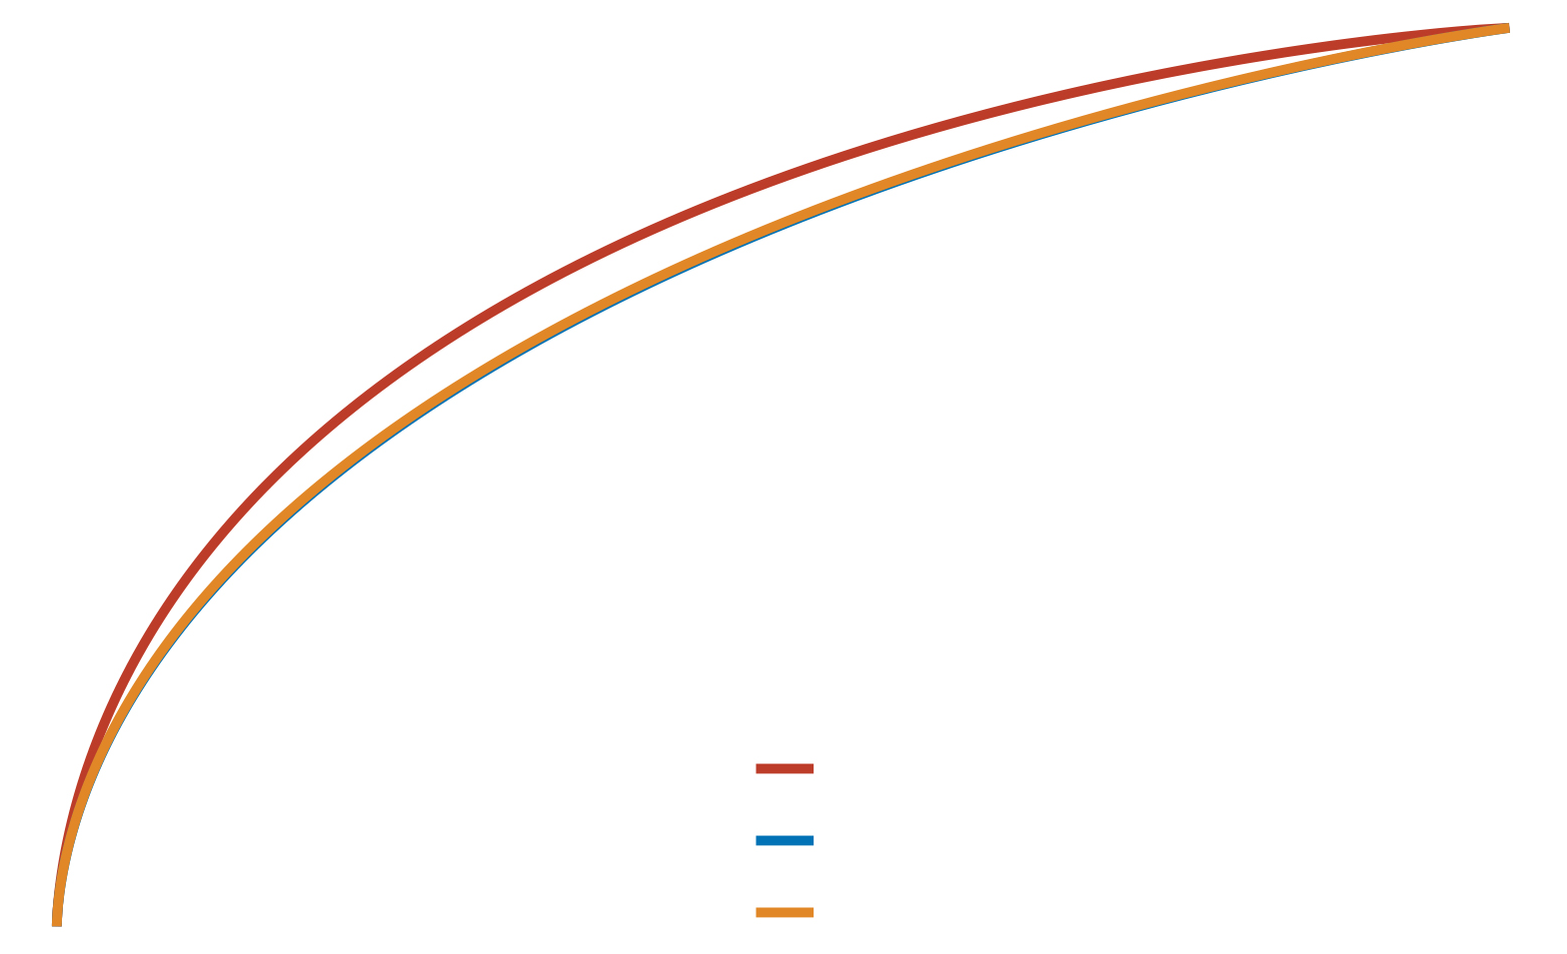
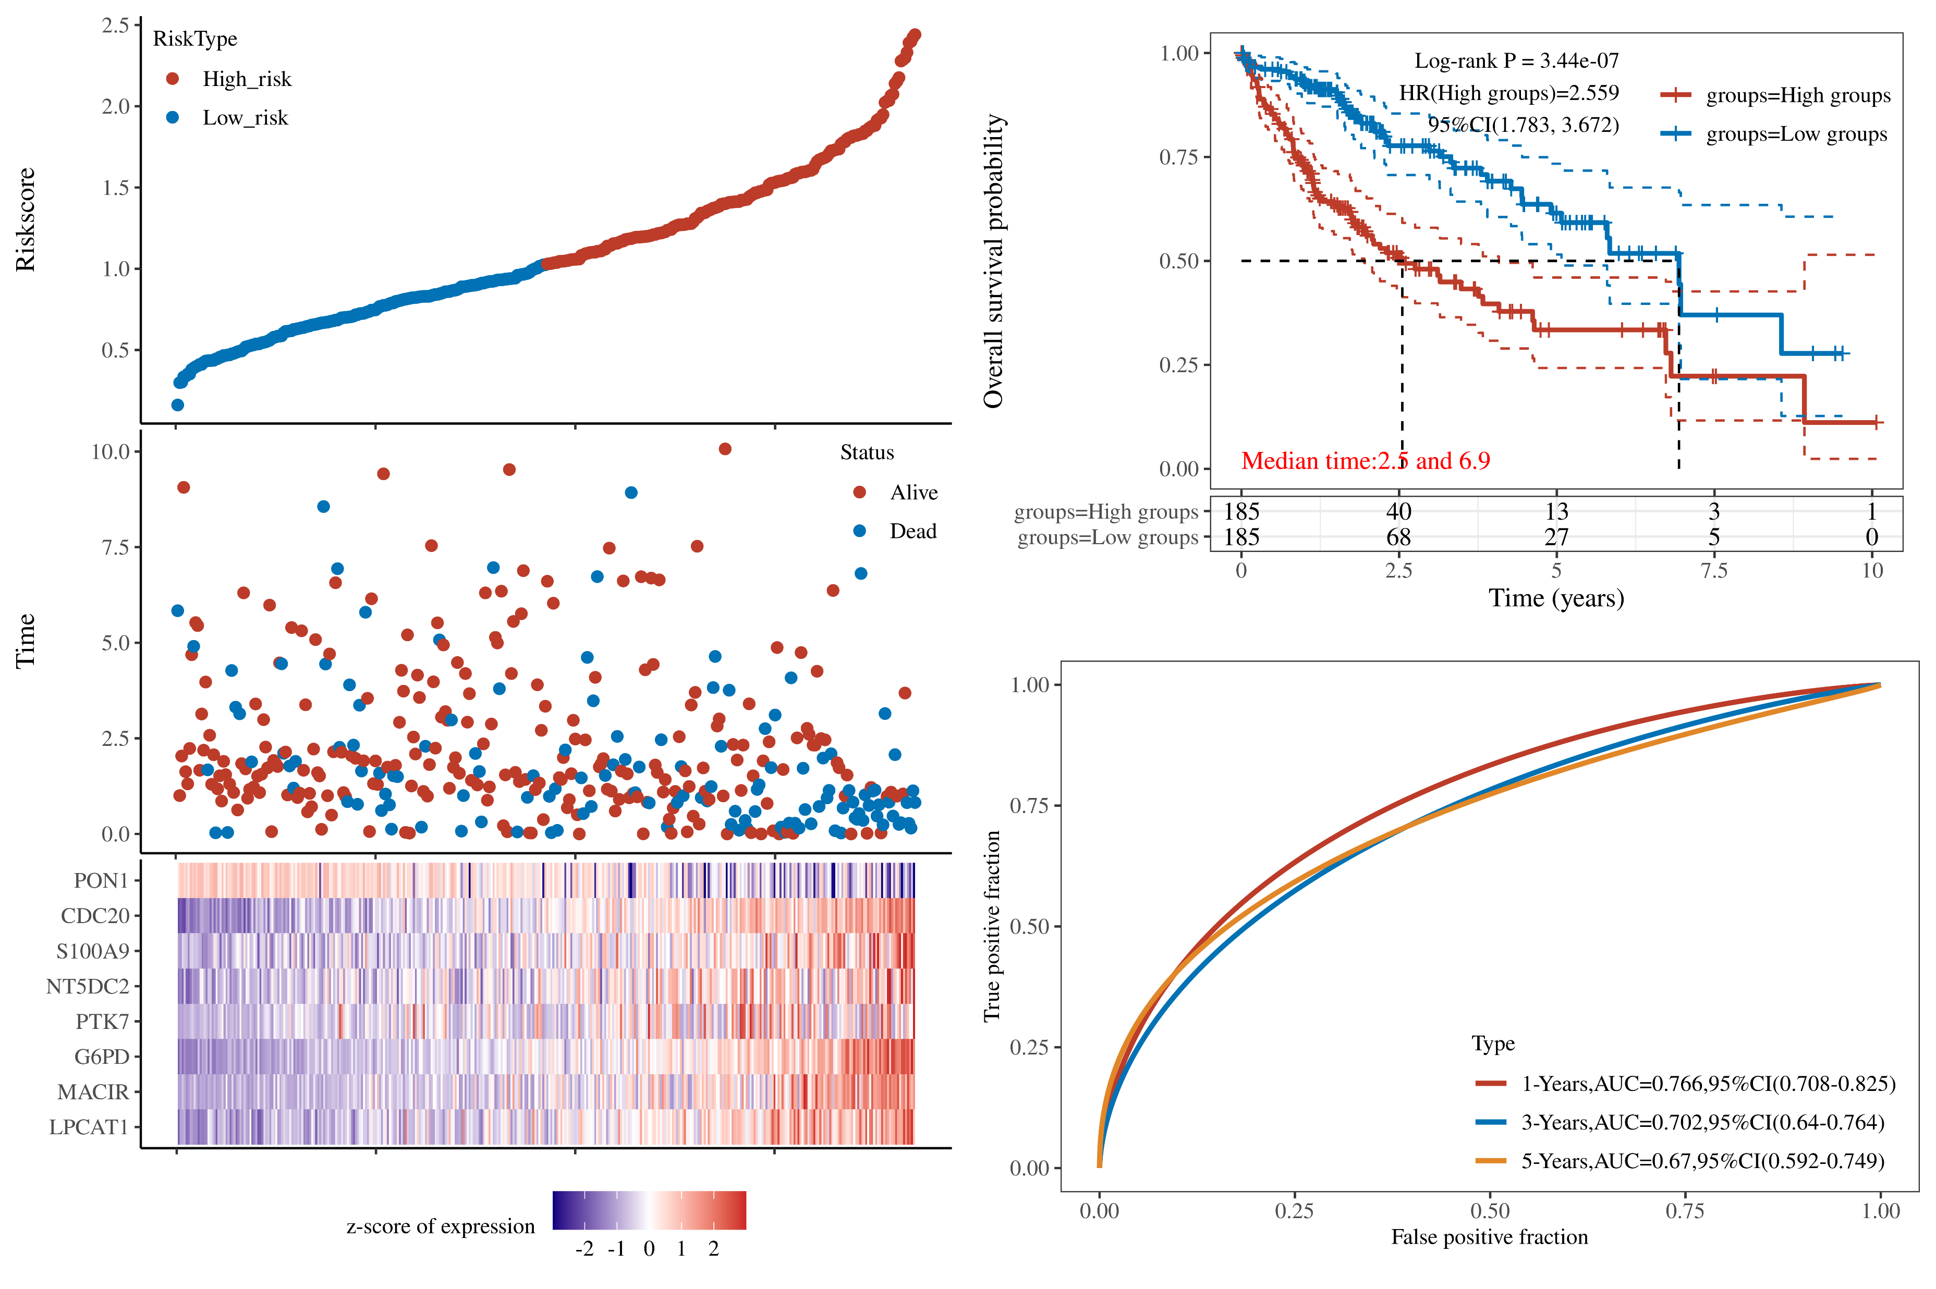
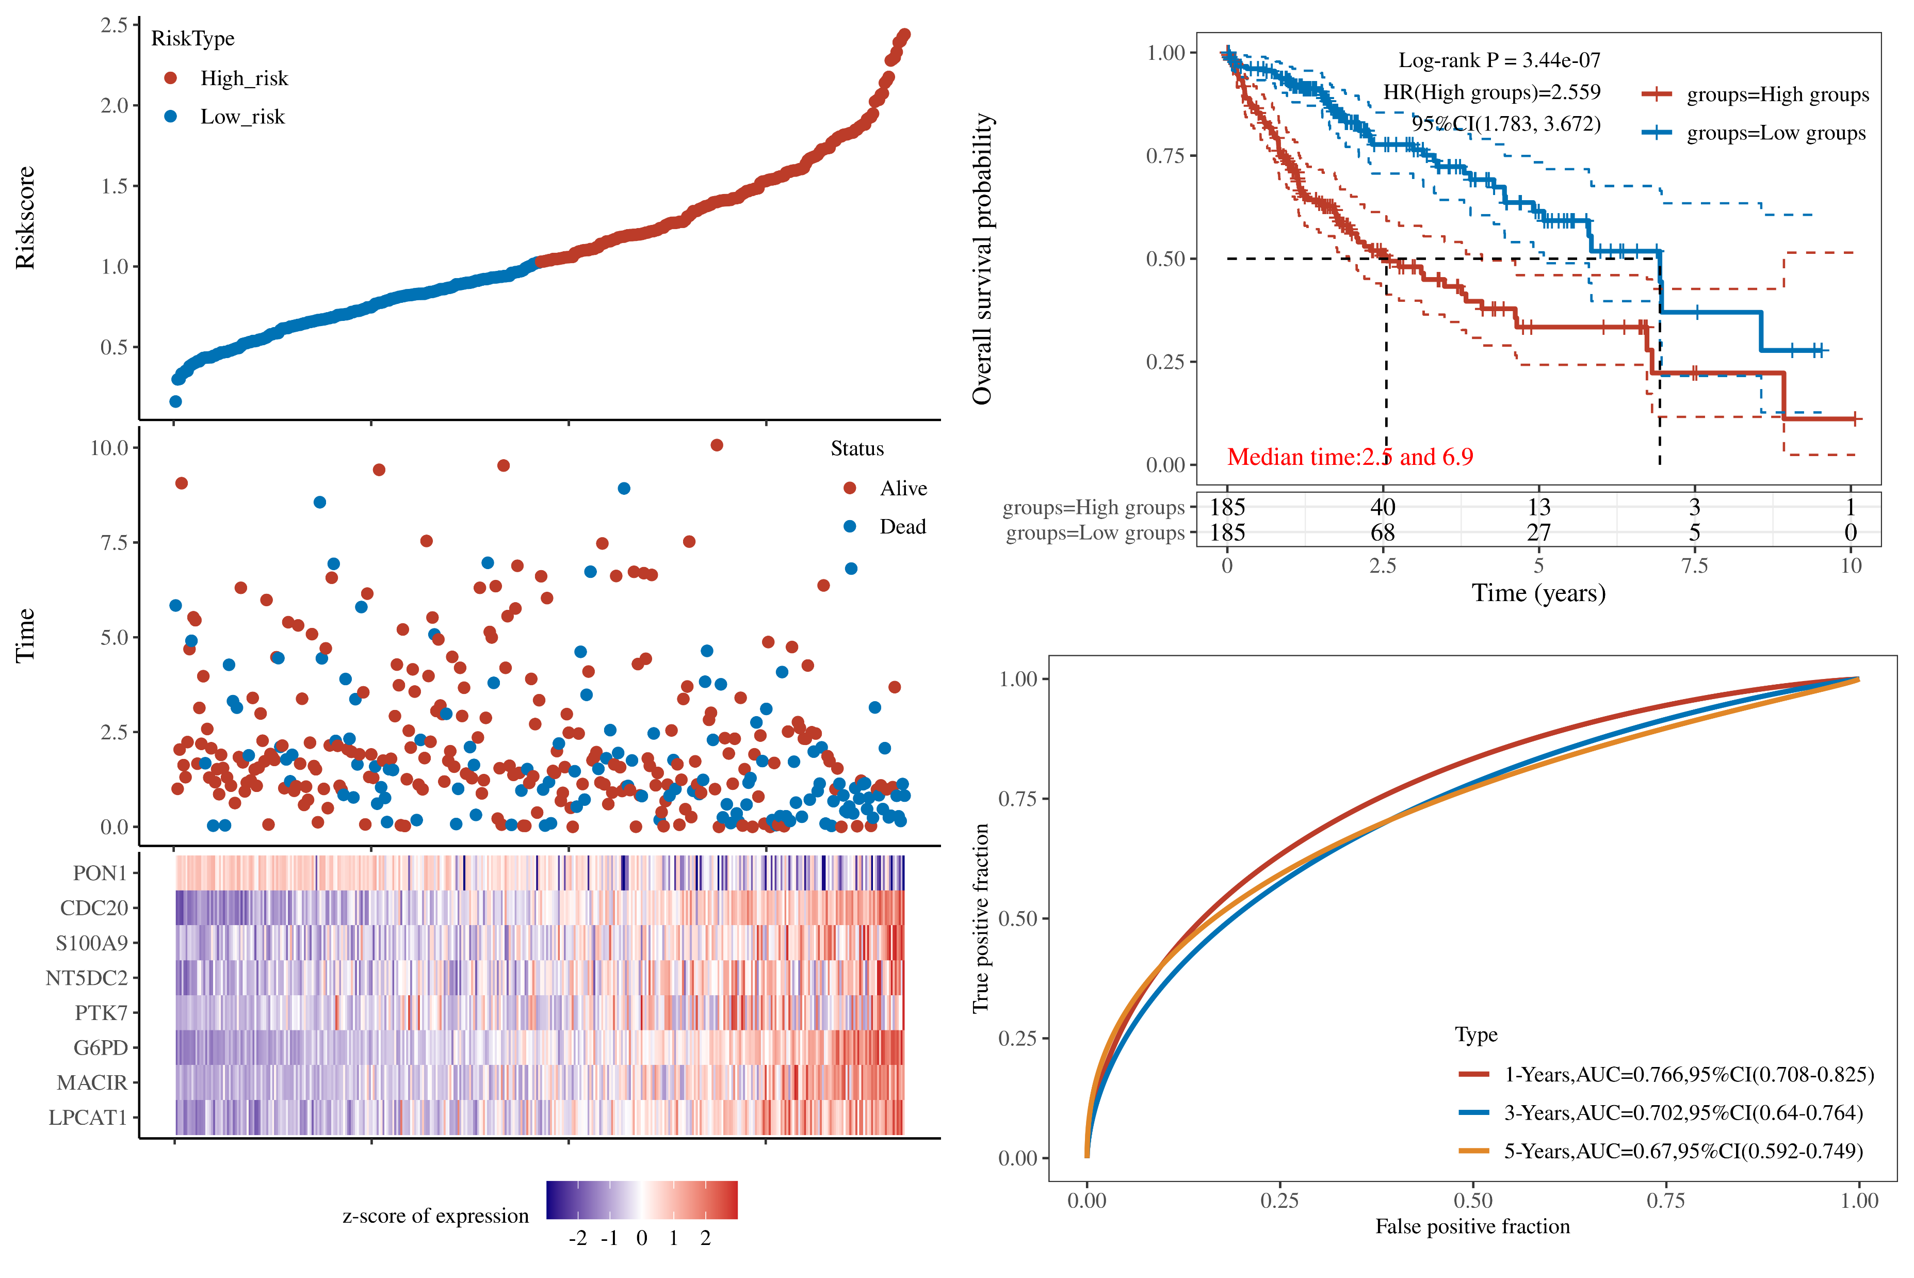
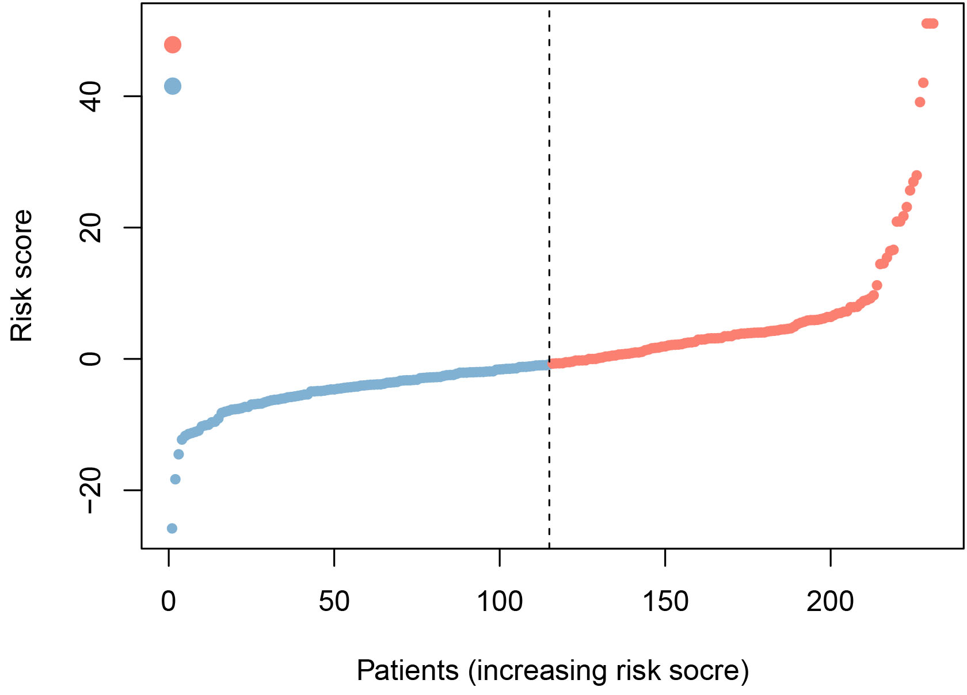
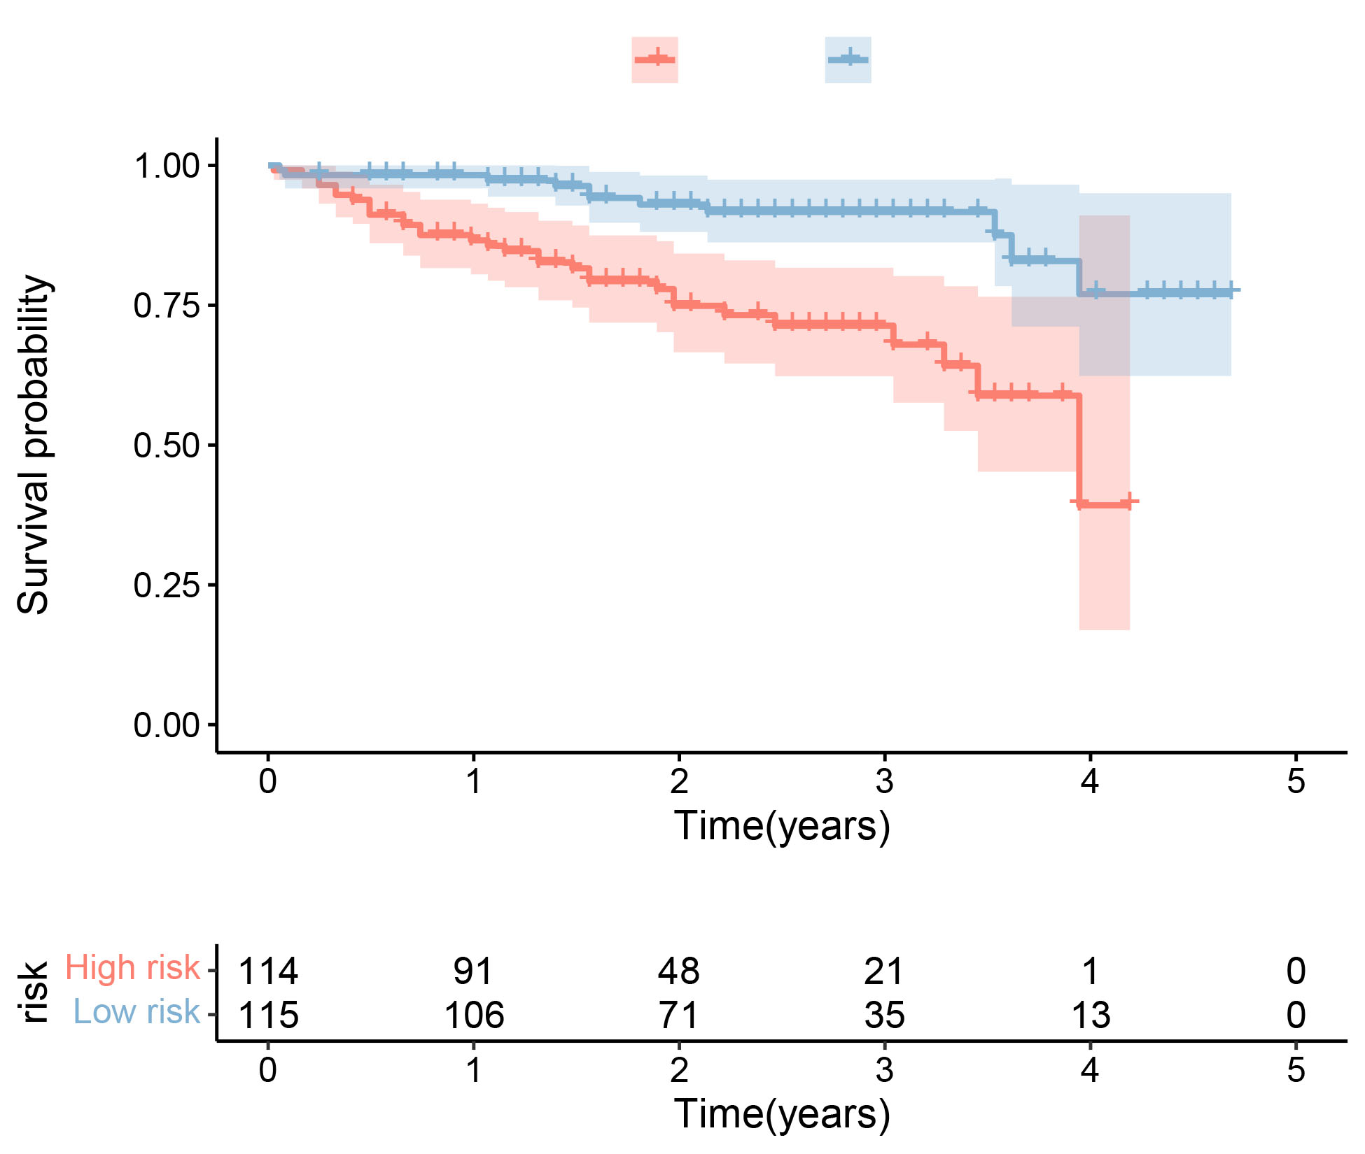
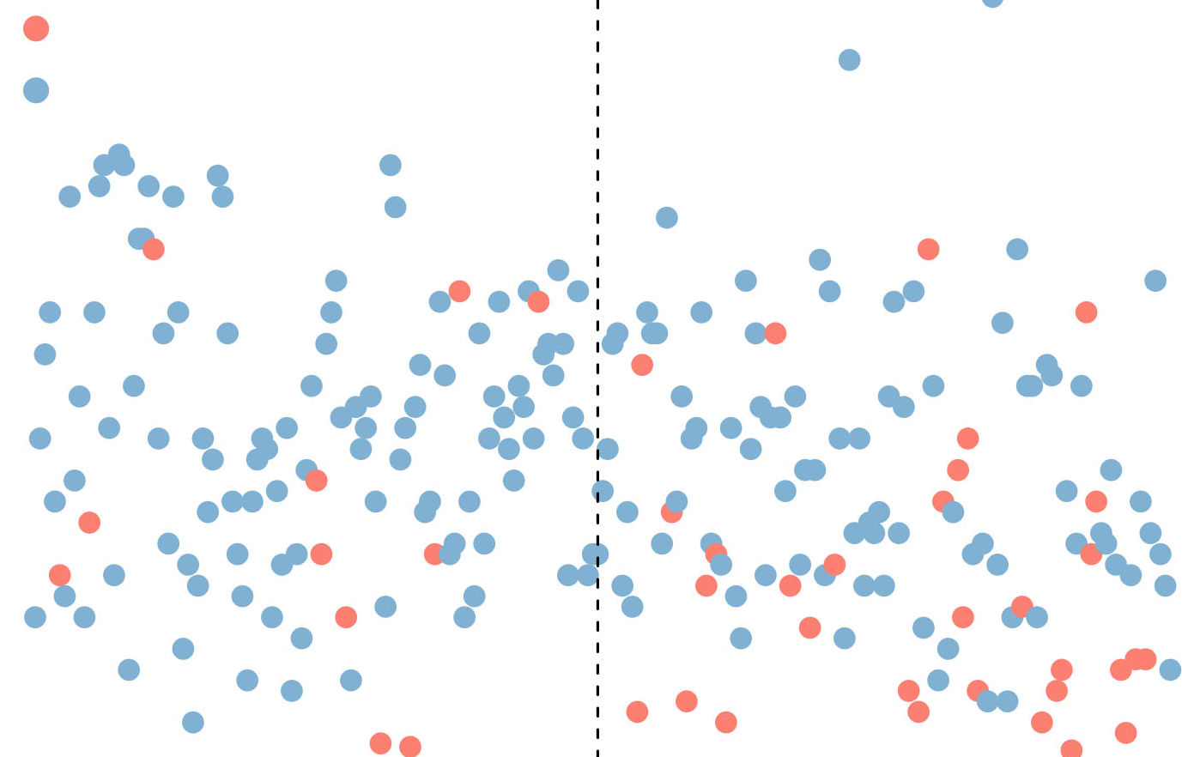
1.00
0.75
0.50
0.25
0.00
TCGA LIHC
Figure S6
A
TCGA LIHC
B
2.5
2.0
1.5
1.0
0.5
RiskType
High risk
Low risk
Riskscore
High risk
Low risk
10.0
7.5
5.0
2.5
0.0
p = 3.44e-07
Time
Status
Alive
Dead
Number at risk
High risk
Low risk
185 40 13 3 1
Overall survival probability
185 68 27 5 0
C
0 2.5 5.0 7.5 10
True positive fraction
Times years
1.00
0.75
0.50
0.25
0.00
PON1
CDC20
S100A9
NT5DC2
PTK7
G6PD
MACIR
LPCAT1
1-years, AUC=0.766
3-years, AUC=0.705
5-years, AUC=0.702
z-score of expression
0.00 0.25 0.50 0.75 1.00
-2 -1 0 1 2
False positive fraction
D
E
RiskType
ICGC-JP
Survival probability
ICGC-JP
40
20
0
-20
High risk
Low risk
1.00
0.75
0.50
0.25
0.00
High risk
Low risk
Risk score
p < 0.001
0 50 100 150 200
0 1 2 3 4 5
Patients (increasing risk score)
Number at risk
Survival time (years)
High risk
Low risk
114 91 48 21 1 0
6
5
4
3
2
1
0
RiskType
115 106 71 35 13 0
High risk
Low risk
0 1 2 3 4 5
Time (years)
0 50 100 150 200
Patients (increasing risk score)

Slide 7
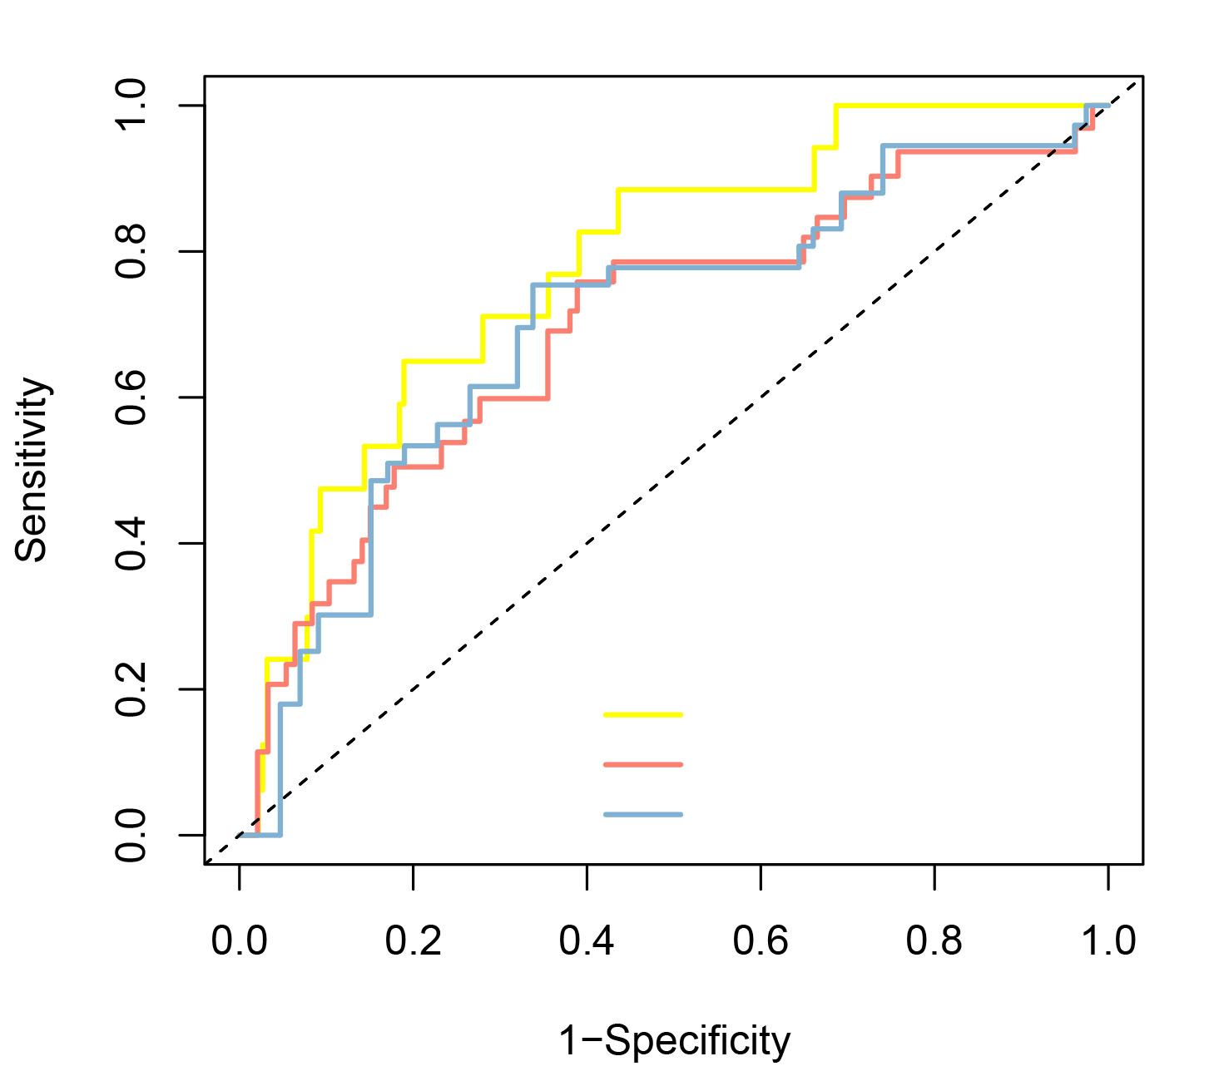
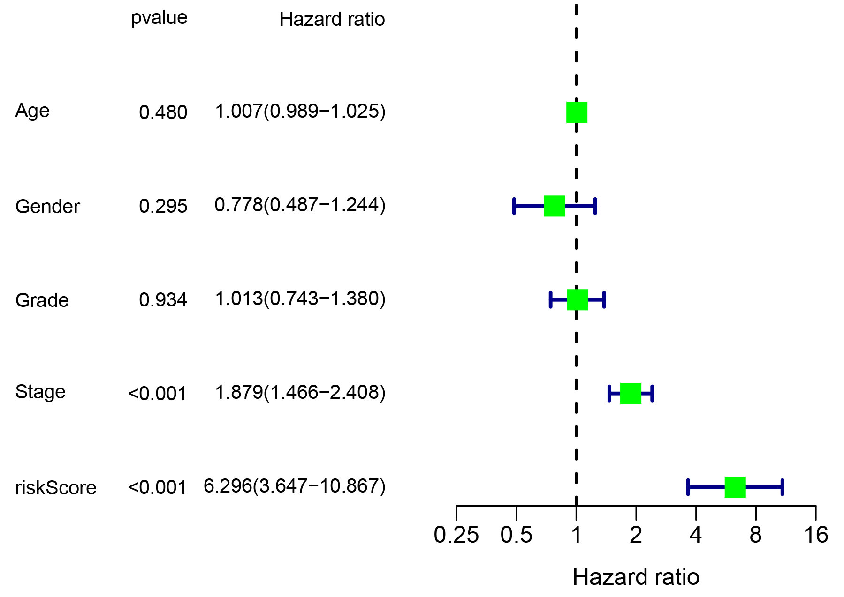
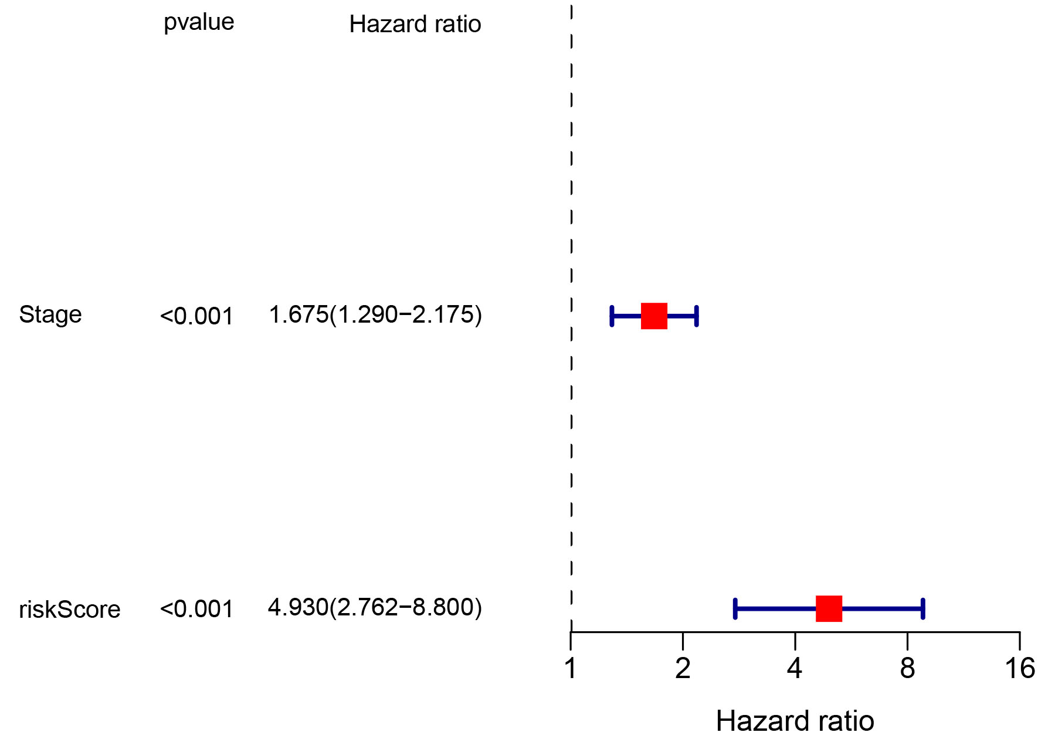
Figure S7
A
1.0
0.8
0.6
0.4
0.2
0.0
Sensitivity
AUC at 1 years: 0.780
AUC at 2 years: 0.698
AUC at 3 years: 0.699
0.0 0.2 0.4 0.6 0.8 1.0
1-Specificity
B
C
p value Hazard ratio
p value Hazard ratio
0.480
0.295
0.934
<0.001
<0.001
Age
Gender
Grade
Stage
riskScore
1.007(0.989−1.025)
0.778(0.487−1.244)
1.013(0.743−1.380)
1.879(1.466−2.408)
6.296(3.647−10.867)
Stage
riskScore
<0.001
<0.001
1.675(1.290−2.175)
4.930(2.762−8.800)
0.25 0.50 1 2 4 6 8
1 2 4 8 16
Hazard ratio
Hazard ratio

