Slide 1
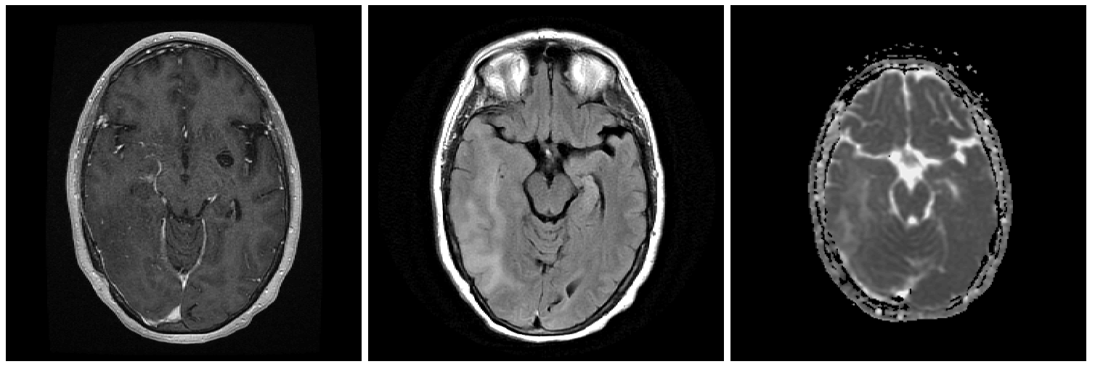
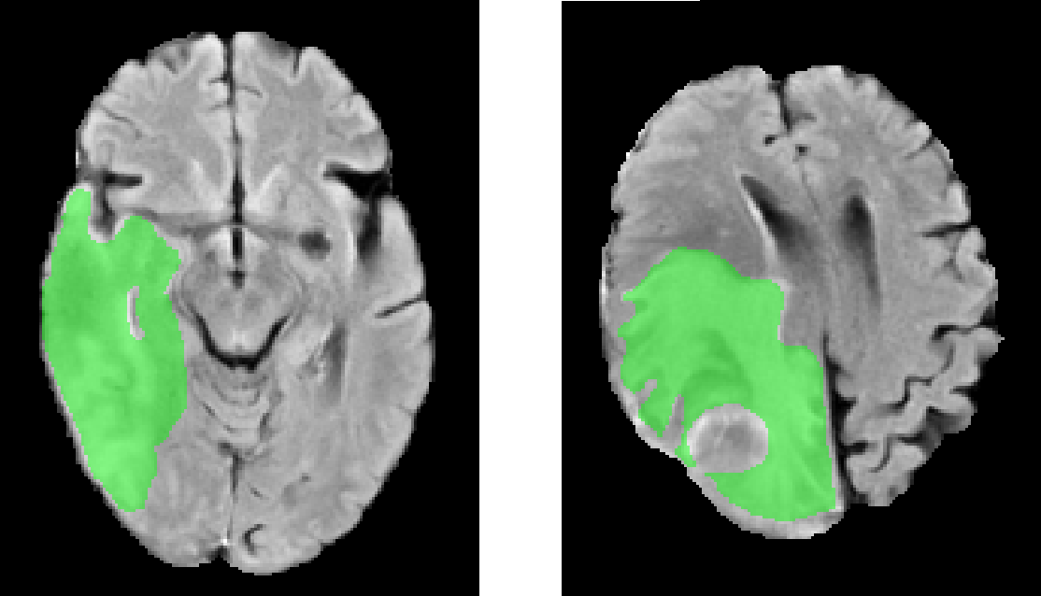
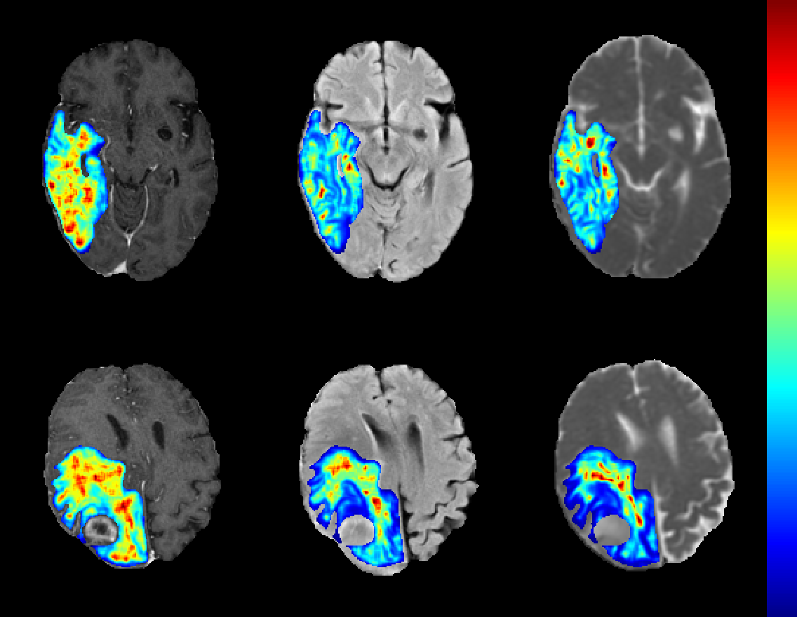
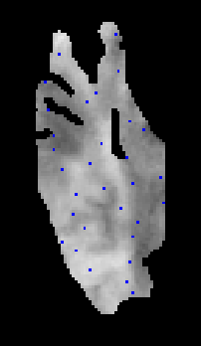
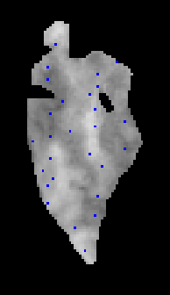
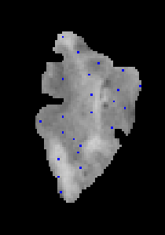
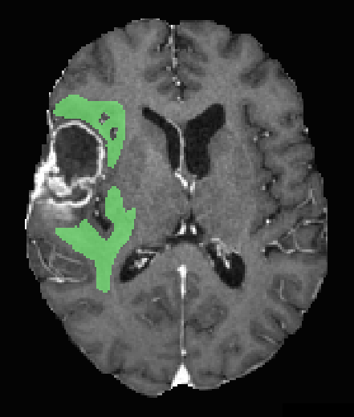
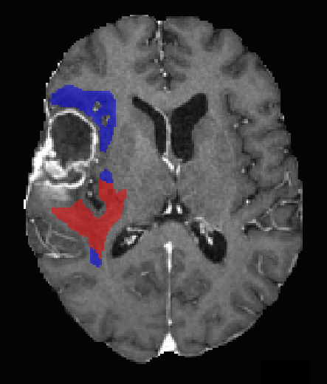
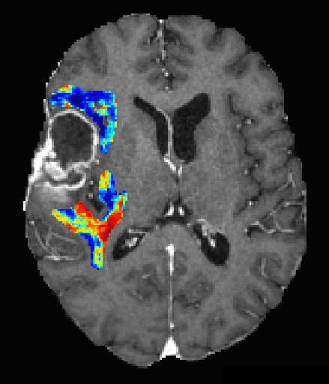
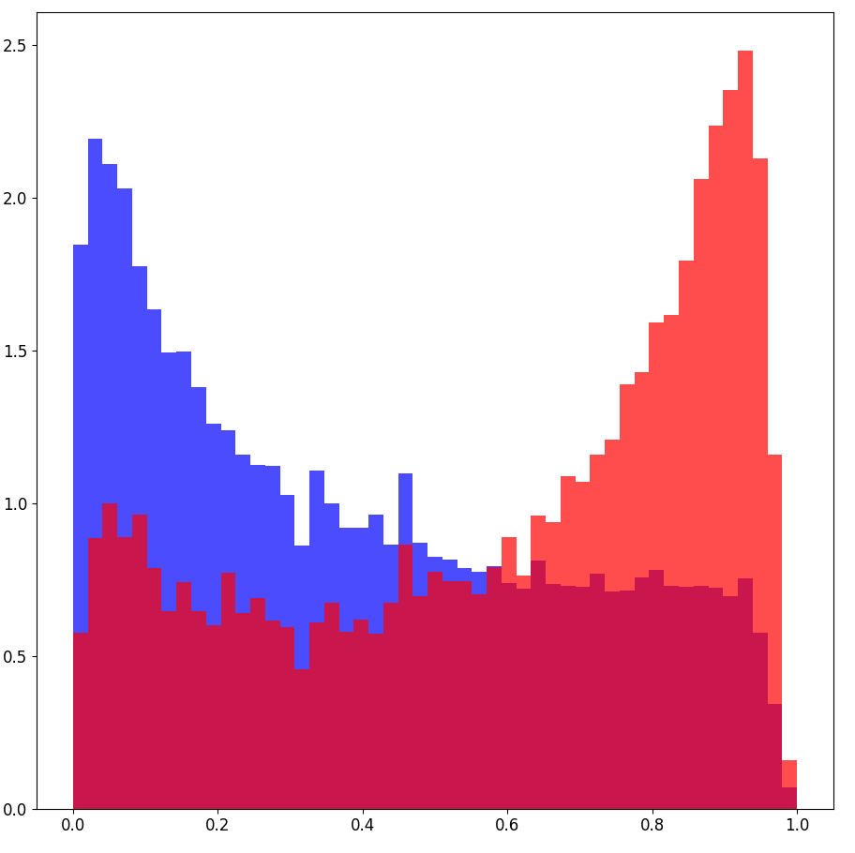
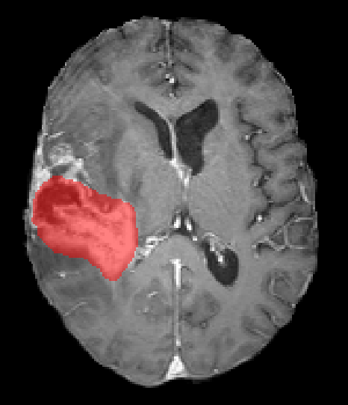
a
Skull Stripping
& Registration
Edema Segmentation
Image Preprocessing
Voxel-Wise
Feature Extraction
1 mm³ Resampling
First-Order (18)
GLCM (21)
GLDM (14)
GLRLM (16)
GLSZM (16)
NGTDM (5)
T2F
ADC
Intensity Standardization
Fixed Bin-Width
Discretization
T1c
LGG
BM
b
Voxel-Wise
Feature Maps
Training Set
Downsampling
Support Vector Machine Classifier
LGG
BM
T1c
T2F
ADC
BM
LGG
c
Segmentation
& Registration
RT Planning
Registered
Recurrence
RT Planning
Voxel-Wise Edema Classification
Classification Assessment
(Density normalized histogram)
RT Planning
Edema
Stable
Tumour
Stable
Recurrence
Probability Density
Follow-up Recurrence
Recurrence
Edema
Classification Probability

