Slide 1
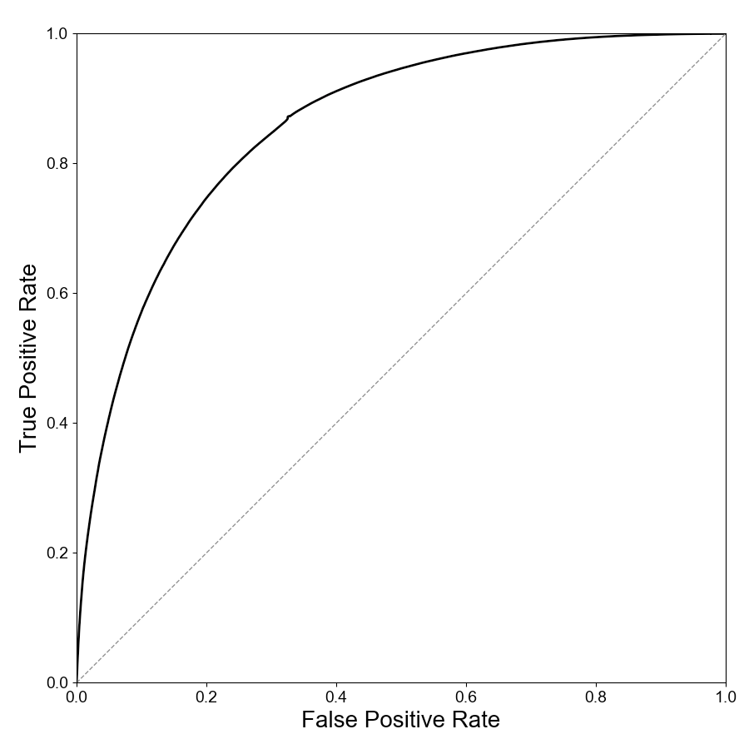
True Positive Rate
AUC 0.86
False Positive Rate

