Slide 1
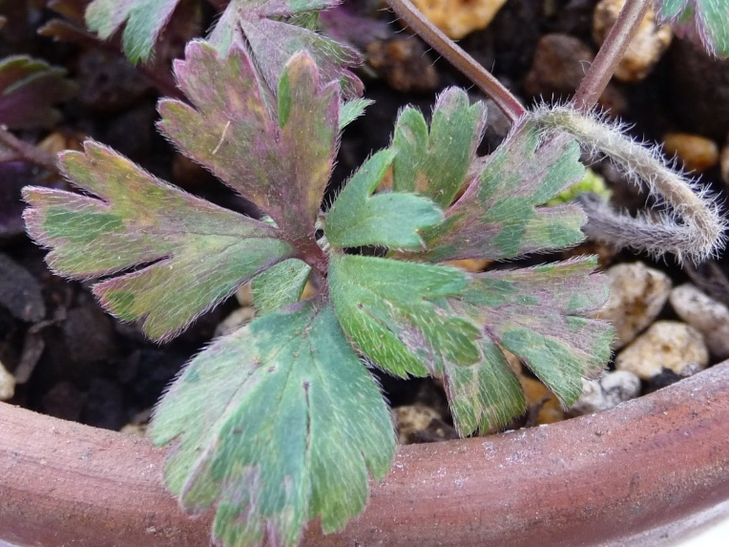
Supplementary Figure. 1 Disease symptom in the anemone plant in this study

Slide 2
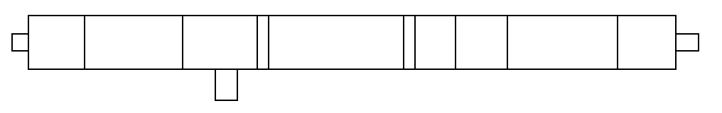
A
0 9,698
109 / 110 1,021 / 1,022 2,392 / 2,393 3,487 / 3,488 5,545 / 5,546 6,271 / 6,272 7,009 / 7,010 8,563 / 8,564 9,376 / 9,377
5’-UTR
3’-UTR
NIa-
VPg
NIa-
Pro
P1 HC-Pro P3 CI NIb CP
Poly (A)
GA₇
6K1
6K2
PIPO
3,643 / 3,644 5,701 / 5,702
NGS
2,901 / 2,902 3,132 / 3,133
F0 (5’RACE)
F22 (3’RACE)
PCR
F2 R2 F4 R4 F6 R6 F8 R8 F10 R10 F12 R12 F14 R14 F16 R16 F18 R18 F20 R20
F1 R1 F3 R3 F5 R5 F7 R7 F9 R9 F11 R11 F13 R13 F15 R15 F17 R17 F19 R19 F21 R21
B
0 9,537
122 / 123 1,025 / 1,026 2,399 / 2,400 3,452 / 3,453 5,513 / 5,514 6,242 / 6,243 6,971 / 6,972 8,519 / 8,520 9,347 / 9,348
5’-UTR
3’-UTR
NIa-
VPg
NIa-
Pro
P1 HC-Pro P3 CI NIb CP
Poly (A)
GA₆
6K1
6K2
PIPO
3,608 / 3,609 5,672 / 5,673
NGS
2,863 / 2,864 3,139 / 3,140
F0 (5’RACE)
F23 (3’RACE)
PCR
F2 R2 F4 R4 F6 R6 F8 R8 F10 R10 F12 R12 F14 R14 F16 R16 F18 R18 F20 R20 F22 R22
F1 R1 F3 R3 F5 R5 F7 R7 F9 R9 F11 R11 F13 R13 F15 R15 F17 R17 F19 R19 F21 R21
Supplementary Figure. 2
The genome structure of AnMV-NL and RanMMV-NL isolated from an anemone plant originated from the Netherlands, positions of all contigs obtained by NGS, and primers used to obtain the complete genome of two viruses.
A anemone mosaic virus isolated from anemone plant imported from the Netherlands (AnMV-NL)
B ranunculus mild mosaic virus isolated from anemone plant imported from the Netherlands (RanMMV-NL)

Slide 3
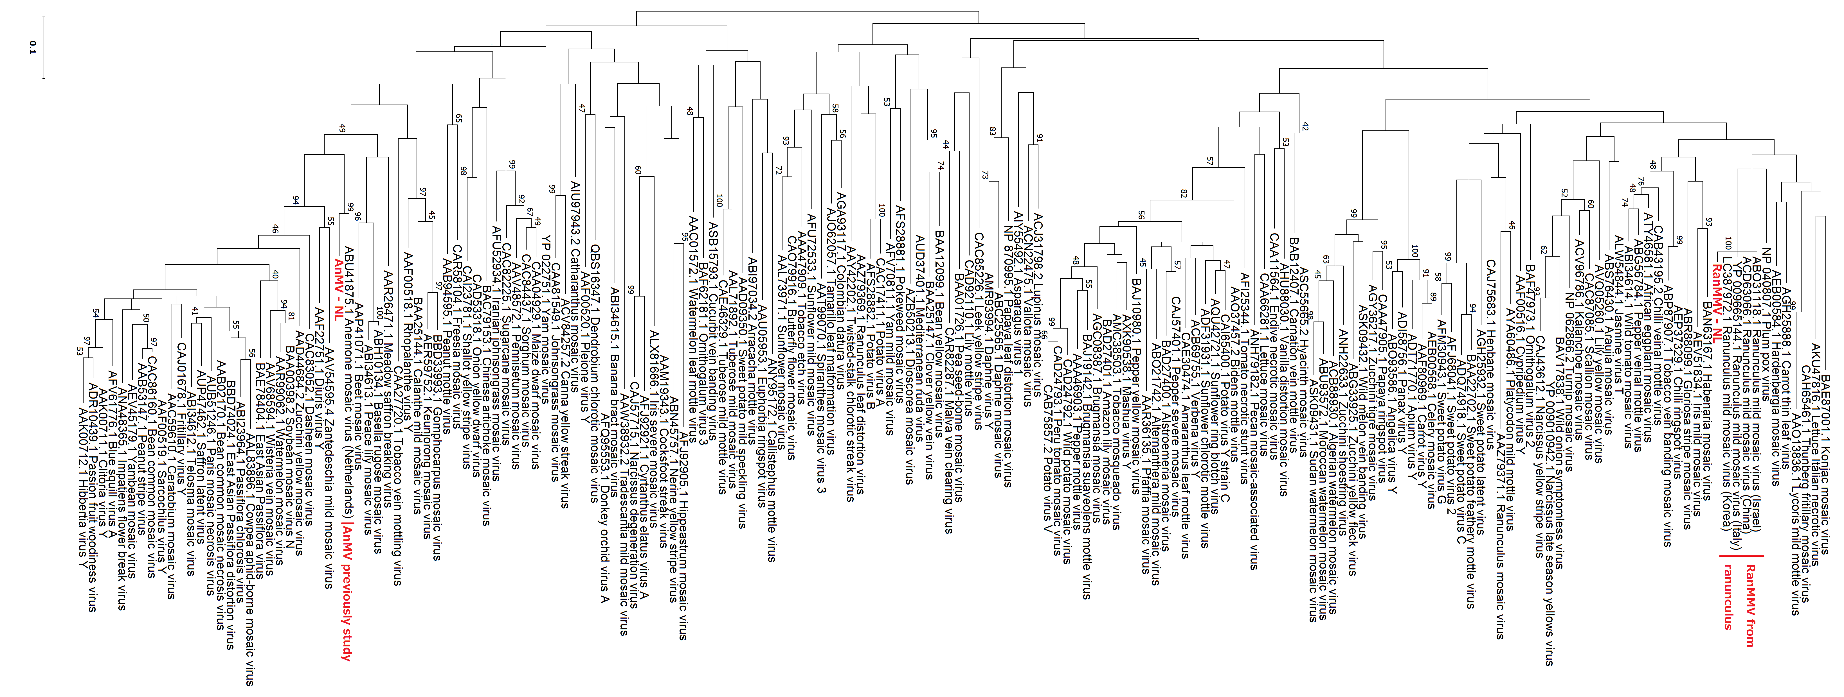
Supplementary Figure. 3
Phylogenetic analysis based on the amino acid sequence of the coat protein region of anemone mosaic virus (AnMV-NL) and ranunculus mild mosaic virus (RanMMV-NL) isolated from anemone plant imported from the Netherlands, and sequences of other potyviruses which included other RanMMV isolated from ranunculus and AnMV from a previous study, performed by the maximum-likelihood method using MEGA X software with bootstrap resampling analysis (1,000 replications). Only bootstrap values of ≥40% were shown. The amino acid sequence of RanMMV (korea) in this tree was translated from its nucleotide sequence (accession number LC387972.1).

