Slide 1
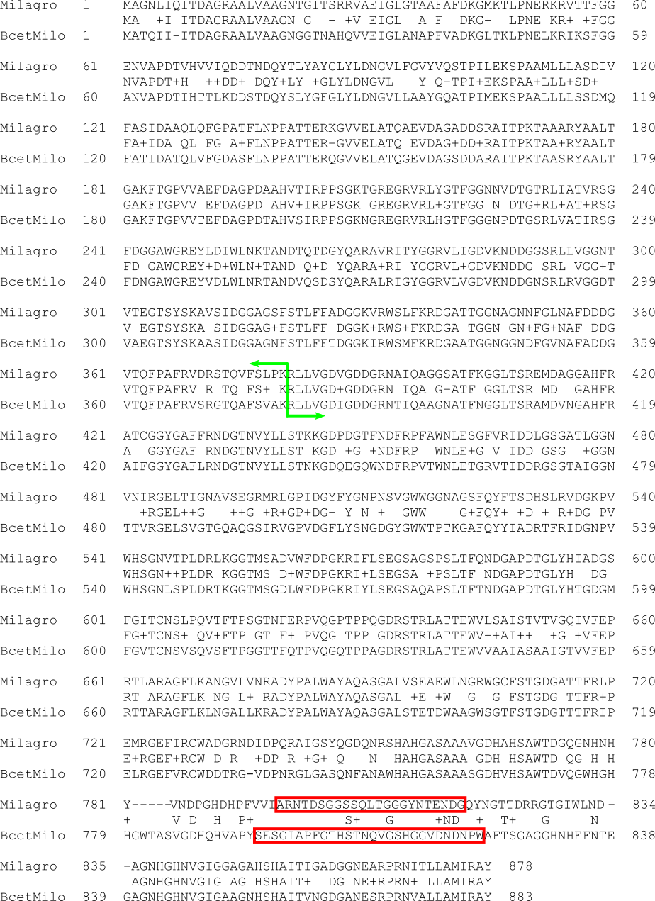
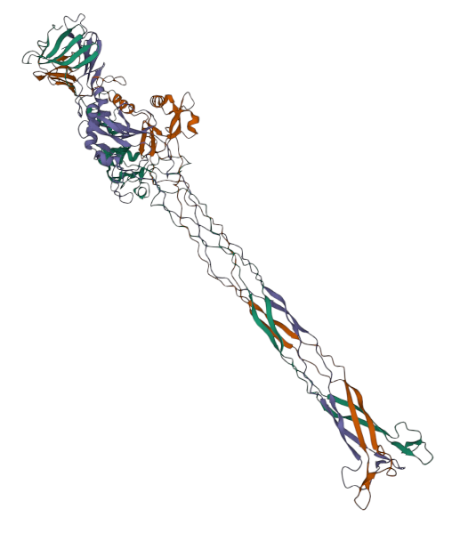
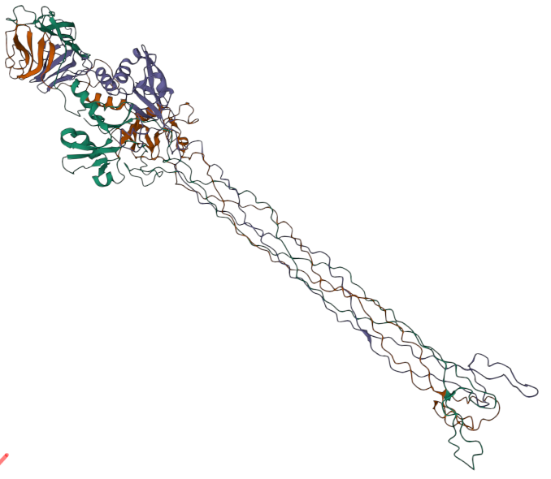
Milagro
BceTMilo
Supplementary Figure 1. Left: BLASTp protein sequence alignment of the Milagro tail fiber (gp20) and the BceTMilo tail fiber (NCBI ARB05763). The fusion junction between the Milagro and BceTMilo tail fibers at Milagro gp20 residue R381 is shown by the green bar with arrows; upstream of this marker is Milagro sequence and downstream is BceTMilo sequence. The tail-tip loops of the Milagro and BceTMilo tail fibers predicted by AlphaFold2 (right) are boxed in red. Right: Partial structures of the Milagro and BceTMilo tail fibers as predicted by AlphaFold2. The C-terminal 300 residues of each protein were used for AlphaFold2 analysis; predictions were conducted on ColabFold (Mirdita et al. 2022) with proteins as homotrimers using template_mode pdb70 at default settings.

