Slide 1
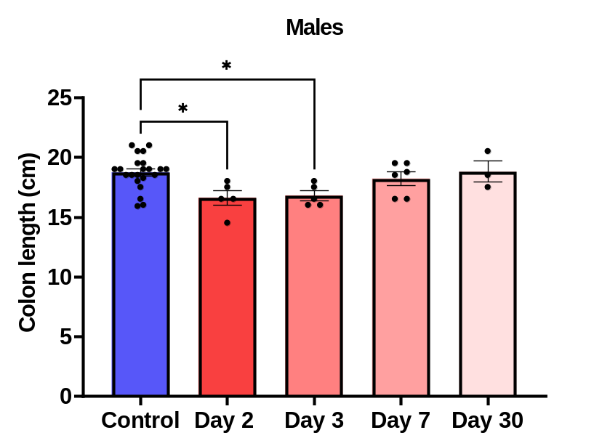
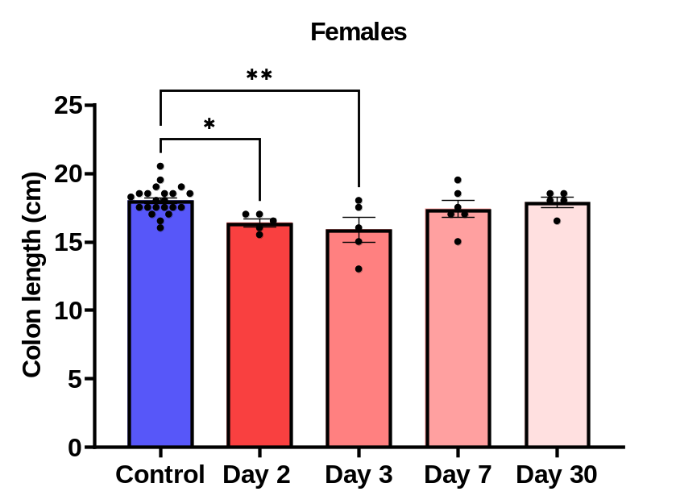
A
B
Supplemental Figure 1. Colon length was decreased in both male (A) and female (B) IBD rats on days 2 and 3 following injection (* = p ≤ 0.05; ** = p ≤ 0.01). The colon lengths return to normal at day 7 and day 30.

Slide 2
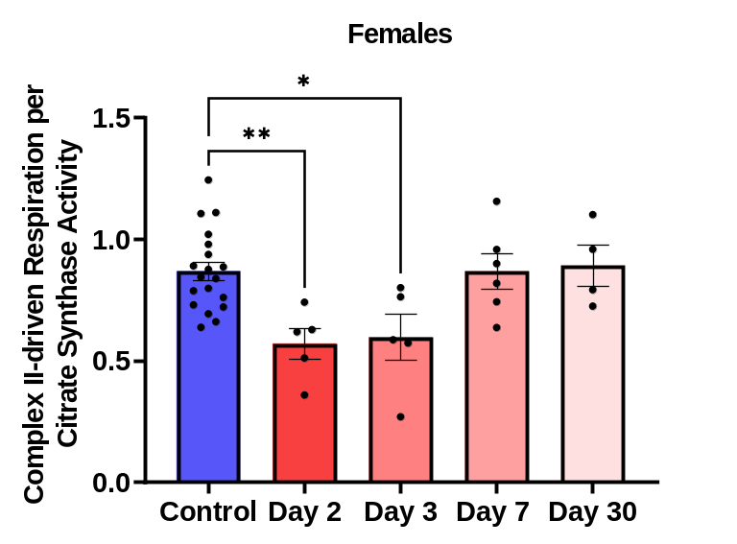
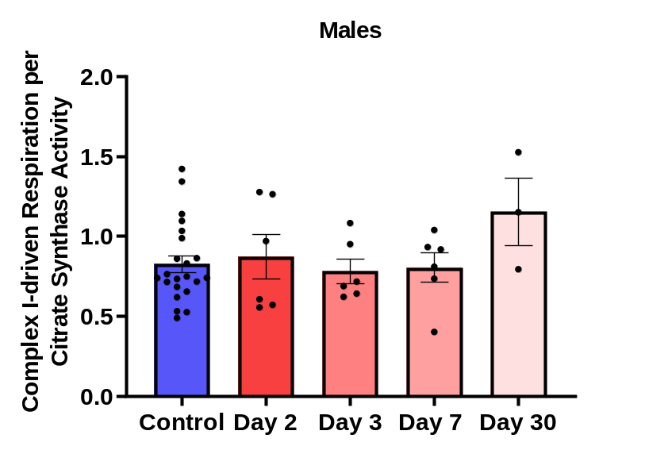
A
B
Supplemental Figure 2. (A) Complex I-driven mitochondrial respiration (20 mM glutamate and 10 mM malate plus 2mM ADP) shows a significant decrease in females with IBD compared to controls (* = p ≤ 0.05; ** = p ≤ 0.01) at days 2 and 3 with activity returning on day 7 and day 30. (B) No significant difference was observed in males with IBD compared to controls for all days.

Slide 3
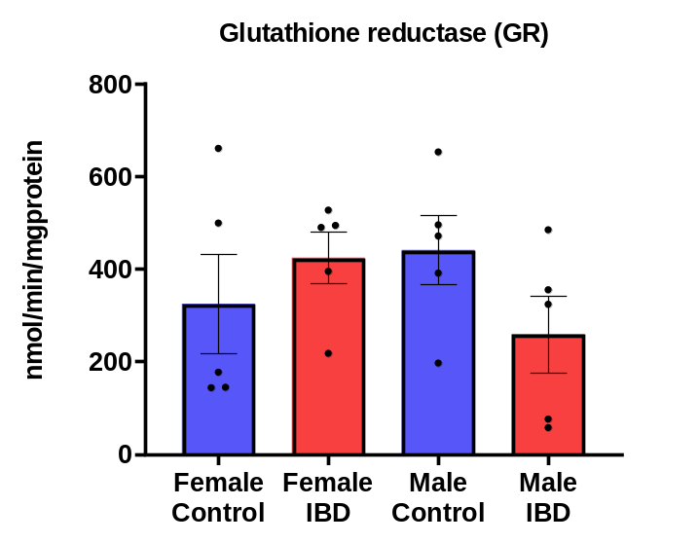
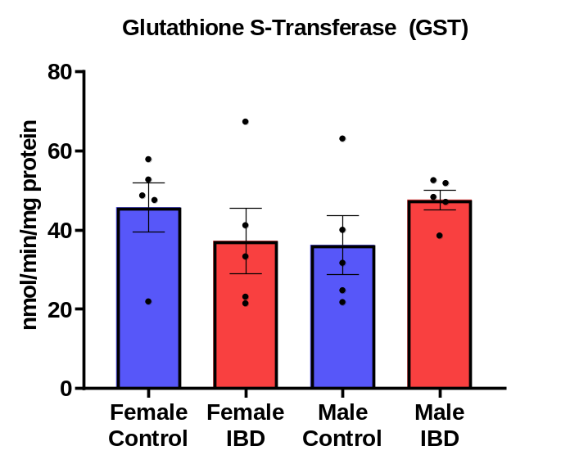
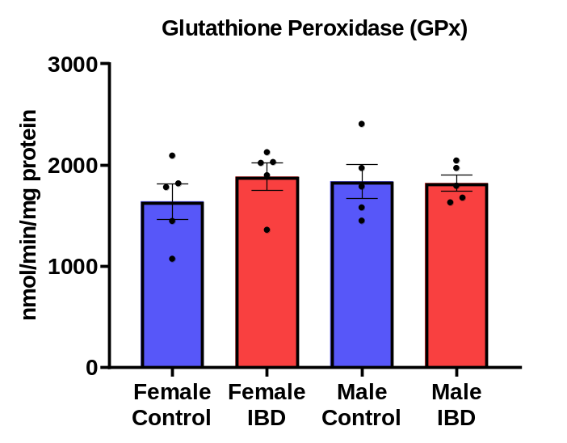
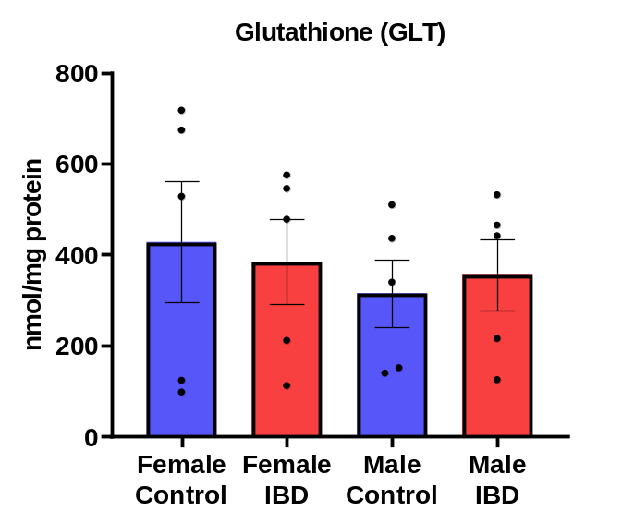
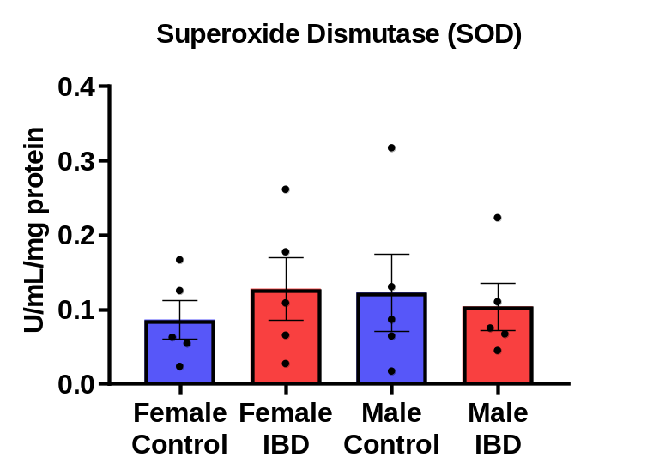
A
B
C
D
E
Supplemental Figure 3. No change was observed in colon antioxidant defenses such as (A) glutathione reductase (GR), (B) glutathione S-transferase (GST), (C) glutathione peroxidase (GPx), (D) glutathione (GLT), and (E) superoxide dismutase (SOD) between control and IBD animals.

