Slide 1
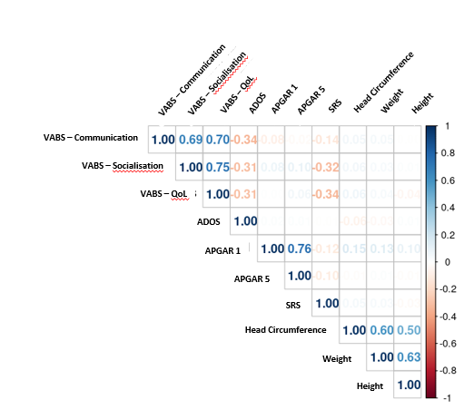
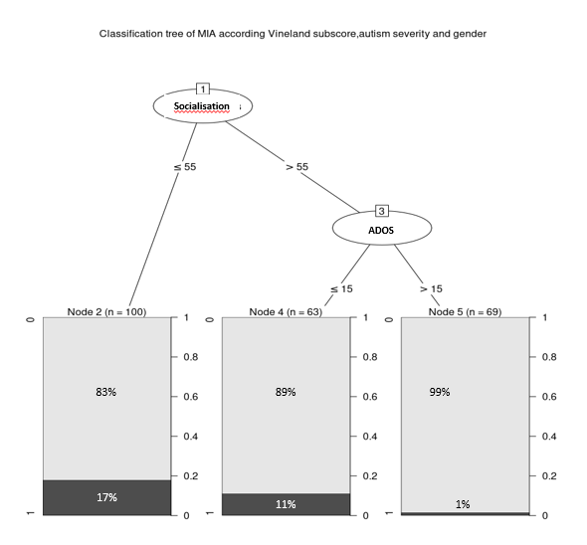
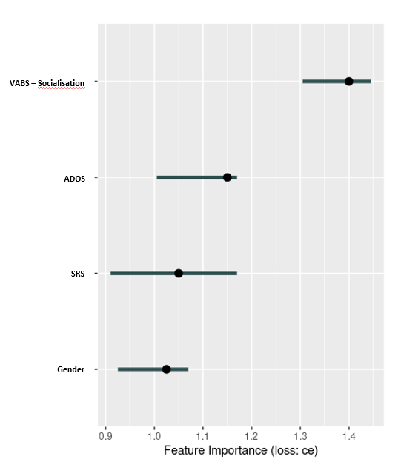
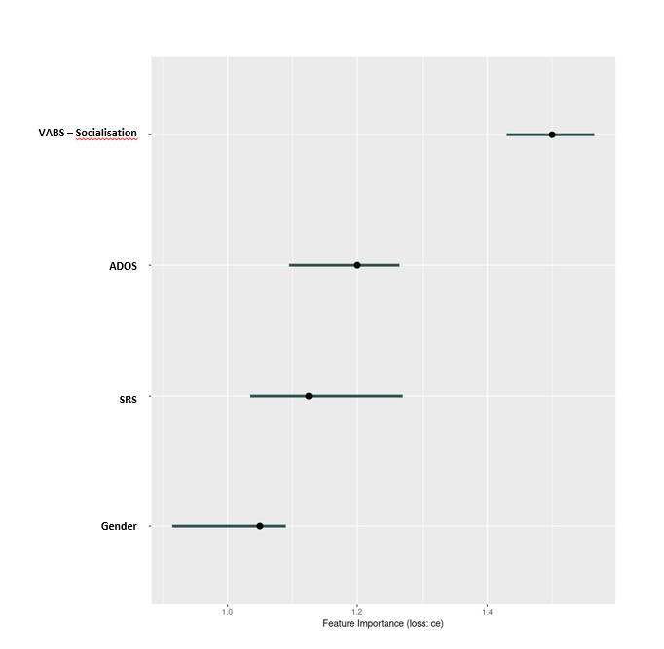
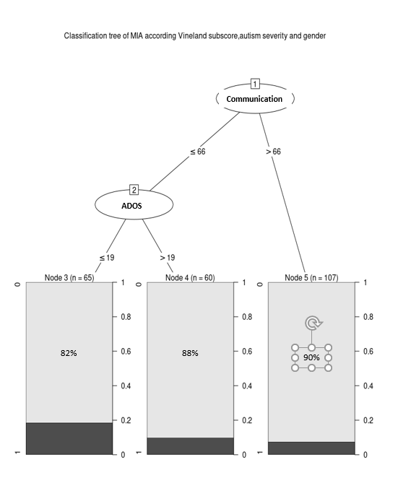
A
B
C
C
D
E
Figure 1: More severe impact on adaptative behaviors related to socialization is associated with maternal immune activation during pregnancy. A) Correlogram of the different subscores of the Vineland II with clinical parameters. B) Classification decision tree of the risk of maternal immune activation during pregnancy depending on Vineland II – Socialisation sub-score and ADOS total score on the autistic offspring. C) Feature importance for the supervised analysis. Feature importance computes the importance of features by calculating the increase in the model prediction error after permuting the feature. D) Feature importance for the supervised linear discriminant analysis. E) Classification decision tree of the risk of maternal immune activation during pregnancy depending on Vineland II – Communication sub-score and ADOS total score on the autistic offspring.
MIA: Maternal immune activation, SRS: Social Responsiveness Scale 2nd edition; ADOS Autism Diagnostic Observation Schedule 2nd edition, VABS: Vineland Adaptive Behavior Scales 2nd edition
18%
12%
10%

