Slide 1
SUPPLEMENTARY INFORMATION
Antifungal potential of extracellular metabolites produced by Streptomyces sp CACIS-1.16CA to inhibit the growth of soil-borne phytopathogenic fungi
Karen A. Vargas-Gómez^{†1}, Zahaed Evangelista-Martínez^{*†1}, Élida Gastélum-Martínez¹, Evangelina Esmeralda Quiñones-Aguilar², Gabriel Rincón-Enríquez²
Centro de Investigación y Asistencia en Tecnología y Diseño del Estado de Jalisco, AC (CIATEJ). ¹Subsede Sureste, Parque Científico de Yucatán, Tablaje Catastral 31264 km 5.5 Carretera Sierra Papacal - Chuburná Puerto, CP 97302. Mérida, Yucatán, México. ²Subsede Zapopan.
† These authors contributed equally
*Corresponding author
Z. E-M: zevangelista@ciatej.mx

Slide 2
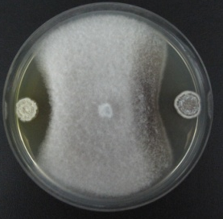
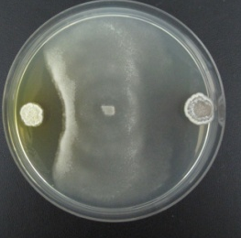
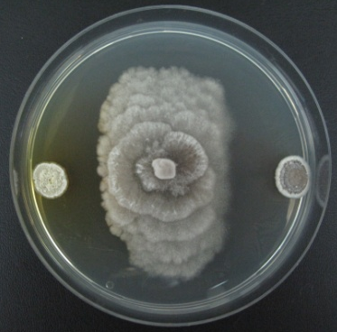
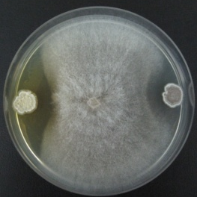
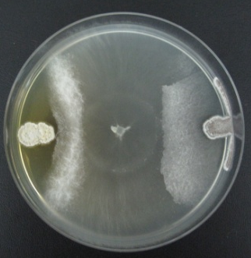
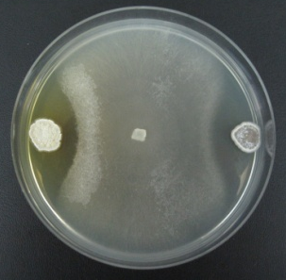
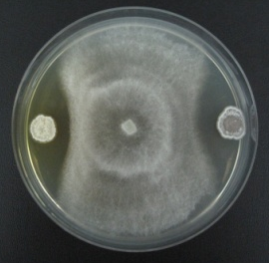
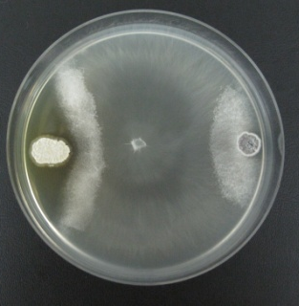
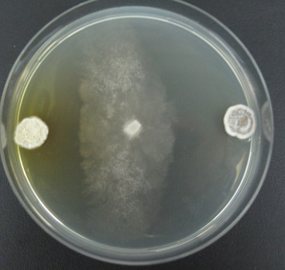
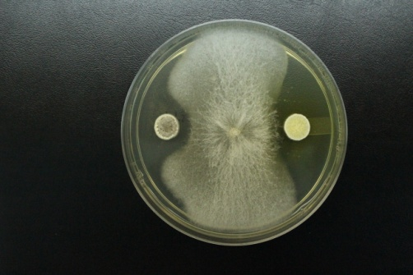
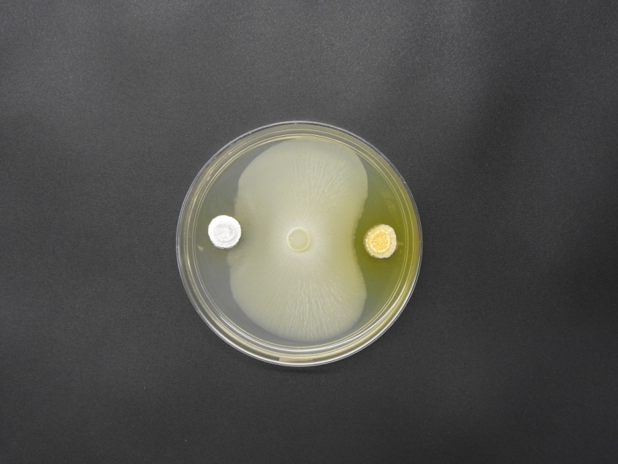
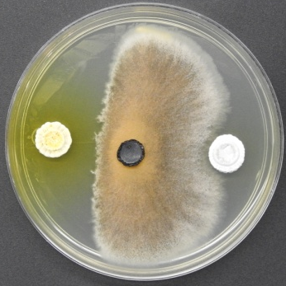
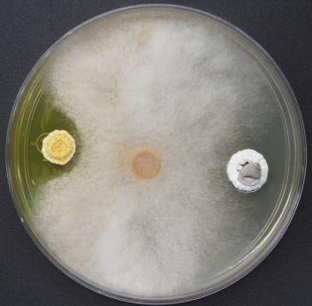
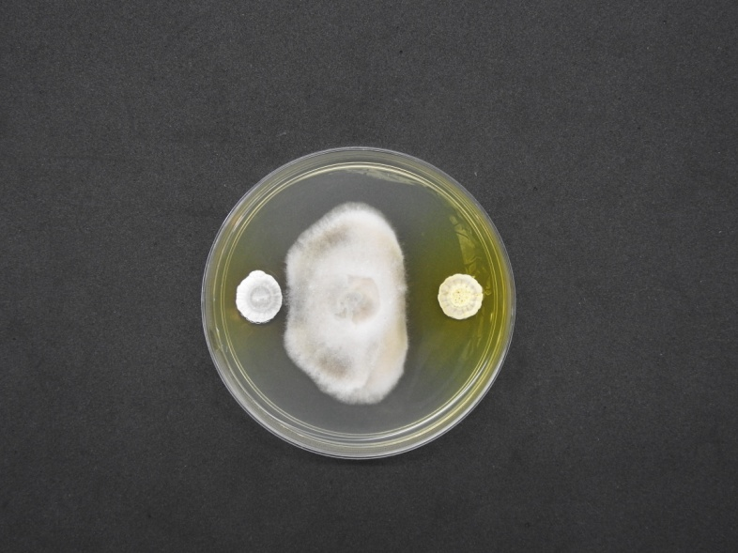
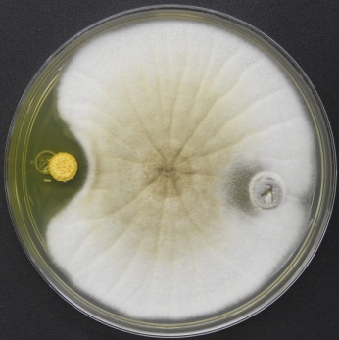
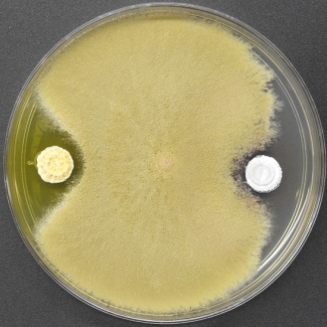
Bi
Ph
Cc
Fe
*
**
Fol
FC
FS
Fo
Pc
Rs
Scl
Cs
Cm
Al
As
Bc
Online Resoruce 1 In vitro antagonistic activity of Streptomyces sp CACIS-1.16CA against different phytopathogenic fungi. Bipolaris sp (Bi), Phomopsis sp (Ph), Corynespora casiicolla (Cc), Fusarium equisetti (Fe), F. oxysporum f. sp. lycopersici (Fol), Fusarium sp CDBB 1172 (FC), F. solani (Fs), F. oxysporum (Fo), Phytophthora capsici (Pc), Rhizoctonia solani (Rs), Sclerotium sp (Scl), Colletotrichum siamense M1.2 (Cs), C. musae Cm6 (Cm), Alternaria sp (Al), Aspergillus sp (As), Botrytis cinerea (Bc). *Left side: Streptomyces sp CACIS-1,16CA, ** Right side: S. lydicus WYEC108

Slide 3
Online Resoruce 2 Scanning electron micrography showing spore morphology of Streptomyces sp. CACIS-1.16CA

