Slide 1
Supplementary figures
Loci Associated with Postpartum Depression: A Genome-Wide Association Study
Xue Li M.D, Nagahide Takahashi Ph.D, Akira Narita Ph.D, Yukako Nakamura Ph.D, Mika Sakurai-Yageta Ph.D, Keiko Murakami Ph.D, Mami Ishikuro Ph.D, Taku Obara Ph.D, Masahiro Kikuya Ph.D, Fumihiko Ueno Ph.D, Hirohito Metoki Ph.D, Hisashi Ohseto M.D, Ippei Takahashi MS.c, Tomohiro Nakamura Ph.D, Noriko Warita M.W, Tomoka Shoji MS.c, Zhiqian Yu Ph.D, Chiaki Ono Ph.D, Natsuko Kobayashi Ph.D, Saya Kikuchi Ph.D, Fuji Nagami Ph.D, Soichi Ogishima Ph.D , Junichi Sugawara Ph.D, Tetsuro Hoshiai Ph.D , Masatoshi Saito Ph.D, Nobuo Fuse Ph.D, Kengo Kinoshita Ph.D, Masayuki Yamamoto Ph.D, Nobuo Yaegashi Ph.D, Norio Ozaki Ph.D, Gen Tamiya Ph.D, Shinichi Kuriyama Ph.D, Hiroaki Tomita Ph.D

Slide 2
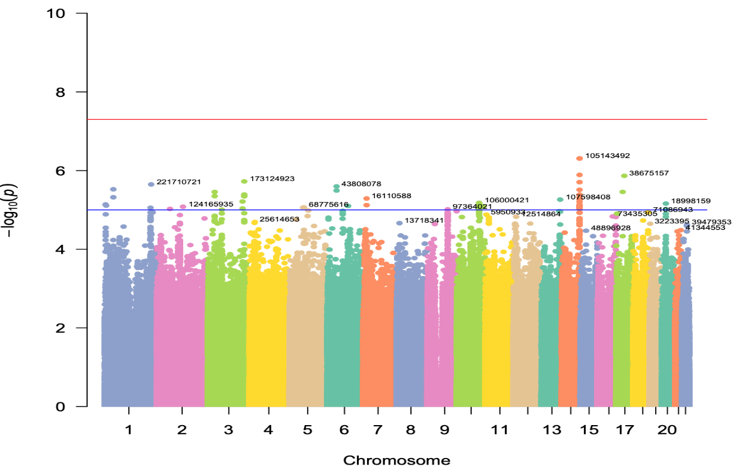
Figure S1 Manhattan plot of the association study from TMM-V2 with PCA and age

Slide 3
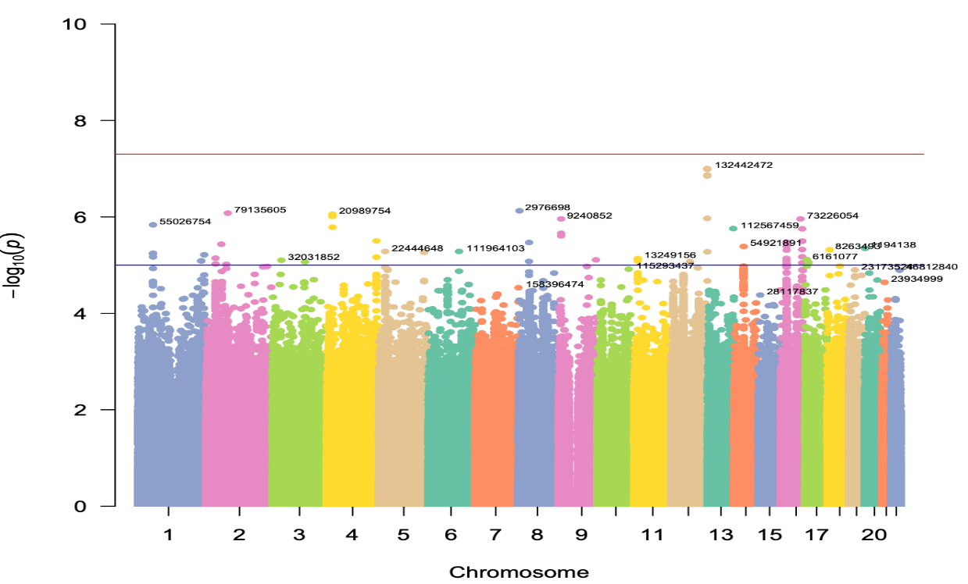
Figure S2 Manhattan plot of the association study from TMM-NEO with PCA and age

Slide 4
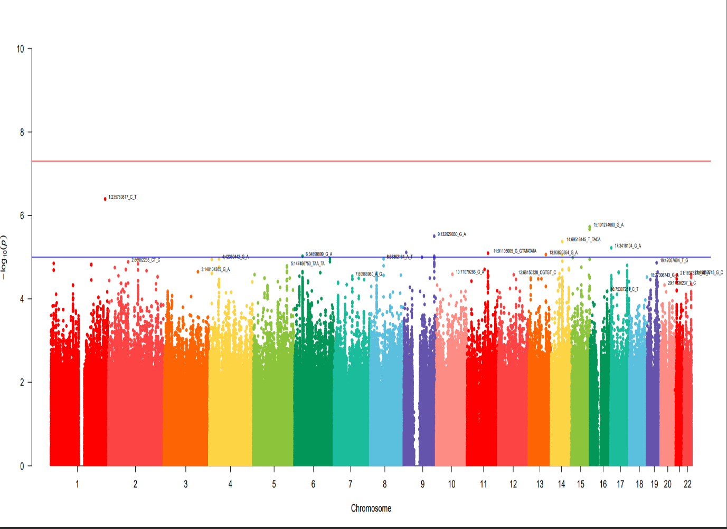
Figure S3 Manhattan plot of the association study from NGO-NEO with PCA and age

Slide 5
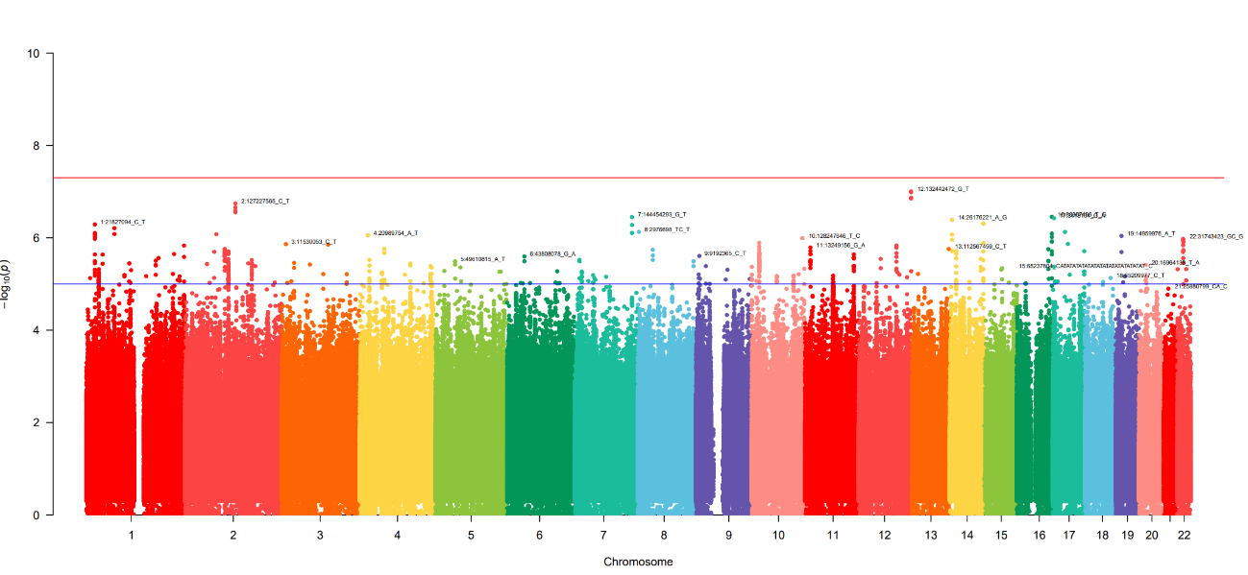
Figure S4 Manhattan plot of the meta-analysis of participants in TMM-V2, TMM-NEO, and NGO-NEO with PCA and age

Slide 6
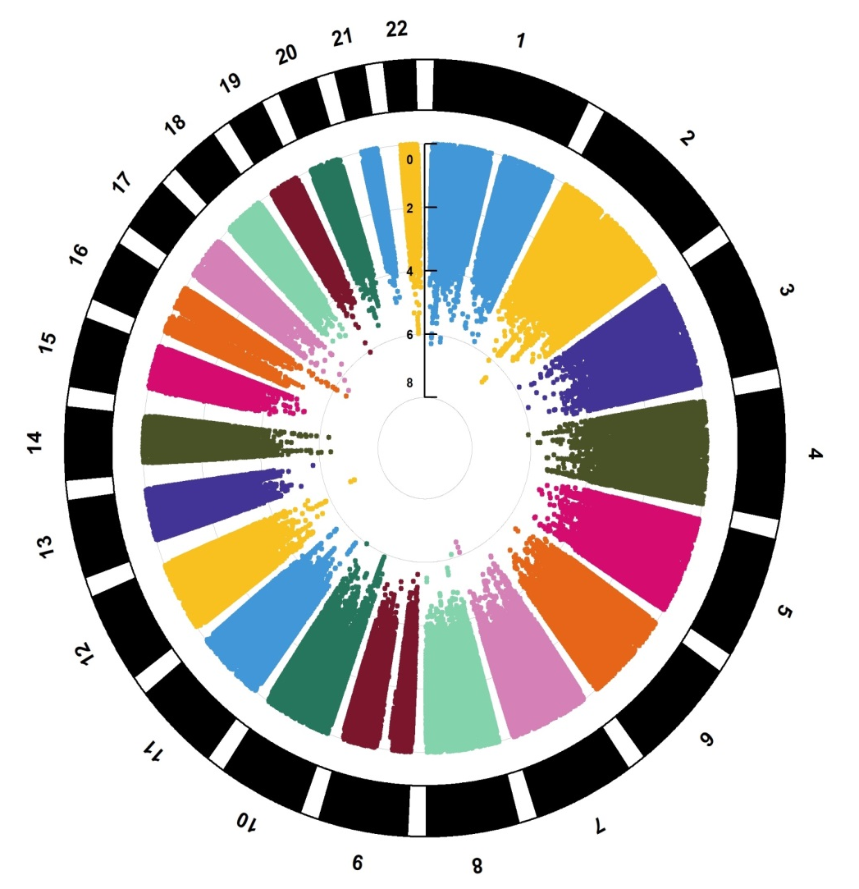
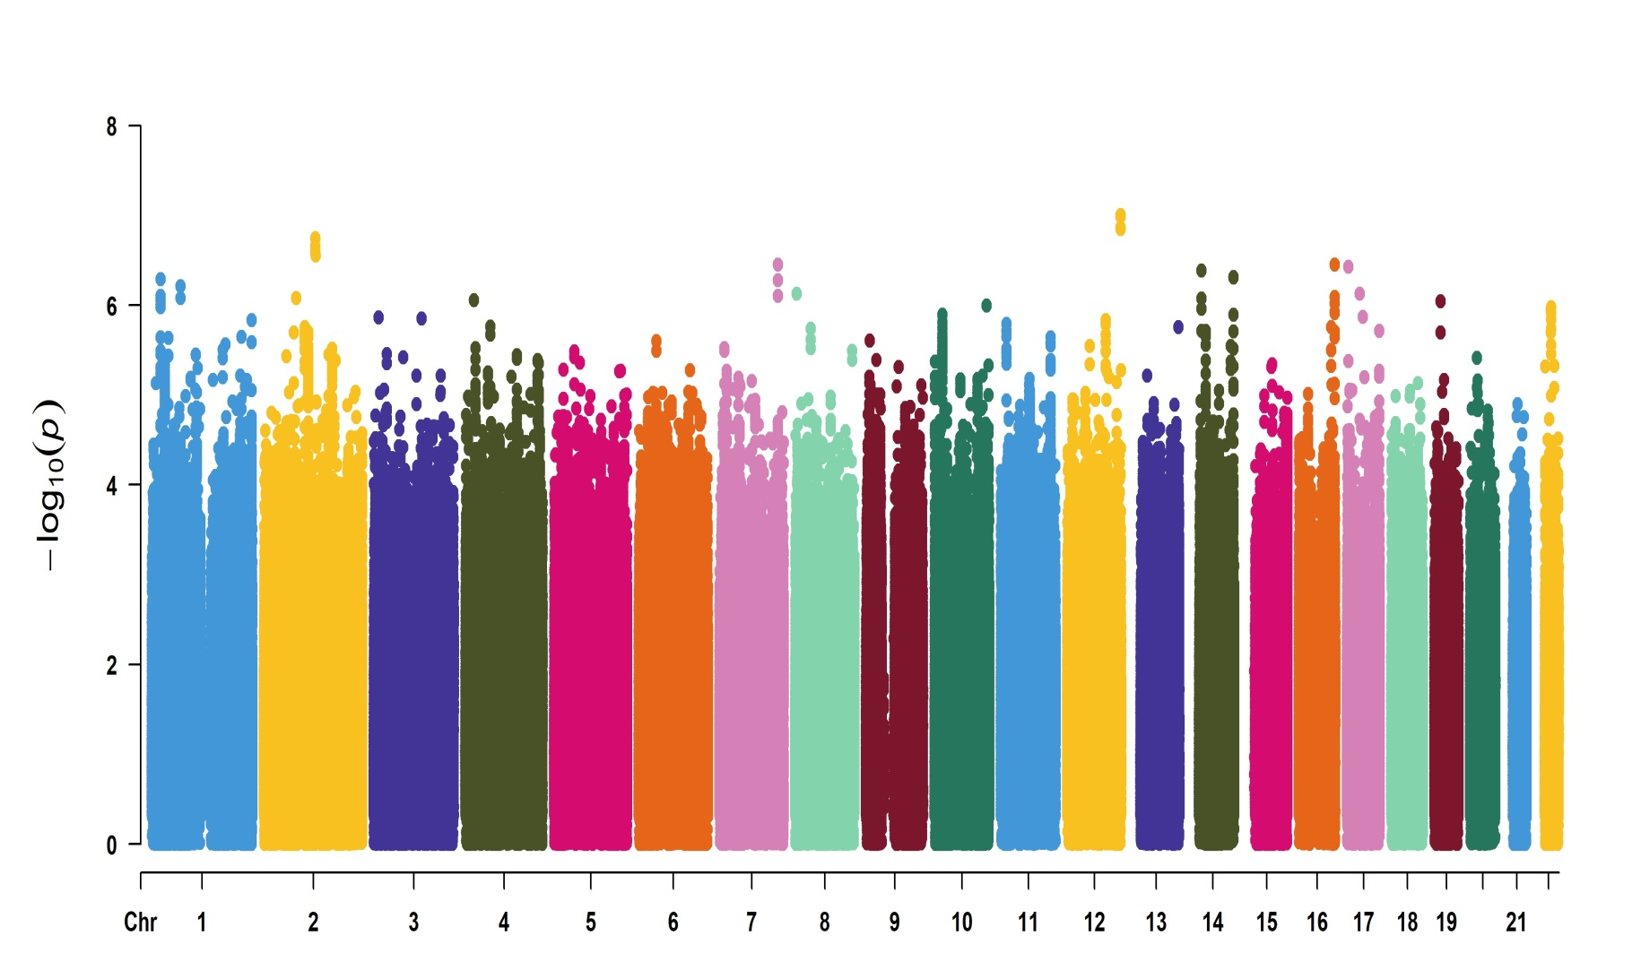
Figure S5 Manhattan plot of the meta-analysis of participants in TMM-V2, TMM-NEO, and NGO-NEO with PCA and age based on fastGWA and REGENIE

Slide 7
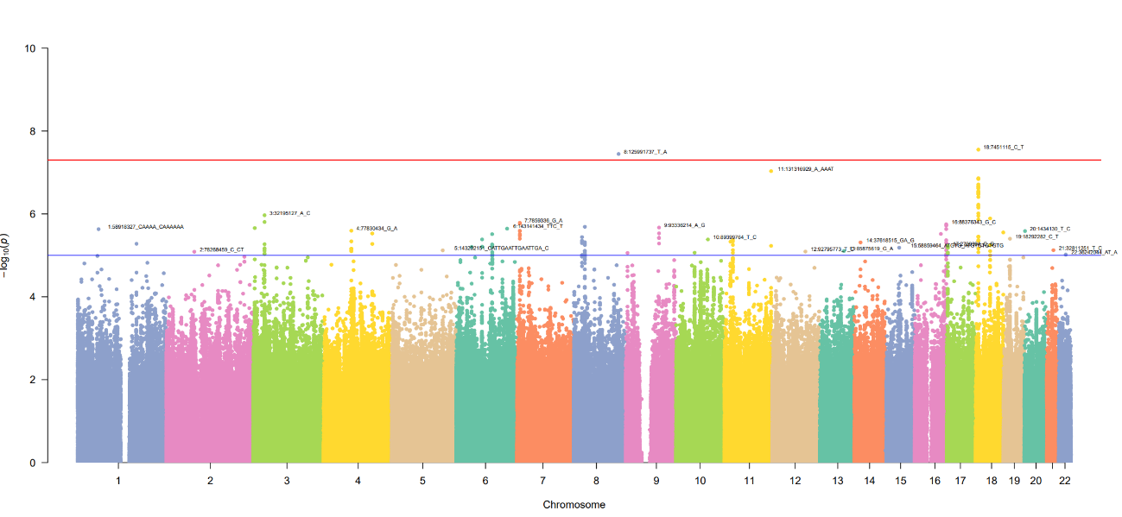
Figure S6 Manhattan plot of the association study from TMM-V2 considering factors related to PPD
ZNF572
PTPRM

Slide 8
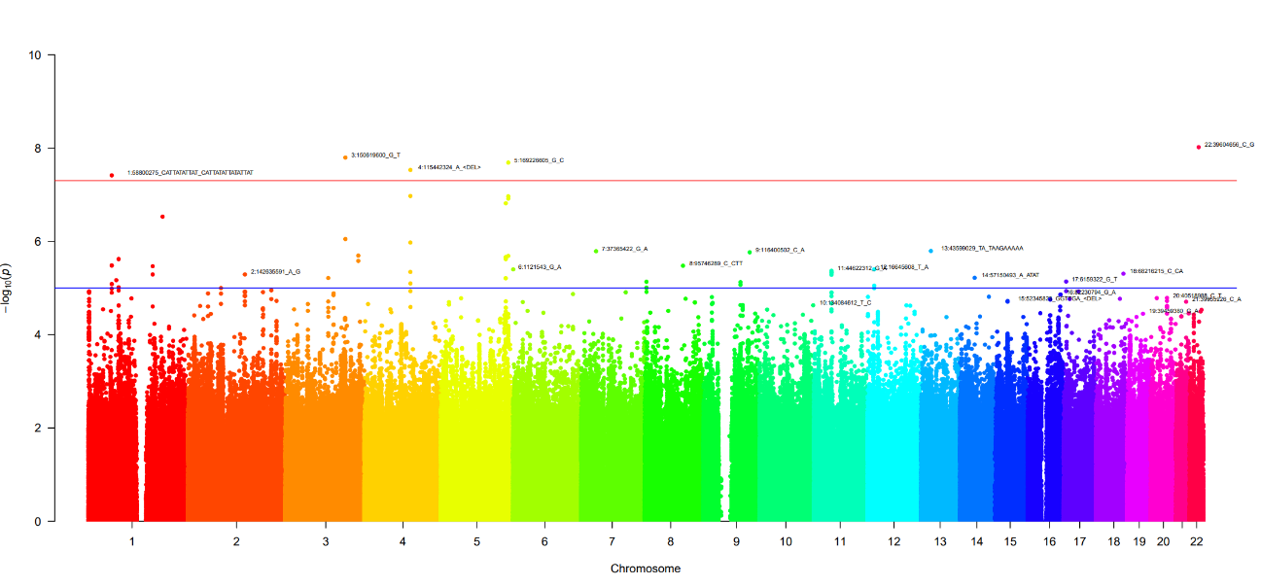
Figure S7 Manhattan plot of the association study from TMM-NEO considering factors related to PPD
DOCK2
PDGFB
RP11-166N6.3
UGT8
DAB1

Slide 9
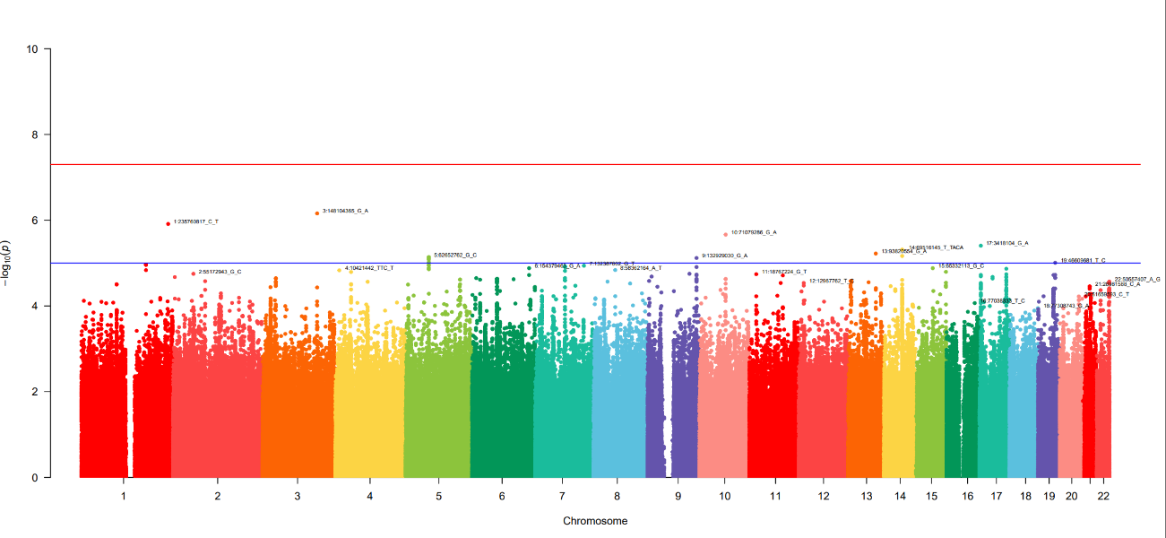
Figure S8 Manhattan plot of the association study from NGO-NEO considering factors related to PPD

Slide 10

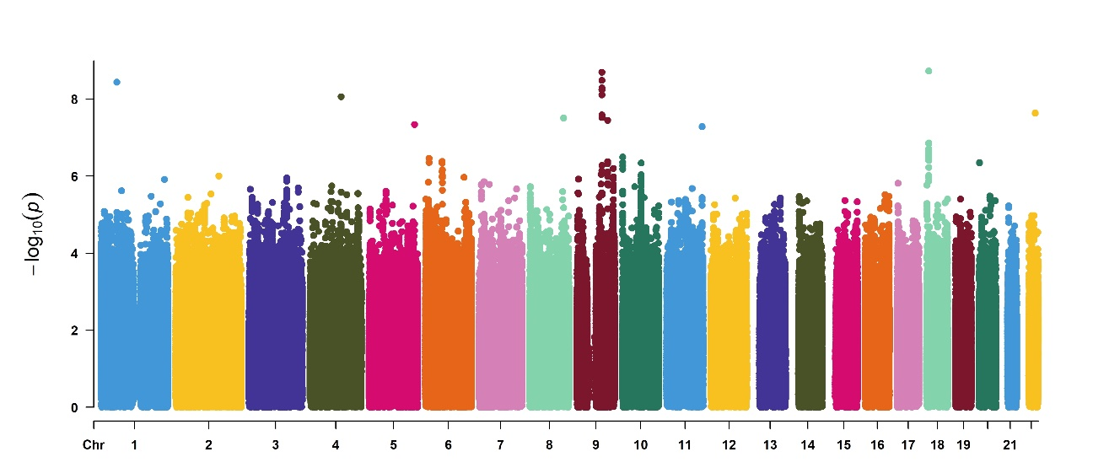
Figure S9 Manhattan plot of the meta-analysis of participants in TMM-V2, TMM-NEO, and NGO-NEO considering factors related to PPD
DIRAS2
ZNF618
DAB1
DOCK2
PDGFB
UGT8
PTPRM
ZNF572

Slide 11

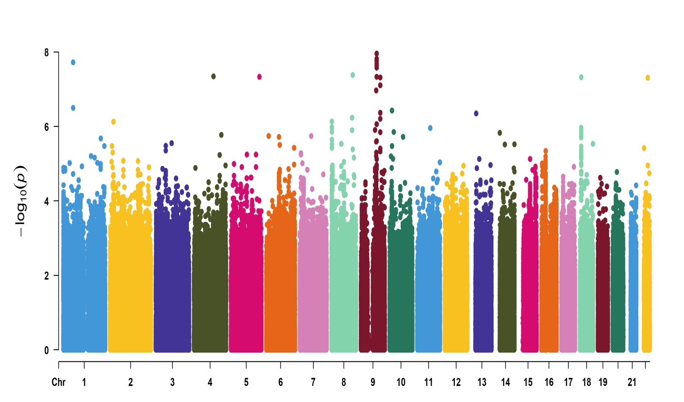
Figure S10 Manhattan plot of the meta-analysis of participants in TMM-V2, TMM-NEO, and NGO-NEO considering factors related to PPD based on fastGWA and REGENIE
DOCK2
DIRAS2
ZNF618
PDGFB
DAB1
PTPRM
UGT8
ZNF572

Slide 12
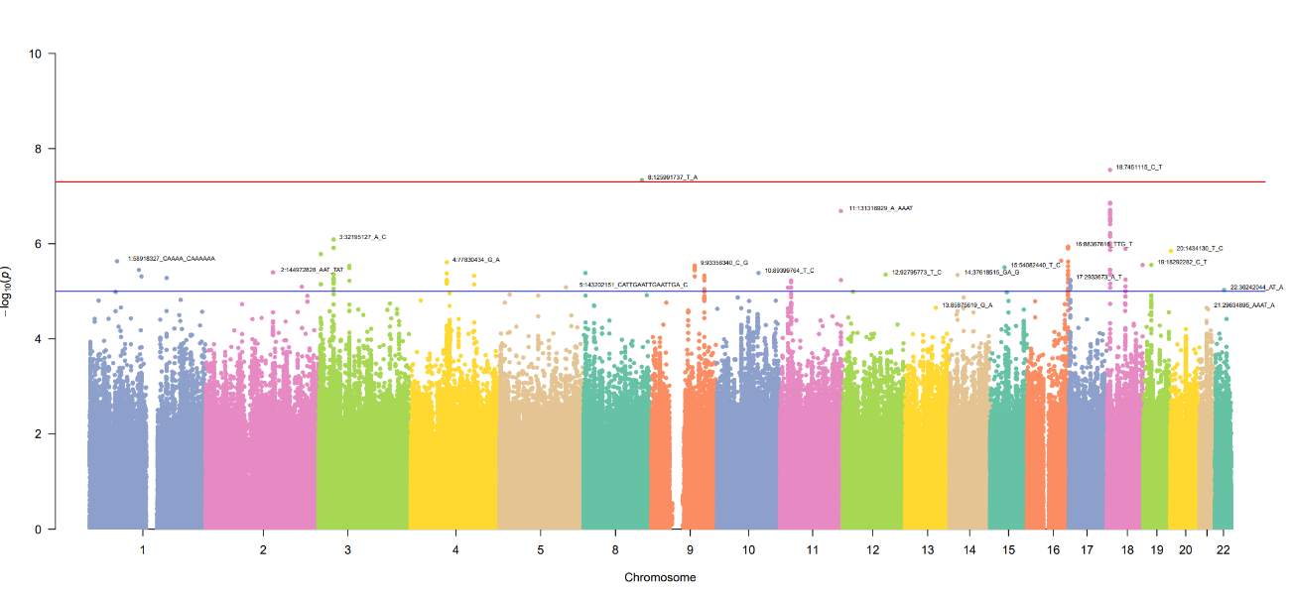
Figure S11 Manhattan plot of the association study from TMM-V2 considering important factors related to PPD
ZNF572
PTPRM

Slide 13
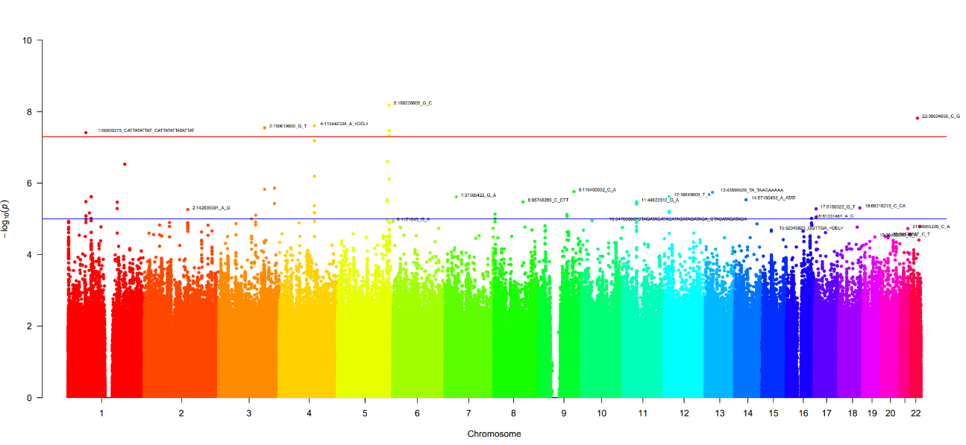
Figure S12 Manhattan plot of the association study from TMM-NEO considering important factors related to PPD
DOCK2
RP11-166N6.3
UGT8
PDGFB
DAB1

Slide 14
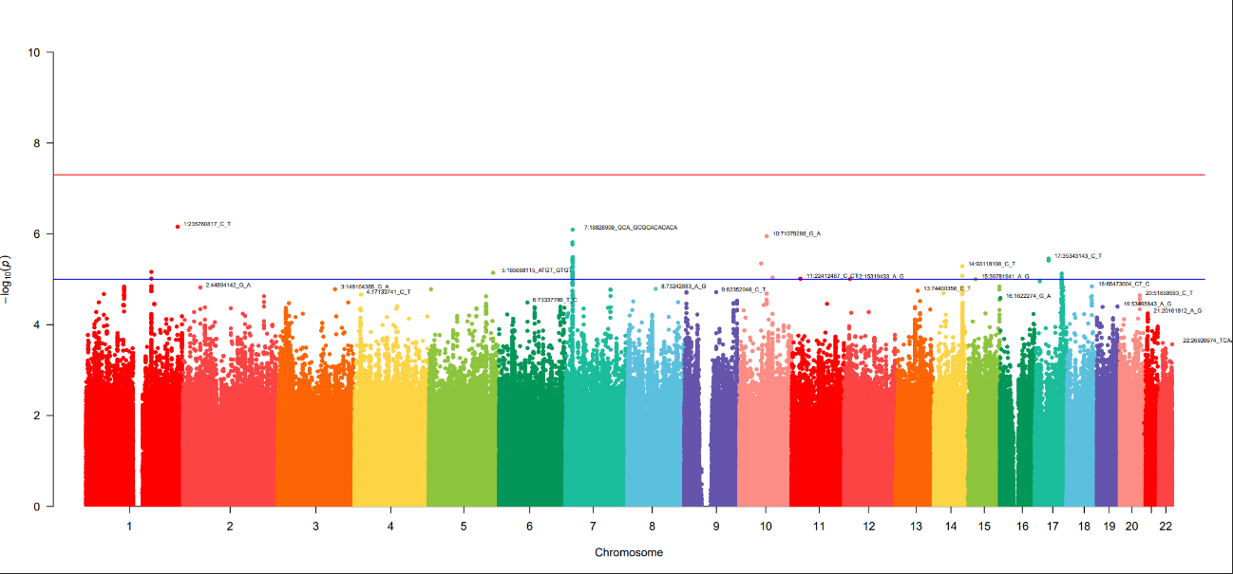
Figure S13 Manhattan plot of the association study from NGO-NEO considering important factor related to PPD

Slide 15
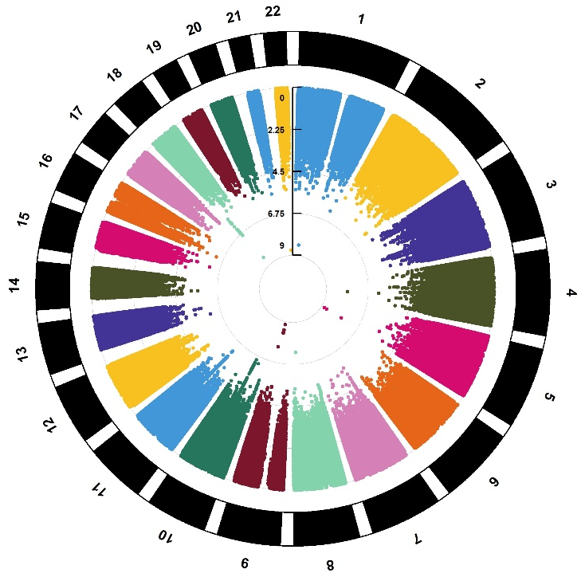
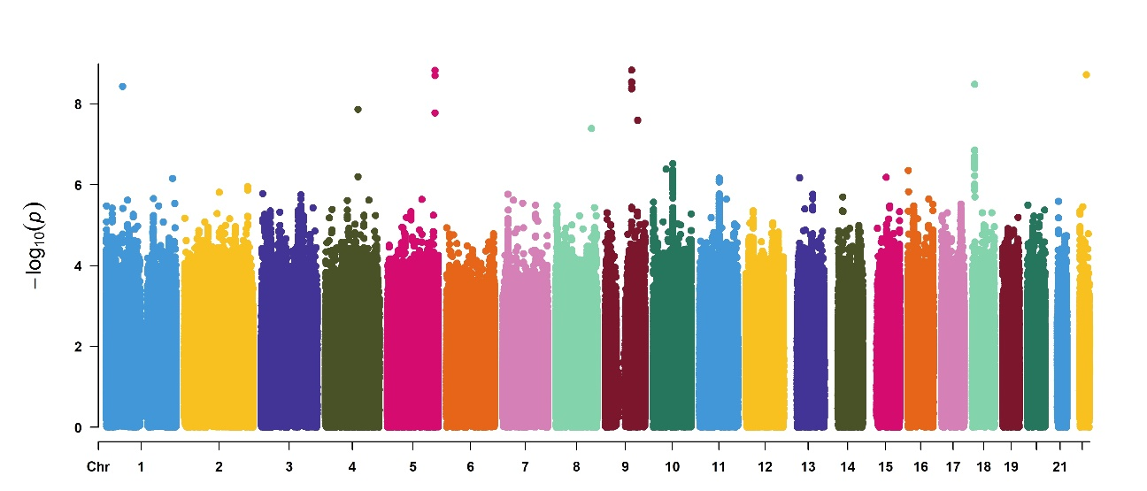
Figure S14 Manhattan plot of the meta-analysis of participants in TMM-V2, TMM-NEO, and NGO-NEO considering important factors related to PPD
DOCK2
DIRAS2
ZNF618
PDGFB
DAB1
UGT8
PTPRM
ZNF572

Slide 16
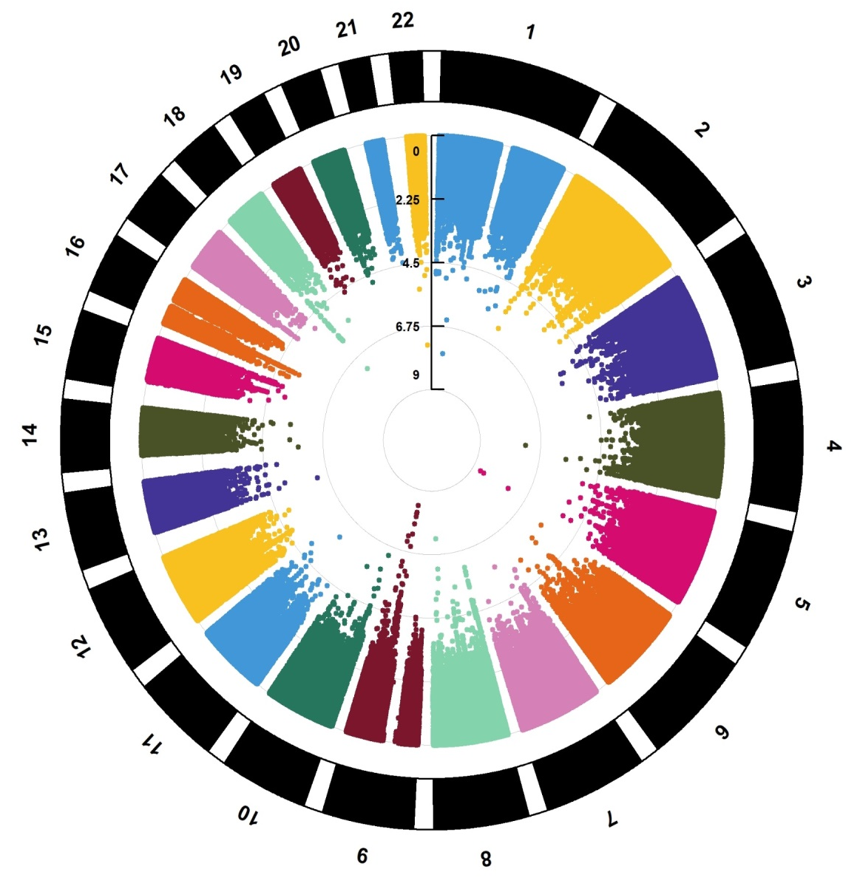
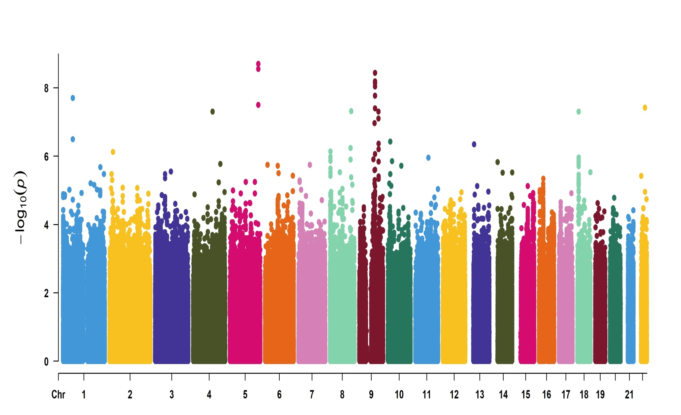
Figure S15 Manhattan plot of the meta-analysis of participants in TMM-V2, TMM-NEO, and NGO-NEO considering important factors related to PPD based on fastGWA and REGENIE
DIRAS2
ZNF618
DAB1
DOCK2
PDGFB
PTPRM
UGT8
ZNF572

Slide 17
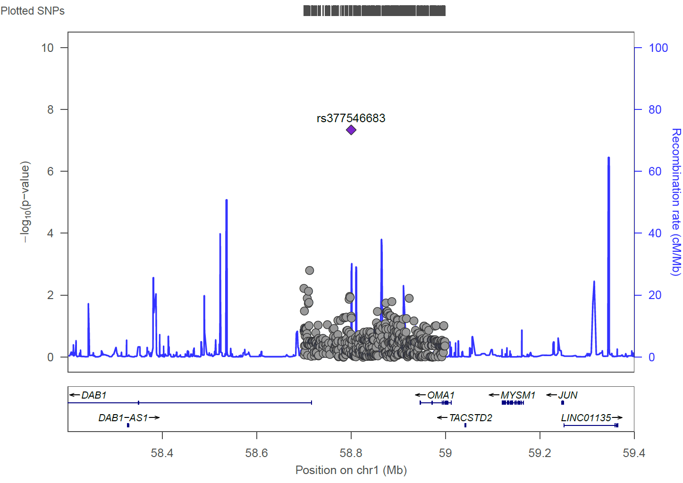
Figure S16 Regional association plot for rs377546683

Slide 18
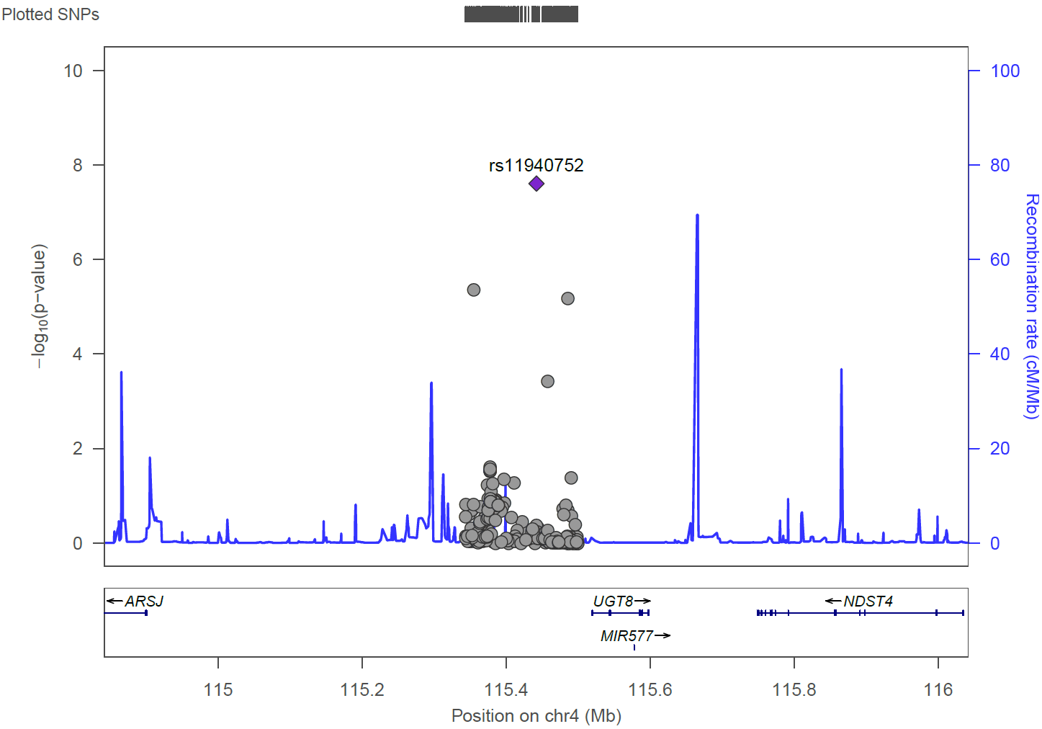
Figure S17 Regional association plot for rs11940752

Slide 19
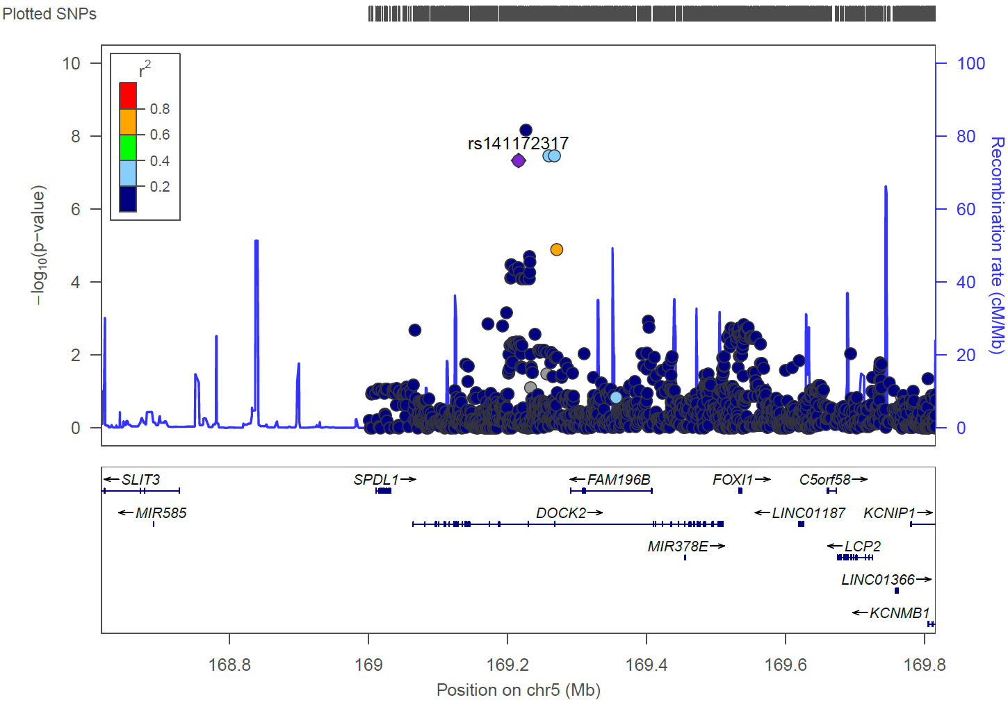
Figure S18: Regional association plot for rs141172317

Slide 20
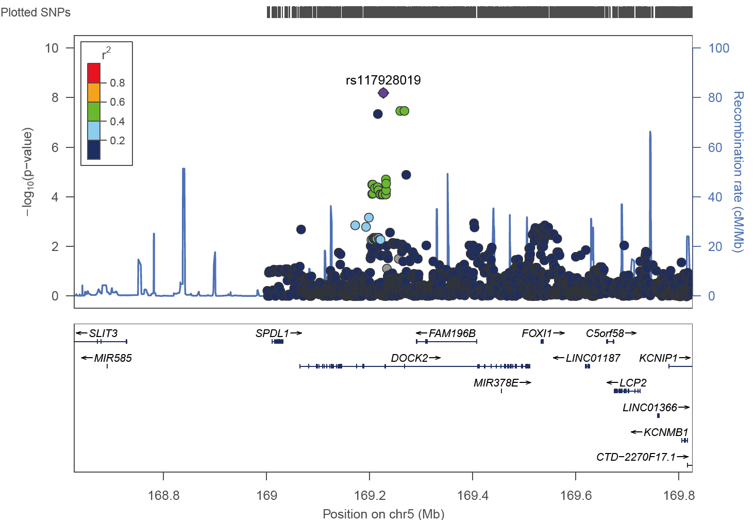
Figure S19: Regional association plot for rs117928019

Slide 21
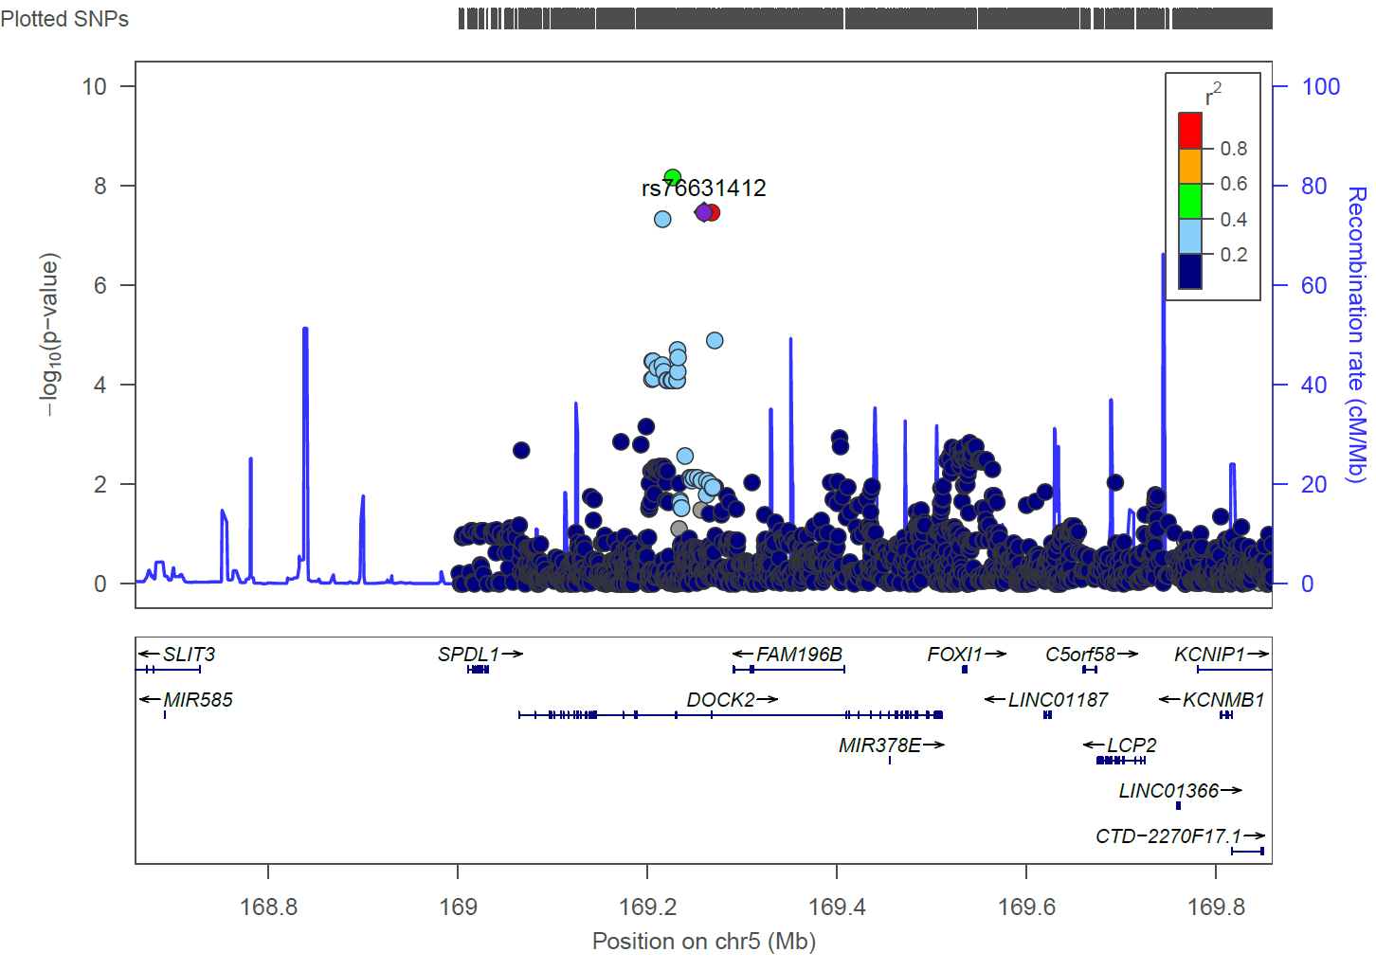
Figure S20: Regional association plot for rs76631412

Slide 22
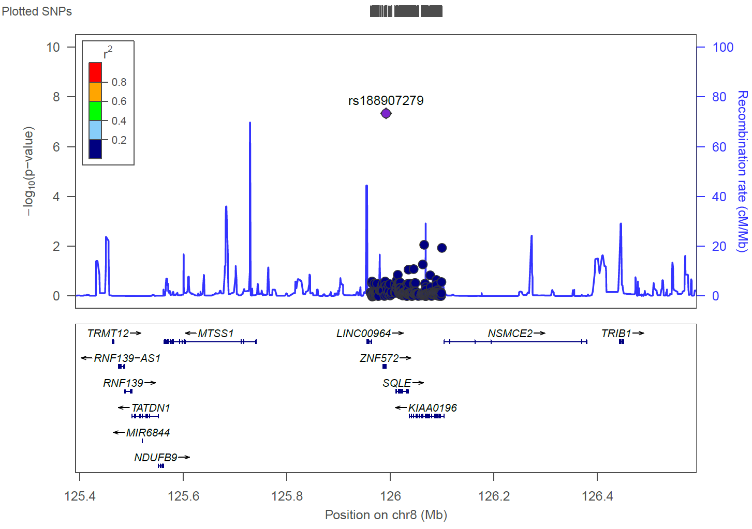
Figure S21: Regional association plot for rs188907279

Slide 23
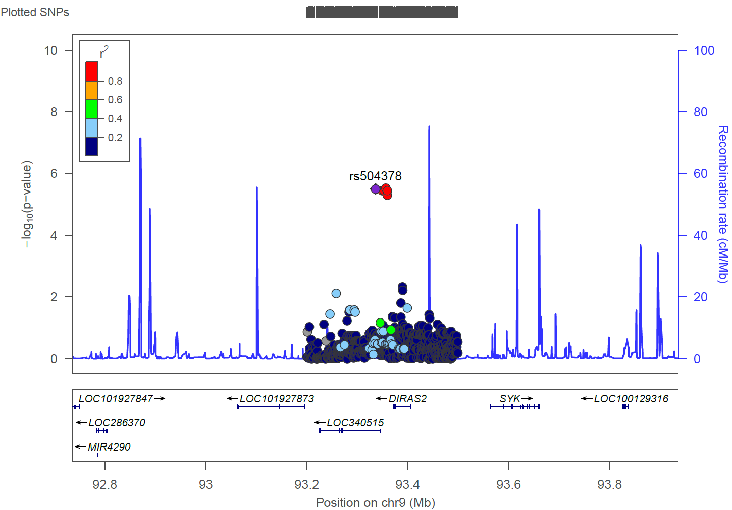
Figure S22: Regional association plot for rs504378

Slide 24
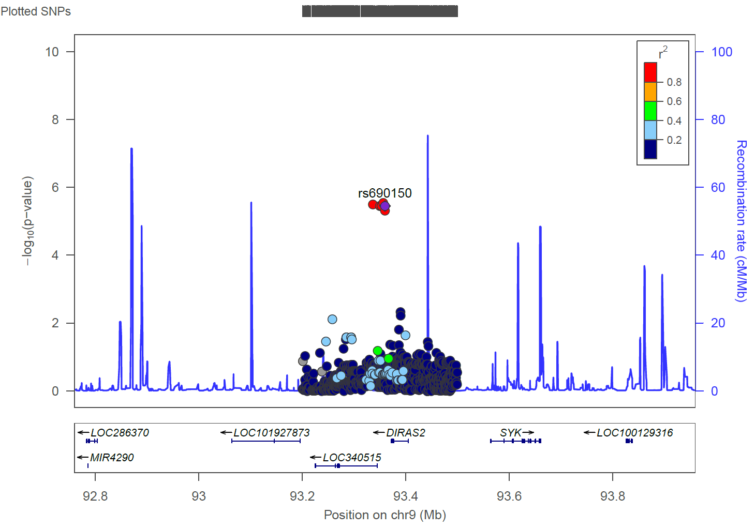
Figure S23: Regional association plot for rs690150

Slide 25
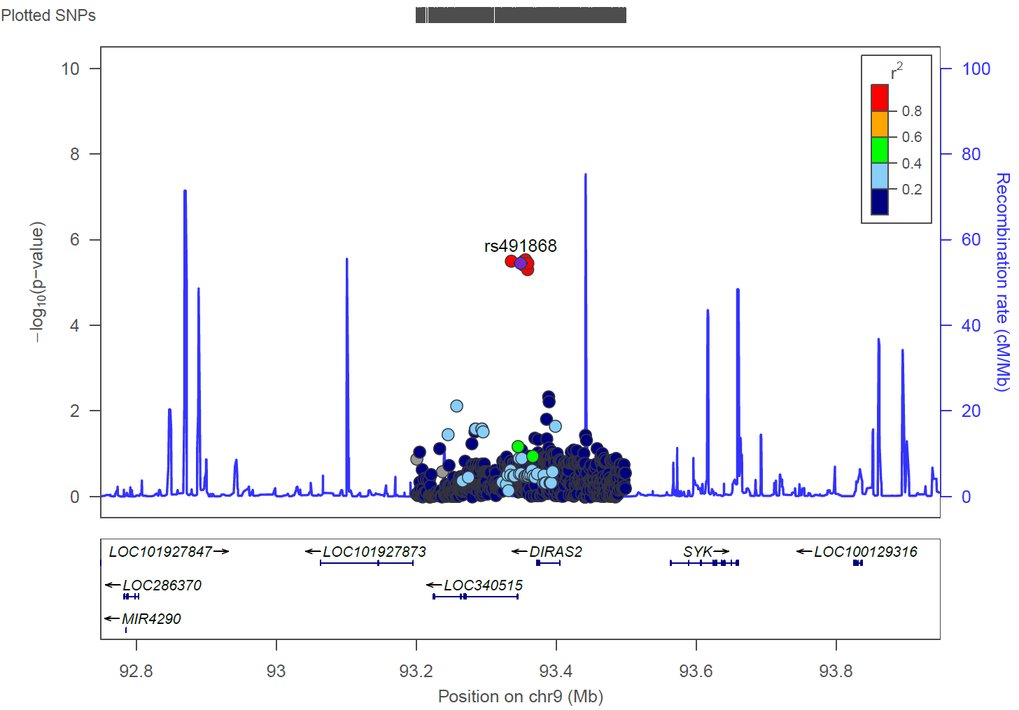
Figure S24: Regional association plot for rs491868

Slide 26

Figure S25: Regional association plot for rs689917

Slide 27
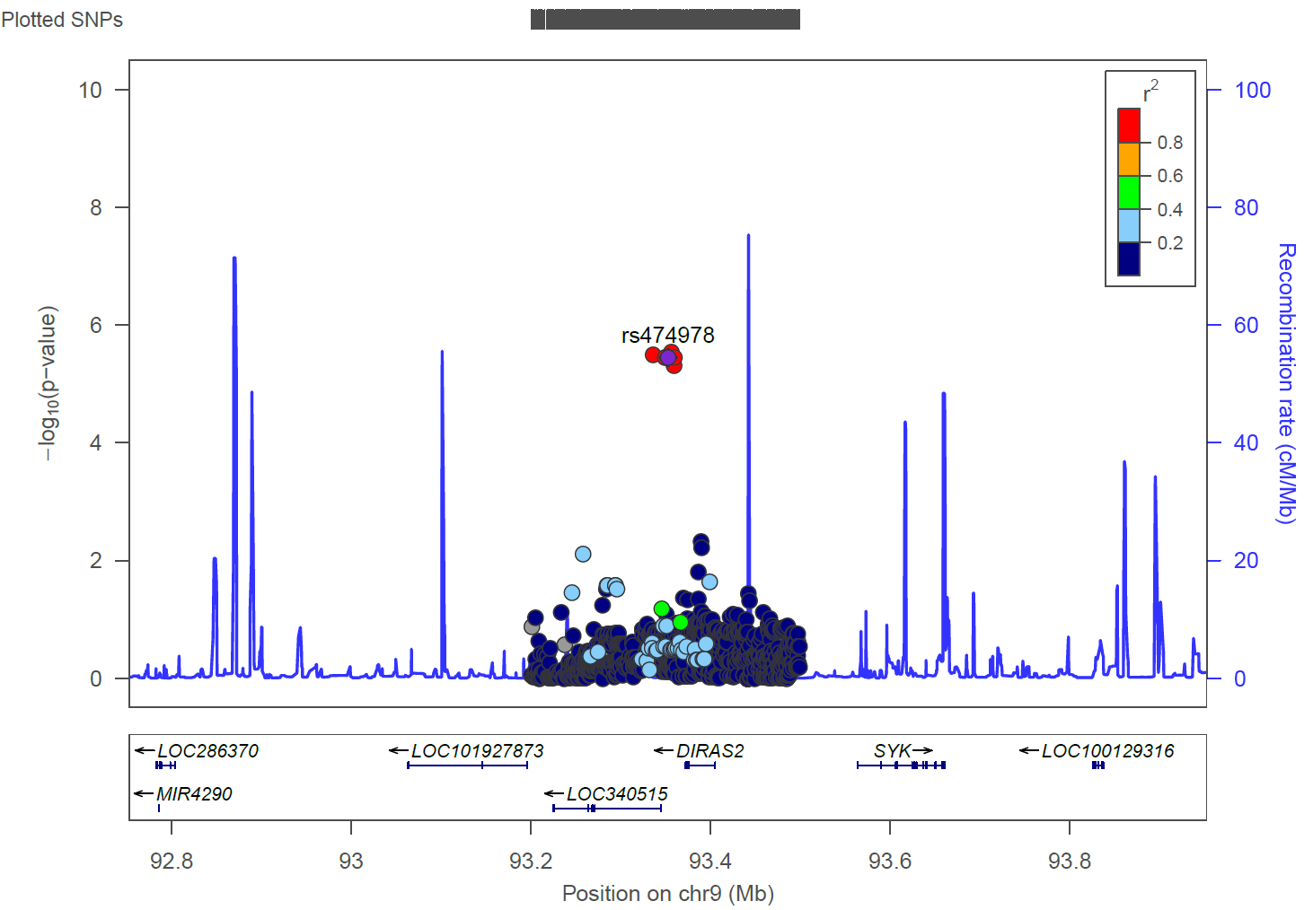
Figure S26: Regional association plot for rs474978

Slide 28
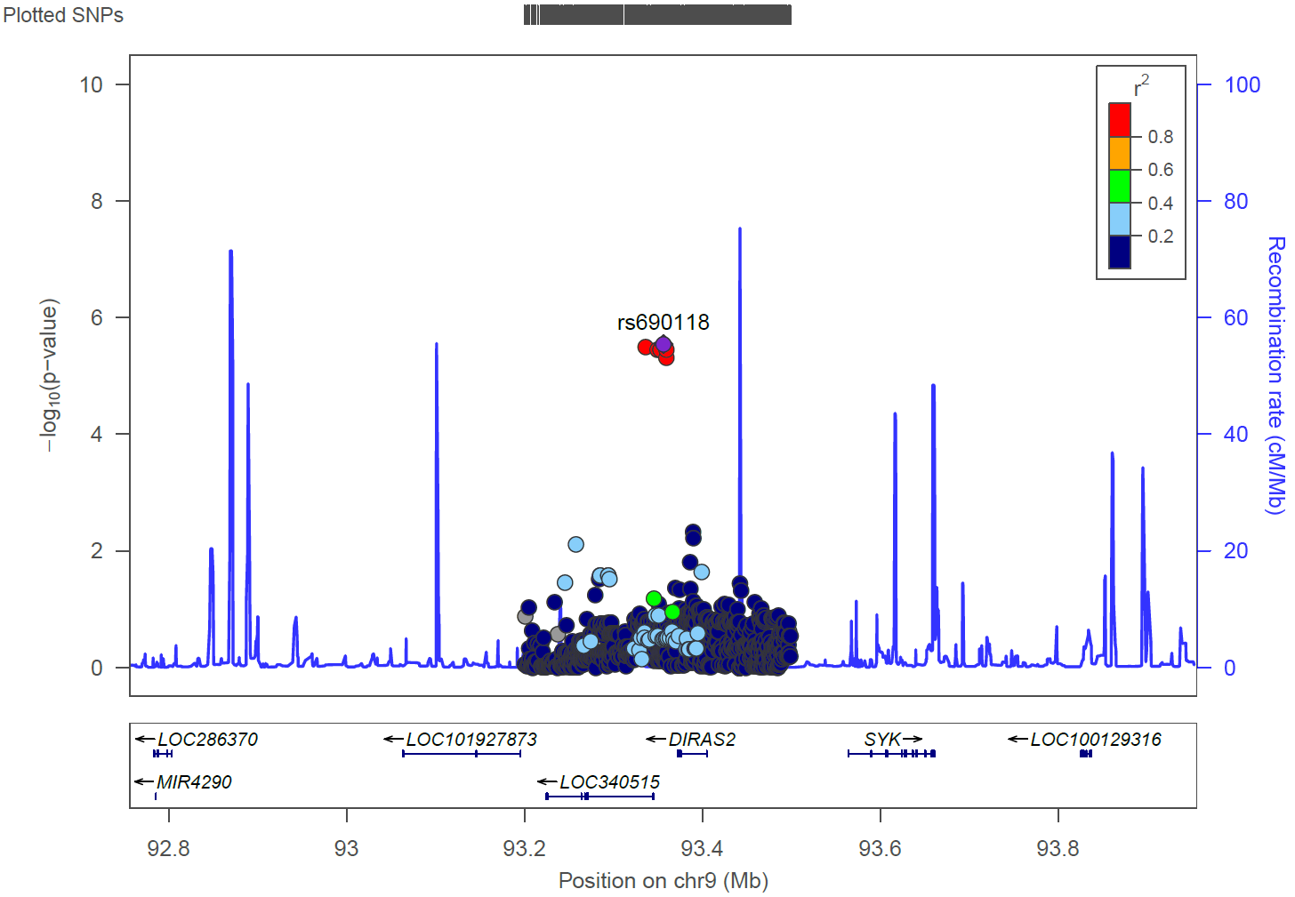
Figure S27: Regional association plot for rs690118

Slide 29
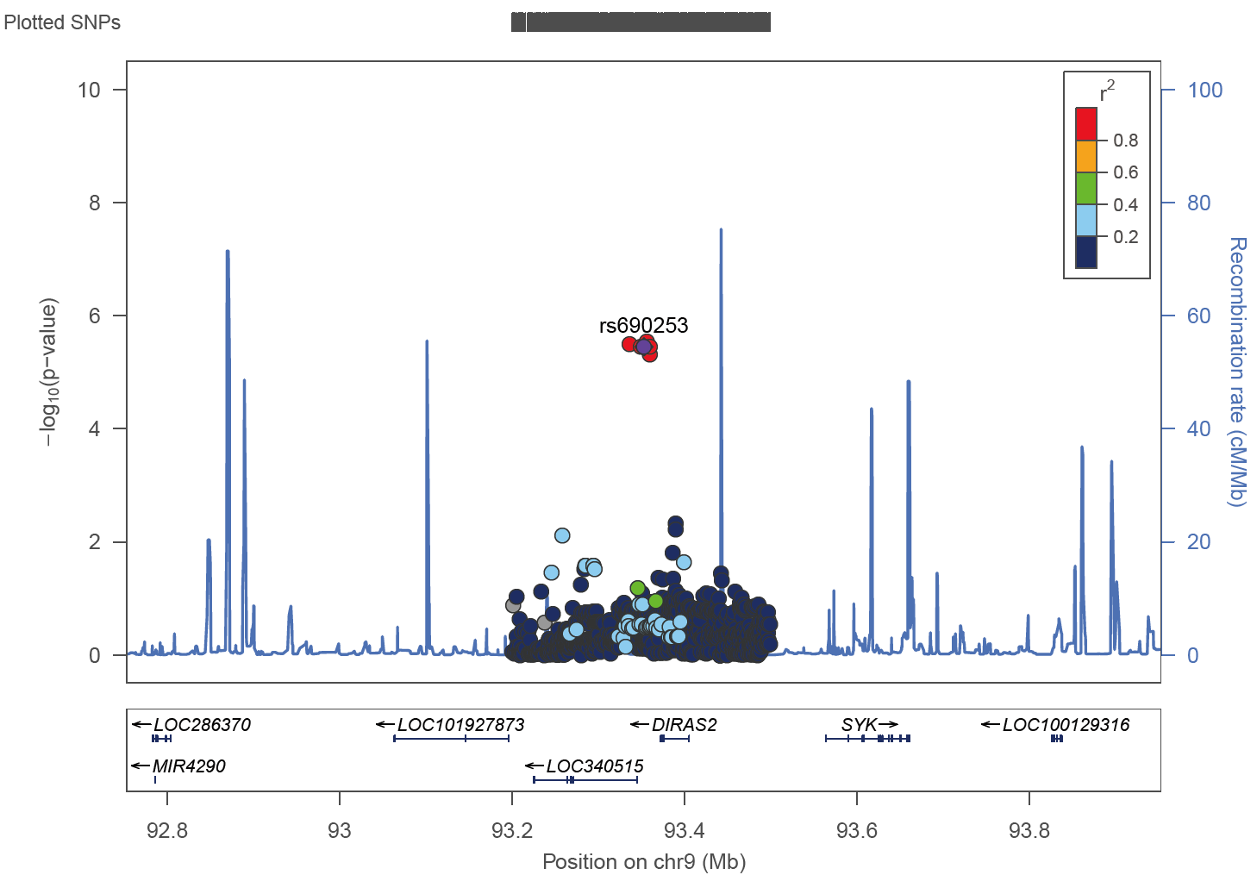
Figure S28: Regional association plot for rs690253

Slide 30
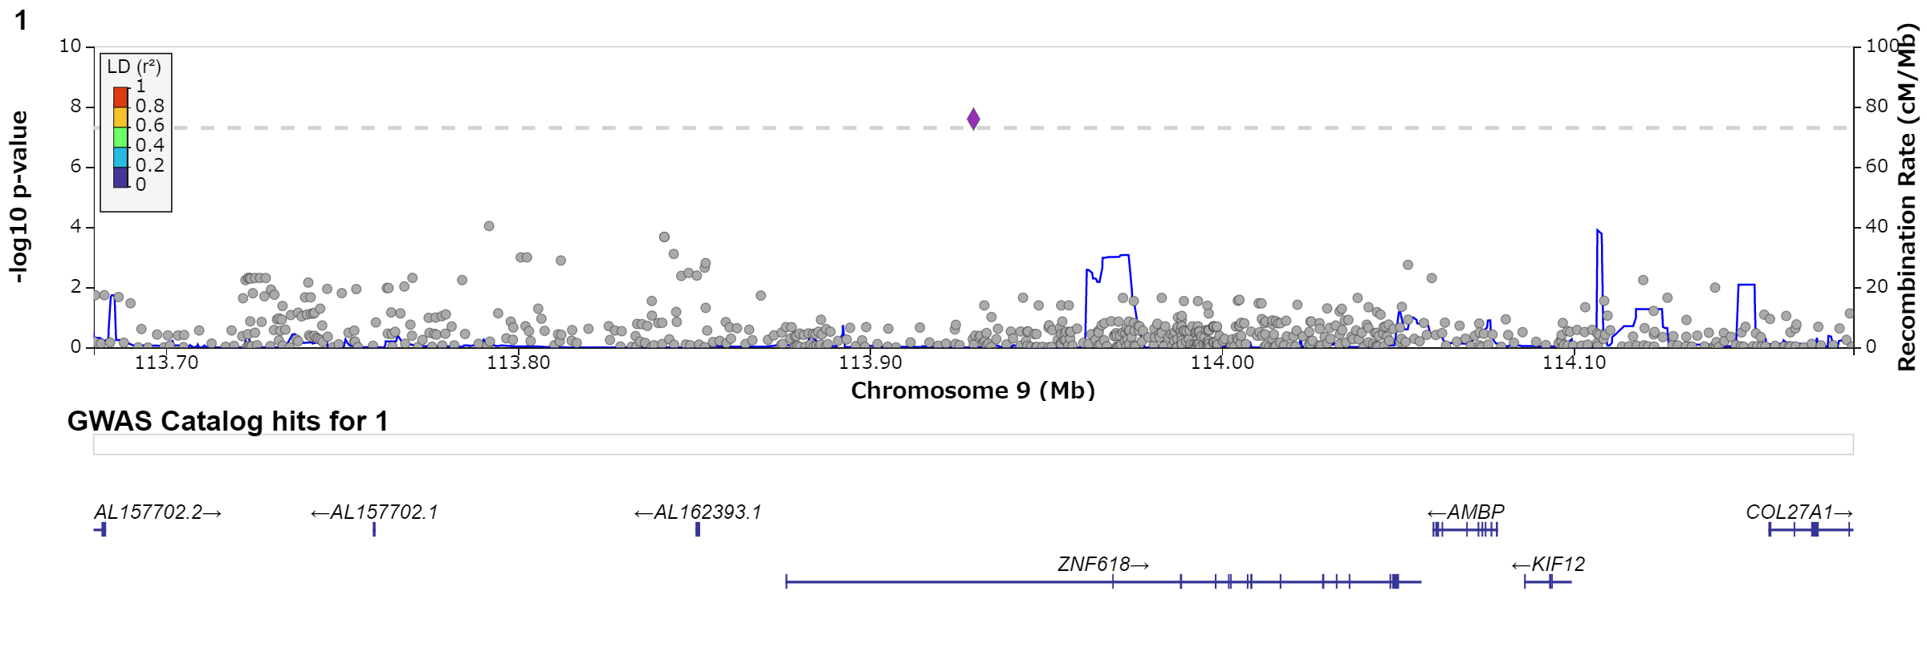
Figure S29: Regional association plot for rs1435984417

Slide 31
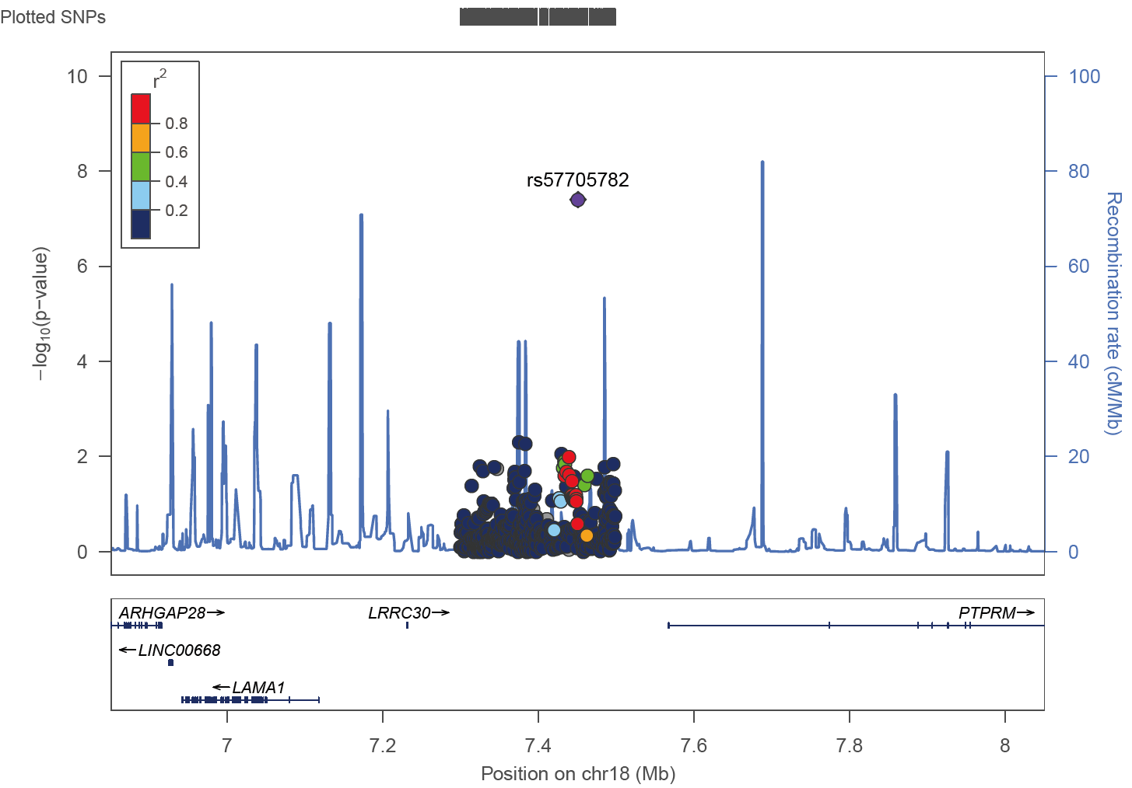
Figure S30: Regional association plot for rs57705782

Slide 32
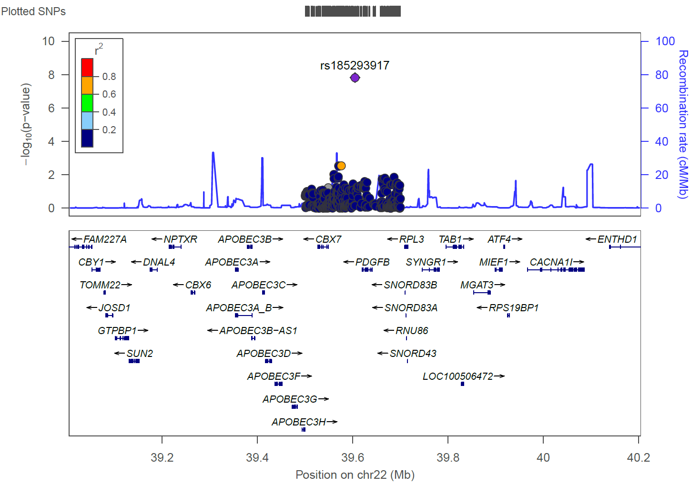
Figure S31: Regional association plot for rs185293917

