Slide 1
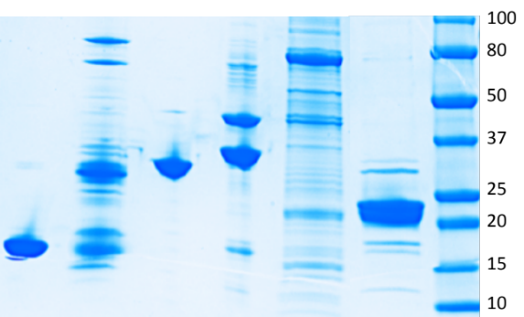
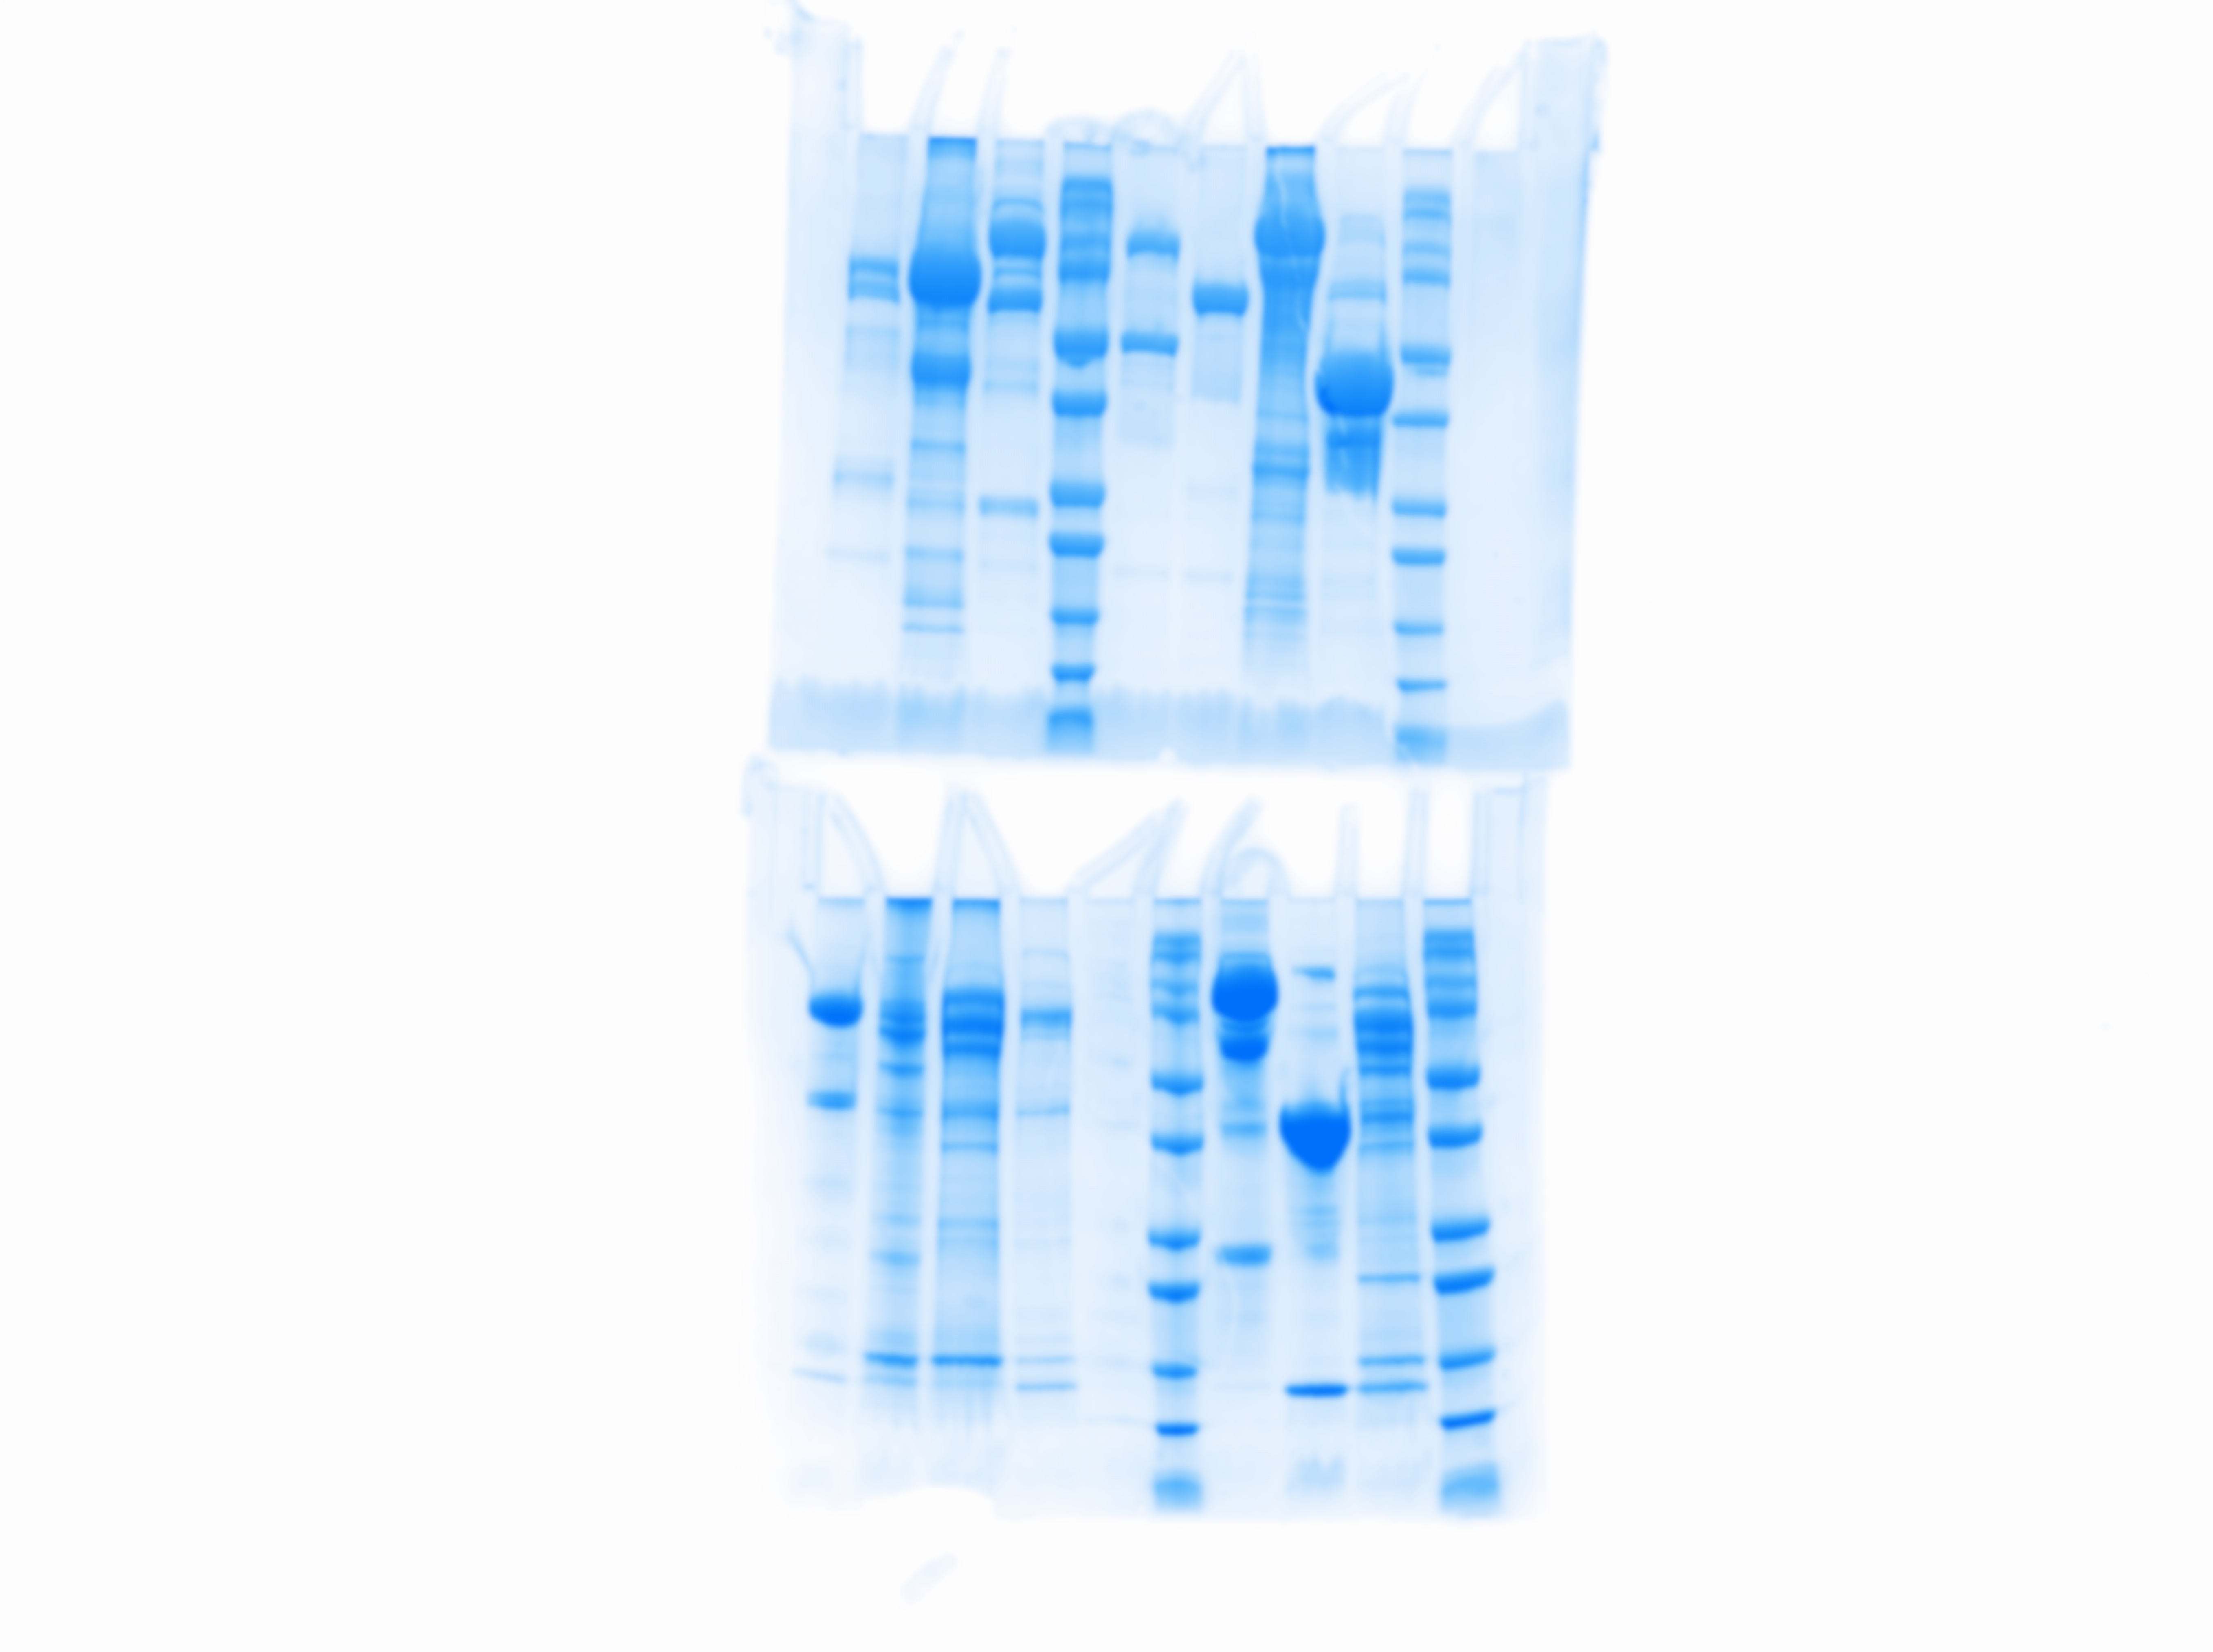
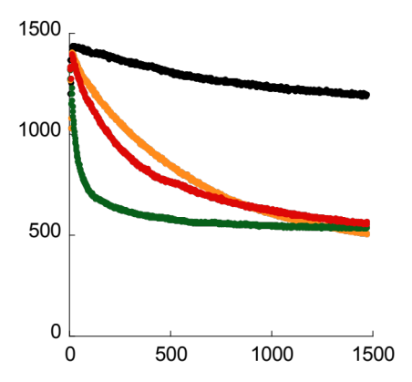
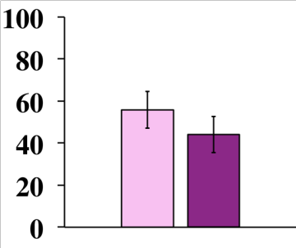
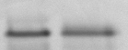
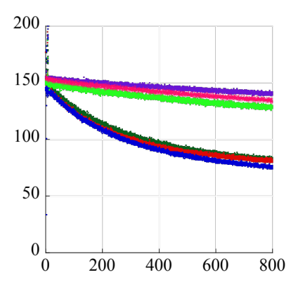
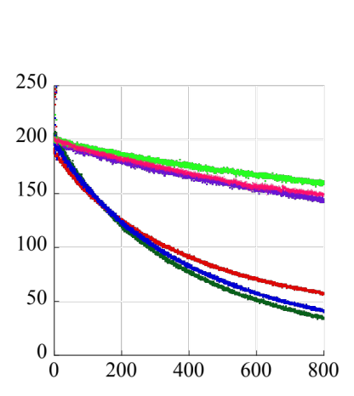
A
B
4-EPAC1^{Nt-DEP-CNB}
3-EPAC1^{DEP-CNB}
5-EPAC1^{CNB-GEF}
2-EPAC1^{Nt-DEP}
1-EPAC1^{DEP}
MW
(kDa)
regulatory
catalytic
Rap1
1
50
DEP
184
>
100
75
2
1
Nt
DEP
184
50
3
50
DEP
CNB
318
>
>
>
37
25
4
1
Nt
DEP
CNB
318
>
20
5
184
CNB
GEF
881
15
6
149
CNB
GEF
881
6-EPAC1^{α-CNB-GEF}
7-EPAC1^{FL}
8-EPAC1^{GEF}
100
150
75
7
1
Nt
DEP
CNB
GEF
881
75
<
100
<
<
50
75
50
8
321
GEF
881
C
D
Nt
DEP
CNB
GEF
U B
< Rap1
fluorescence (a.u)
proteins (% of total)
spontaneous
EPAC1 + cAMP
EPAC1 + PM liposomes
EPAC1 + cAMP + PM liposomes
time (s)
E
Nt
DEP
CNB
GEF
F
Nt
DEP
CNB
GEF
fluorescence (a.u)
fluorescence (a.u)
PA
CL
time (s)
time (s)
Rap1+EPAC1
+ PA or CL liposome
+ neutral liposome
+ neutral liposome + cAMP
+ PA or CL liposome + cAMP
+ cAMP
Figure S1

Slide 2
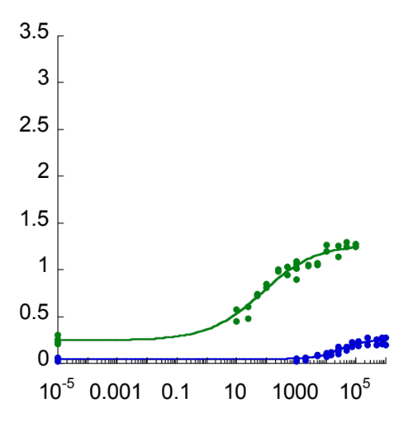
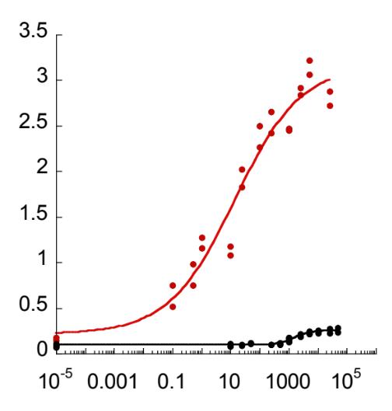
A
k_{obs} (10⁻²s⁻¹)
74 nM
liposome
28 μM
solution
cAMP (nM)
B
liposome
k_{obs} (10⁻²s⁻¹)
14 nM
1.5 μM
solution
007 (nM)
Figure S2

Slide 3
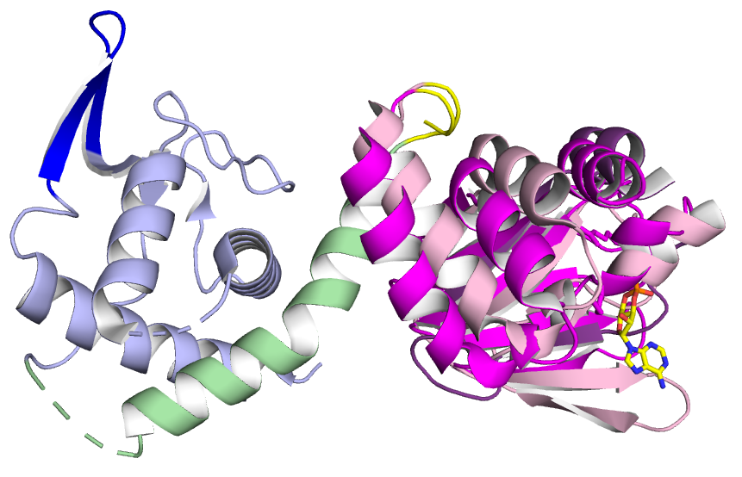
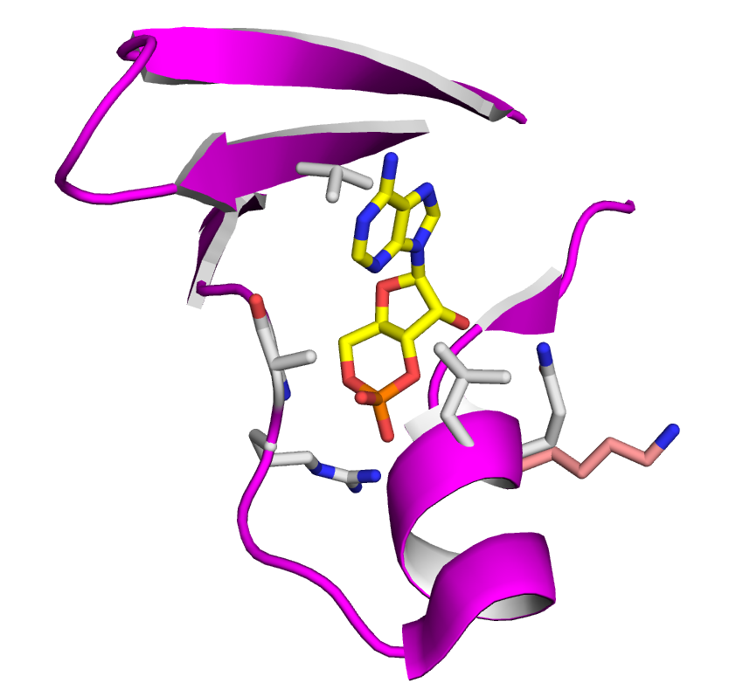
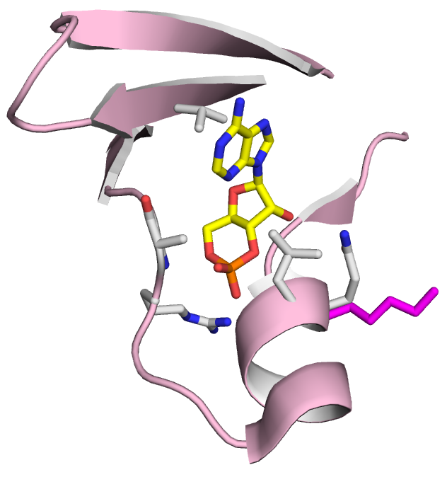
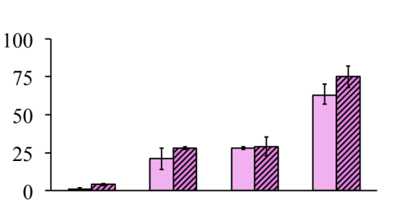
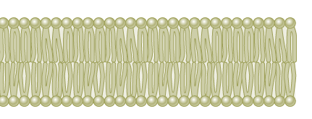
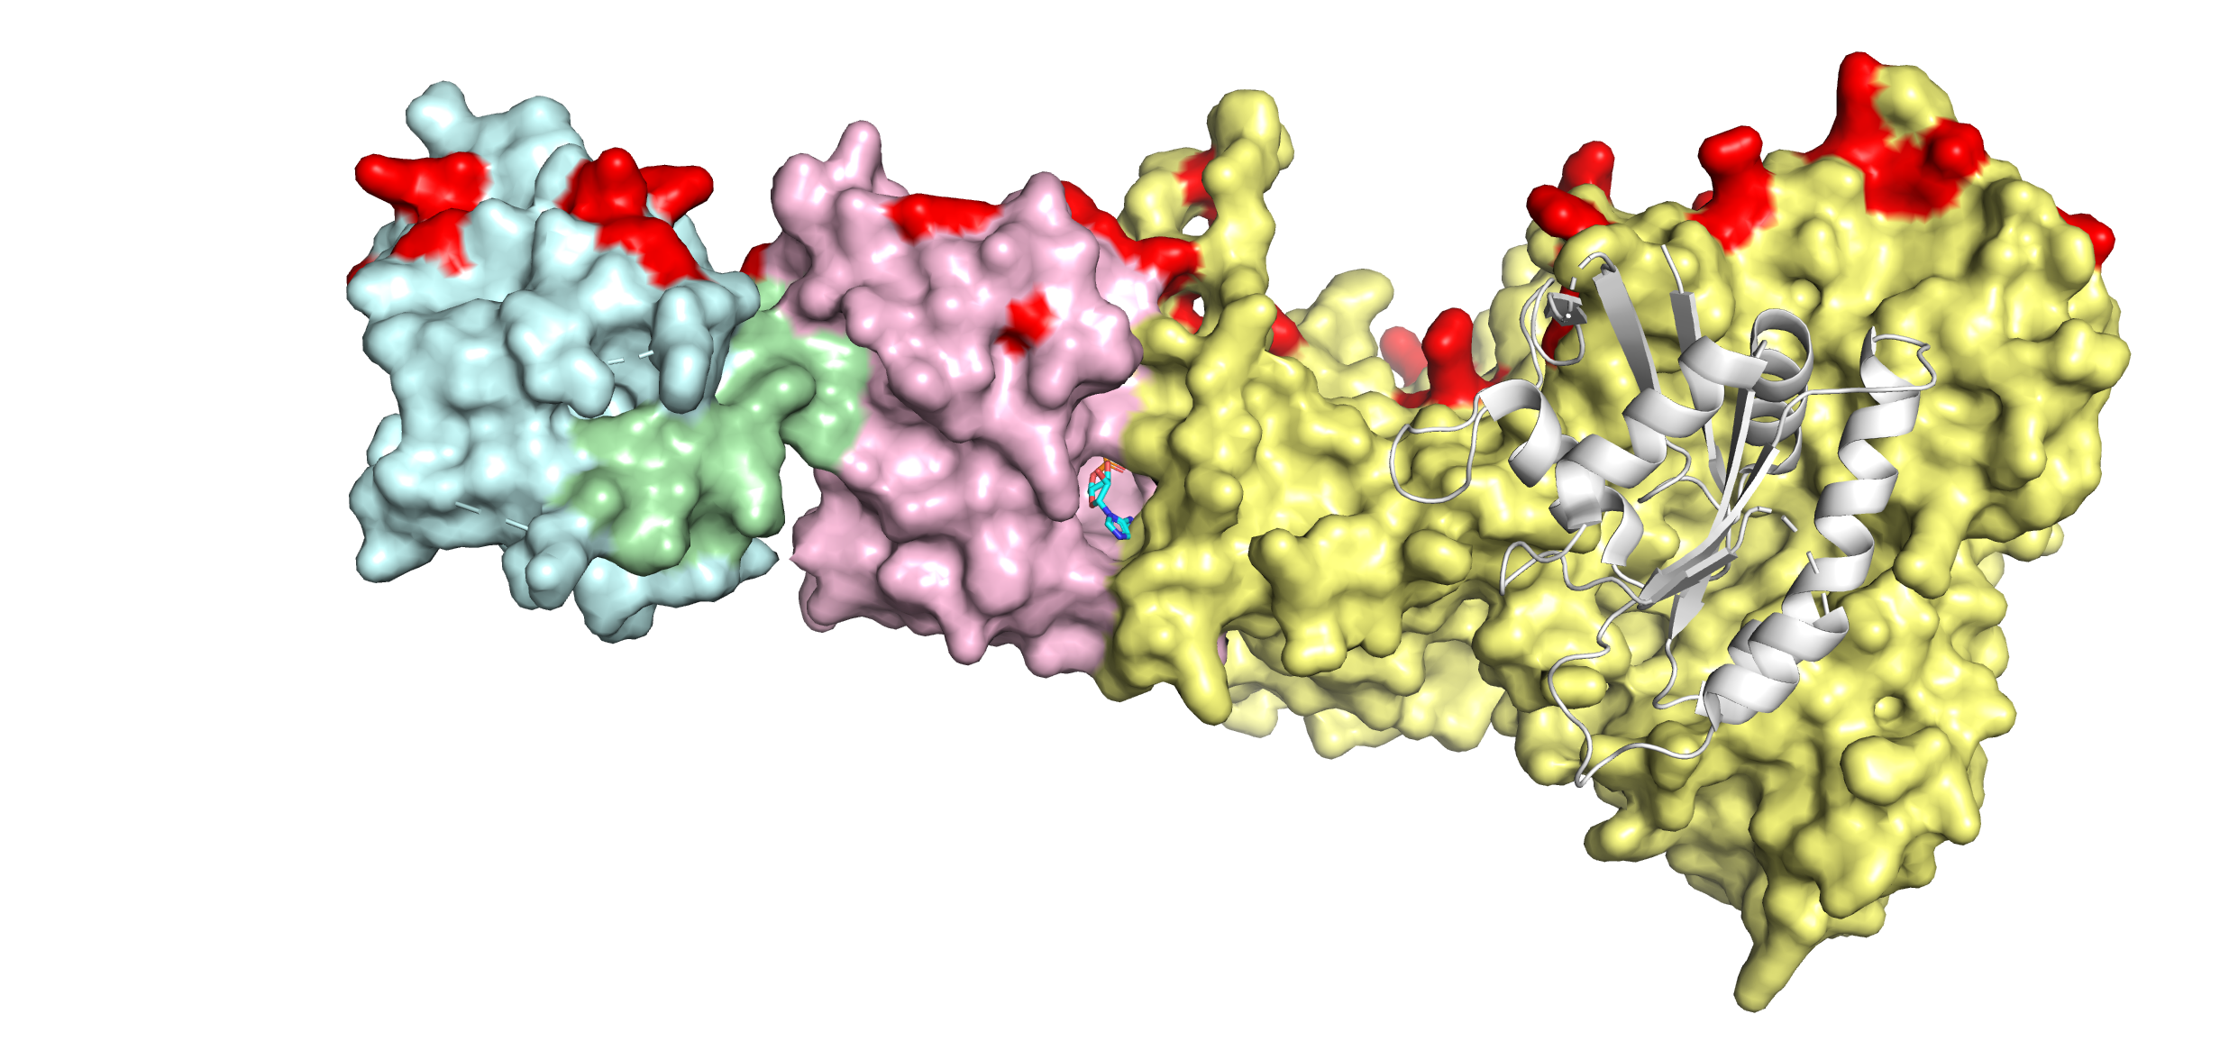
A
EPAC1^{CNB}
polybasic
loop
¹⁸²PPG¹⁸⁴
EPAC2^{CNB}
DEP
cAMP
kinked
α-helix
B
V259
A280
Q270^{EPAC1}
L271
K405^{EPAC2}
R279
C
1
CNB
GEF
- cAMP
2
DEP
CNB
liposome-bound proteins (% of total)
+ cAMP
3
Nt
DEP
CNB
4
Nt
DEP
CNB
GEF
1
2
3
4
D
Rap
DEP
CNB
GEF
Figure S3

Slide 4
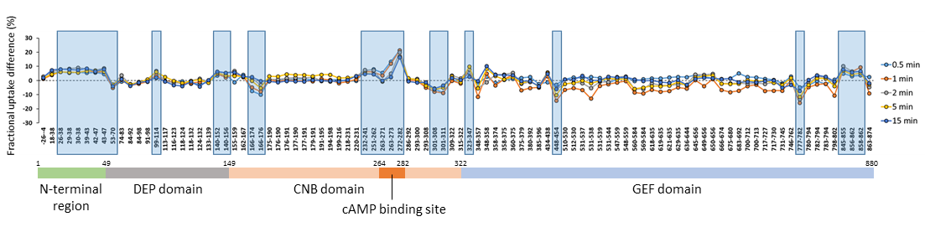
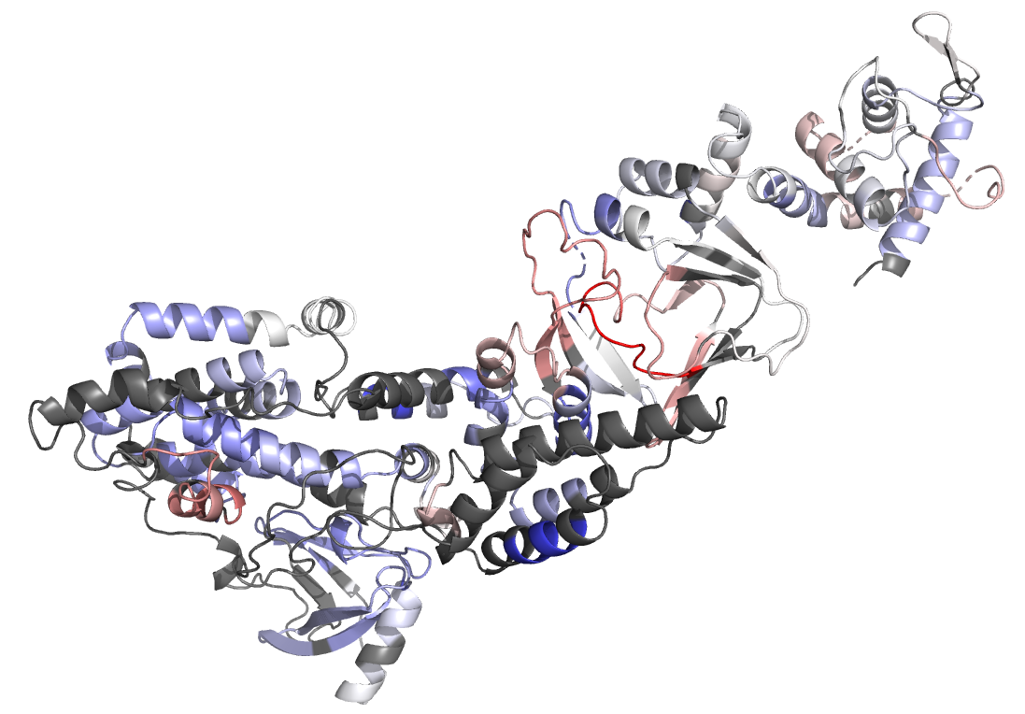
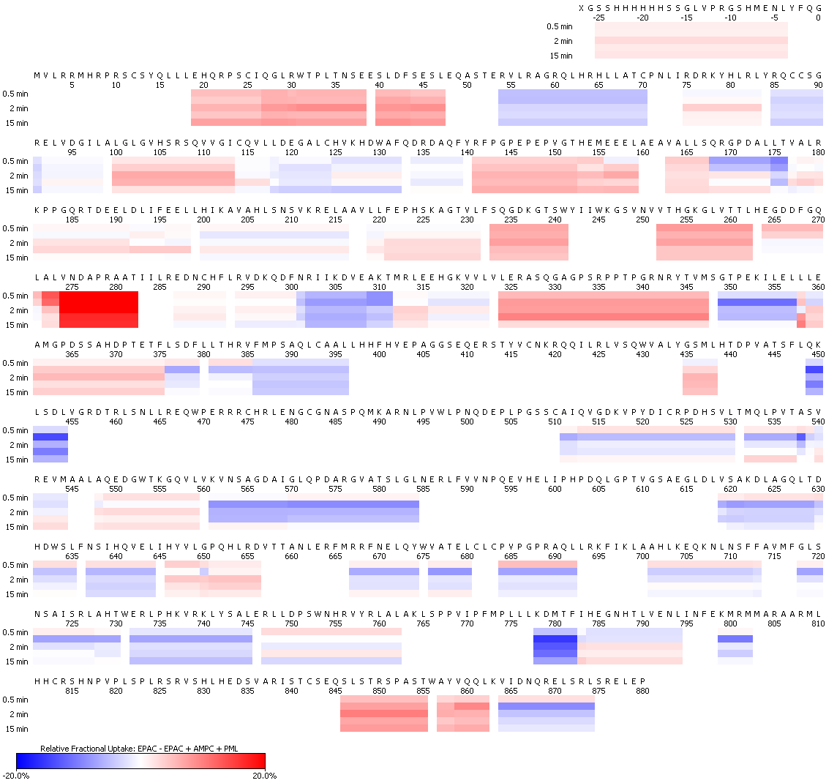
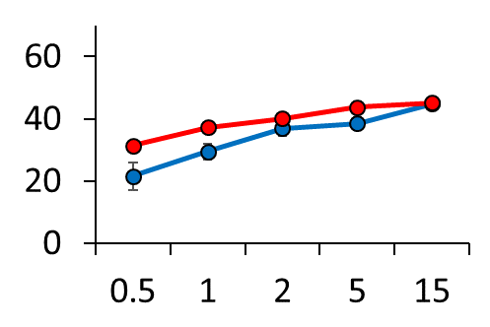
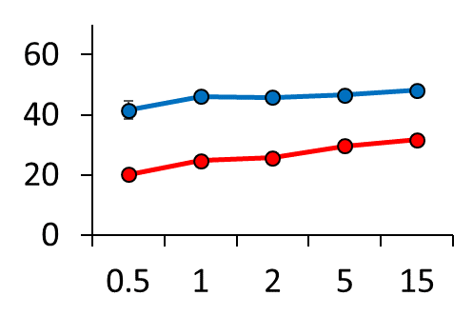

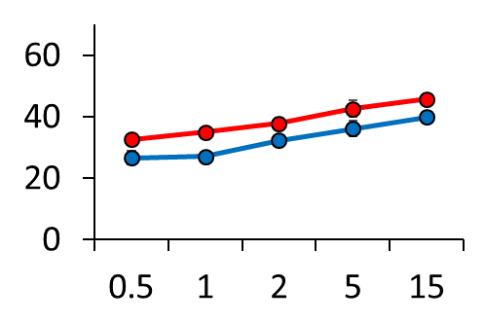
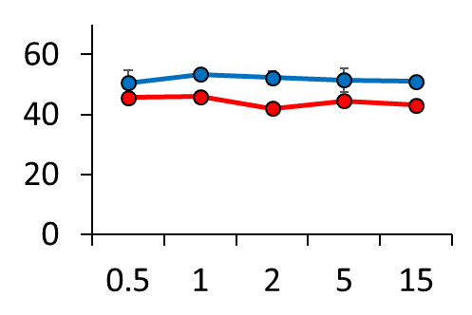
A
26-47
140-156
166-176
232-241
251-282
301-311
99-114
323-347
448-454
777-782
845-862
B
-20 %
20 %
301-308
DEP domain
no coverage
CNB domain
kinked helix
166-176
845-862
cAMP binding site
251-282
GEF domain
C
166-176 (kinked helix)
LSQRGPDALLT
272-282 (cAMP-binding site)
ALVNDAPRAAT
unbound EPAC1^{FL}
EPAC1^{FL} + cAMP + liposomes
Relative fractional uptake (%)
301-308 (CNB domain)
NRIIKDVE
845-855 (GEF domain)
QSLSTRSPAST
Time (min)
Figure S4

Slide 5
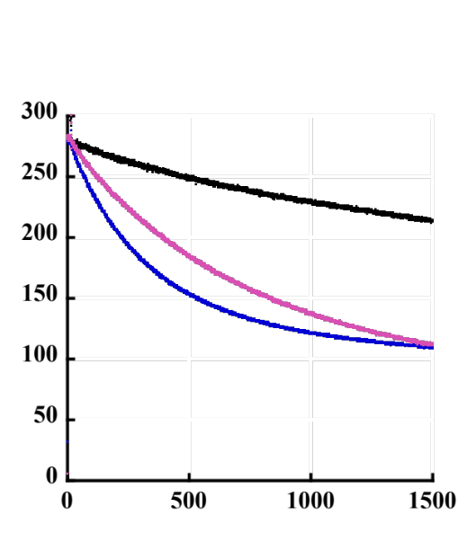
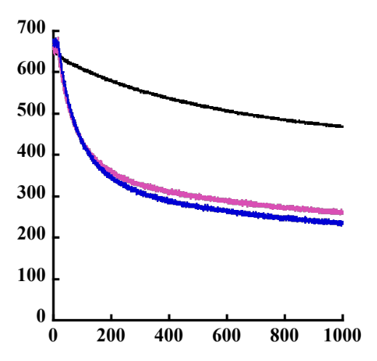
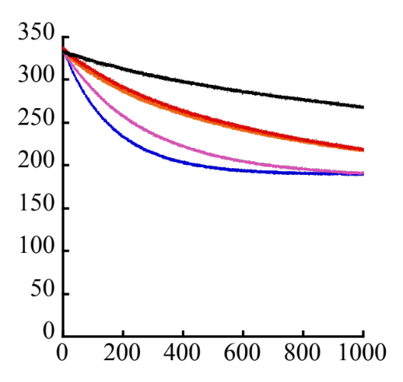
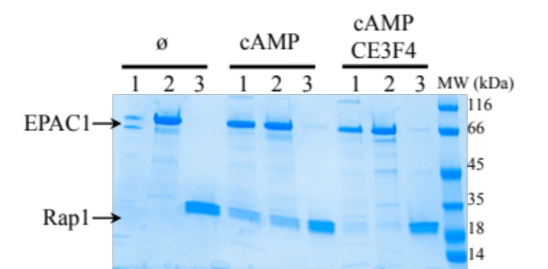
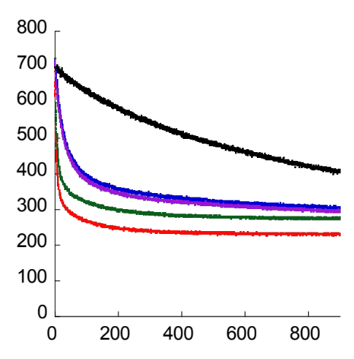
A
B
GEF
Nt
DEP
CNB
GEF
fluorescence (u.a)
fluorescence (a.u.)
spontaneous
EPAC1
EPAC1+ CE3F4
spontaneous
EPAC1+ cAMP
EPAC1+ cAMP + CE3F4
Time (s)
Time (s)
C
D
CNB
GEF
CNB
GEF
fluorescence (a.u.)
Rap1
+EPAC1
+EPAC1+CE3F4
EPAC1+cAMP
+EPAC1+cAMP + CE3F4
Time (s)
E
Nt
DEP
CNB
GEF
fluorescence (a.u.)
Rap1
+EPAC1
+EPAC1+CE3F4
EPAC1+cAMP
+EPAC1+cAMP + CE3F4
Time (s)
Figure S5

Slide 6
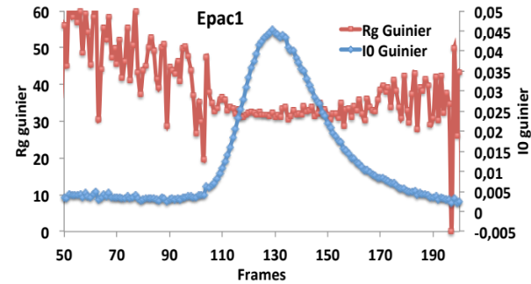
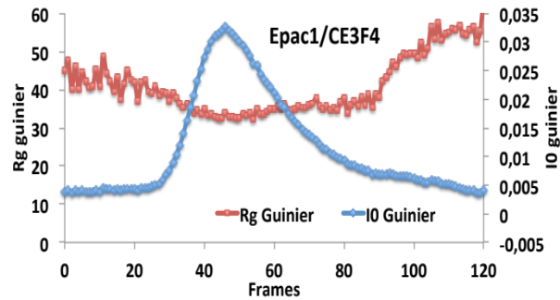
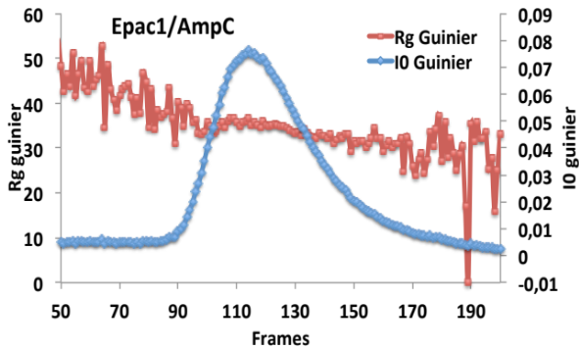
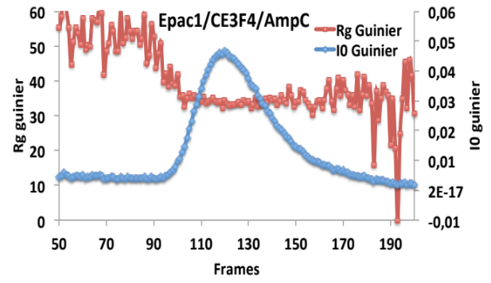
CNB
GEF
A
B
EPAC1
EPAC1-CE3F4
C
D
EPAC1-cAMP
EPAC1-cAMP-CE3F4
Figure S6

Slide 7
receptor
adenylate cyclase
Ga
Nt
DEP
CNB
cAMP
GEF
Rap
cAMP
cAMP
cAMP
cAMP
cAMP
cAMP
nanodomain
cytosol
Figure S7

