Slide 1
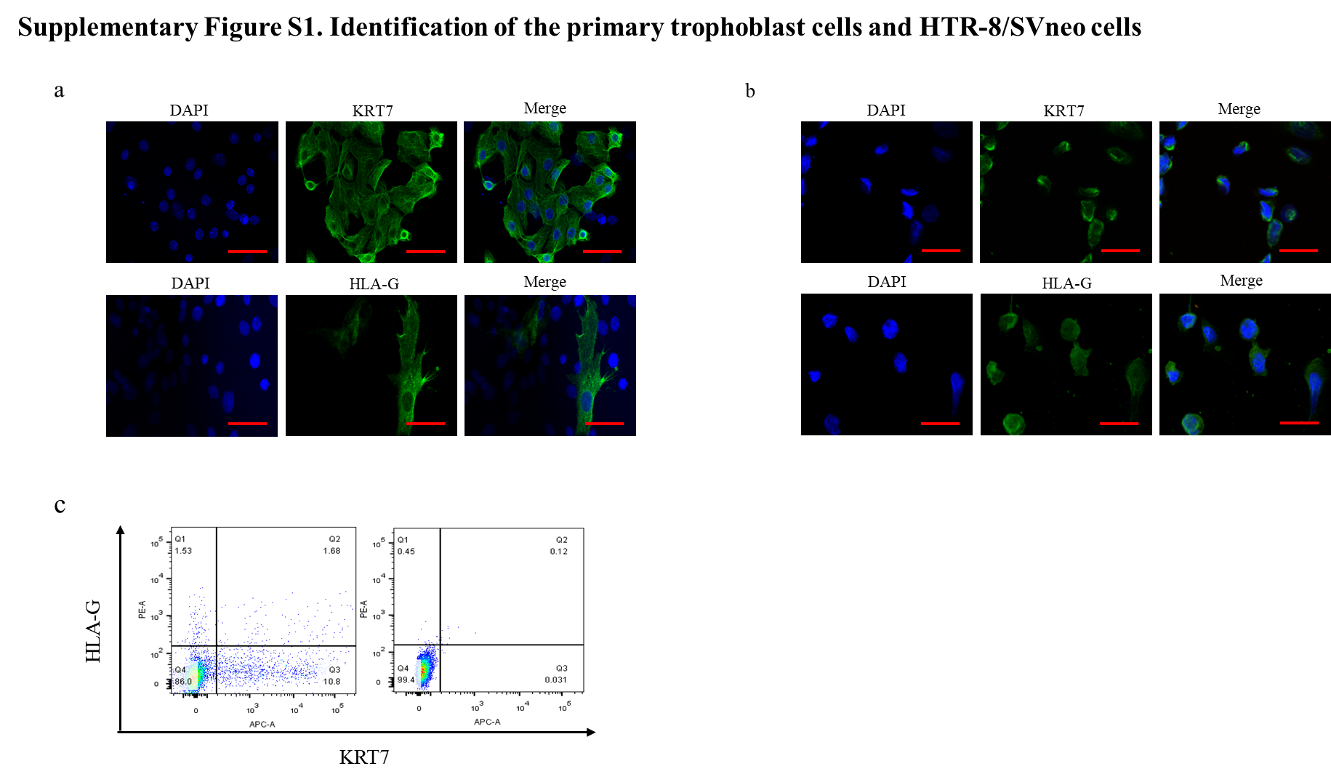

Slide 2
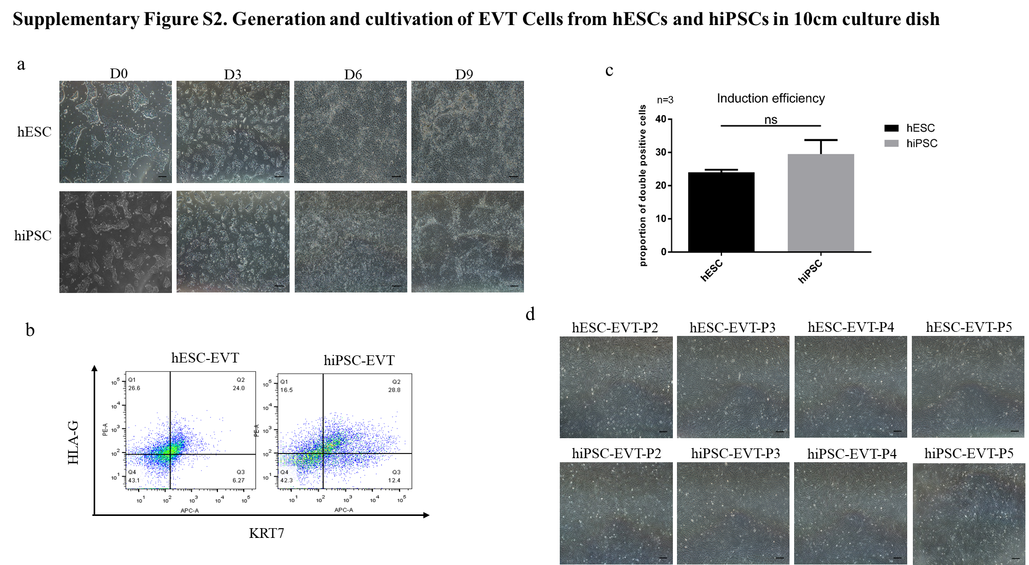

Slide 3
Fig S1. Identification of the primary trophoblast cells and HTR-8/SVneo cells. (a) Immunostaining for KRT7 and HLA-G in the primary trophoblast cells from the first-trimester human placentae (sixth to nine weeks of gestation). Nuclei were stained with DAPI. Scale bar, 20 μm. (b ) Immunostaining for KRT7 and HLA-G in HTR-8/SVneo cells. Nuclei were stained with DAPI. Scale bar, 20 μm. (c) Flowcytometry analysis of KRT7and HLA-G on the primary trophoblast cells from two patients.
Fig S2. Generation and cultivation of EVT Cells from hESCs and hiPSCs in 10cm culture dish. (a) Images showing morphological changes of hESCs and hiPSCs after differentiation induction at day 0, 3, 6 and 9, respectively. The EVT medium contains Y27632, A83-01, NRG1, matrigel and KSR at day 0. AT day 3, this medium was replaced with another medium without NRG1. At day 6, the medium was replaced with another medium without NRG1 and KSR. The EVT-like cells were harvested at day 9. The cells have an epithelial-like morphology. Scale bar, 200 μm. (b) Flow cytometry analysis of HLA-G+ and KRT7+ cells derived from the differentiation of hESCs and hiPSCs at day 9. (c) Percentage of KRT7 and HLA-G positive cells derived from hESCs and hiPSCs. *P＜0.05 compared with the control. (d) Images showing morphological changes of hiESCs-EVT and hiPSCs-EVT cells after passed three to five times. The cells underwent epithelial-mesenchymal transition. Scale bar, 200 μm. Data shown were compiled from three independent experiments.

