Slide 1
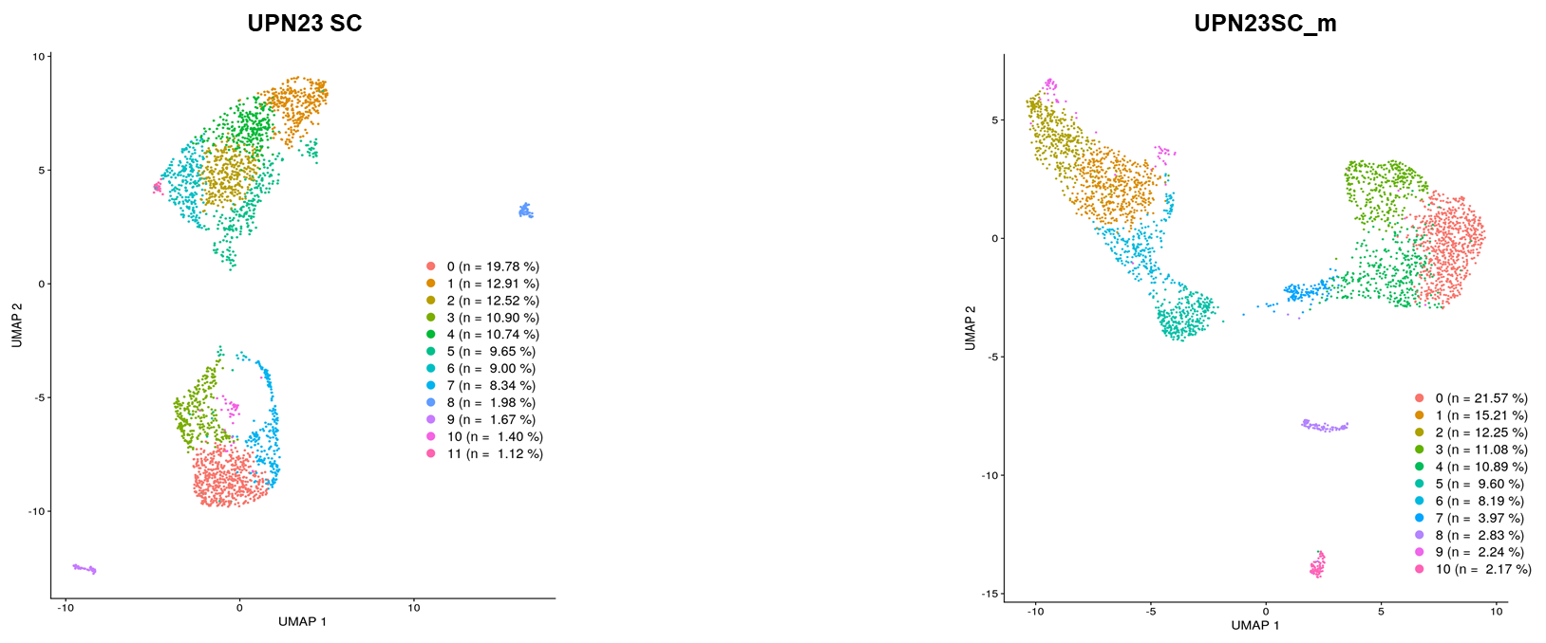
Supplementary data 1a and 1b
a
b

Slide 2
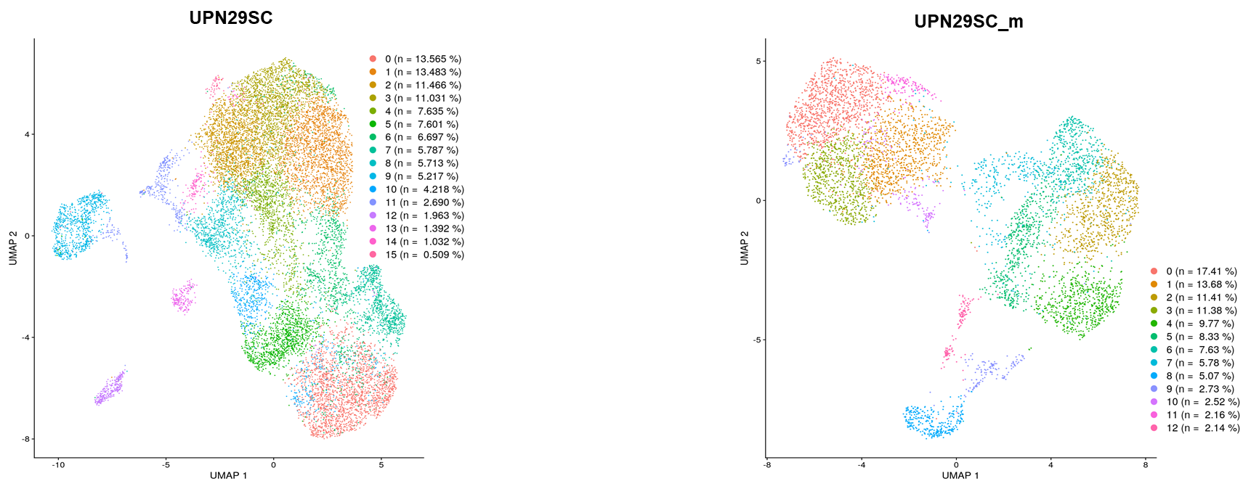
Supplementary data 1c and 1d
c
d

Slide 3
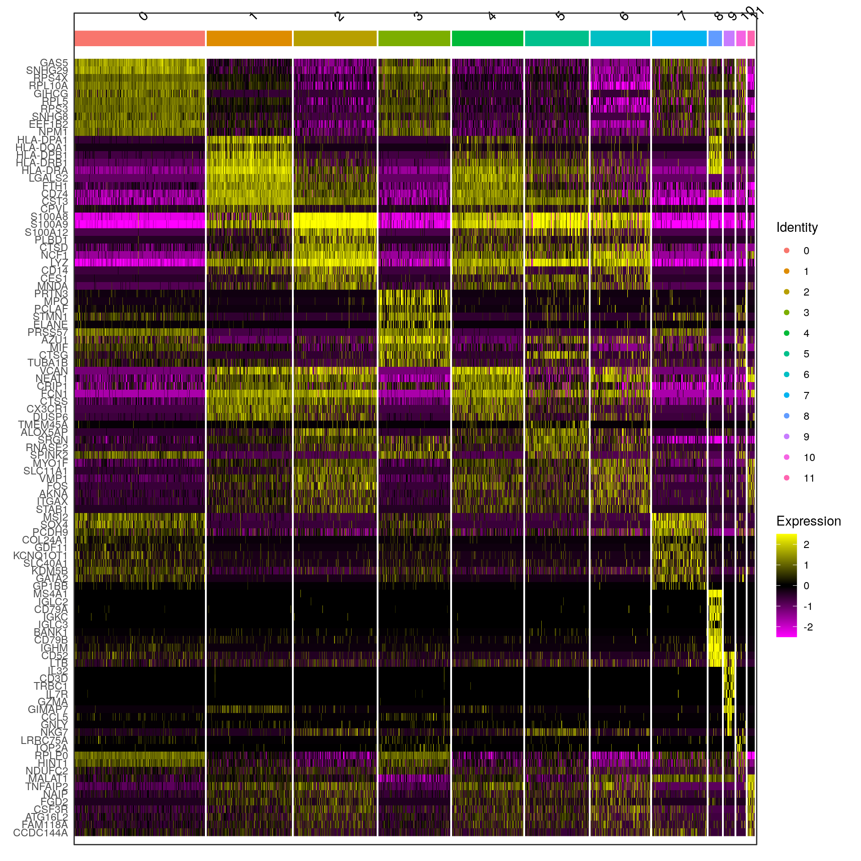
Supplementary data 2a
UPN23 SC
a

Slide 4
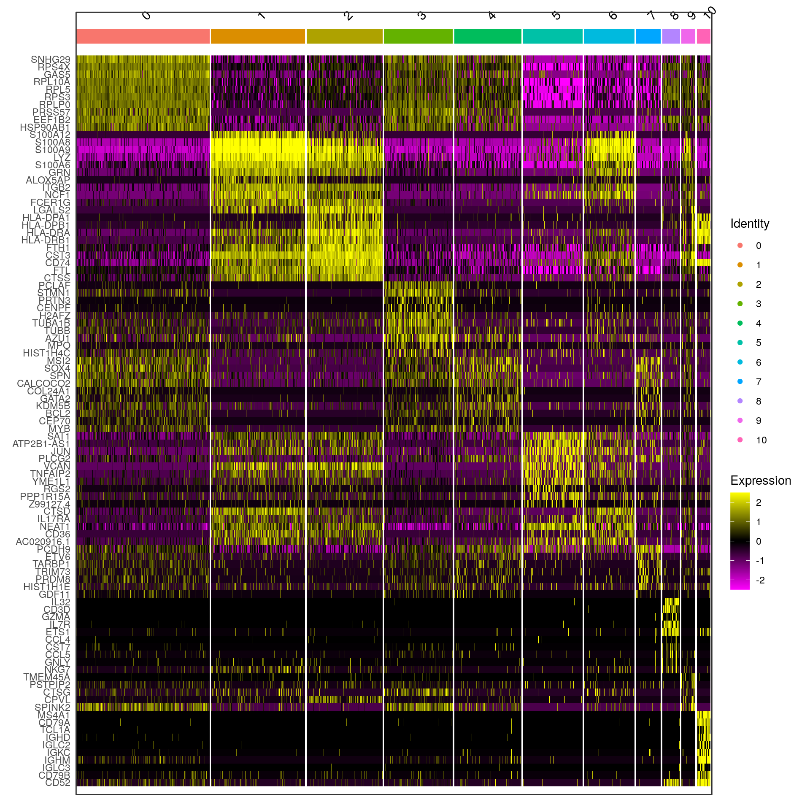
Supplementary data 2b
UPN23 SC_m
b

Slide 5
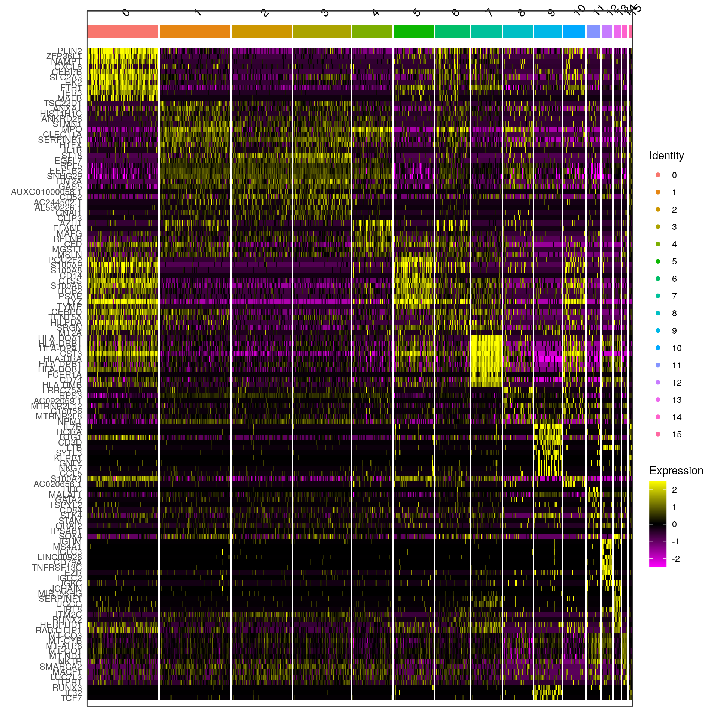
Supplementary data 2c
UPN29 SC
c

Slide 6
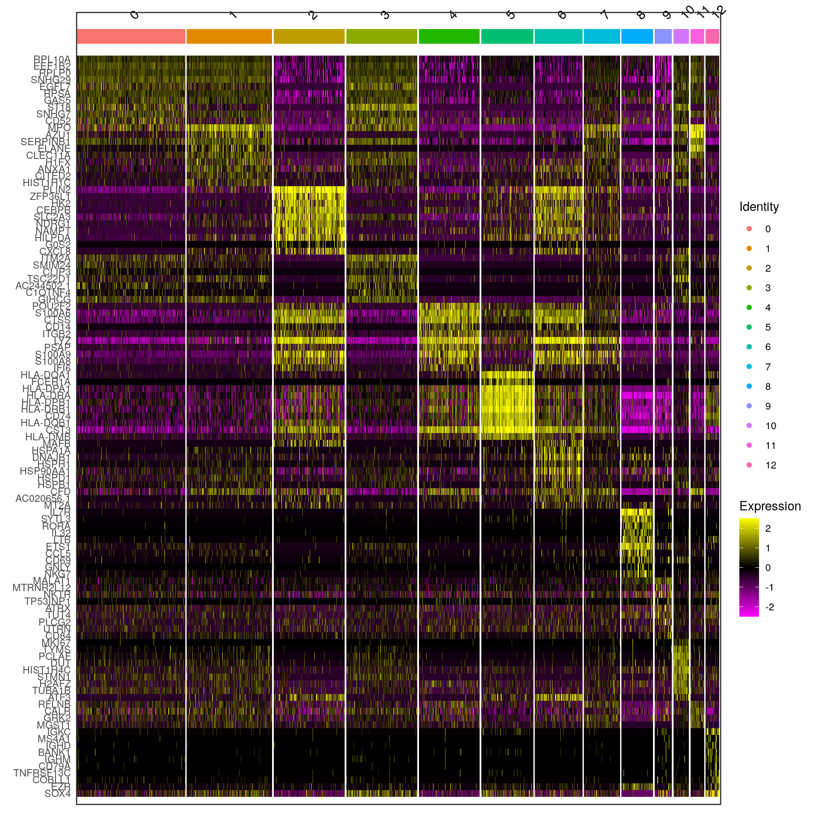
Supplementary data 2d
UPN29 SC_m
d

